Slide 1
Jolly Grammar
5a-1

Slide 2
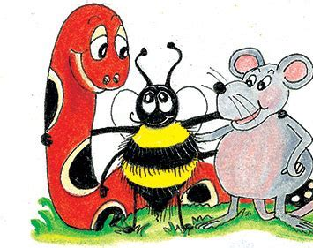
Spelling Test 36
(Grammar 4)

Slide 3
telex

Slide 4
telex
telecast

Slide 5
telex
telecast
telethon

Slide 6
telex
telecast
telethon
telegram

Slide 7
telex
telecast
telethon
telegram
teleport

Slide 8
telex
telecast
telethon
telegram
teleport
telescope

Slide 9
telex
telecast
telethon
telegram
teleport
telescope
7.telepathic

Slide 10
telex
telecast
telethon
telegram
teleport
telescope
7.telepathic
8.telegraph

Slide 11
telex
telecast
telethon
telegram
teleport
telescope
7.telepathic
8.telegraph
9.telephone

Slide 12
telex
telecast
telethon
telegram
teleport
telescope
7.telepathic
8.telegraph
9.telephone
10.telephoto

Slide 13
telex
telecast
telethon
telegram
teleport
telescope
7.telepathic
8.telegraph
9.telephone
10.telephoto
11.televise

Slide 14
telex
telecast
telethon
telegram
teleport
telescope
7.telepathic
8.telegraph
9.telephone
10.telephoto
11.televise
12.telepathy

Slide 15
telex
telecast
telethon
telegram
teleport
telescope
7.telepathic
8.telegraph
9.telephone
10.telephoto
11.televise
12.telepathy
13.telescopic

Slide 16
telex
telecast
telethon
telegram
teleport
telescope
7.telepathic
8.telegraph
9.telephone
10.telephoto
11.televise
12.telepathy
13.telescopic
14.television

Slide 17
telex
telecast
telethon
telegram
teleport
telescope
7.telepathic
8.telegraph
9.telephone
10.telephoto
11.televise
12.telepathy
13.telescopic
14.television
15.telekinesis

Slide 18
telex
telecast
telethon
telegram
teleport
telescope
7.telepathic
8.telegraph
9.telephone
10.telephoto
11.televise
12.telepathy
13.telescopic
14.television
15.telekinesis
16.teleconference

Slide 19
telex
telecast
telethon
telegram
teleport
telescope
7.telepathic
8.telegraph
9.telephone
10.telephoto
11.televise
12.telepathy
13.telescopic
14.television
15.telekinesis
16.teleconference
17.telecommuting

Slide 20
telex
telecast
telethon
telegram
teleport
telescope
7.telepathic
8.telegraph
9.telephone
10.telephoto
11.televise
12.telepathy
13.telescopic
14.television
15.telekinesis
16.teleconference
17.telecommuting
18.telemarketing

Slide 21
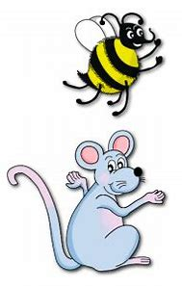
Let’s review
Long Vowels.

Slide 22
Activity Page
Spelling Review

Slide 23
cake
music
tomatoes
pearls
seal
baby
fairy
worms
night
keys
loaves
horse
hippo
island
castle
watches

Slide 24
Spelling Point

Slide 25
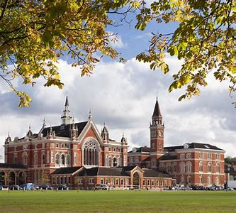
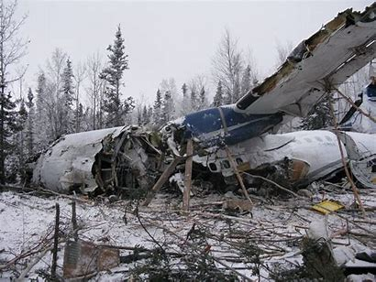
college wreckage

Slide 26
college wreckage

Slide 27
college wreckage

Slide 28
Spelling List
<age><ege>

Slide 29
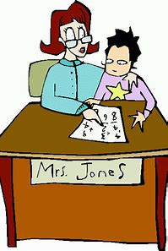
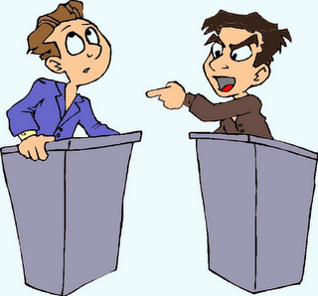
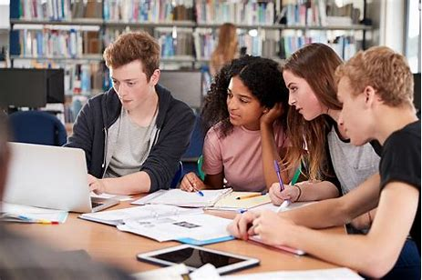
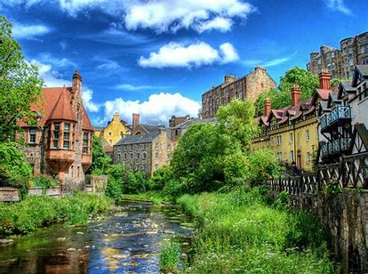
college privilege allege
manage cottage village

Slide 30
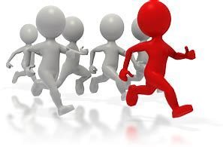
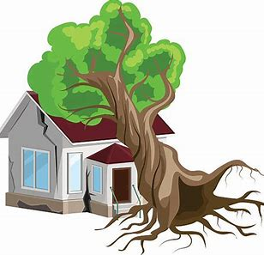
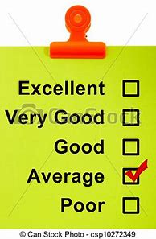
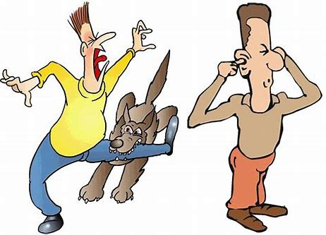
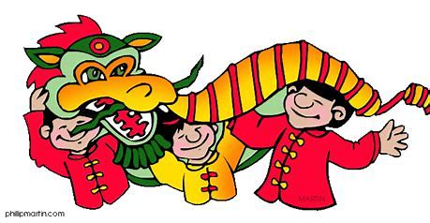
message advantage damage
heritage average savage

Slide 31
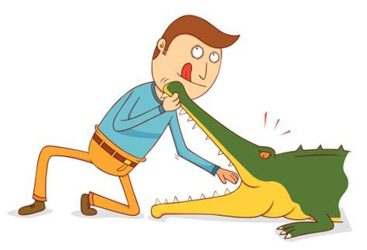
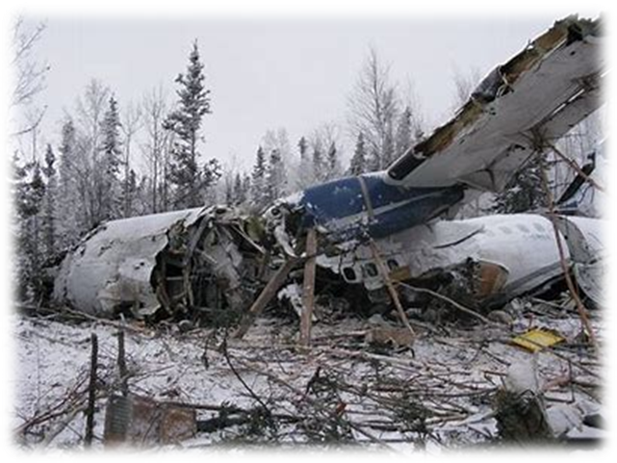
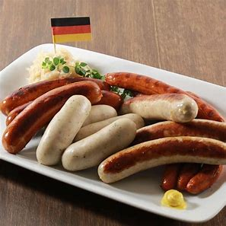
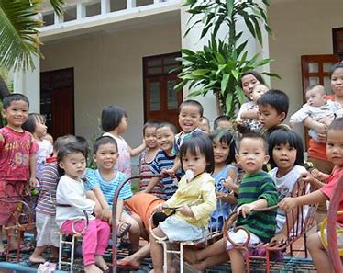
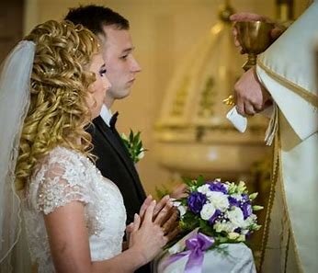
courage wreckage sausage
language orphanage marriage

Slide 32
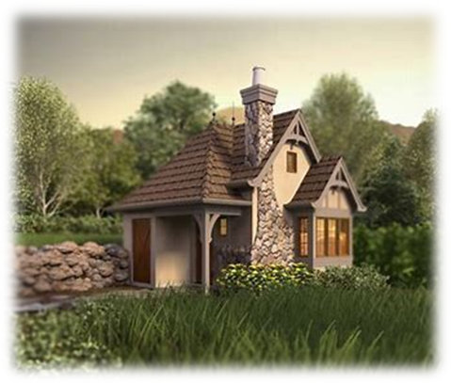
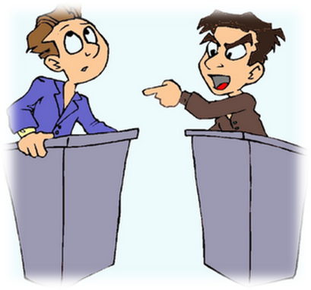
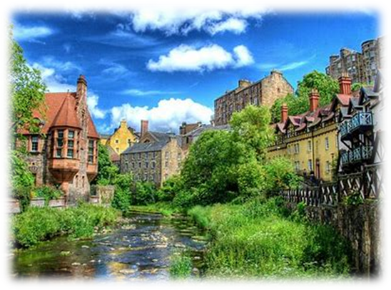
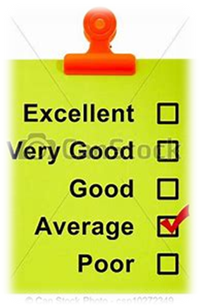
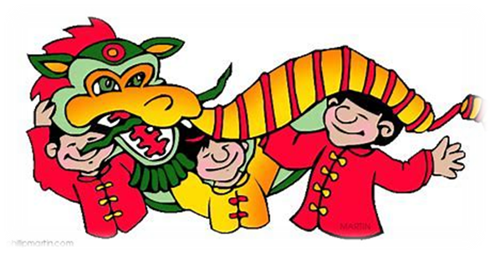
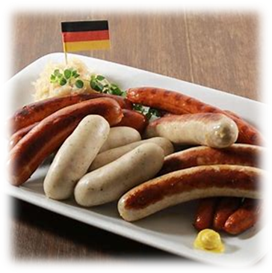
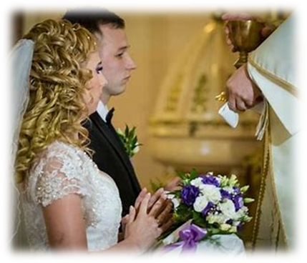
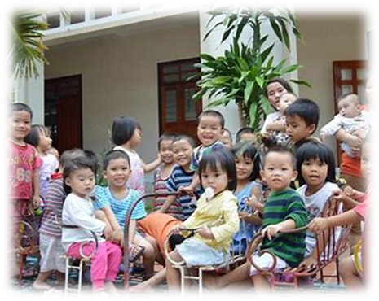
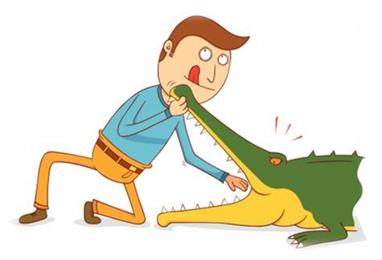

Slide 33
Jolly Grammar
5a-1

Slide 34
parsing

Slide 35
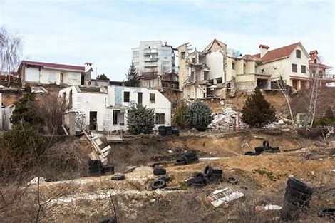
The terrible hurricane severely damaged the cottages and houses in the village.

Slide 36
The terrible hurricane severely damaged the cottages and houses in the village.

Slide 37
The terrible hurricane severely damaged the cottages and houses in the village.

Slide 38
The terrible hurricane severely damaged the cottages and houses in the village.

Slide 39
The terrible hurricane severely damaged the cottages and houses in the village.

Slide 40
The terrible hurricane severely damaged the cottages and houses in the village.

Slide 41
The terrible hurricane severely damaged the cottages and houses in the village.

Slide 42
The terrible hurricane severely damaged the cottages and houses in the village.

Slide 43
The terrible hurricane severely damaged the cottages and houses in the village.

Slide 44
The terrible hurricane severely damaged the cottages and houses in the village.

Slide 45
The terrible hurricane severely damaged the cottages and houses in the village.
3rd person singular
Simple past

Slide 46
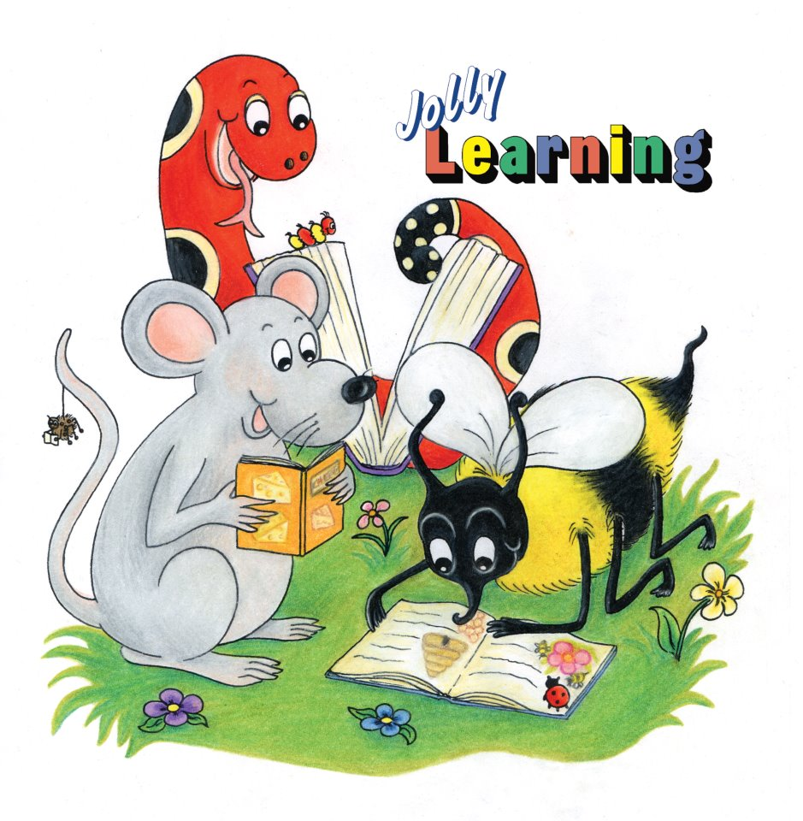
Dictation

Slide 47
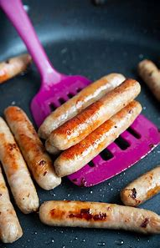
“Did you manage to cook the sausages?” asked Tom.

Slide 48
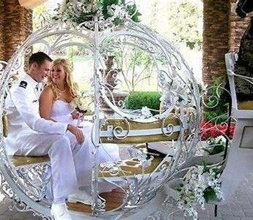
The princess arrived in a carriage for her marriage.

Slide 49
It is an advantage to speak many languages.

Slide 50
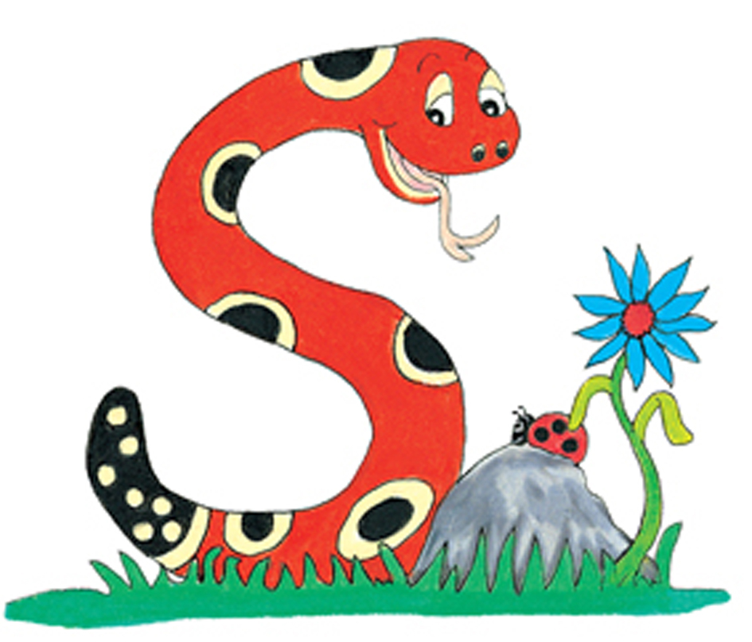
Thank you.
See you
next time!

