Slide 1
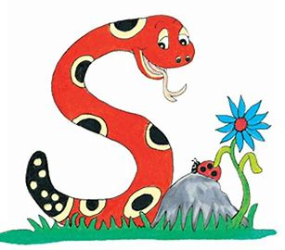
Jolly Grammar
4-33

Slide 2
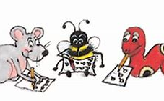
Spelling Test 32

Slide 3
submit

Slide 4
submit
subdue

Slide 5
submit
subdue
subplot

Slide 6
submit
subdue
subplot
subside

Slide 7
submit
subdue
subplot
subside
subvert

Slide 8
submit
subdue
subplot
subside
subvert
subway

Slide 9
submit
subdue
subplot
subside
subvert
subway
7.subdivide

Slide 10
submit
subdue
subplot
subside
subvert
subway
7.subdivide
8.submission

Slide 11
submit
subdue
subplot
subside
subvert
subway
7.subdivide
8.submission
9.submerge

Slide 12
submit
subdue
subplot
subside
subvert
subway
7.subdivide
8.submission
9.submerge
10.subtitle

Slide 13
submit
subdue
subplot
subside
subvert
subway
7.subdivide
8.submission
9.submerge
10.subtitle
11.sub-zero

Slide 14
submit
subdue
subplot
subside
subvert
subway
7.subdivide
8.submission
9.submerge
10.subtitle
11.sub-zero
12.submersible

Slide 15
submit
subdue
subplot
subside
subvert
subway
7.subdivide
8.submission
9.submerge
10.subtitle
11.sub-zero
12.submersible
13.subheading

Slide 16
submit
subdue
subplot
subside
subvert
subway
7.subdivide
8.submission
9.submerge
10.subtitle
11.sub-zero
12.submersible
13.subheading
14.subordinate

Slide 17
submit
subdue
subplot
subside
subvert
subway
7.subdivide
8.submission
9.submerge
10.subtitle
11.sub-zero
12.submersible
13.subheading
14.subordinate
15.submarine

Slide 18
submit
subdue
subplot
subside
subvert
subway
7.subdivide
8.submission
9.submerge
10.subtitle
11.sub-zero
12.submersible
13.subheading
14.subordinate
15.submarine
16.submissive

Slide 19
submit
subdue
subplot
subside
subvert
subway
7.subdivide
8.submission
9.submerge
10.subtitle
11.sub-zero
12.submersible
13.subheading
14.subordinate
15.submarine
16.submissive
17.subconscious

Slide 20
submit
subdue
subplot
subside
subvert
subway
7.subdivide
8.submission
9.submerge
10.subtitle
11.sub-zero
12.submersible
13.subheading
14.subordinate
15.submarine
16.submissive
17.subconscious
18.subterranean

Slide 21
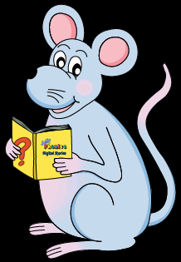
Let’s review
onomatopoeia.

Slide 22
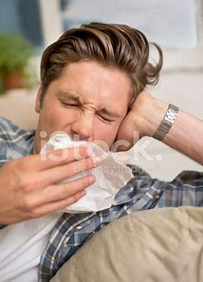
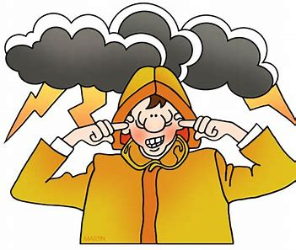
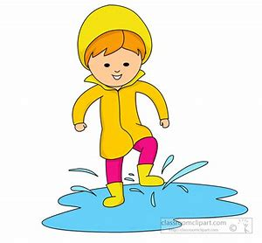

Slide 23
atishoo
boom
splash

Slide 24
Let’s review
Punctuation.

Slide 25
Add the correct punctuation to these sentences.
I bought anti-perspirant toothpaste antibacterial soap
Anti-dandruff shampoo and a bottle of antiseptic
What an anticlimax exclaimed Meena
The captain asked Are the submarine crew on deck

Slide 26
Add the correct punctuation to these sentences.
I bought anti-perspirant, toothpaste, antibacterial soap,
anti-dandruff shampoo and a bottle of antiseptic.
“What an anticlimax!” exclaimed Meena.
The captain asked, “Are the submarine crew on deck?”

Slide 27
Let’s learn
Hyphens.

Slide 28
42
58
21
75
36
93

Slide 29
42 forty-two
58
21
75
36
93

Slide 30
42 forty-two
58 fifty-eight
21
75
36
93

Slide 31
42 forty-two
58 fifty-eight
21 twenty-one
75
36
93

Slide 32
42 forty-two
58 fifty-eight
21 twenty-one
75 seventy-five
36
93

Slide 33
42 forty-two
58 fifty-eight
21 twenty-one
75 seventy-five
36 thirty-six
93

Slide 34
42 forty-two
58 fifty-eight
21 twenty-one
75 seventy-five
36 thirty-six
93 ninety-three

Slide 35
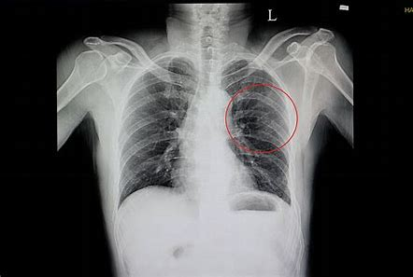
She had an X-ray to see if any of her ribs were broken.

Slide 36
I was making a U-turn into the southbound lanes.

Slide 37
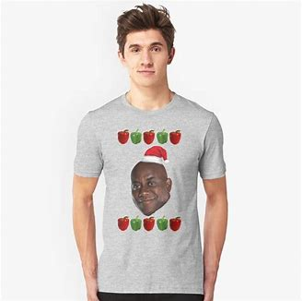
I was wearing a T-shirt under my jumper.
I got spaghetti stain on it.

Slide 38
Decide where these hyphenated words should go and complete each sentence.

Slide 39
My brother-in-law is married to my sister.
The artist sketched a small self-portrait.
Have you got some left-handed scissors?
We arrived at the check-in desk just in time.
The exhibition had life-size model of an alien.
Dad installed new locks at home after the break-in.

Slide 40
Activity Page
Spelling <anti->

Slide 41
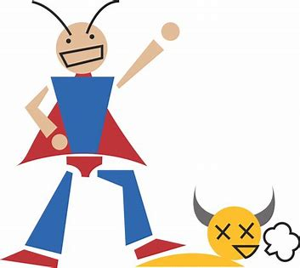
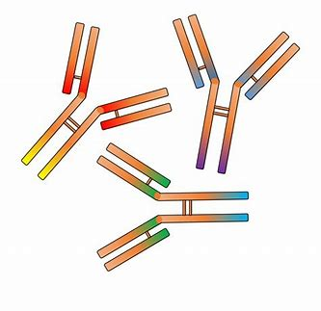
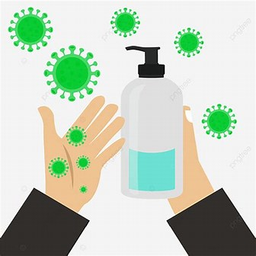
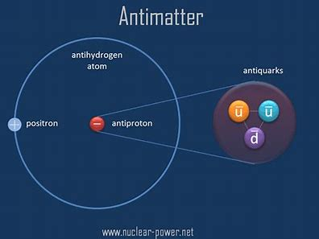
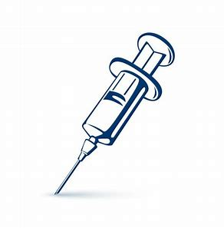
anti-war anti-hero antibody
a central character in a story, novel, or play who lacks traditional heroic qualities, such as high purpose or moral strength.
a protein in blood that reacts to particular toxic substances by neutralizing or destroying them. Antibodies provide immunity against these toxic substances
Against war
antidote antiseptic antimatter
a substance that stops poison from working or cures a disease.
a substance or drug that kills germs that cause disease or decay.
in physics, matter having particles comparable to those of common matter, but with opposite electrical charges or magnetic characteristics.

Slide 42
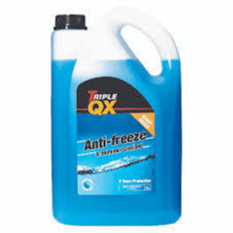
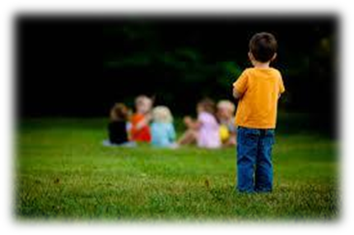
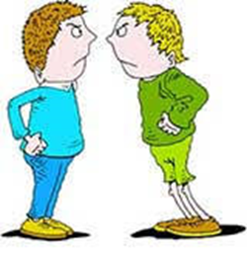
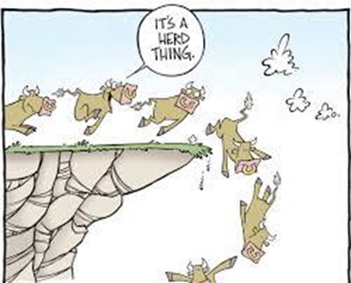
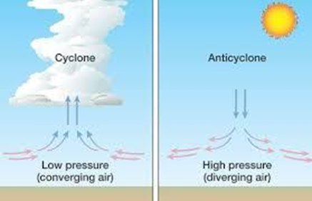
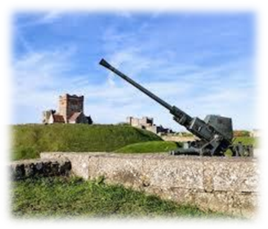
antifreeze antisocial antipathy
a substance that lowers the freezing point of a liquid such as water.
opposed or harmful to the values, institutions, or laws of an organized society.
a deep, continuing dislike; aversion; hatred.
anticlimax anticyclone anti-aircraft
a disappointingly weak or ordinary conclusion or event, following events or statements that build expectations for something powerful or moving.
a large system of winds that rotates around a center of high barometric pressure, moving clockwise in the Northern Hemisphere and counterclockwise in the Southern, and usu. producing cool, dry weather.
designed for defense, esp. by ground-based weapons, against enemy air attack.

Slide 43
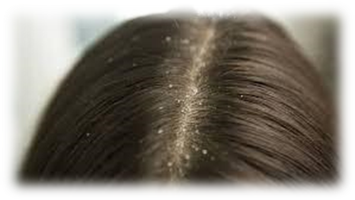
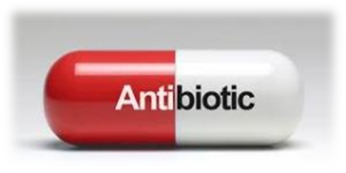
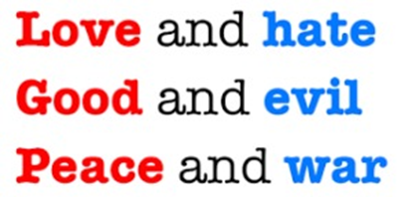
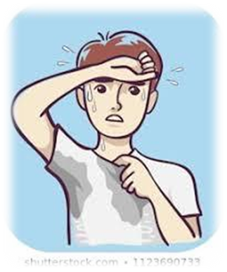
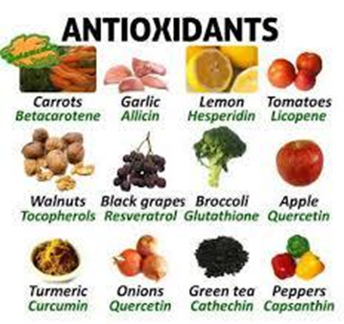
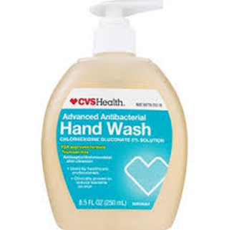
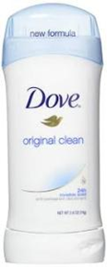
anti-dandruff antibiotic antithesis
Prevent dandruff
substance derived from fungi or other organisms and used to destroy or prevent the growth of bacteria or other disease-causing organisms.
the exact opposite
antioxidant antibacterial anti-perspirant
a substance that inhibits oxidation, the removal of electrons from atoms, compounds, or ions.
active in killing bacteria.
a preparation used to decrease perspiration, esp. in the underarms.

Slide 44
parsing

Slide 45
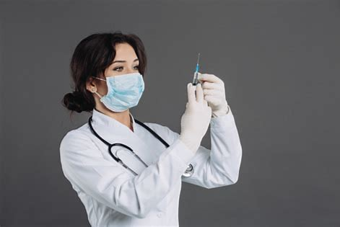
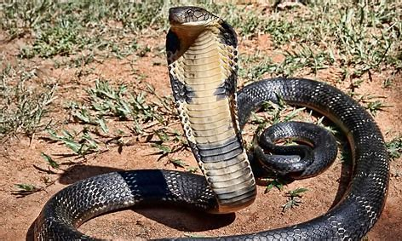
The doctor quickly gives him the antidote for the snake’s venom.

Slide 46
The doctor quickly gives him the antidote for the snake’s venom.

Slide 47
The doctor quickly gives him the antidote for the snake’s venom.

Slide 48
The doctor quickly gives him the antidote for the snake’s venom.

Slide 49
The doctor quickly gives him the antidote for the snake’s venom.

Slide 50
The doctor quickly gives him the antidote for the snake’s venom.

Slide 51
The doctor quickly gives him the antidote for the snake’s venom.

Slide 52
The doctor quickly gives him the antidote for the snake’s venom.

Slide 53
The doctor quickly gives him the antidote for the snake’s venom.

Slide 54
The doctor quickly gives him the antidote for the snake’s venom.
3rd person singular
Simple present

Slide 55
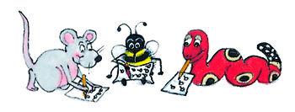
Dictation

Slide 56
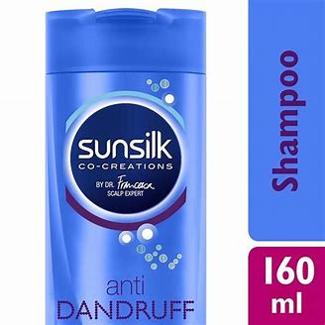
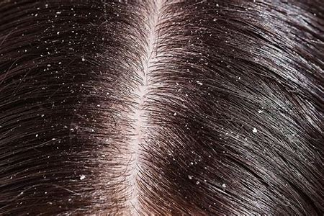
“I bought some anti-dandruff shampoo,” said Jill.

Slide 57
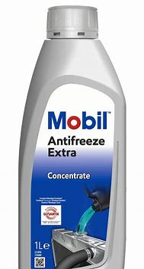
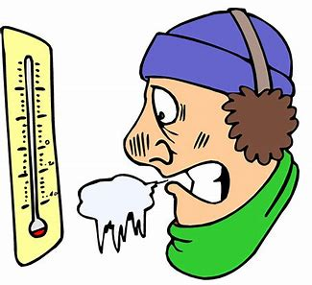
Antifreeze is necessary in sub-zero temperatures.

Slide 58
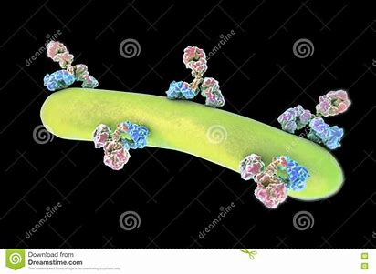
Antibodies in his blood killed the harmful bacteria.

Slide 59
Thank you.
See you
next time!

