Slide 1
Jolly Grammar 2-30

Slide 2
Mini Test 29

Slide 3
must

Slide 4
must
stuck

Slide 5
must
stuck
nation

Slide 6
must
stuck
nation
station

Slide 7
must
stuck
nation
station
relation

Slide 8
must
stuck
nation
station
relation
6. action

Slide 9
must
stuck
nation
station
relation
6. action
7. fiction

Slide 10
must
stuck
nation
station
relation
6. action
7. fiction
8. dictionary

Slide 11
must
stuck
nation
station
relation
6. action
7. fiction
8. dictionary
9. minute

Slide 12
must
stuck
nation
station
relation
6. action
7. fiction
8. dictionary
9. minute
10. second

Slide 13
Let’s review
Contractions

Slide 14
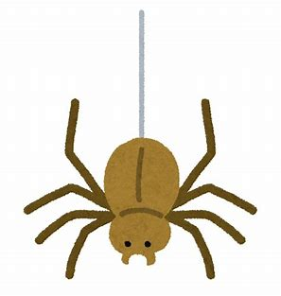
Write a contraction to complete the answer to each question.
“Is it raining?”
“Do you like mustard?”
“No, it .”
“No, I .”
“Did she telephone?”
“Could he swim?”
“No, she .”
“No, he .”

Slide 15
Write a contraction to complete the answer to each question.
“Is it raining?”
“Do you like mustard?”
“No, it isn’t .”
“No, I .”
“Did she telephone?”
“Could he swim?”
“No, she .”
“No, he .”

Slide 16
Write a contraction to complete the answer to each question.
“Is it raining?”
“Do you like mustard?”
“No, it isn’t .”
“No, I .”
“Did she telephone?”
“Could he swim?”
“No, she didn’t .”
“No, he .”

Slide 17
Write a contraction to complete the answer to each question.
“Is it raining?”
“Do you like mustard?”
“No, it isn’t .”
“No, I don’t .”
“Did she telephone?”
“Could he swim?”
“No, she didn’t .”
“No, he .”

Slide 18
Write a contraction to complete the answer to each question.
“Is it raining?”
“Do you like mustard?”
“No, it isn’t .”
“No, I don’t .”
“Did she telephone?”
“Could he swim?”
“No, she didn’t .”
“No, he couldn’t .”

Slide 19
Let’s revise
Parts of speech

Slide 20
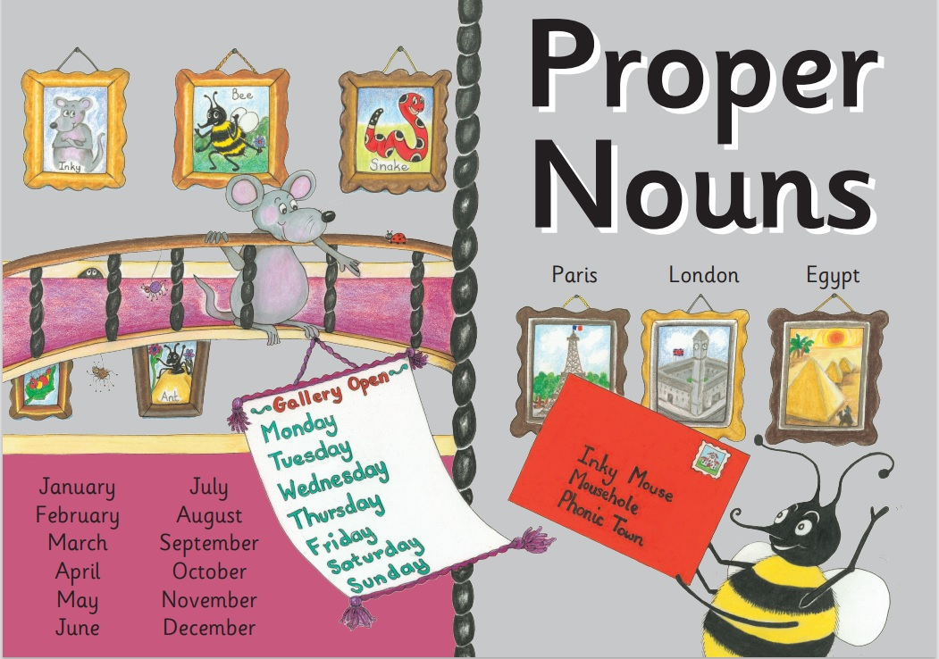

Slide 22
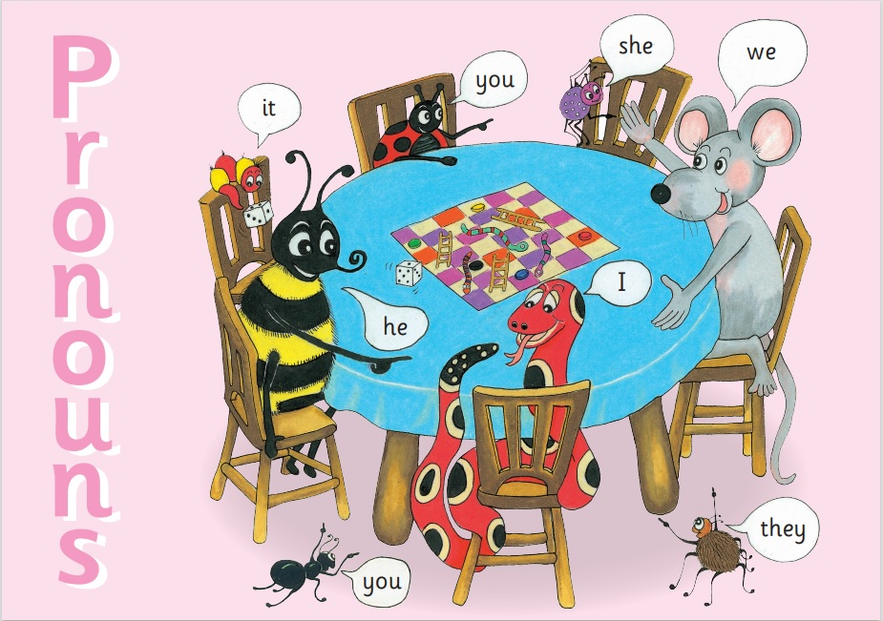

Slide 23
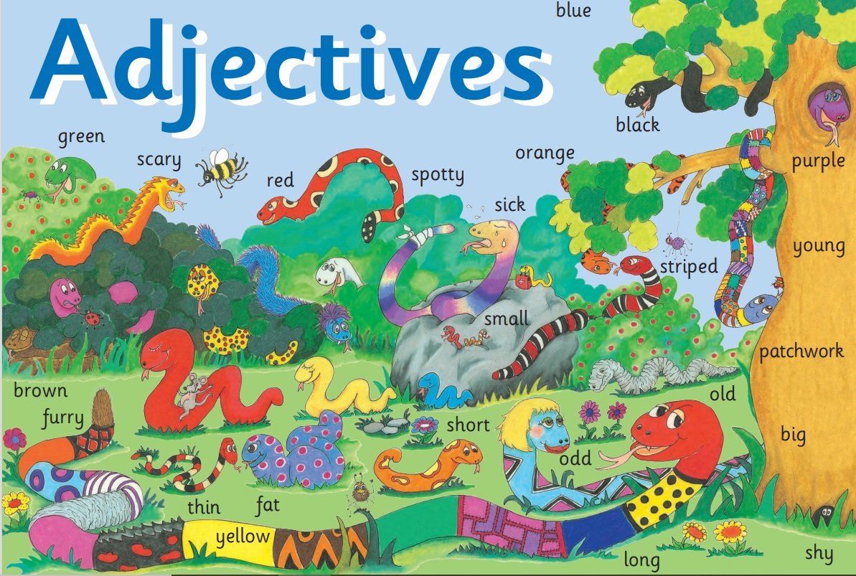

Slide 24
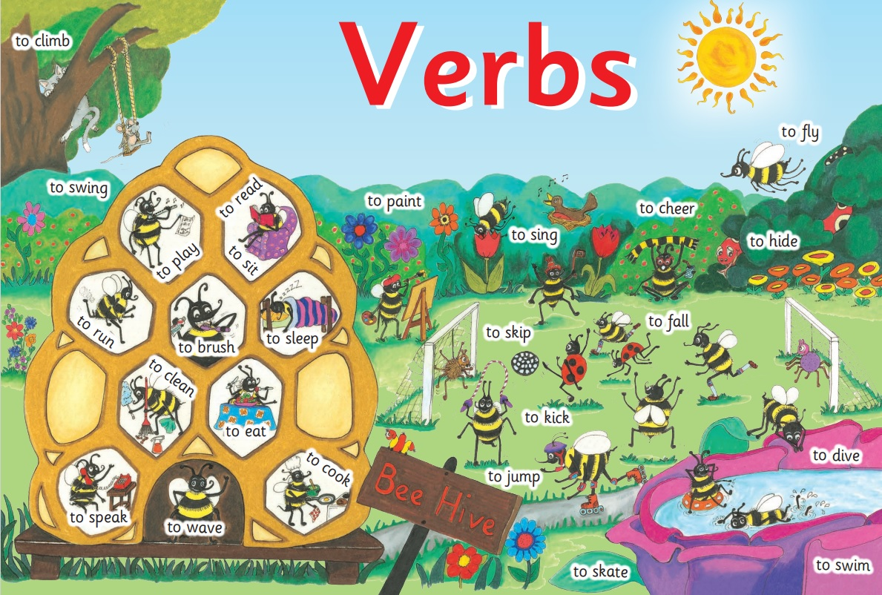

Slide 25
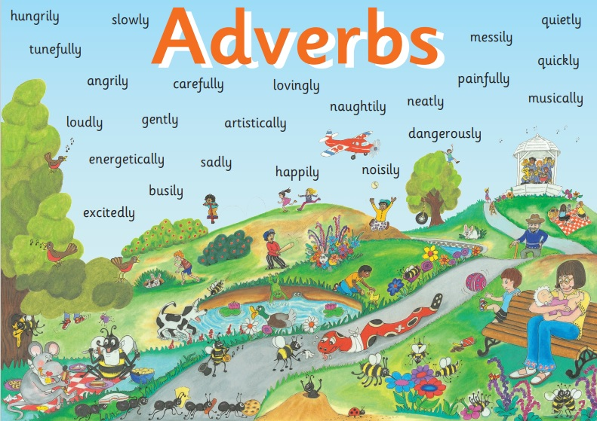

Slide 27
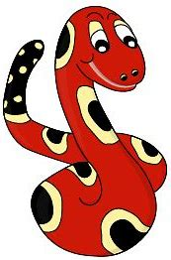
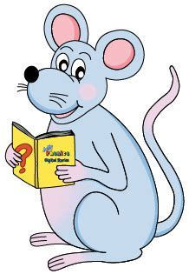
Noun Verb Pronouns Adjective
Adverb Conjunction
Bee flies over the wood.
Snake slithered slowly into a dark hole.
I dropped my pencil and it rolled under a chair.

Slide 28
Noun Verb Pronouns Adjective
Adverb Conjunction
Bee flies over the wood.
Snake slithered slowly into a dark hole.
I dropped my pencil and it rolled under a chair.

Slide 29
Noun Verb Pronouns Adjective
Adverb Conjunction
Bee flies over the wood.
Snake slithered slowly into a dark hole.
I dropped my pencil and it rolled under a chair.

Slide 30
Noun Verb Pronouns Adjective
Adverb Conjunction
Bee flies over the wood.
Snake slithered slowly into a dark hole.
I dropped my pencil and it rolled under a chair.

Slide 31
Noun Verb Pronouns Adjective
Adverb Conjunction
Bee flies over the wood.
Snake slithered slowly into a dark hole.
I dropped my pencil and it rolled under a chair.

Slide 32
Noun Verb Pronouns Adjective
Adverb Conjunction
Bee flies over the wood.
Snake slithered slowly into a dark hole.
I dropped my pencil and it rolled under a chair.

Slide 33
Noun Verb Pronouns Adjective
Adverb Conjunction
Bee flies over the wood.
Snake slithered slowly into a dark hole.
I dropped my pencil and it rolled under a chair.

Slide 34
Noun Verb Pronouns Adjective
Adverb Conjunction
Bee flies over the wood.
Snake slithered slowly into a dark hole.
I dropped my pencil and it rolled under a chair.

Slide 35
Noun Verb Pronouns Adjective
Adverb Conjunction
Bee flies over the wood.
Snake slithered slowly into a dark hole.
I dropped my pencil and it rolled under a chair.

Slide 36
Noun Verb Pronouns Adjective
Adverb Conjunction
Bee flies over the wood.
Snake slithered slowly into a dark hole.
I dropped my pencil and it rolled under a chair.

Slide 37
Noun Verb Pronouns Adjective
Adverb Conjunction
Bee flies over the wood.
Snake slithered slowly into a dark hole.
I dropped my pencil and it rolled under a chair.

Slide 38
Noun Verb Pronouns Adjective
Adverb Conjunction
Bee flies over the wood.
Snake slithered slowly into a dark hole.
I dropped my pencil and it rolled under a chair.

Slide 39
Noun Verb Pronouns Adjective
Adverb Conjunction
Bee flies over the wood.
Snake slithered slowly into a dark hole.
I dropped my pencil and it rolled under a chair.

Slide 40
Noun Verb Pronouns Adjective
Adverb Conjunction
Bee flies over the wood.
Snake slithered slowly into a dark hole.
I dropped my pencil and it rolled under a chair.

Slide 41
Noun Verb Pronouns Adjective
Adverb Conjunction
Bee flies over the wood.
Snake slithered slowly into a dark hole.
I dropped my pencil and it rolled under a chair.

Slide 42
Noun Verb Pronouns Adjective
Adverb Conjunction
Bee flies over the wood.
Snake slithered slowly into a dark hole.
I dropped my pencil and it rolled under a chair.

Slide 43
Noun Verb Pronouns Adjective
Adverb Conjunction
Bee flies over the wood.
Snake slithered slowly into a dark hole.
I dropped my pencil and it rolled under a chair.

Slide 44
Noun Verb Pronouns Adjective
Adverb Conjunction
Bee flies over the wood.
Snake slithered slowly into a dark hole.
I dropped my pencil and it rolled under a chair.

Slide 45
Noun Verb Pronouns Adjective
Adverb Conjunction Preposition
Bee flies over the wood.
Snake slithered slowly into a dark hole.
I dropped my pencil and it rolled under a chair.

Slide 46
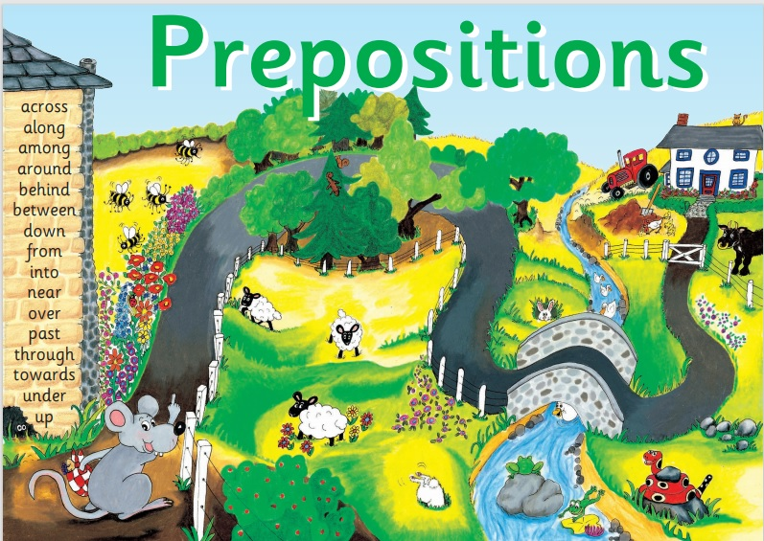

Slide 47
Activity page1
Preposition

Slide 48
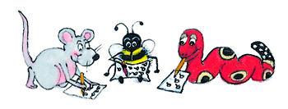
across near among
into from towards to through in around
over past between
besides down under
along round up behind

Slide 49
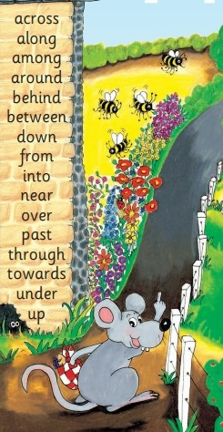
Inky’s Journey
Inky left her mouse-hole and went…
the path,
the flowers,
the fence,
the garden,
the field,
the forest,
the trees,
the bridge and
the farm.

Slide 50
Inky’s Journey
Inky left her mouse-hole and went…
down the path,
the flowers,
the fence,
the garden,
the field,
the forest,
the trees,
the bridge and
the farm.

Slide 51
Inky’s Journey
Inky left her mouse-hole and went…
down the path,
near the flowers,
the fence,
the garden,
the field,
the forest,
the trees,
the bridge and
the farm.

Slide 52
Inky’s Journey
Inky left her mouse-hole and went…
down the path,
near the flowers,
along the fence,
the garden,
the field,
the forest,
the trees,
the bridge and
the farm.

Slide 53
Inky’s Journey
Inky left her mouse-hole and went…
down the path,
near the flowers,
along the fence,
through the garden,
the field,
the forest,
the trees,
the bridge and
the farm.

Slide 54
Inky’s Journey
Inky left her mouse-hole and went…
down the path,
near the flowers,
along the fence,
through the garden,
past the field,
the forest,
the trees,
the bridge and
the farm.

Slide 55
Inky’s Journey
Inky left her mouse-hole and went…
down the path,
near the flowers,
along the fence,
through the garden,
past the field,
into the forest,
the trees,
the bridge and
the farm.

Slide 56
Inky’s Journey
Inky left her mouse-hole and went…
down the path,
near the flowers,
along the fence,
through the garden,
past the field,
into the forest,
among the trees,
the bridge and
the farm.

Slide 57
Inky’s Journey
Inky left her mouse-hole and went…
down the path,
near the flowers,
along the fence,
through the garden,
past the field,
into the forest,
among the trees,
across the bridge and
the farm.

Slide 58
Inky’s Journey
Inky left her mouse-hole and went…
down the path,
near the flowers,
along the fence,
through the garden,
past the field,
into the forest,
among the trees,
across the bridge and
toward the farm.

Slide 59
Measurement Words
centimetre cm
metre m
gram g
kilogram kg
millilitre ml
litre l
weight
volume
minute
second
fraction
estimate

Slide 60
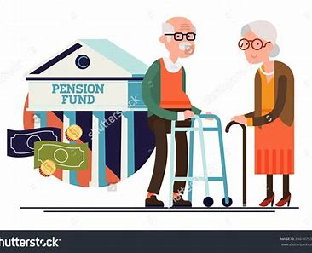
television
/zh/
pension
/sh/

Slide 61
Activity page2

Slide 62
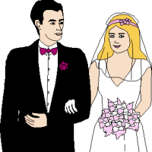
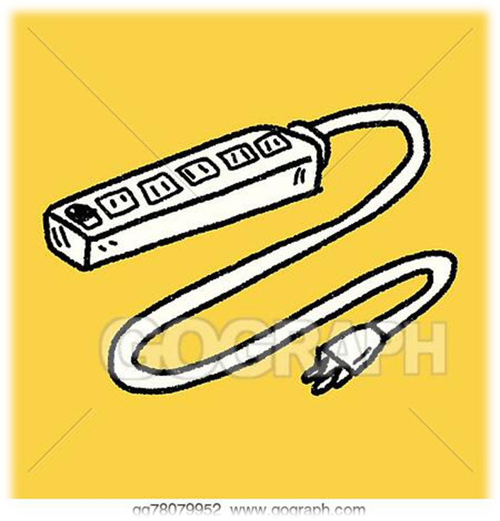
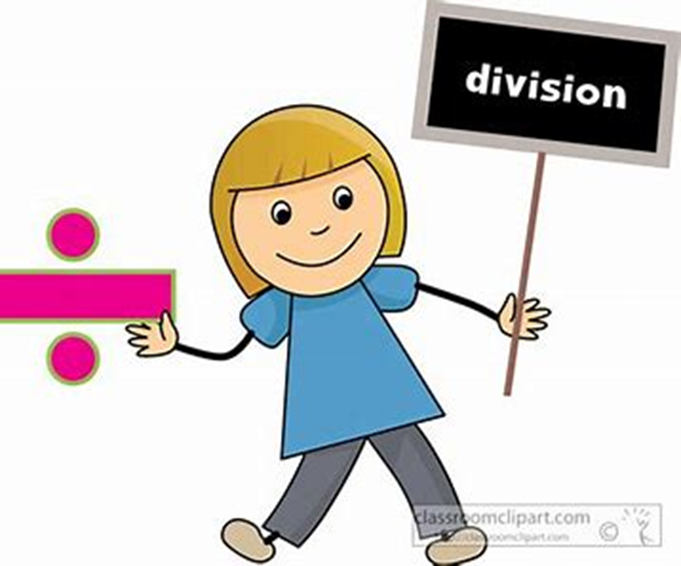
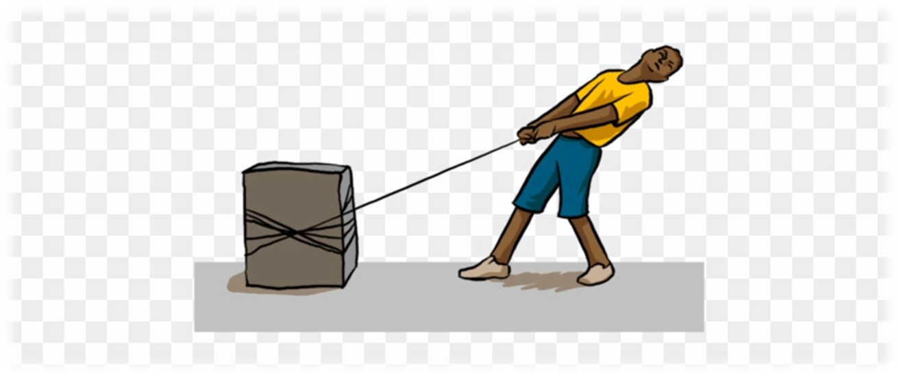
occasion
explosion
extension
fist
best
occasion
division
revision
invasion
explosion
television
fraction
estimate
division
television
pension
revision
vision
permission
invasion
tension

Slide 63
Dictation

Slide 64
Name:
1. 2. 3.
4. 5. 6.
7.
8.
9.

Slide 65
vision

Slide 66
vision 2. division

Slide 67
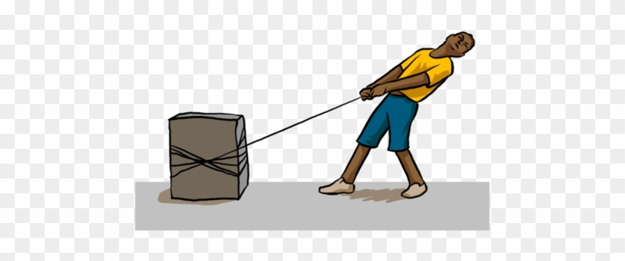
vision 2. division 3. tension

Slide 68
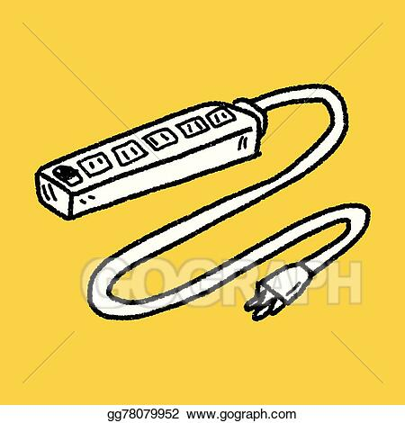
vision 2. division 3. tension
4. extension

Slide 69
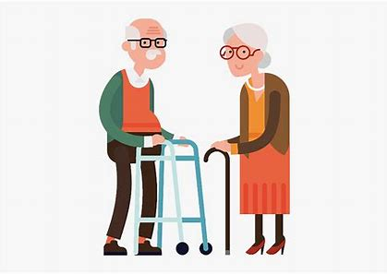
vision 2. division 3. tension
4. extension 5. pension

Slide 70
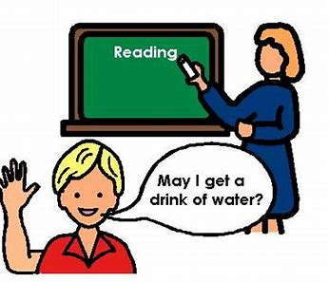
vision 2. division 3. tension
4. extension 5. pension 6. permission

Slide 71
vision 2. division 3. tension
4. extension 5. pension 6. permission
7. He honestly needs his pension.

Slide 72
vision 2. division 3. tension
4. extension 5. pension 6. permission
7. He honestly needs his pension.
8. There was a huge
explosion.

Slide 73
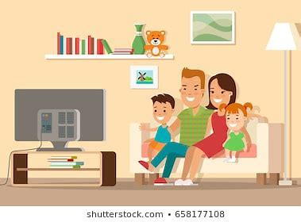
vision 2. division 3. tension
4. extension 5. pension 6. permission
7. He honestly needs his pension.
8. There was a huge
explosion.
9. They watched television
for hours.

Slide 74
Homework

Slide 75
Complete each sentence with a preposition.
to from in beside up
I want to sit my best friend.
Kayla climbed the ladder.
We read left right.
Grandpa keeps his keys his pocket.

Slide 76
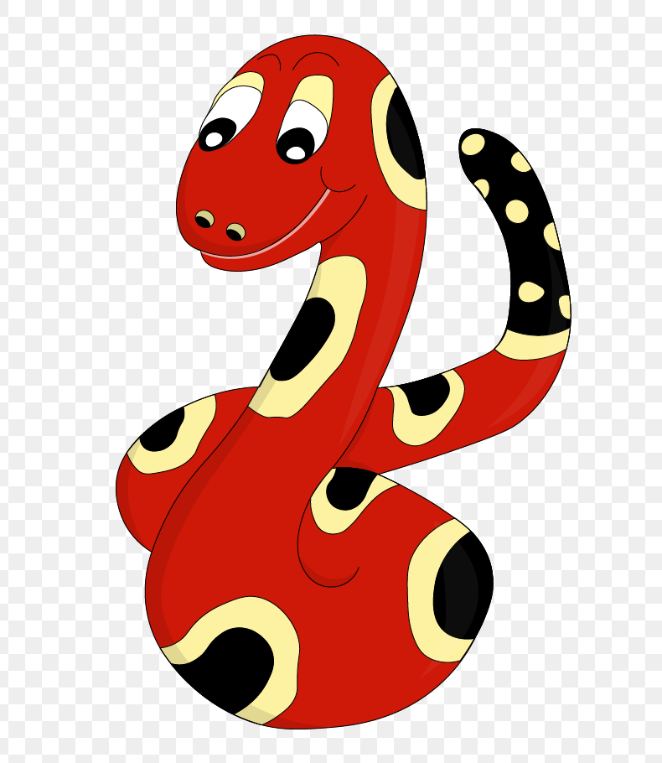
Thank you!
See you
next lesson.

