Slide 1
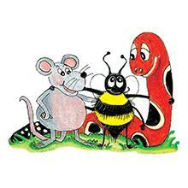
Jolly Grammar 2-33

Slide 2
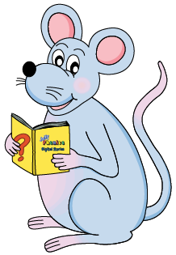
Mini Test 32

Slide 3
1. ark

Slide 4
1. ark
2. clever

Slide 5
1. ark
2. clever
3. gloves

Slide 6
1. ark
2. clever
3. gloves
4. son

Slide 7
1. ark
2. clever
3. gloves
4. son
5. front

Slide 8
1. ark
2. clever
3. gloves
4. son
5. front
6. dozen

Slide 9
1. ark
2. clever
3. gloves
4. son
5. front
6. dozen
7. monkey

Slide 10
1. ark
2. clever
3. gloves
4. son
5. front
6. dozen
7. monkey
8. somebody

Slide 11
1. ark
2. clever
3. gloves
4. son
5. front
6. dozen
7. monkey
8. somebody
9. woman

Slide 12
1. ark
2. clever
3. gloves
4. son
5. front
6. dozen
7. monkey
8. somebody
9. woman
10. women

Slide 13
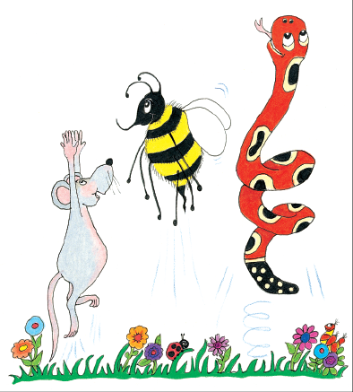
Let’s review
Suffix<-ing>

Slide 14
Add the suffix <-ing> to each verb root, and write the new word on the line.
make
stop
jump
swing
cook
raise
try
whine

Slide 15
Add the suffix <-ing> to each verb root, and write the new word on the line.
make making
stop
jump
swing
cook
raise
try
whine

Slide 16
Add the suffix <-ing> to each verb root, and write the new word on the line.
make making
stop stopping
jump
swing
cook
raise
try
whine

Slide 17
Add the suffix <-ing> to each verb root, and write the new word on the line.
make making
stop stopping
jump jumping
swing
cook
raise
try
whine

Slide 18
Add the suffix <-ing> to each verb root, and write the new word on the line.
make making
stop stopping
jump jumping
swing swinging
cook
raise
try
whine

Slide 19
Add the suffix <-ing> to each verb root, and write the new word on the line.
make making
stop stopping
jump jumping
swing swinging
cook cooking
raise
try
whine

Slide 20
Add the suffix <-ing> to each verb root, and write the new word on the line.
make making
stop stopping
jump jumping
swing swinging
cook cooking
raise raising
try
whine

Slide 21
Add the suffix <-ing> to each verb root, and write the new word on the line.
make making
stop stopping
jump jumping
swing swinging
cook cooking
raise raising
try trying
whine

Slide 22
Add the suffix <-ing> to each verb root, and write the new word on the line.
make making
stop stopping
jump jumping
swing swinging
cook cooking
raise raising
try trying
whine whining

Slide 23
Suffixes

Slide 24
talk
kind
happy
talking
kindness
happiness

Slide 25
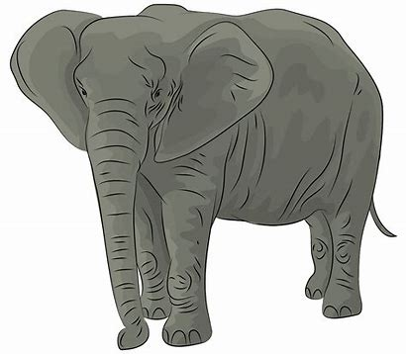
big

Slide 26
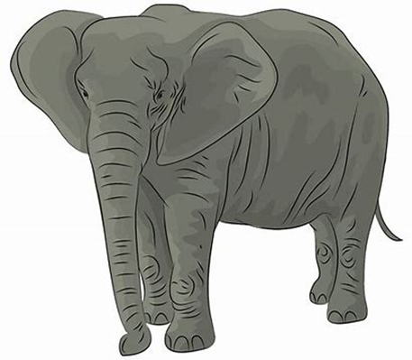
bigger
big

Slide 27
biggest
bigger
big

Slide 28
superlative
comparative
biggest
bigger
big

Slide 29
comparative
superlative
tall
strong
rare
safe
big
hot
happy
angry

Slide 30
tall
strong
rare
safe
big
hot
happy
angry
taller

Slide 31
tall
strong
rare
safe
big
hot
happy
angry
taller
tallest

Slide 32
tall
strong
rare
safe
big
hot
happy
angry
taller
stronger
tallest

Slide 33
tall
strong
rare
safe
big
hot
happy
angry
taller
stronger
tallest
strongest

Slide 34
tall
strong
rare
safe
big
hot
happy
angry
taller
stronger
rarer
tallest
strongest

Slide 35
tall
strong
rare
safe
big
hot
happy
angry
taller
stronger
rarer
tallest
strongest
rarest

Slide 36
tall
strong
rare
safe
big
hot
happy
angry
taller
stronger
rarer
safer
tallest
strongest
rarest

Slide 37
tall
strong
rare
safe
big
hot
happy
angry
taller
stronger
rarer
safer
tallest
strongest
rarest
safest

Slide 38
tall
strong
rare
safe
big
hot
happy
angry
taller
stronger
rarer
safer
bigger
tallest
strongest
rarest
safest

Slide 39
tall
strong
rare
safe
big
hot
happy
angry
taller
stronger
rarer
safer
bigger
tallest
strongest
rarest
safest
biggest

Slide 40
tall
strong
rare
safe
big
hot
happy
angry
taller
stronger
rarer
safer
bigger
hotter
tallest
strongest
rarest
safest
biggest

Slide 41
tall
strong
rare
safe
big
hot
happy
angry
taller
stronger
rarer
safer
bigger
hotter
tallest
strongest
rarest
safest
biggest
hottest

Slide 42
tall
strong
rare
safe
big
hot
happy
angry
taller
stronger
rarer
safer
bigger
hotter
happier
tallest
strongest
rarest
safest
biggest
hottest

Slide 43
tall
strong
rare
safe
big
hot
happy
angry
taller
stronger
rarer
safer
bigger
hotter
happier
tallest
strongest
rarest
safest
biggest
hottest
happiest

Slide 44
tall
strong
rare
safe
big
hot
happy
angry
taller
stronger
rarer
safer
bigger
hotter
happier
angrier
tallest
strongest
rarest
safest
biggest
hottest
happiest

Slide 45
tall
strong
rare
safe
big
hot
happy
angry
taller
stronger
rarer
safer
bigger
hotter
happier
angrier
tallest
strongest
rarest
safest
biggest
hottest
happiest
angriest

Slide 46
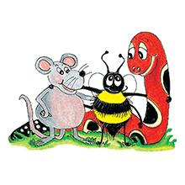
Activity page1
Comparatives
Superlatives

Slide 47
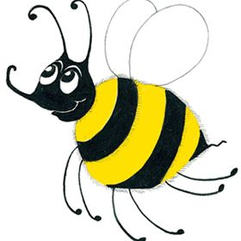
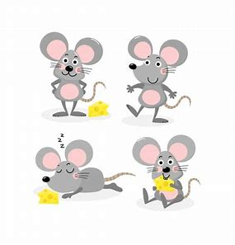
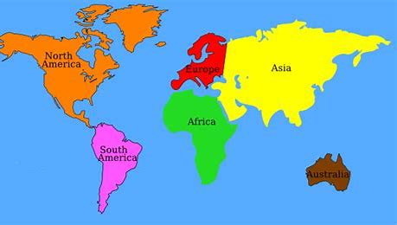
Tricky Plurals (and more)
child
children
woman
women
mouse
mice
library
computer
English
language
continent
world

Slide 48
picture
/t/ /ue/ /r/

Slide 49
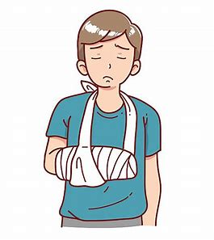
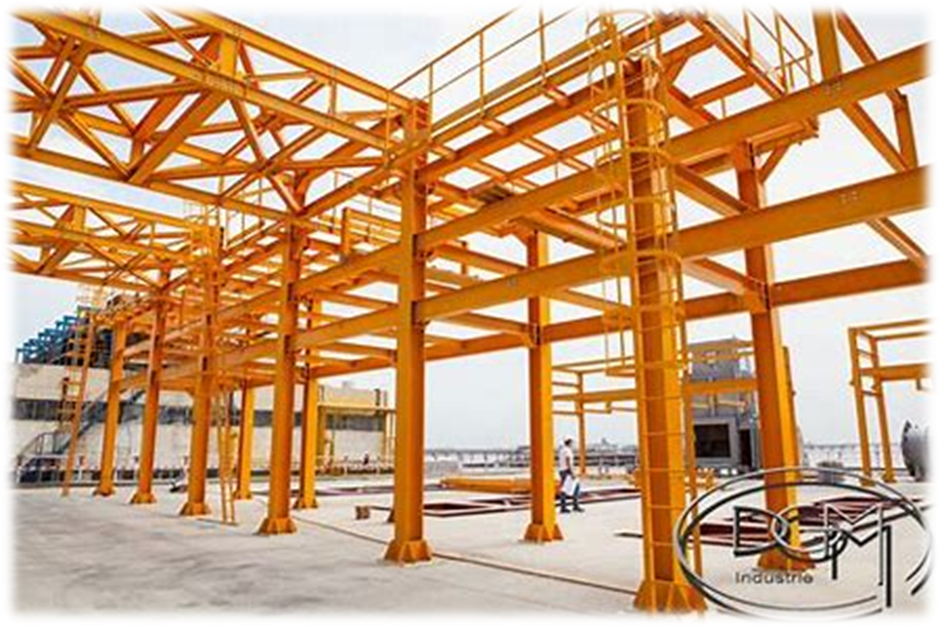
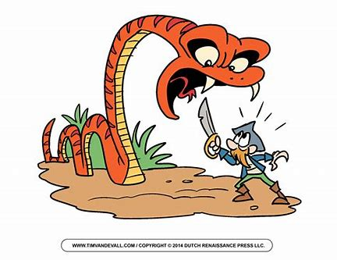
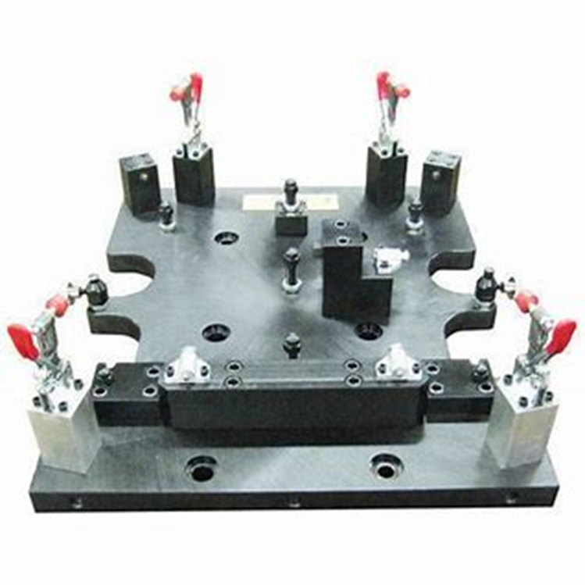
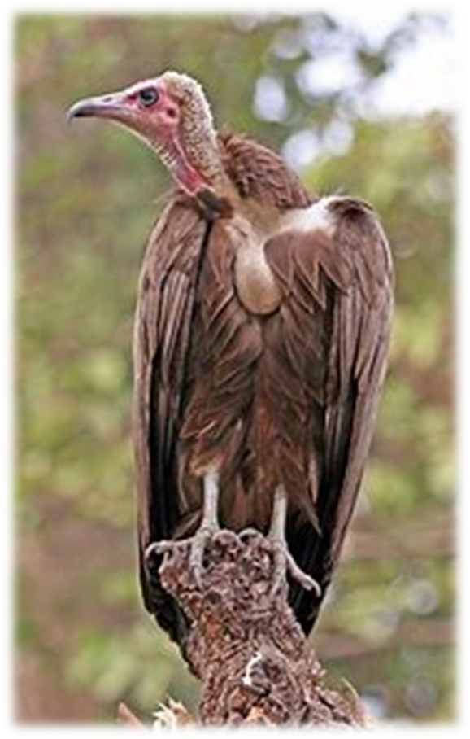
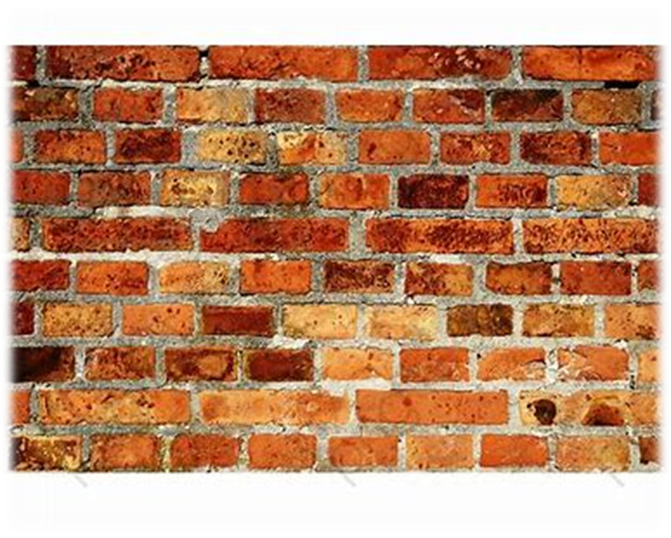
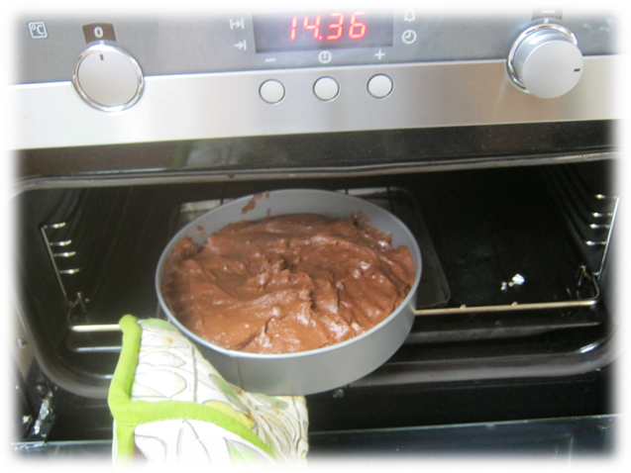
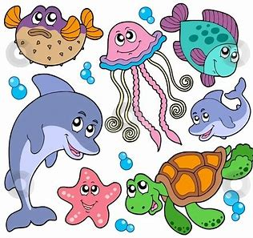
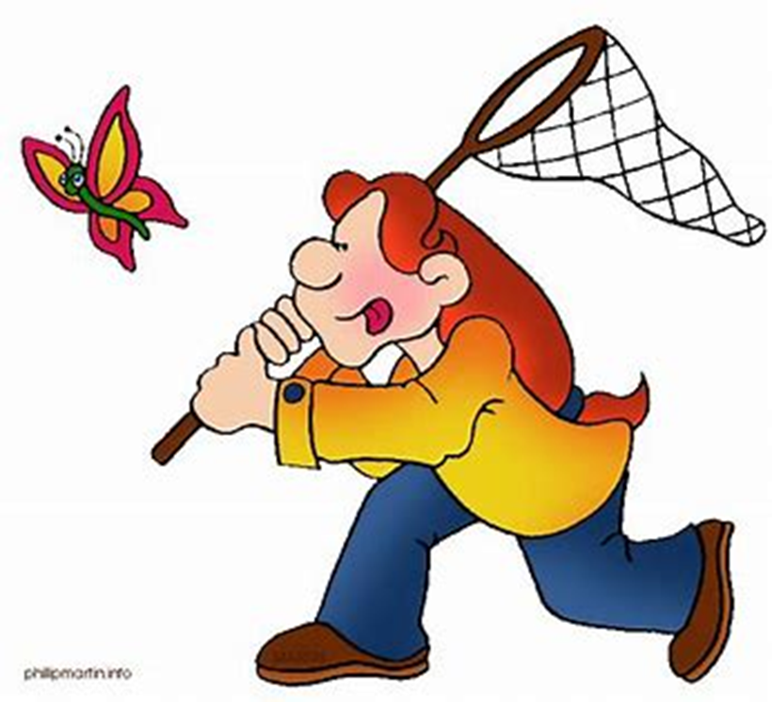
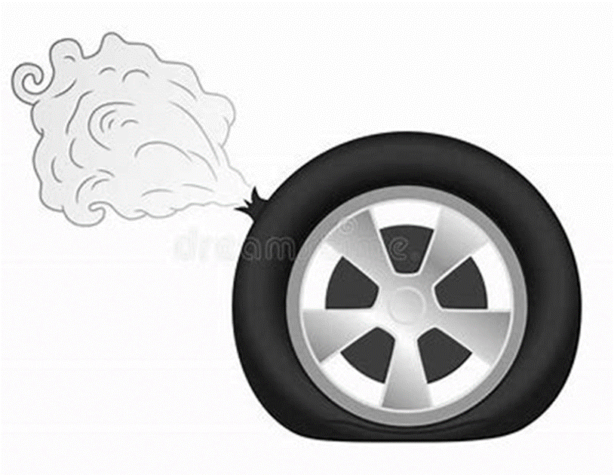
picture
fracture
structure
shook
often
picture
future
nature
creature
fracture
adventure
mouse
mice
future
adventure
fixture
vulture
nature
texture
furniture
mixture
creature
capture
puncture

Slide 50
Activity page2

Slide 51
Dictation

Slide 52
Name:
1. 2. 3.
4. 5. 6.
7.
8.
9.

Slide 53
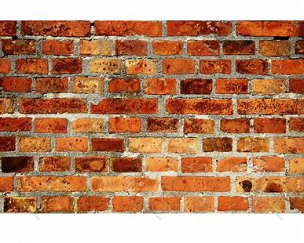
texture

Slide 54
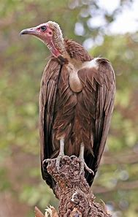
texture 2. vulture

Slide 55
texture 2. vulture 3. capture

Slide 56
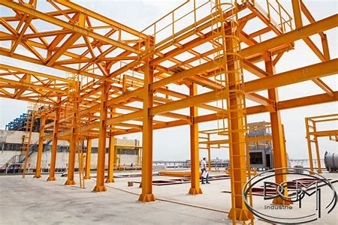
texture 2. vulture 3. capture
4. structure

Slide 57
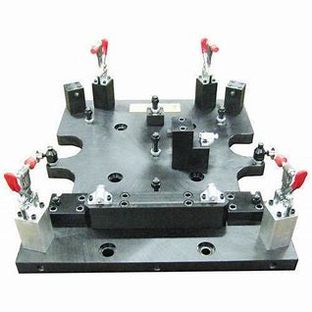
texture 2. vulture 3. capture
4. structure 5. fixture

Slide 58
texture 2. vulture 3. capture
4. structure 5. fixture 6. furniture

Slide 59
texture 2. vulture 3. capture
4. structure 5. fixture 6. furniture
7. Your spare wheel has a puncture.

Slide 60
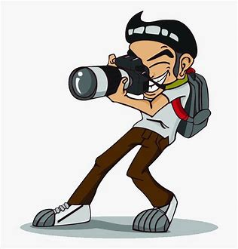
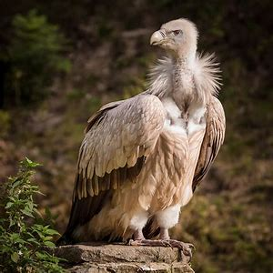
texture 2. vulture 3. capture
4. structure 5. fixture 6. furniture
7. Your spare wheel has a puncture.
8. Come and photograph
this vulture.

Slide 61
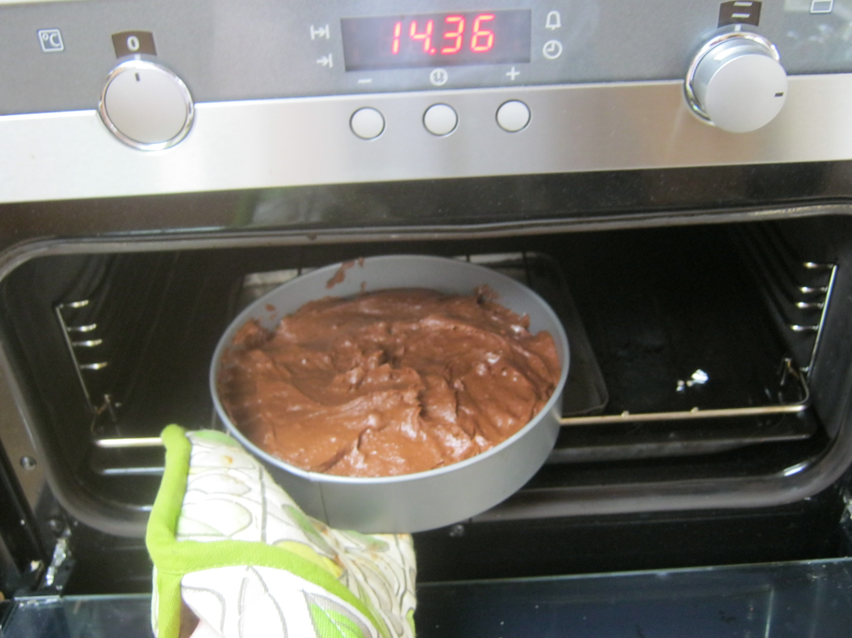
texture 2. vulture 3. capture
4. structure 5. fixture 6. furniture
7. Your spare wheel has a puncture.
8. Come and photograph
this vulture.
9. Is the mixture
ready to go in the oven?

Slide 62
Homework

Slide 63
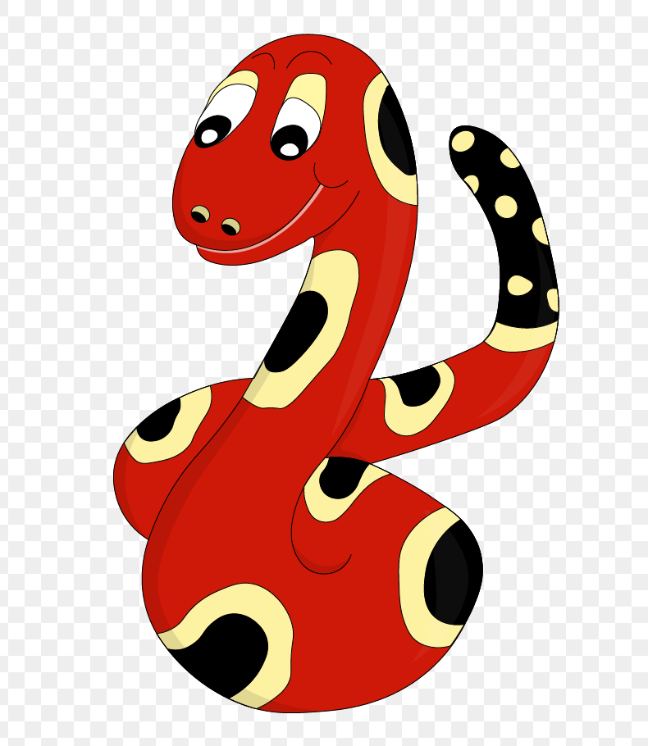
Thank you!
See you
next lesson.

