Slide 1
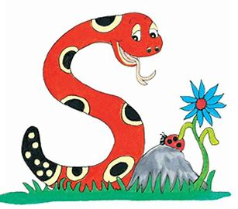
Jolly Grammar
4b-24

Slide 2
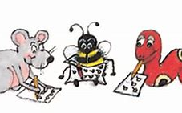
Spelling Test 30

Slide 3
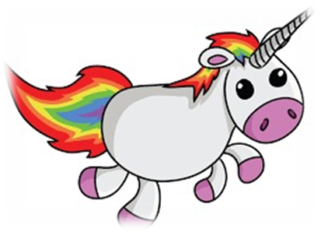
exist

Slide 4
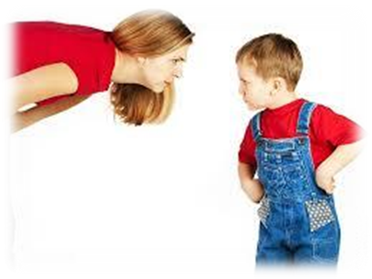
exist
resist

Slide 5
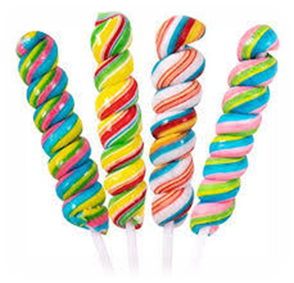
exist
resist
twist

Slide 6
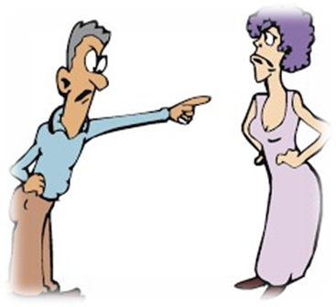
exist
resist
twist
insist

Slide 7
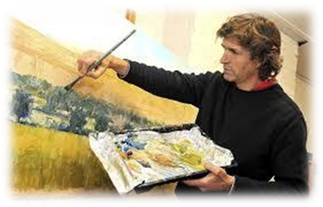
exit
resist
twist
insist
artist

Slide 8
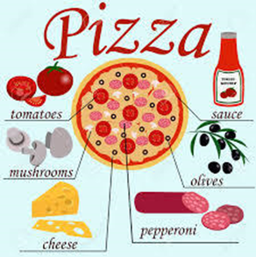
exit
resist
twist
insist
artist
consist

Slide 9
exist
resist
twist
insist
artist
consist
7.chemist

Slide 10
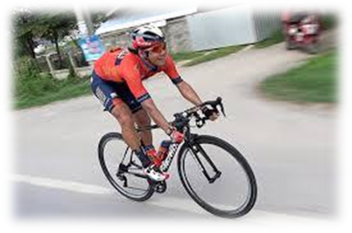
exist
resist
twist
insist
artist
consist
7.chemist
8.cyclist

Slide 11
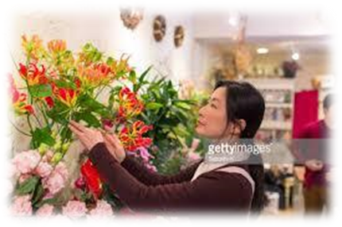
exist
resist
twist
insist
artist
consist
7.chemist
8.cyclist
9.florist

Slide 12
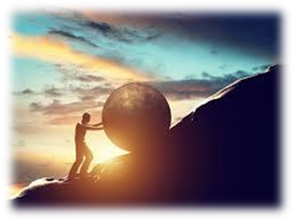
exist
resist
twist
insist
artist
consist
7.chemist
8.cyclist
9.florist
10.persist

Slide 13
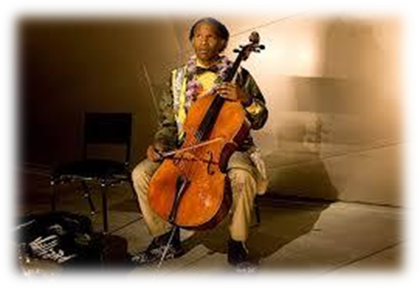
exist
resist
twist
insist
artist
consist
7.chemist
8.cyclist
9.florist
10.persist
11.soloist

Slide 14
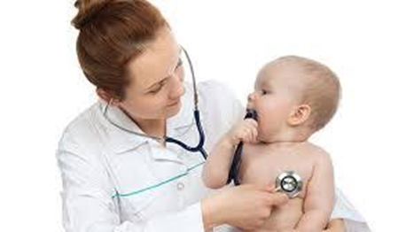
exit
resist
twist
insist
artist
consist
7.chemist
8.cyclist
9.florist
10.persist
11.soloist
12.specialist

Slide 15
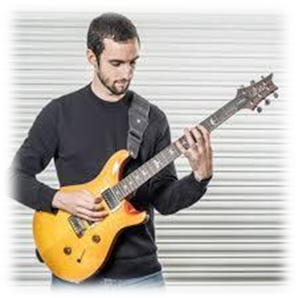
exist
resist
twist
insist
artist
consist
7.chemist
8.cyclist
9.florist
10.persist
11.soloist
12.specialist
13.guitarist

Slide 16
exist
resist
twist
insist
artist
consist
7.chemist
8.cyclist
9.florist
10.persist
11.soloist
12.specialist
13.guitarist
14.scientist

Slide 17
exist
resist
twist
insist
artist
consist
7.chemist
8.cyclist
9.florist
10.persist
11.soloist
12.specialist
13.guitarist
14.scientist
15.linguist

Slide 18
exist
resist
twist
insist
artist
consist
7.chemist
8.cyclist
9.florist
10.persist
11.soloist
12.specialist
13.guitarist
14.scientist
15.linguist
16.tourist

Slide 19
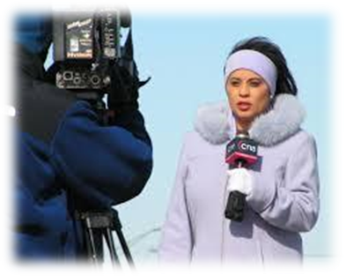
exist
resist
twist
insist
artist
consist
7.chemist
8.cyclist
9.florist
10.persist
11.soloist
12.specialist
13.guitarist
14.scientist
15.linguist
16.tourist
17.journalist

Slide 20
exist
resist
twist
insist
artist
consist
7.chemist
8.cyclist
9.florist
10.persist
11.soloist
12.specialist
13.guitarist
14.scientist
15.linguist
16.tourist
17.journalist
18.therapist

Slide 21
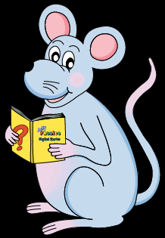
Let’s Review
phrases and sentences

Slide 22
in my swimming class
a moment in time
at the restaurant
I saw a boy in the distance.
He lost his memory.
I saw a different doctor at the hospital.

Slide 23
in my swimming class phrase
a moment in time
at the restaurant
I saw a boy in the distance.
He lost his memory.
I saw a different doctor at the hospital.

Slide 24
in my swimming class phrase
a moment in time phrase
at the restaurant
I saw a boy in the distance.
He lost his memory.
I saw a different doctor at the hospital.

Slide 25
in my swimming class phrase
a moment in time phrase
at the restaurant phrase
I saw a boy in the distance.
He lost his memory.
I saw a different doctor at the hospital.

Slide 26
in my swimming class phrase
a moment in time phrase
at the restaurant phrase
I saw a boy in the distance. sentence
He lost his memory.
I saw a different doctor at the hospital.

Slide 27
in my swimming class phrase
a moment in time phrase
at the restaurant phrase
I saw a boy in the distance. sentence
He lost his memory. sentence
I saw a different doctor at the hospital.

Slide 28
in my swimming class phrase
a moment in time phrase
at the restaurant phrase
I saw a boy in the distance. sentence
He lost his memory. sentence
I saw a different doctor at the hospital. sentence

Slide 29
Let’s learn
clauses

Slide 30
He was tired so he went to bed.

Slide 31
He was tired so he went to bed.

Slide 32
He was tired so he went to bed.
clause
clause

Slide 33
He was tired so he went to bed.
clause
clause
Because he was tired, he went to bed.

Slide 34
He was tired so he went to bed.
clause
clause
Because he was tired, he went to bed.

Slide 35
He was tired so he went to bed.
clause
clause
Because he was tired, he went to bed.
clause

Slide 36
He was tired so he went to bed.
clause
clause
Because he was tired, he went to bed.
clause
clause

Slide 37
He was tired so he went to bed.
Independent clause
clause
Because he was tired, he went to bed.
clause
clause

Slide 38
He was tired so he went to bed.
Independent clause
Independent clause
Because he was tired, he went to bed.
clause
clause

Slide 39
He was tired so he went to bed.
Independent clause
Independent clause
Because he was tired, he went to bed.
clause
Independent clause

Slide 40
He was tired so he went to bed.
Independent clause
Independent clause
Because he was tired, he went to bed.
×Independent clause
Independent clause

Slide 41
He was tired so he went to bed.
Independent clause
Independent clause
Because he was tired, he went to bed.
×Independent clause
〇 dependent clause
subordinate clause
Independent clause

Slide 42
Activity Page
Grammar:
Phrases,
Clauses
And
Sentences

Slide 43
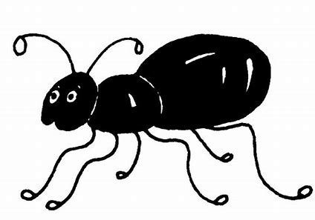
Look at each group of words below. If there is a verb, underline it in red and put a box with a small <s> in the corner around the subject, then circle the word ‘clause’. If there is no verb and subject, circle ‘phrase’.
We are going to the restaurant

Slide 44
Look at each group of words below. If there is a verb, underline it in red and put a box with a small <s> in the corner around the subject, then circle the word ‘clause’. If there is no verb and subject, circle ‘phrase’.
We are going to the restaurant

Slide 45
Look at each group of words below. If there is a verb, underline it in red and put a box with a small <s> in the corner around the subject, then circle the word ‘clause’. If there is no verb and subject, circle ‘phrase’.
s
We are going to the restaurant
phrase / clause

Slide 46
Look at each group of words below. If there is a verb, underline it in red and put a box with a small <s> in the corner around the subject, then circle the word ‘clause’. If there is no verb and subject, circle ‘phrase’.
s
We are going to the restaurant
phrase / clause

Slide 47
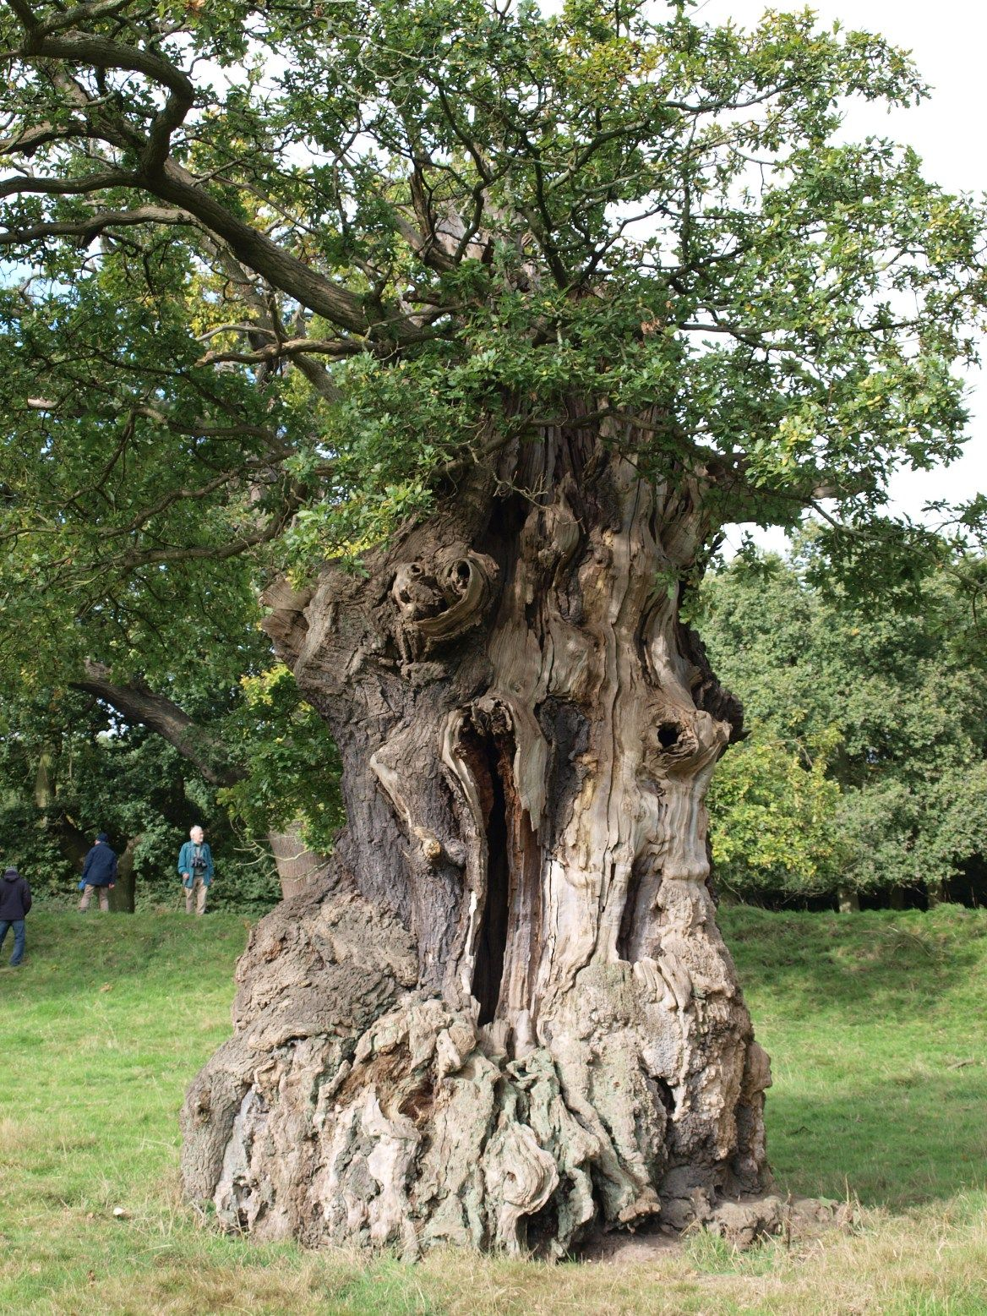
the old gnarled oak tree

Slide 48
the old gnarled oak tree

Slide 49
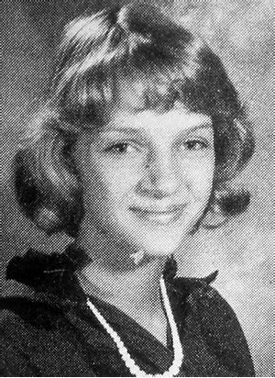
when she was young
s

Slide 50
s
when she was young

Slide 51
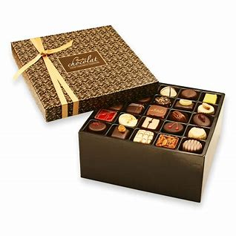
a large box of chocolate

Slide 52
a large box of chocolate

Slide 53
under the mistletoe

Slide 54
under the mistletoe

Slide 55
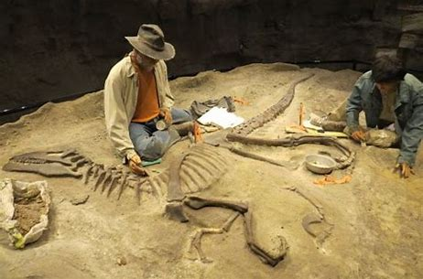
★
they were digging up a fossil

Slide 56
★
s
they were digging up a fossil

Slide 57
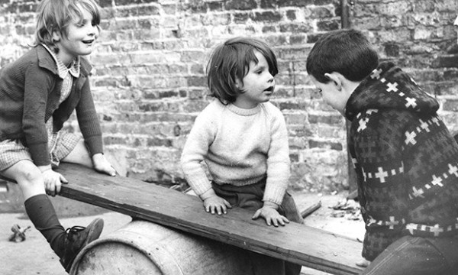
while we waited outside

Slide 58
s
while we waited outside

Slide 59
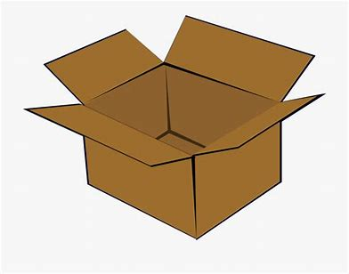
at the bottom of the box

Slide 60
at the bottom of the box

Slide 61
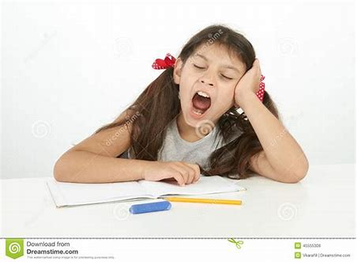
although she was tired

Slide 62
s
although she was tired

Slide 63
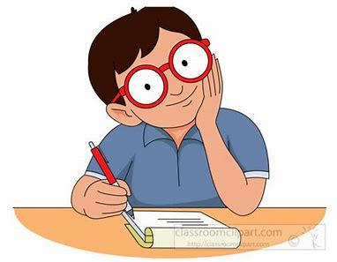
★
he will write a sequel to the novel

Slide 64
s
★
he will write a sequel to the novel

Slide 65
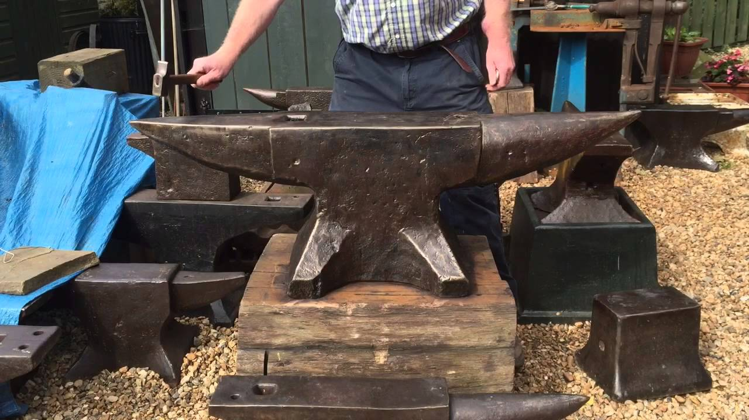
the blacksmith’s anvil

Slide 66
the blacksmith’s anvil

Slide 67
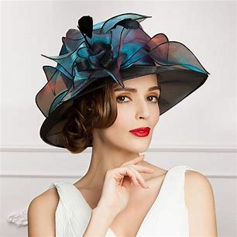
the lady with a hat

Slide 68
the lady with a hat

Slide 69
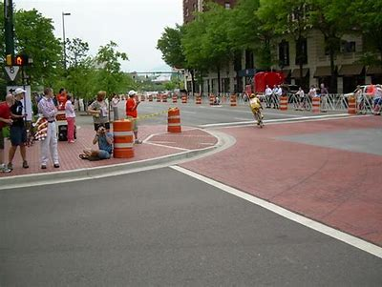
as he ran around the corner

Slide 70
s
as he ran around the corner

Slide 71
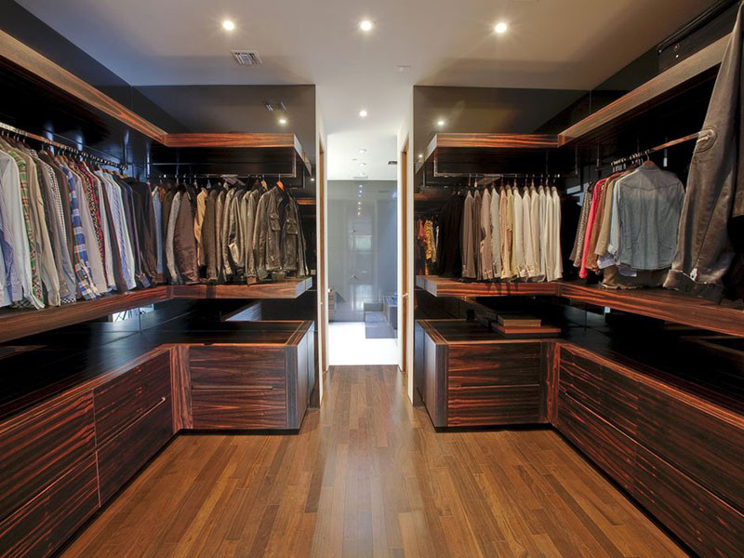
inside the dark wardrobe

Slide 72
inside the dark wardrobe

Slide 73
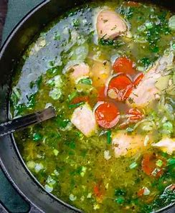
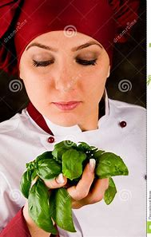
★
the cook was adding some basil to the stew

Slide 74
★
s
the cook was adding some basil to the stew

Slide 75
They were digging up a fossil.
He will write a sequel to the novel.
The cook was adding some basil to the stew.

Slide 76
Thank you.
See you
next time!

