Slide 1
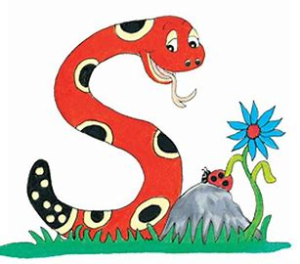
Jolly Grammar
4b-21

Slide 2
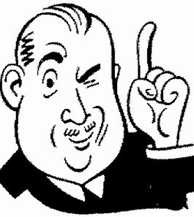
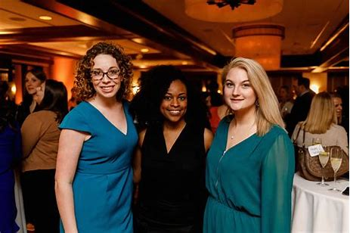
guessed
You have guessed right.
guest
I will have three guests today.

Slide 3
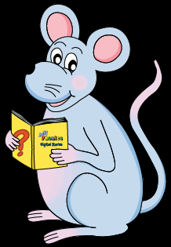
Let’s Review
Punctuation

Slide 4
“Good evening to mums, dads, brothers
and sisters,” began the students.
The president asked, “Do you have the measurements?”
“What a lot of equipment!” exclaimed the explorer.

Slide 5
Revision
<-ery>
<-ary>
<-ory>
<-ant>

Slide 6
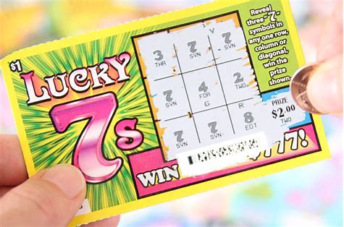
<-ary><-ery><-ory><-ant>
lottery
dictionary
merchant
literary
accessory
distant

Slide 7
Activity Page
Spelling <-ent>

Slide 8
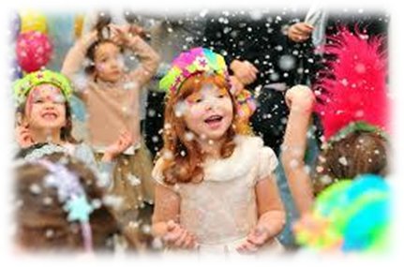
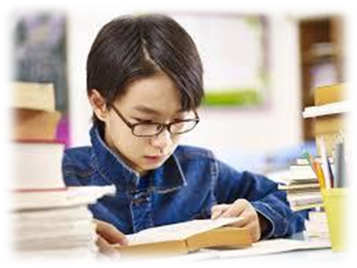
event present parent
happening or existing now your mother or father
spent student moment
the past tense of ‘spend’ a very short period of time

Slide 9
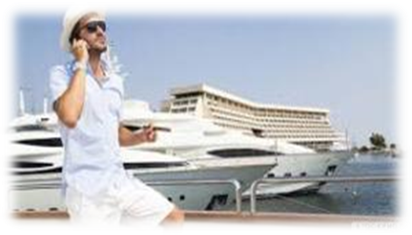
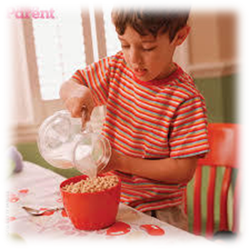
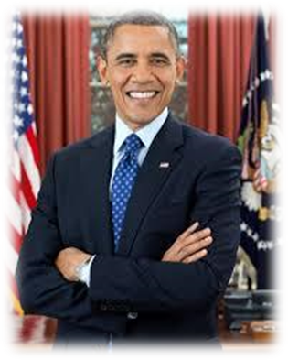
movement affluent equipment
having plenty of money
president treatment independent
the leader of a country not controlled by anyone else

Slide 10
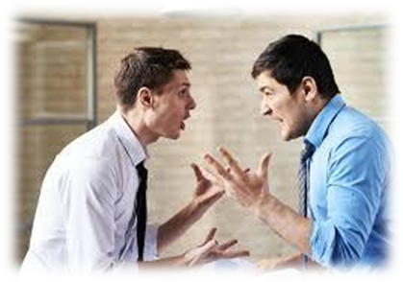
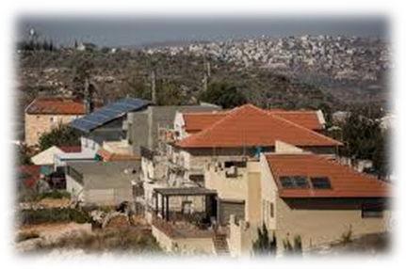
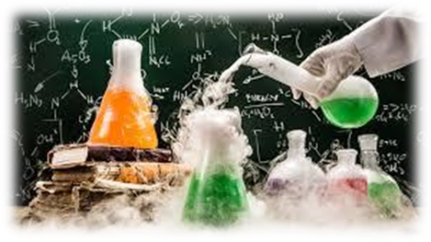
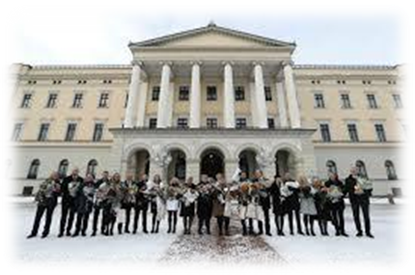
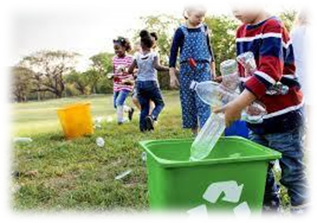
argument settlement experiment
an angry disagreement a scientific test
government environment development
people who control a country surroundings we live in a gradual change

Slide 13
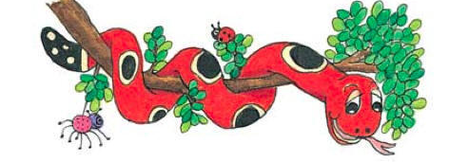
Activity Page :

Slide 14
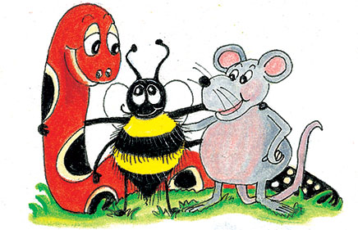
parsing

Slide 15
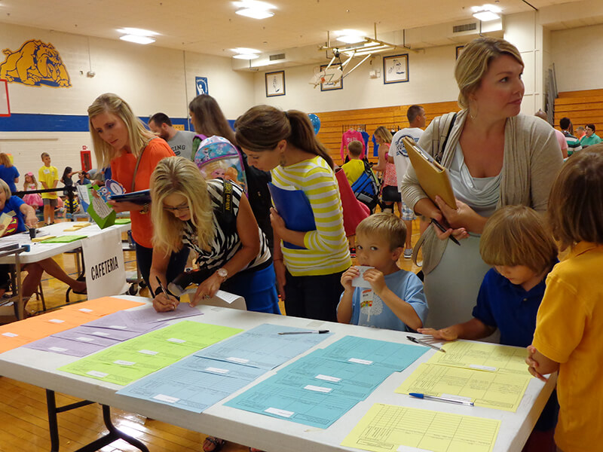
The student’s parents will attend the school event next week.

Slide 16
The student’s parents will attend the school event next week.

Slide 17
The student’s parents will attend the school event next week.

Slide 18
The student’s parents will attend the school event next week.

Slide 19
The student’s parents will attend the school event next week.

Slide 20
The student’s parents will attend the school event next week.

Slide 21
The student’s parents will attend the school event next week.

Slide 22
The student’s parents will attend the school event next week.

Slide 23
The student’s parents will attend the school event next week.
3rd person plural
Simple future

Slide 24
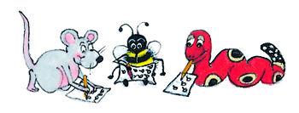
Dictation

Slide 25
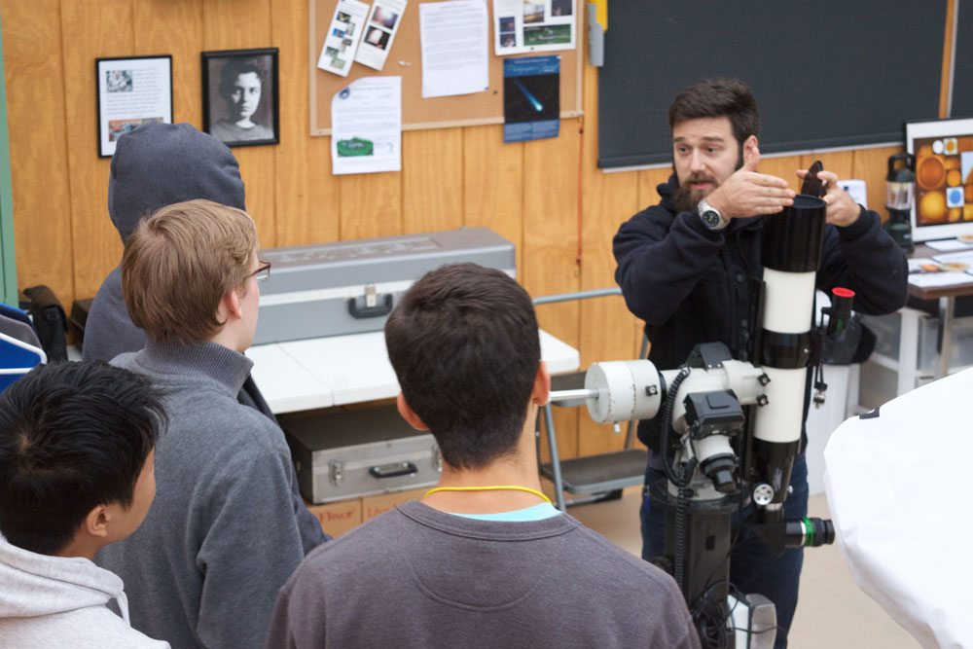

Slide 26
The students spent several hours at the observatory.

Slide 27
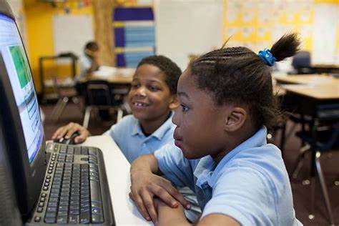

Slide 28
It is not relevant at the present moment.

Slide 29
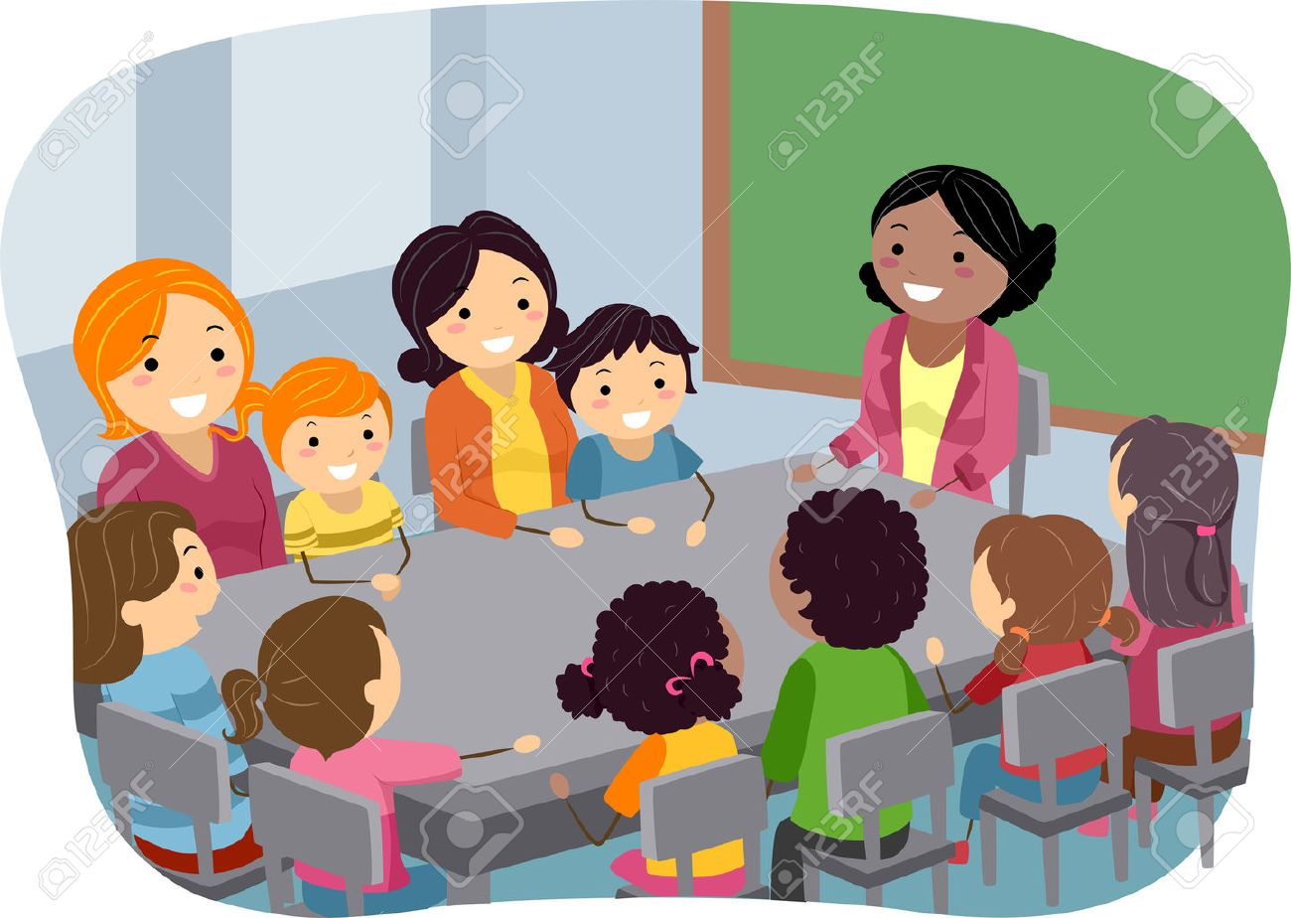

Slide 30
“We need your parent’s agreement,” said the teacher.

Slide 31
Thank you.
See you
next time!

