Slide 1
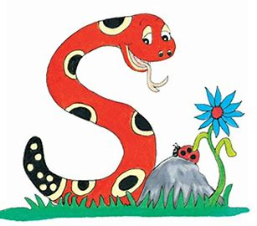
Jolly Grammar
4b-20

Slide 2
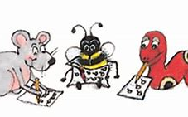
Spelling Test 28

Slide 3
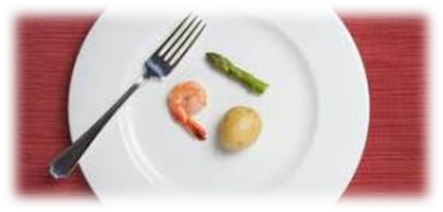
scant

Slide 4
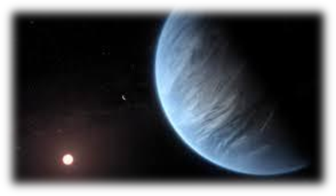
scant
distant

Slide 5
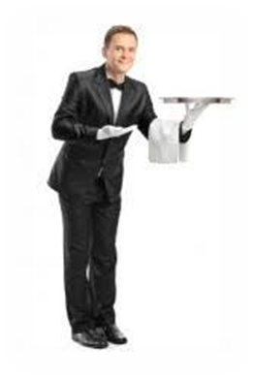
scant
distant
servant

Slide 6
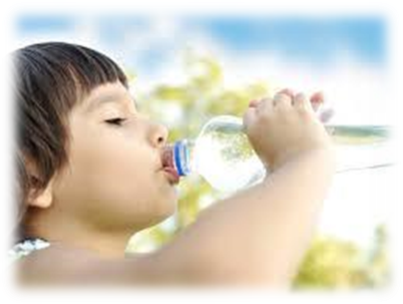
scant
distant
servant
important

Slide 7
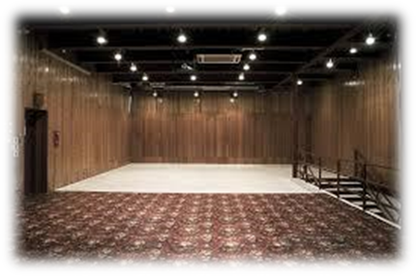
scant
distant
servant
important
vacant

Slide 8
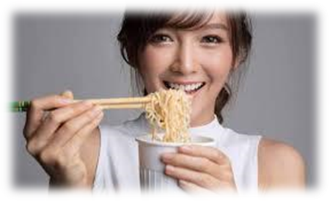
scant
distant
servant
important
vacant
instant

Slide 9
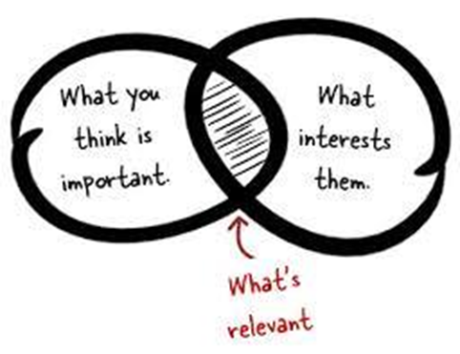
scant
distant
servant
important
vacant
instant
7.relevant

Slide 10
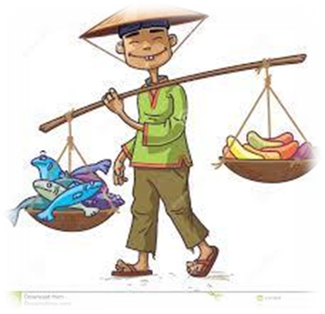
scant
distant
servant
important
vacant
instant
7.relevant
8.merchant

Slide 11
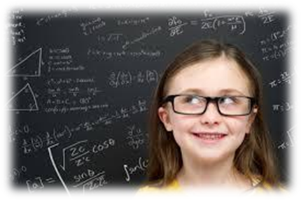
scant
distant
servant
important
vacant
instant
7.relevant
8.merchant
9.brilliant

Slide 12
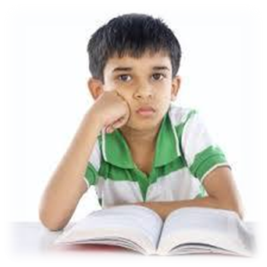
scant
distant
servant
important
vacant
instant
7.relevant
8.merchant
9.brilliant
10.reluctant

Slide 13
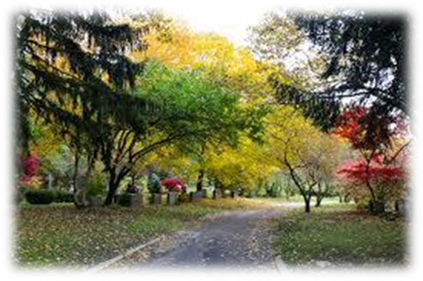
scant
distant
servant
important
vacant
instant
7.relevant
8.merchant
9.brilliant
10.reluctant
11.pleasant

Slide 14
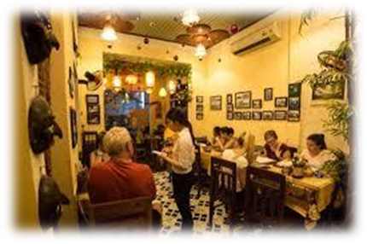
scant
distant
servant
important
vacant
instant
7.relevant
8.merchant
9.brilliant
10.reluctant
11.pleasant
12.restaurant

Slide 15
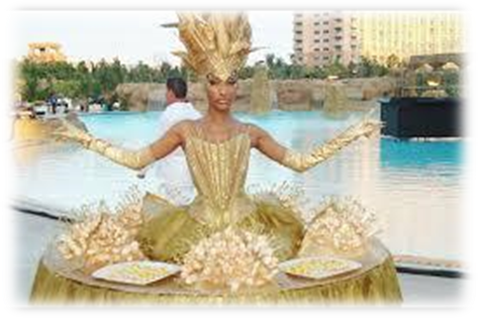
scant
distant
servant
important
vacant
instant
7.relevant
8.merchant
9.brilliant
10.reluctant
11.pleasant
12.restaurant
13.extravagant

Slide 16
scant
distant
servant
important
vacant
instant
7.relevant
8.merchant
9.brilliant
10.reluctant
11.pleasant
12.restaurant
13.extravagant
14.participant

Slide 17
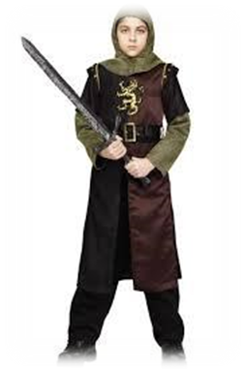
scant
distant
servant
important
vacant
instant
7.relevant
8.merchant
9.brilliant
10.reluctant
11.pleasant
12.restaurant
13.extravagant
14.participant
15.valiant

Slide 18
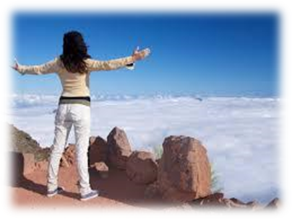
scant
distant
servant
important
vacant
instant
7.relevant
8.merchant
9.brilliant
10.reluctant
11.pleasant
12.restaurant
13.extravagant
14.participant
15.valiant
16.triumphant

Slide 19
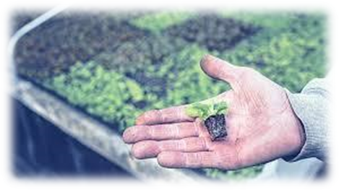
scant
distant
servant
important
vacant
instant
7.relevant
8.merchant
9.brilliant
10.reluctant
11.pleasant
12.restaurant
13.extravagant
14.participant
15.valiant
16.triumphant
17.insignificant

Slide 20
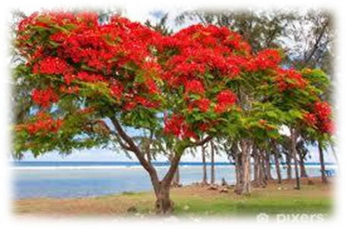
scant
distant
servant
important
vacant
instant
7.relevant
8.merchant
9.brilliant
10.reluctant
11.pleasant
12.restaurant
13.extravagant
14.participant
15.valiant
16.triumphant
17.insignificant
18.flamboyant

Slide 21
Let’s review
homophones

Slide 22
our are
their there they’re
your you’re
its it’s
to two too
where were wear

Slide 23
More Homophone Mix-ups(1)

Slide 24
bridal
bridle

Slide 25
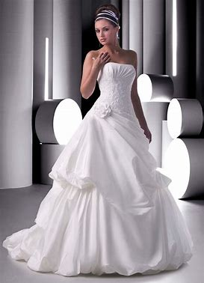
bridal
She got her bridal gown.
bridle

Slide 26
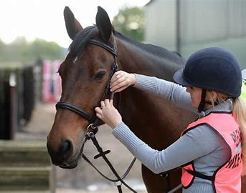
bridal
She got her bridal gown.
bridle
The trainer gave a horse the bridle.

Slide 27
flew
flu
flue

Slide 28
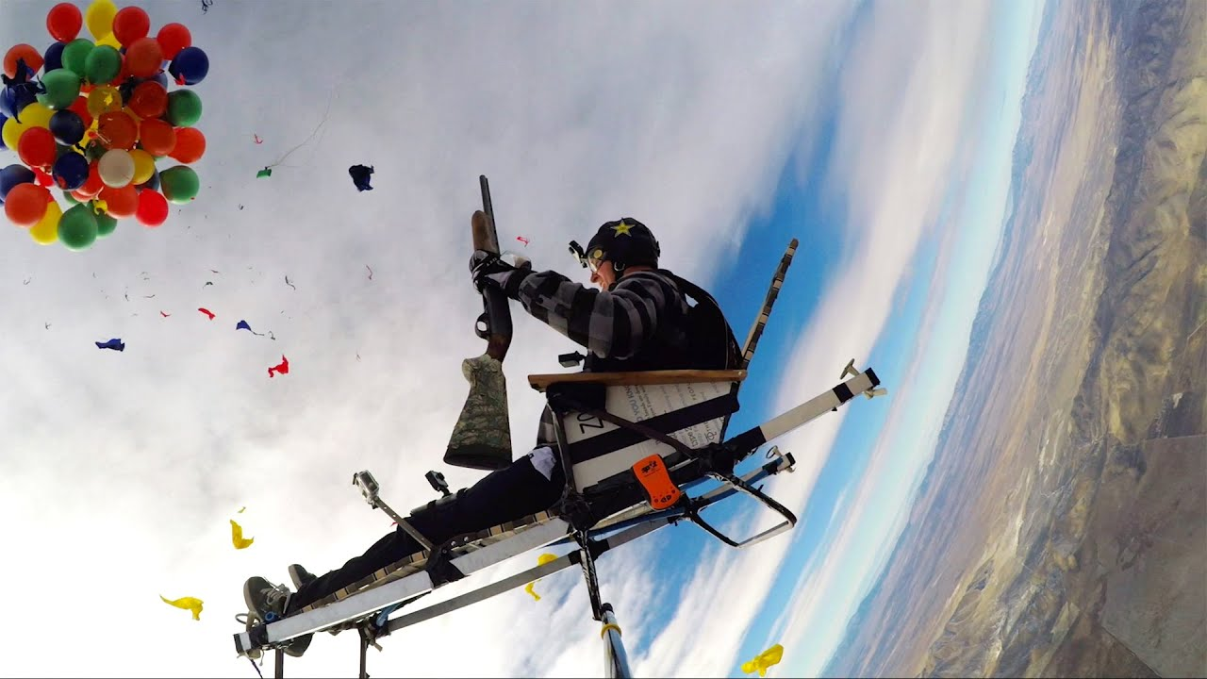
flew
I flew in the air.
flu
flue

Slide 29
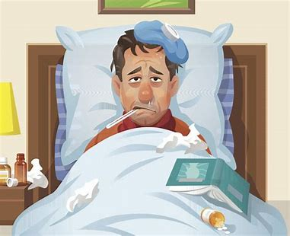
flew
I flew in the air.
flu
He is in bed with the flu.
flue

Slide 30
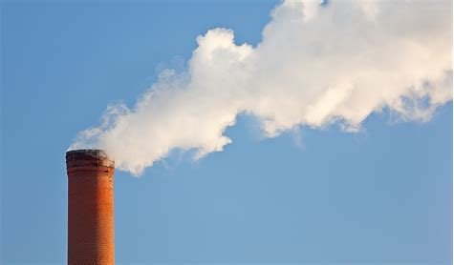
flew
I flew in the air.
flu
He is in bed with the flu.
flue
Flue gas is gas that exits
to the air through a flue.

Slide 31
you
ewe
yew

Slide 32
you
Good morning to you.
ewe
yew

Slide 33
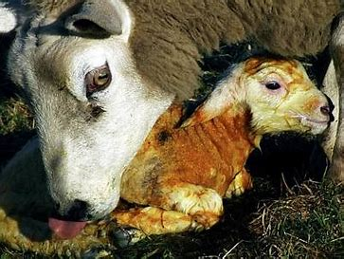
you
Good morning to you.
ewe
A ewe drops a lamb.
yew

Slide 34
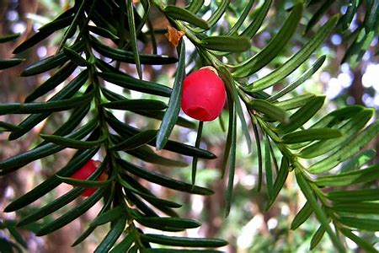
you
Good morning to you.
ewe
A ewe drops a lamb.
yew
I found a plant called yew.

Slide 35
days
daze

Slide 36
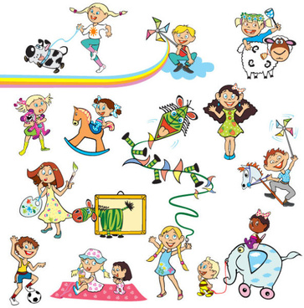
days
We had wonderful days.
daze

Slide 37
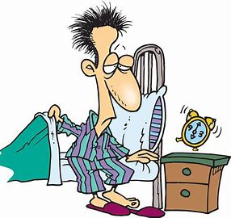
days
We had wonderful days.
daze
Since morning I have been in a daze.

Slide 38
herd
heard

Slide 39
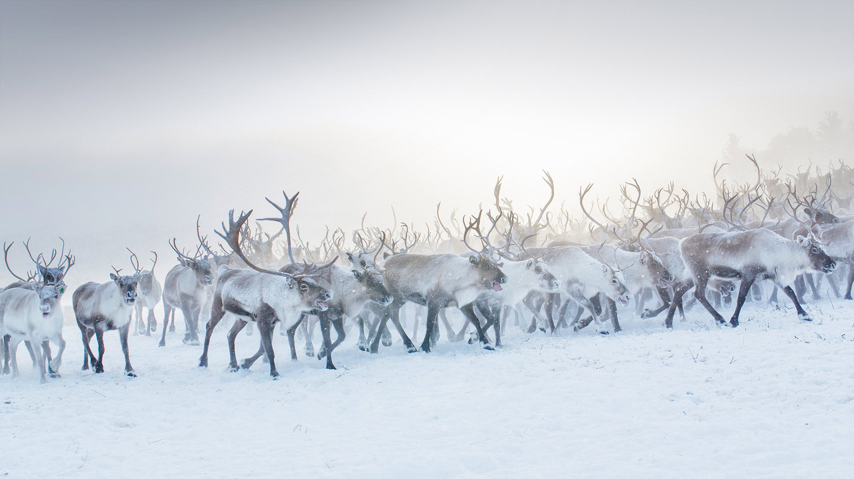
herd
There is a herd of reindeer.
heard

Slide 40
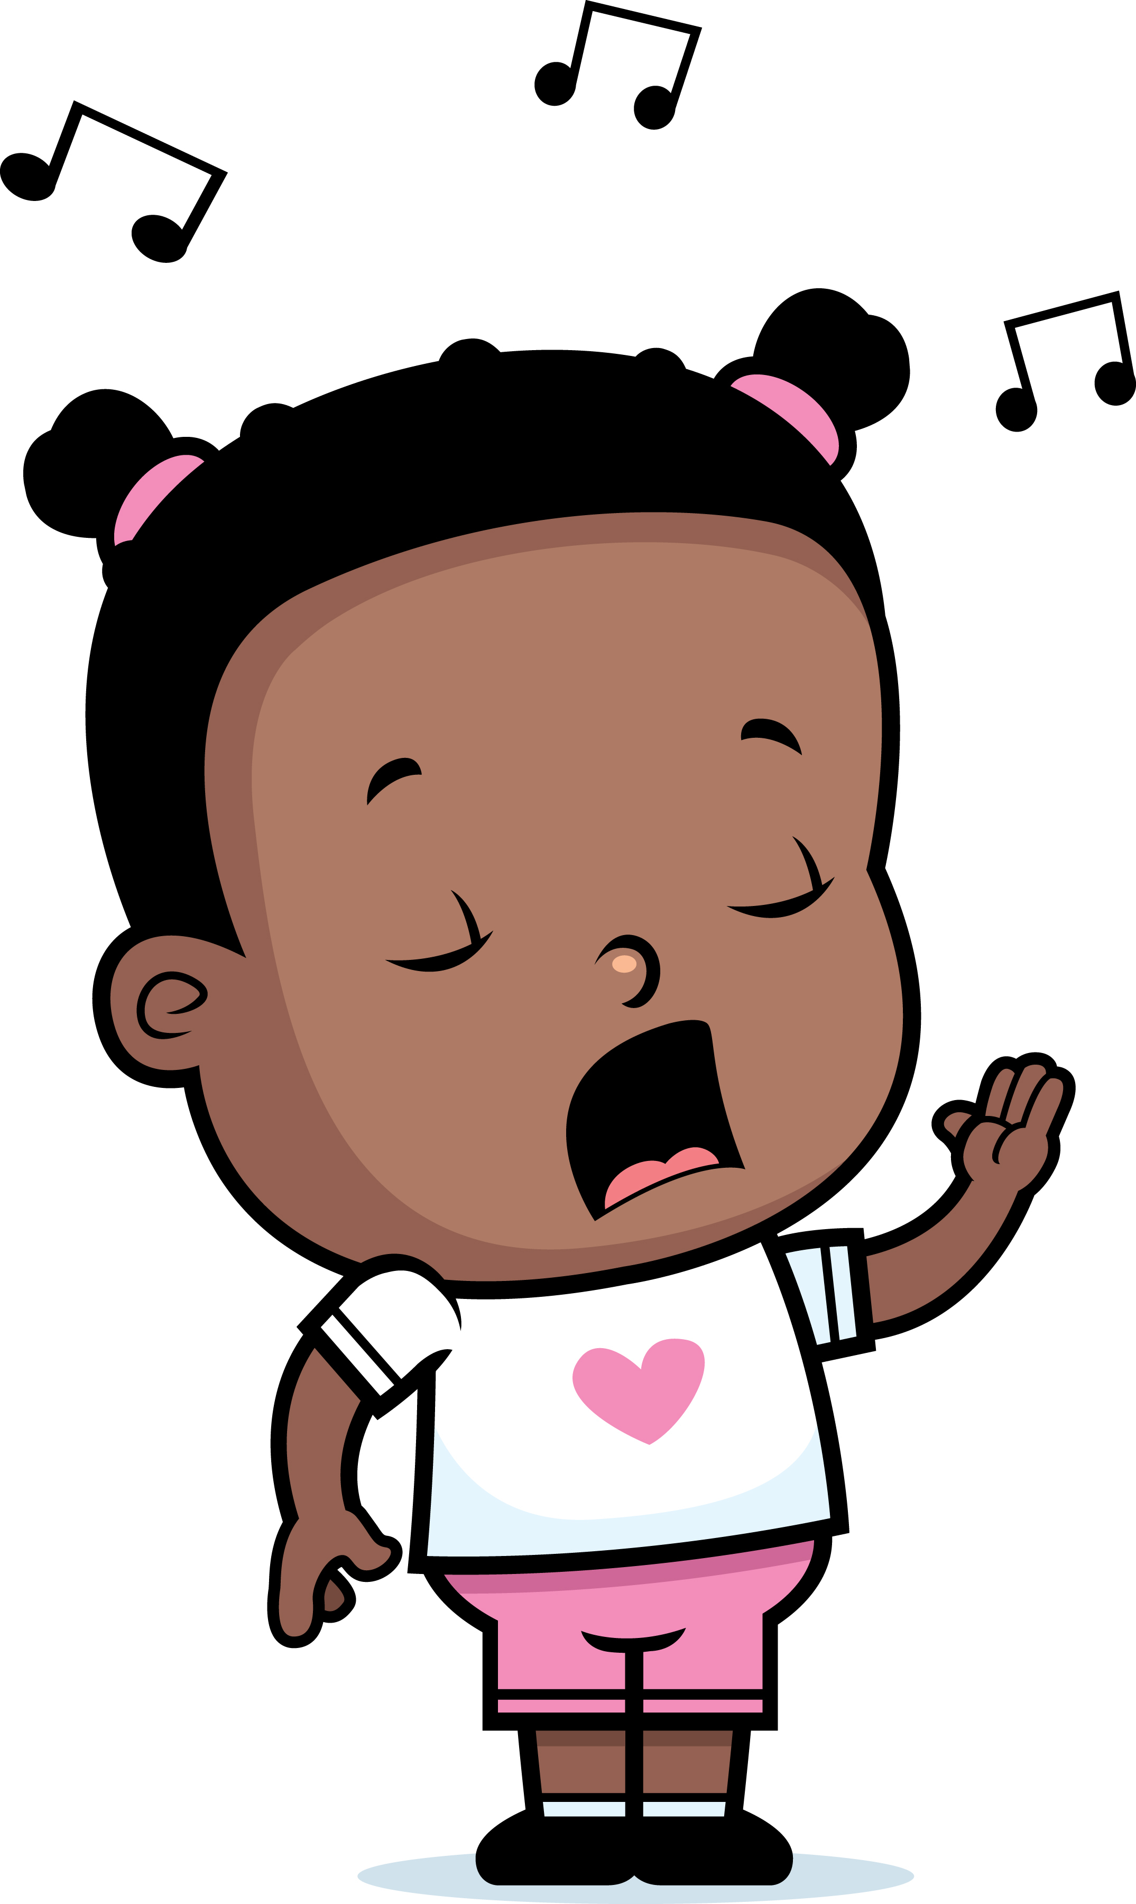
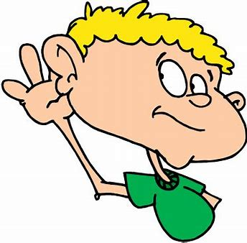
herd
There is a herd of reindeer.
heard
You heard my song.

Slide 41
rest
wrest

Slide 42
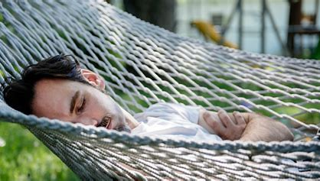
rest
He took a rest.
wrest

Slide 43
rest
He took a rest.
wrest
She wrested the knife from his hands.

Slide 44
genes
jeans

Slide 45
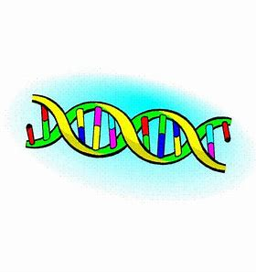
genes
This has good genes.
jeans

Slide 46
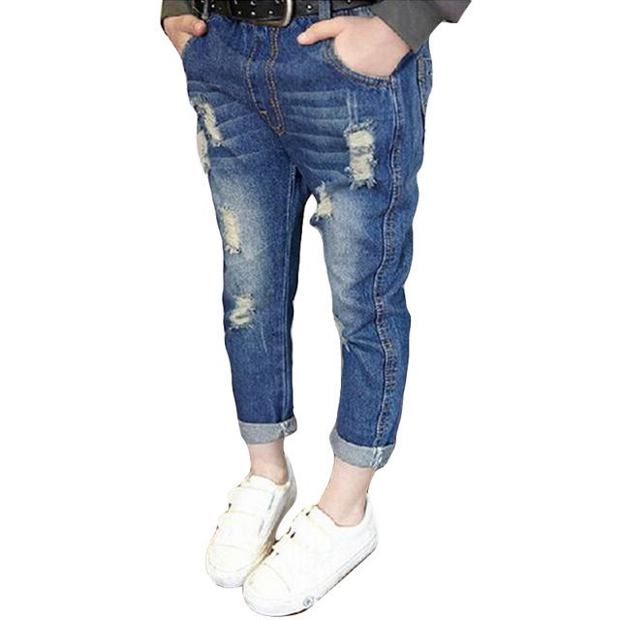
genes
This has good genes.
jeans
I got some holes in my jeans.

Slide 47
guessed
guest

Slide 48
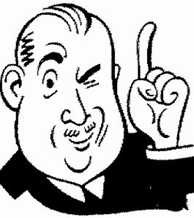
guessed
You have guessed right.
guest

Slide 49
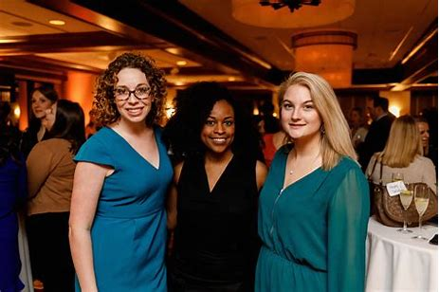
guessed
You have guessed right.
guest
I will have three guests today.

Slide 50
Thank you.
See you
next time!

