Slide 1
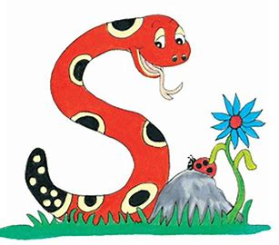
Jolly Grammar
4b-18

Slide 2
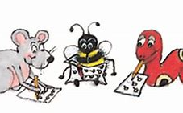
Spelling Test 27

Slide 3
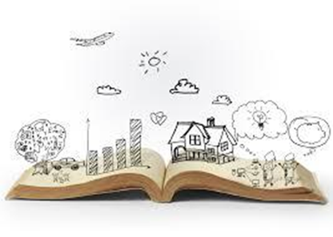
story

Slide 4
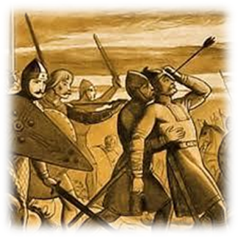
story
history

Slide 5
story
history
victory

Slide 6
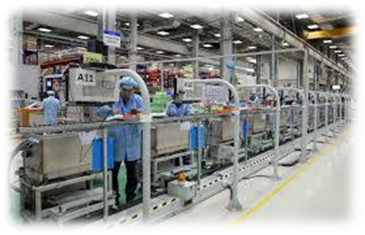
story
history
victory
factory

Slide 7
story
history
victory
factory
theory

Slide 8
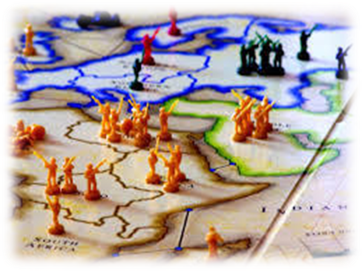
story
history
victory
factory
theory
territory

Slide 9
story
history
victory
factory
theory
territory
7.category

Slide 10
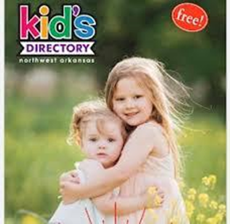
story
history
victory
factory
theory
territory
7.category
8.directory

Slide 11
story
history
victory
factory
theory
territory
7.category
8.directory
9.inventory

Slide 12
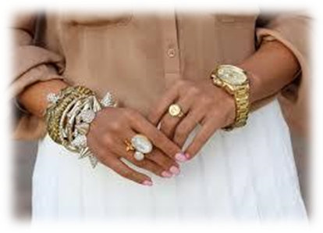
story
history
victory
factory
theory
territory
7.category
8.directory
9.inventory
10.accessory

Slide 13
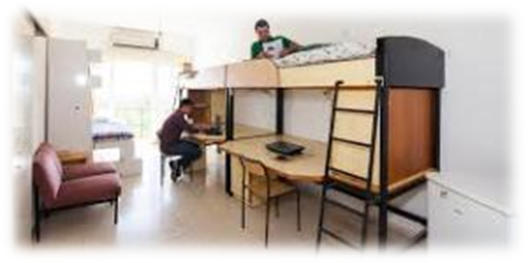
story
history
victory
factory
theory
territory
7.category
8.directory
9.inventory
10.accessory
11.dormitory

Slide 14
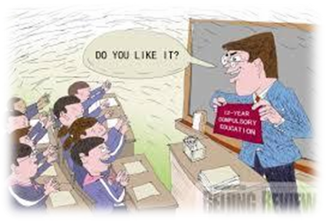
story
history
victory
factory
theory
territory
7.category
8.directory
9.inventory
10.accessory
11.dormitory
12.compulsory

Slide 15
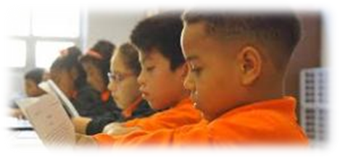
story
history
victory
factory
theory
territory
7.category
8.directory
9.inventory
10.accessory
11.dormitory
12.compulsory
13.preparatory

Slide 16
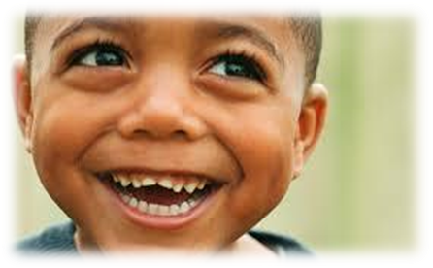
story
history
victory
factory
theory
territory
7.category
8.directory
9.inventory
10.accessory
11.dormitory
12.compulsory
13.preparatory
14.satisfactory

Slide 17
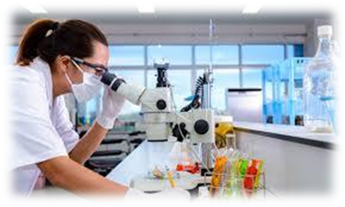
story
history
victory
factory
theory
territory
7.category
8.directory
9.inventory
10.accessory
11.dormitory
12.compulsory
13.preparatory
14.satisfactory
15.laboratory

Slide 18
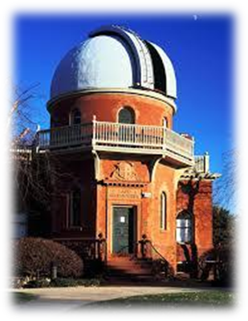
story
history
victory
factory
theory
territory
7.category
8.directory
9.inventory
10.accessory
11.dormitory
12.compulsory
13.preparatory
14.satisfactory
15.laboratory
16.observatory

Slide 19
story
history
victory
factory
theory
territory
7.category
8.directory
9.inventory
10.accessory
11.dormitory
12.compulsory
13.preparatory
14.satisfactory
15.laboratory
16.observatory
17.introductory

Slide 20
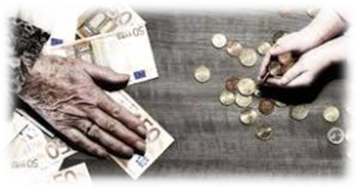
story
history
victory
factory
theory
territory
7.category
8.directory
9.inventory
10.accessory
11.dormitory
12.compulsory
13.preparatory
14.satisfactory
15.laboratory
16.observatory
17.introductory
18.contributory

Slide 21
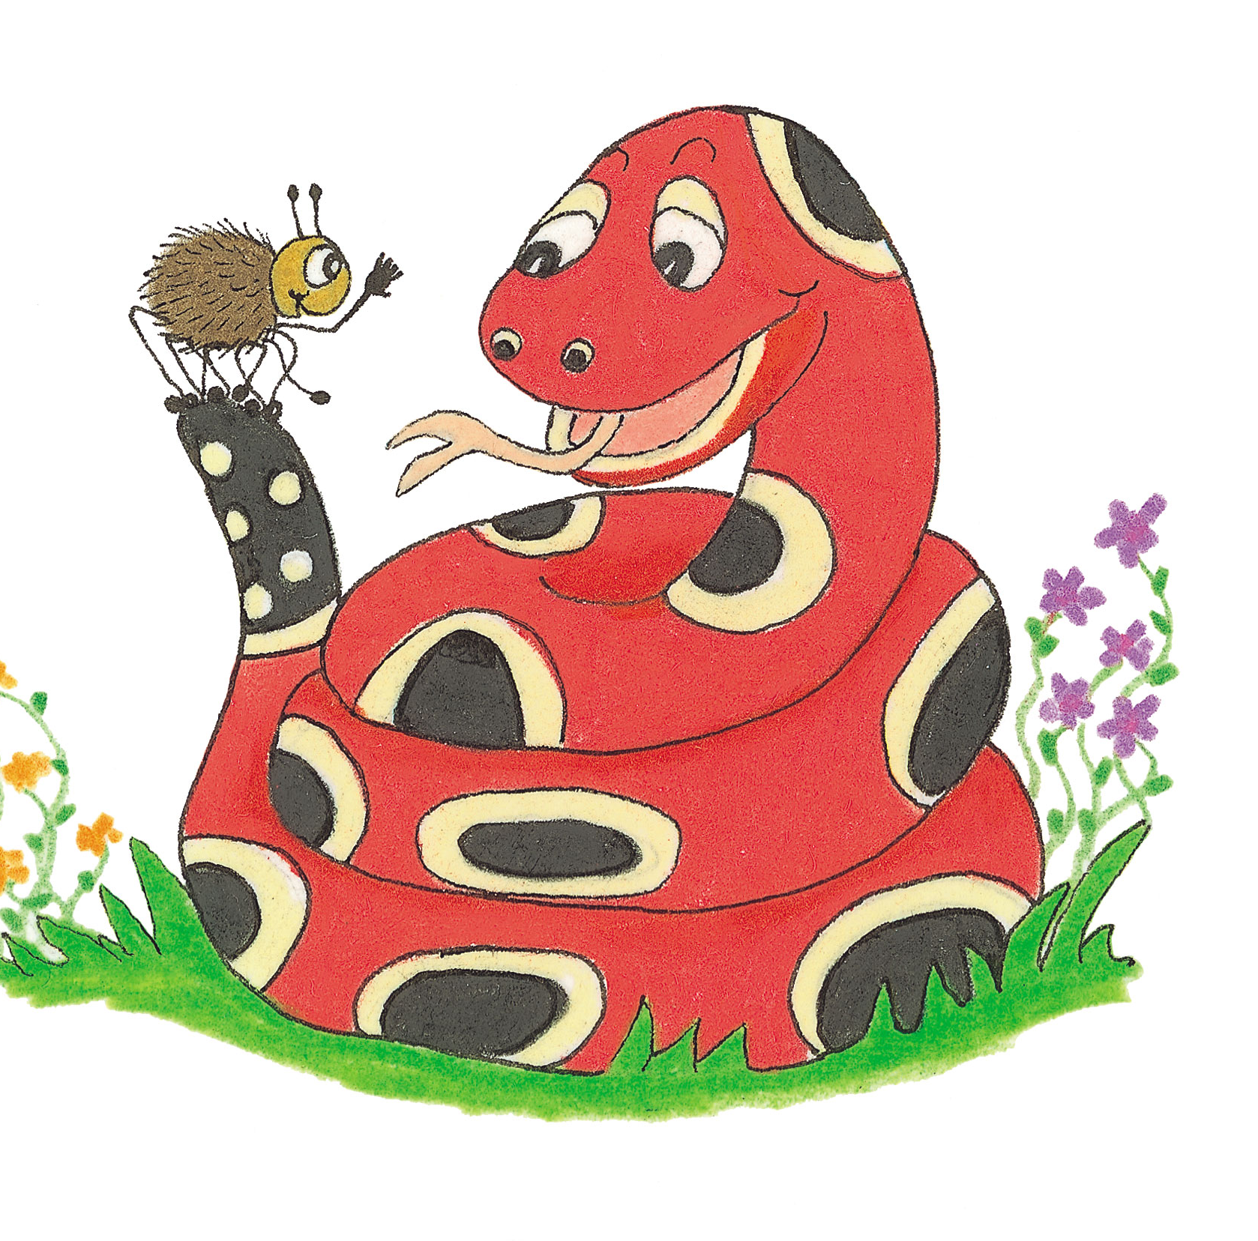
conjunctions

Slide 23
3 types of sentences
●statement
I will do my homework tomorrow.
●question
When did you finish your homework?
●exclamation
I finally finished my homework!

Slide 24
Sentence or phrase?
・We went to the park.
・He stopped.
・ladybird, beetle, bee and flea
・She was frightened of the bird.
・She sang untunefully.

Slide 25
Simple and Compound Sentences

Slide 26
I went to my friend’s house.
We played games.

Slide 27
I went to my friend’s house.
We played games.
↓
I went to my friend‘s house and we played games.

Slide 28
Activity Page
Simple and Compound Sentences

Slide 29
Join each pair of simple sentences to make a compound sentence. Use the conjunction shown in bold and underline it in purple.
Sam goes to the park.
Then he sits by the pond. and
↓
Sam goes to the park and then he sits by the pond.

Slide 30
Jill was good at swimming so she was picked for the team.

Slide 31
He was very tired but he finished the race.

Slide 32
It is a cloudy day yet it is not cold.

Slide 33
Shall we go out today or stay inside?

Slide 34
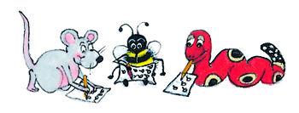
Make two simple sentences out of each compound sentence. Identify the conjunction and underline it in purple. Then write the rest as two separate sentences, making sure both have their own subjects and verb.

Slide 35
She will go to the library and she will take out a book.
↓
She will go to the library.
She will take out a book.

Slide 36
We tried very hard yet we lost the game.
↓
We tried very hard.
We lost the game.

Slide 37
She sings really well but she is not in the choir.
↓
She sings really well.
She is not in the choir.

Slide 38
Thank you.
See you
next time!

