Slide 1
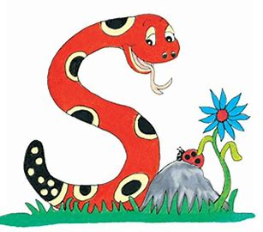
Jolly Grammar
4b-17

Slide 2
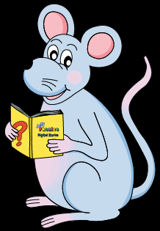
Have fun with
Initial letter.

Slide 3
y
girl‘s name
Yulianna
boy‘s name
Yoshi
animal
yak
food
yogurt
country
Yemen
colour
yellow
job
YMCA staff
city
York
transport
yatch
clothes
yukata

Slide 4
Let’s Revise
<-ery>&<-ary>

Slide 5
<-ary><-ery>
butchery
scenery
diary
library
stationary
ordinary

Slide 6
Activity Page
Spelling <-ary>

Slide 7
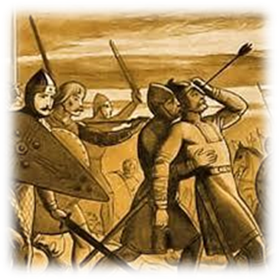
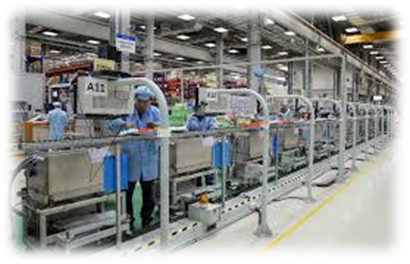
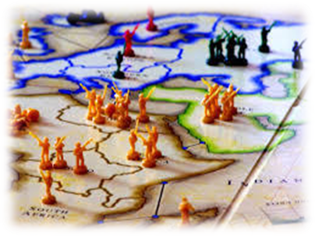
story history victory
factory theory territory

Slide 8
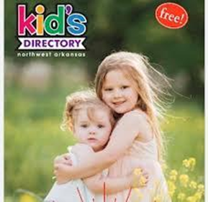
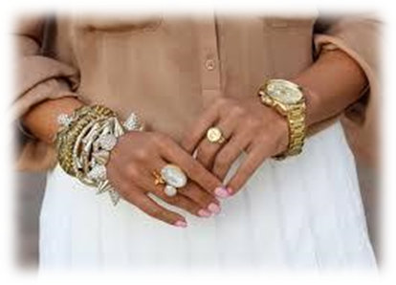
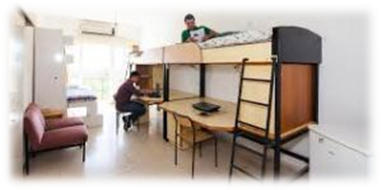
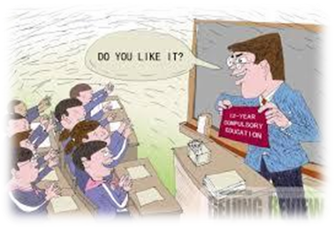
category directory inventory
accessory dormitory compulsory

Slide 9
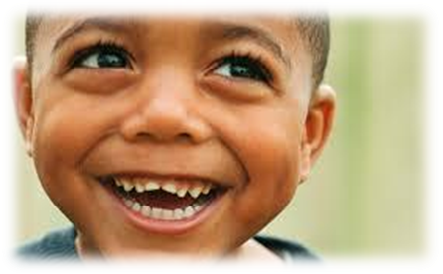
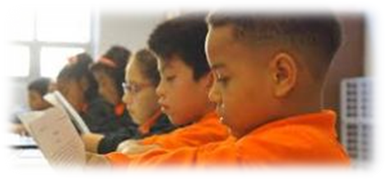
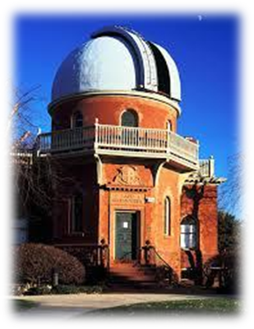
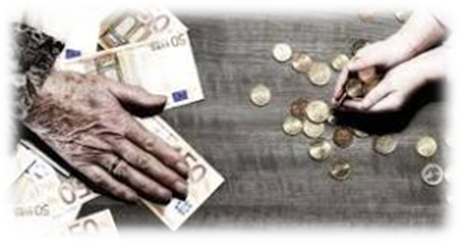
preparatory satisfactory laboratory
observatory introductory contributory

Slide 12
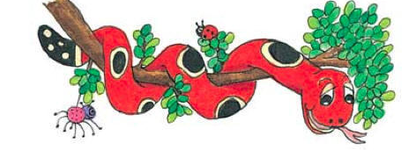
Activity Page : Spelling <-ory>

Slide 13
theory observatory
satisfactory story
dormitory territory
victory compulsory
accessory history
factory category

Slide 14
parsing

Slide 15
You will be writing a story for your history homework.

Slide 16
You will be writing a story for your history homework.

Slide 17
You will be writing a story for your history homework.

Slide 18
You will be writing a story for your history homework.

Slide 19
You will be writing a story for your history homework.

Slide 20
You will be writing a story for your history homework.

Slide 21
You will be writing a story for your history homework.

Slide 22
You will be writing a story for your history homework.

Slide 23
You will be writing a story for your history homework.
2nd person
Singular
Future
Continuous

Slide 24
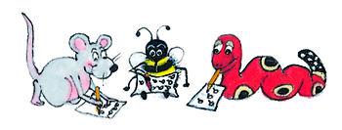
Dictation

Slide 25
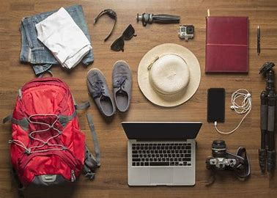

Slide 26
The factory makes exclusive travel accessories.

Slide 27
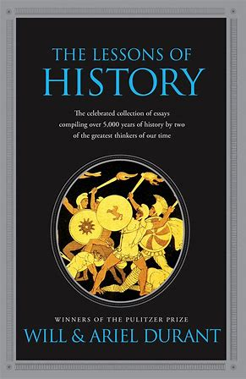

Slide 28
I read the introductory chapter of the history book.

Slide 29
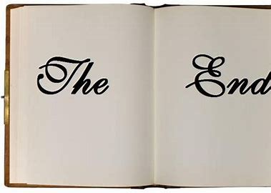

Slide 30
The story has a very unsatisfactory ending.

Slide 31
Thank you.
See you
next time!

