Slide 1
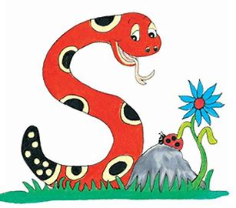
Jolly Grammar
4b-15

Slide 2
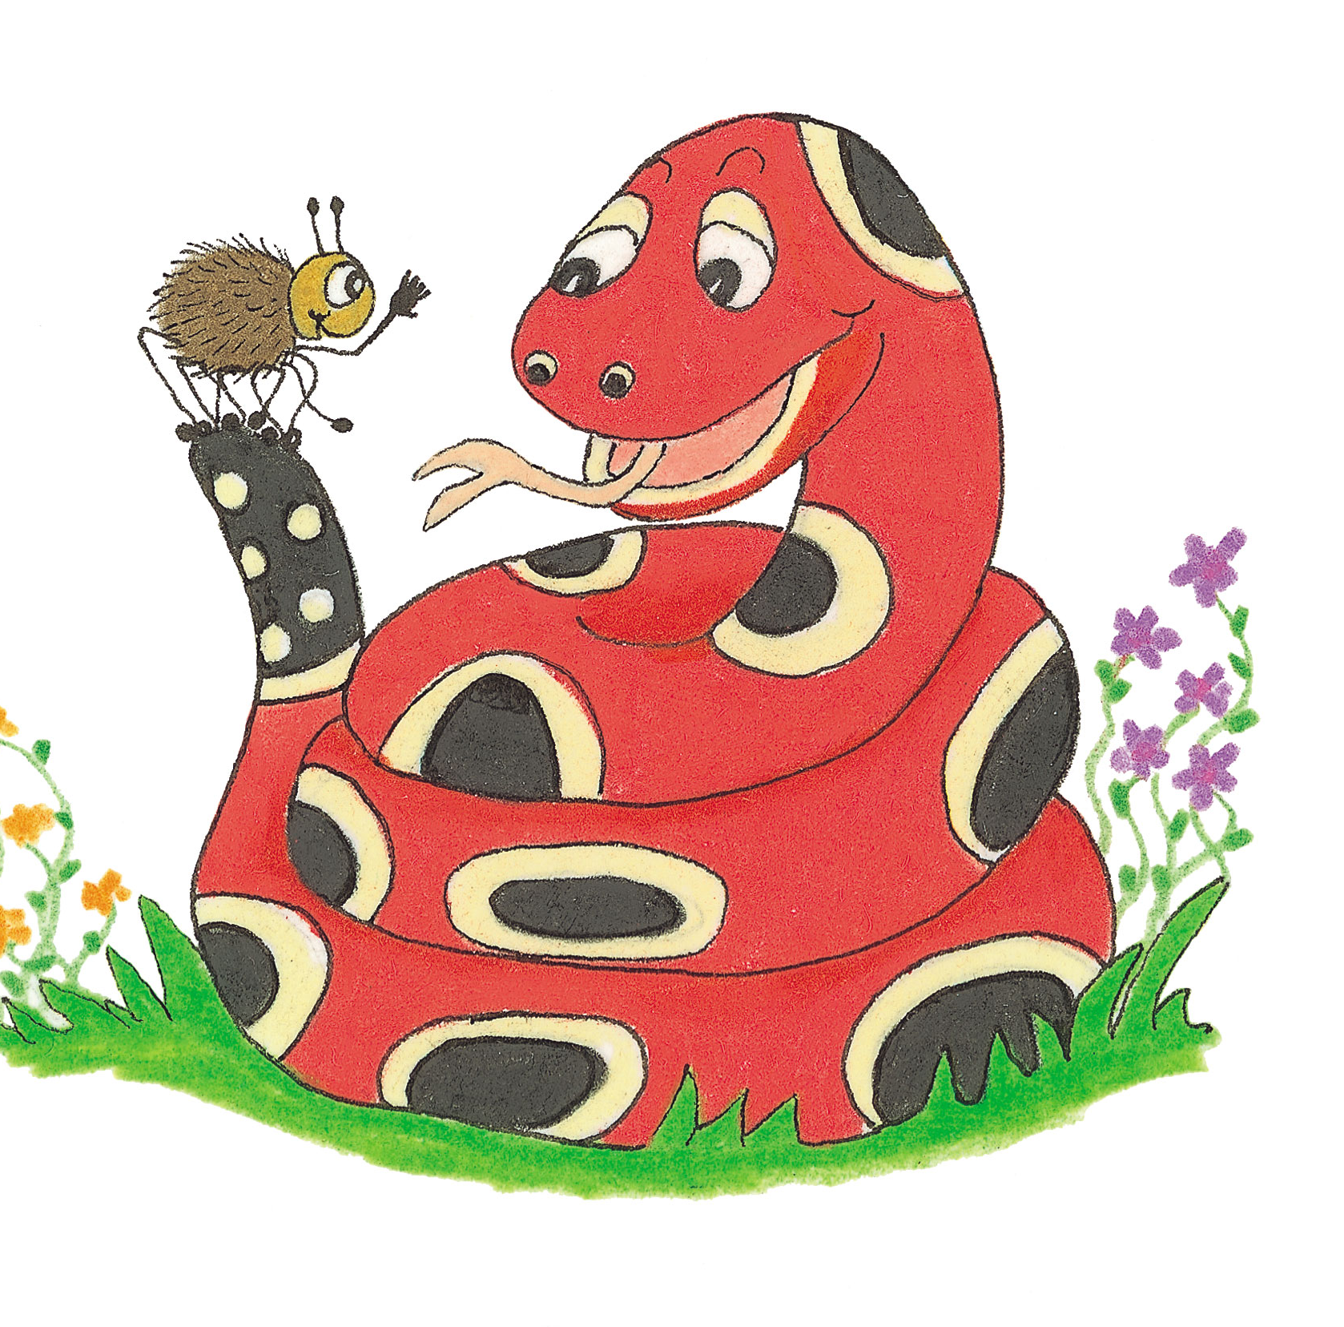
Let’s revise
Questions and statements.

Slide 3
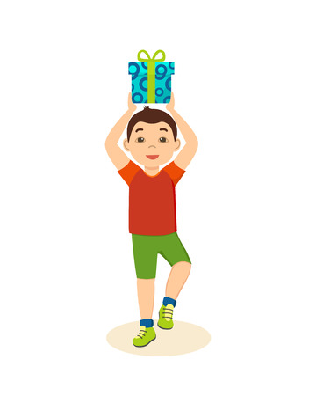
He was in a festive mood.

Slide 4
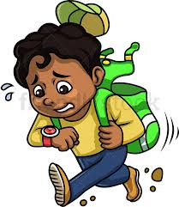
Were you late for school?

Slide 5
Let’s revise
It’s and its.

Slide 6
“It’s poetry day at the local festival,” remarked Dad.
The scientist believe it’s the discovery of the century.
The school has just opened its new library.
The bakery is famous for its confectionery.
The gallery has all its artwork on display.

Slide 7
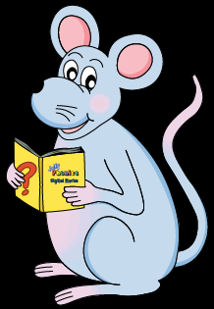
Activity Page

Slide 8
Look at this word.

Slide 9
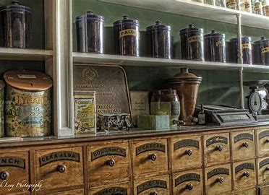
Find out what the word ’apothecary’ means.
Then see how many other words you can make with its letters.
a p o t h e c a r y

Slide 10
Find out what the word ’apothecary’ means.
Then see how many other words you can make with its letters.
a p o t h e c a r y
pharmacy
or
drugstore

Slide 11
a p o t h e c a r y
art

Slide 12
a p o t h e c a r y
art
pot

Slide 13
a p o t h e c a r y
art
pot
eat

Slide 14
a p o t h e c a r y
art
pot
eat
・
・
・

Slide 15
Let’s Revise
Schwa

Slide 16
<al><el><il> /ool/
hospital
novel
pencil
total
travel
pupil

Slide 17
Activity Page
Spelling <-ary>

Slide 18
●Places or things where something is kept
diary
library
glossary
dictionary

Slide 19
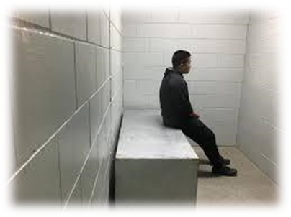
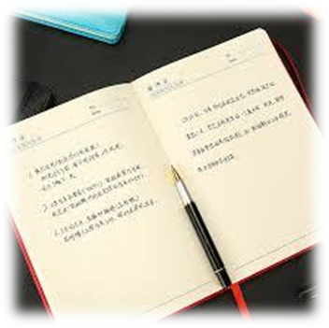
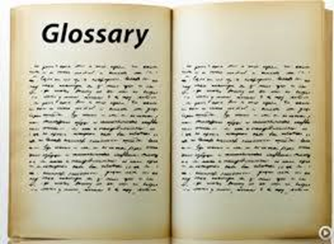
literary primary solitary
diary library glossary

Slide 20
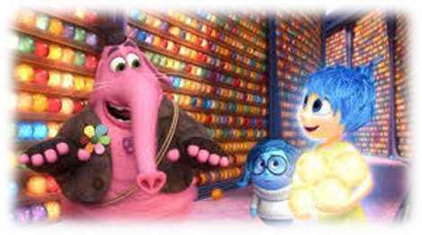
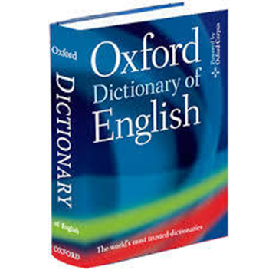
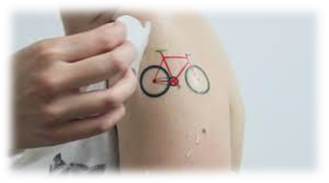
ordinary necessary imaginary
dictionary temporary vocabulary

Slide 21
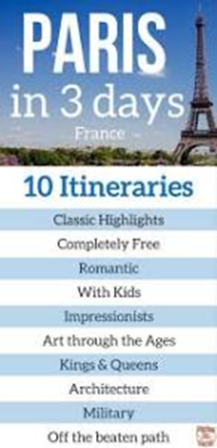
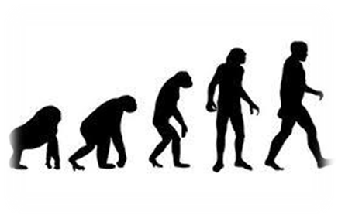
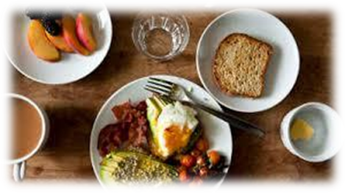
itinerary secretary hereditary
anniversary evolutionary complementary

Slide 24
Activity Page : Spelling <-ary>

Slide 25
parsing

Slide 26
The boy in the library has a huge vocabulary.

Slide 27
The boy in the library has a huge vocabulary.

Slide 28
The boy in the library has a huge vocabulary.

Slide 29
The boy in the library has a huge vocabulary.

Slide 30
The boy in the library has a huge vocabulary.

Slide 31
The boy in the library has a huge vocabulary.

Slide 32
The boy in the library has a huge vocabulary.

Slide 33
The boy in the library has a huge vocabulary.
3rd person
Singular
Simple
present

Slide 34
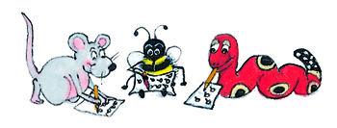
Dictation

Slide 35
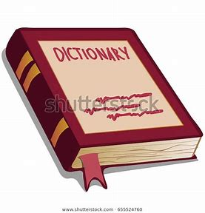

Slide 36
I found
a dictionary in the public library.

Slide 37
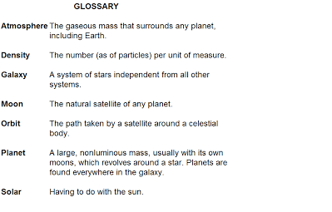

Slide 38
Is the glossary in alphabetical order?

Slide 39
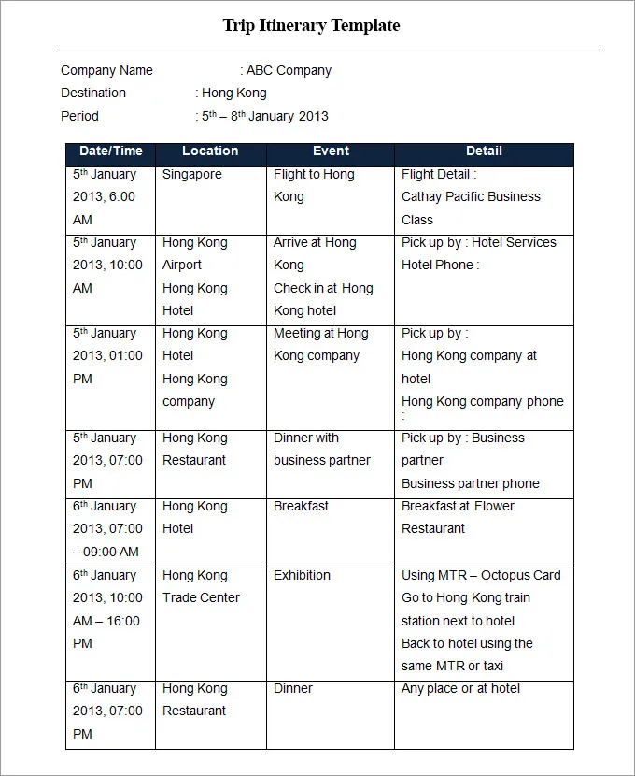

Slide 40
“Here is your itinerary,” said
the secretary.

Slide 41
Thank you.
See you
next time!

