Slide 1
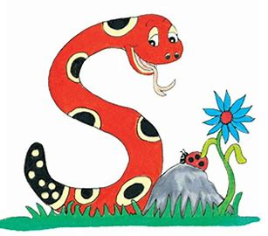
Jolly Grammar
4b-14

Slide 2
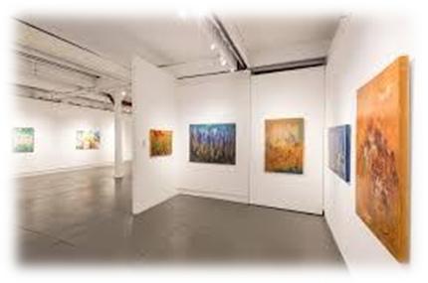
gallery

Slide 3
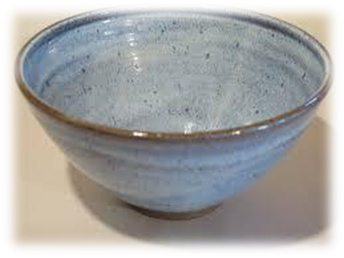
gallery
pottery

Slide 4
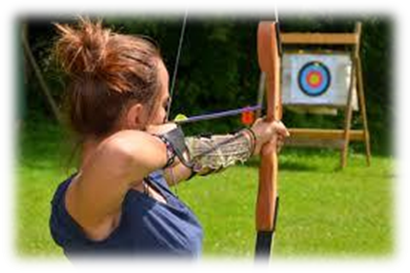
gallery
pottery
archery

Slide 5
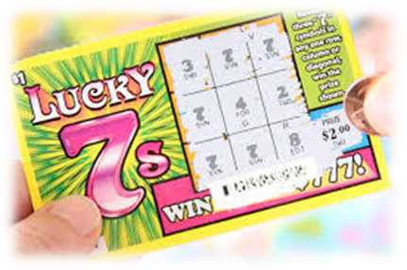
gallery
pottery
archery
lottery

Slide 6
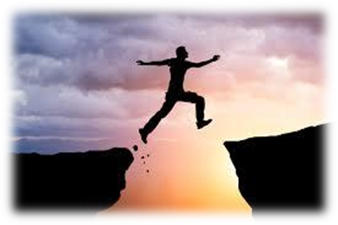
gallery
pottery
archery
lottery
bravery

Slide 7
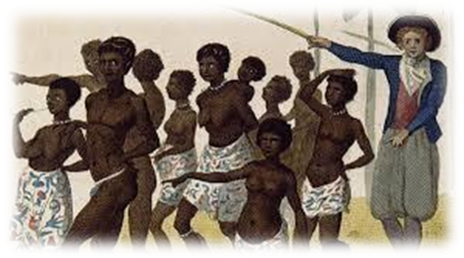
gallery
pottery
archery
lottery
bravery
slavery

Slide 8
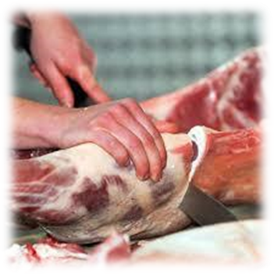
gallery
pottery
archery
lottery
bravery
slavery
7.butchery

Slide 9
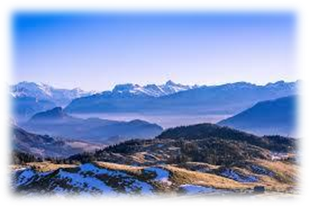
gallery
pottery
archery
lottery
bravery
slavery
7.butchery
8.scenery

Slide 10
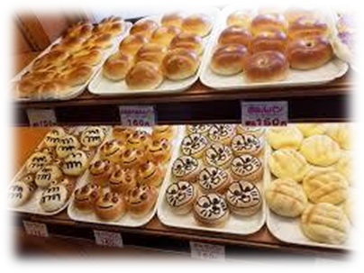
gallery
pottery
archery
lottery
bravery
slavery
7.butchery
8.scenery
9.bakery

Slide 11
gallery
pottery
archery
lottery
bravery
slavery
7.butchery
8.scenery
9.bakery
10.delivery

Slide 12
gallery
pottery
archery
lottery
bravery
slavery
7.butchery
8.scenery
9.bakery
10.delivery
11.imagery

Slide 13
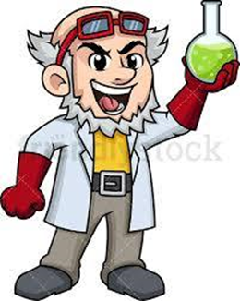
gallery
pottery
archery
lottery
bravery
slavery
7.butchery
8.scenery
9.bakery
10.delivery
11.imagery
12.discovery

Slide 14
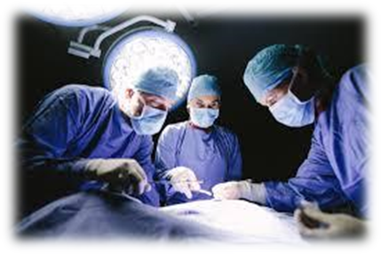
gallery
pottery
archery
lottery
bravery
slavery
7.butchery
8.scenery
9.bakery
10.delivery
11.imagery
12.discovery
13.surgery

Slide 15
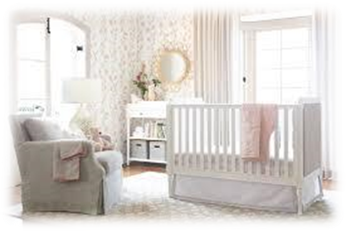
gallery
pottery
archery
lottery
bravery
slavery
7.butchery
8.scenery
9.bakery
10.delivery
11.imagery
12.discovery
13.surgery
14.nursery

Slide 16
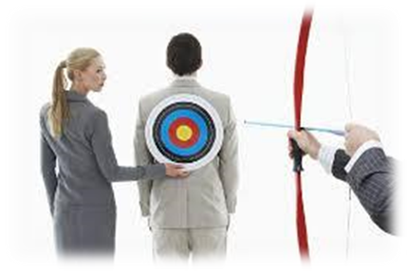
gallery
pottery
archery
lottery
bravery
slavery
7.butchery
8.scenery
9.bakery
10.delivery
11.imagery
12.discovery
13.surgery
14.nursery
15.treachery

Slide 17
gallery
pottery
archery
lottery
bravery
slavery
7.butchery
8.scenery
9.bakery
10.delivery
11.imagery
12.discovery
13.surgery
14.nursery
15.treachery
16.stationery

Slide 18
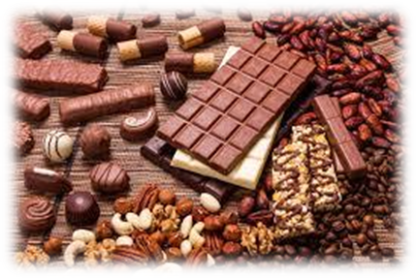
gallery
pottery
archery
lottery
bravery
slavery
7.butchery
8.scenery
9.bakery
10.delivery
11.imagery
12.discovery
13.surgery
14.nursery
15.treachery
16.stationery
17.confectionery

Slide 19
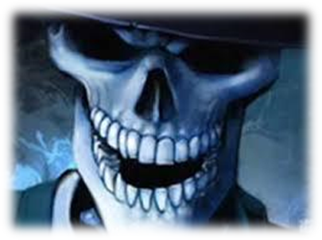
gallery
pottery
archery
lottery
bravery
slavery
7.butchery
8.scenery
9.bakery
10.delivery
11.imagery
12.discovery
13.surgery
14.nursery
15.treachery
16.stationery
17.confectionery
18.skulduggery

Slide 20
Sentence

Slide 21
She went to the hairdressers.

Slide 22
She went to the hairdressers.
full stop

Slide 23
She went to the hairdressers.
verb
full stop

Slide 24
She went to the hairdressers.
verb
full stop
subject

Slide 25
She went to the hairdressers.
verb
full stop
subject
& must make sense

Slide 26
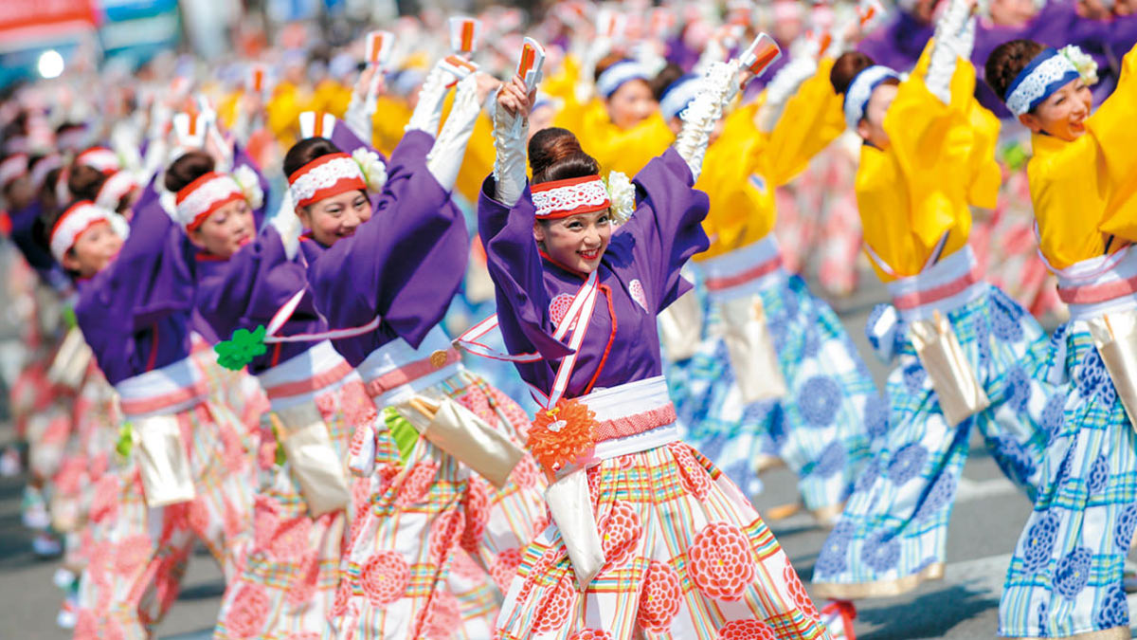
When is the exciting festival?

Slide 27
When is the exciting festival?
question mark

Slide 28
When is the exciting festival?
question word
question mark

Slide 29
When is the exciting festival?
question word
what
why
when
where
who
which
whose
question mark

Slide 30
Questions and Statements

Slide 31
The festival is exciting. → statement
When is the festival? → question

Slide 32
Activity Page
Questions and Statements

Slide 33
A statement provides information and has a full stop at the end, whereas a question asks for information and ends in a question mark. Decide whether these sentences are questions or statements, circle any question
words, and add the correct punctuation.
Who wants to go camping this weekend ?

Slide 34
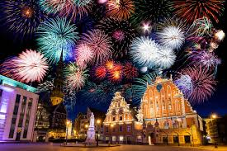
The fireworks were fantastic.

Slide 35
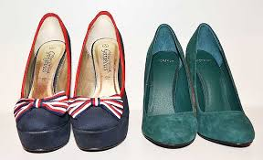
Which shoes do you prefer?

Slide 36
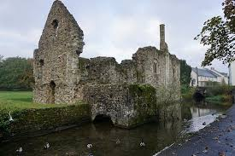
We visited some castle ruins.

Slide 37
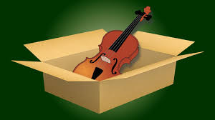
He bought the best violin he could afford.

Slide 38
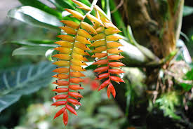
Where does that exotic plant come from?

Slide 39
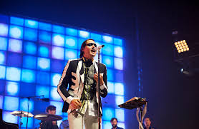
When do you next rehearse your song?

Slide 40
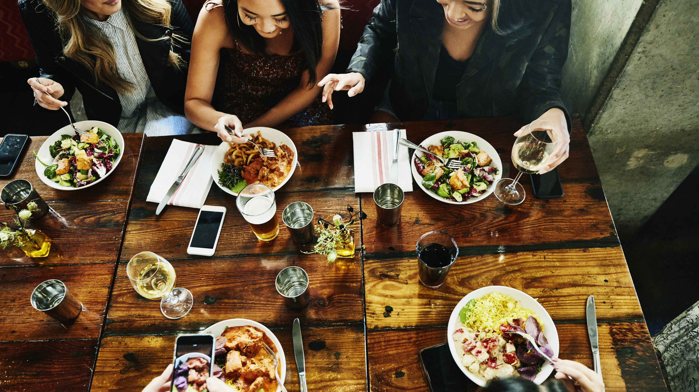
They had a superb meal at the restaurant.

Slide 41
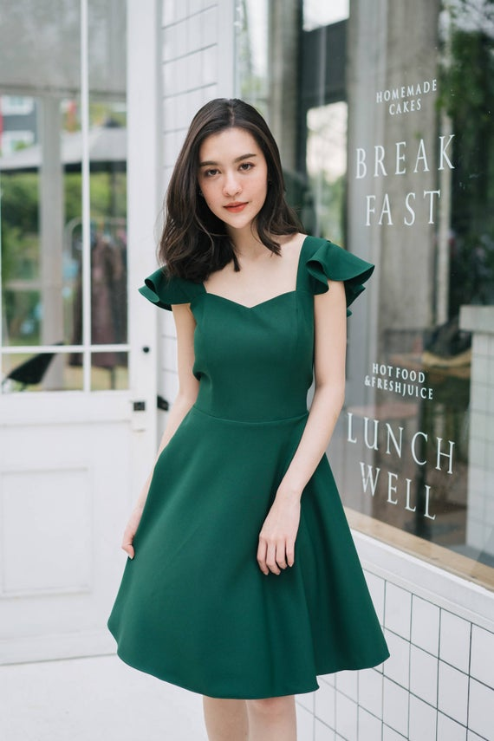
Why did you choose the green dress?

Slide 42
What would you like to do tomorrow?

Slide 43
Whose book is this on the table?

Slide 44
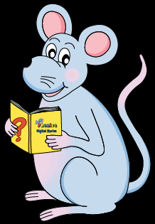
Look at this sentence.

Slide 45
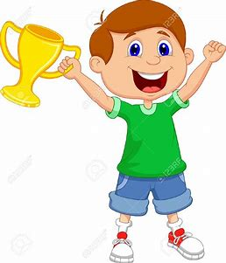
Am I the winner?

Slide 46
Am I the winner?

Slide 47
Activity Page

Slide 48
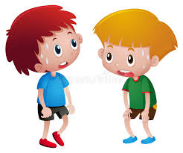
We were very tired yesterday evening.

Slide 49
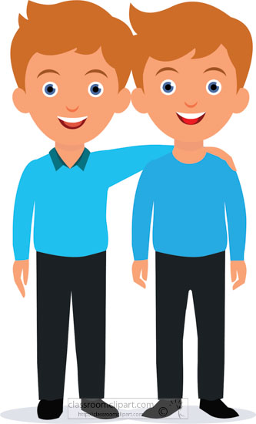
Are the twins the oldest in their class?

Slide 50
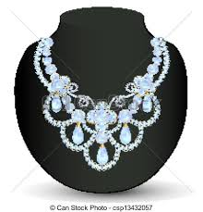
The necklace was very expensive.

Slide 51
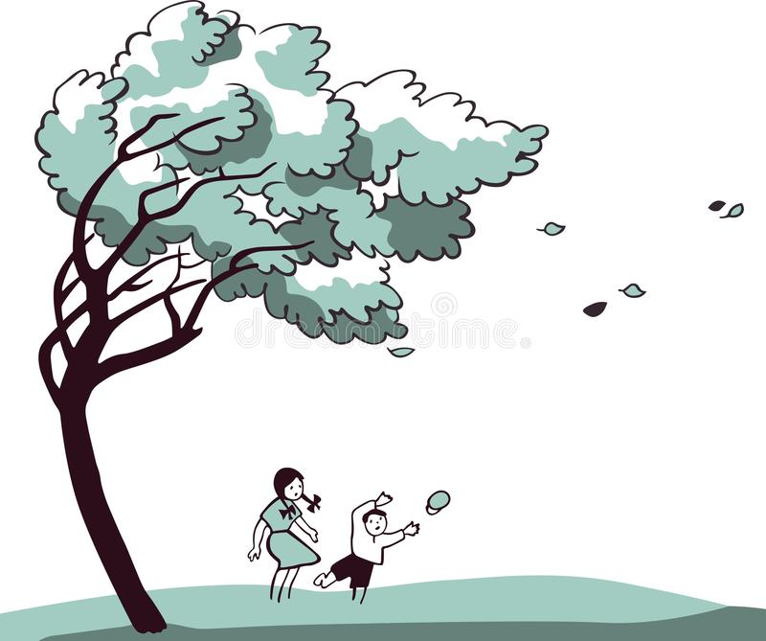
Is the wind strong today?

Slide 52
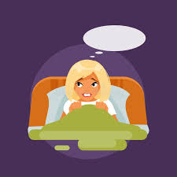
You are frightened of the dark.

Slide 53
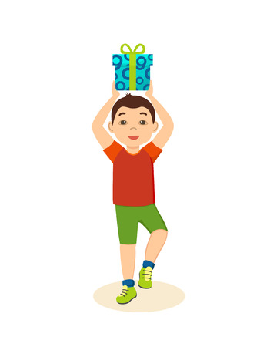
He was in a festive mood.

Slide 54
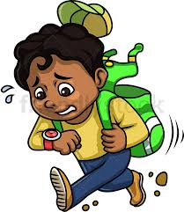
Were you late for school?

Slide 55
Thank you.
See you
next time!

