Slide 1
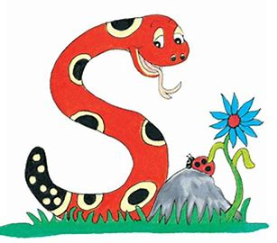
Jolly Grammar
4b-12

Slide 2
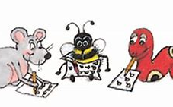
Spelling Test 24

Slide 3
civil

Slide 4
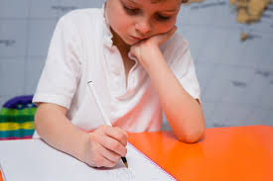
civil
pupil

Slide 5
civil
pupil
pencil

Slide 6
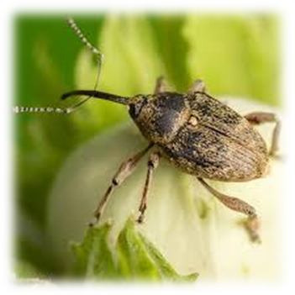
civil
pupil
pencil
weevil

Slide 7
civil
pupil
pencil
weevil
evil

Slide 8
civil
pupil
pencil
weevil
evil
peril

Slide 9
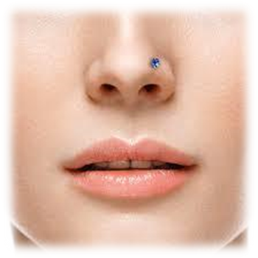
civil
pupil
pencil
weevil
evil
peril
7.nostril

Slide 10
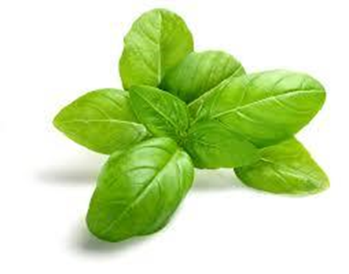
civil
pupil
pencil
weevil
evil
peril
7.nostril
8.basil

Slide 11
civil
pupil
pencil
weevil
evil
peril
7.nostril
8.basil
9.April

Slide 12
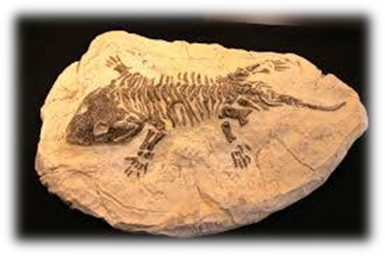
civil
pupil
pencil
weevil
evil
peril
7.nostril
8.basil
9.April
10.fossil

Slide 13
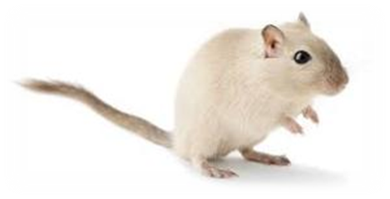
civil
pupil
pencil
weevil
evil
peril
7.nostril
8.basil
9.April
10.fossil
11.gerbil

Slide 14
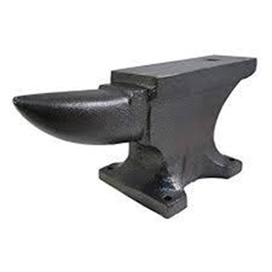
civil
pupil
pencil
weevil
evil
peril
7.nostril
8.basil
9.April
10.fossil
11.gerbil
12.anvil

Slide 15
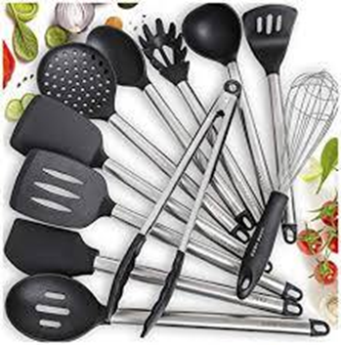
civil
pupil
pencil
weevil
evil
peril
7.nostril
8.basil
9.April
10.fossil
11.gerbil
12.anvil
13.utensil

Slide 16
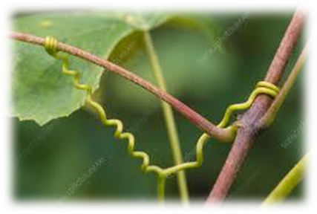
civil
pupil
pencil
weevil
evil
peril
7.nostril
8.basil
9.April
10.fossil
11.gerbil
12.anvil
13.utensil
14.tendril

Slide 17
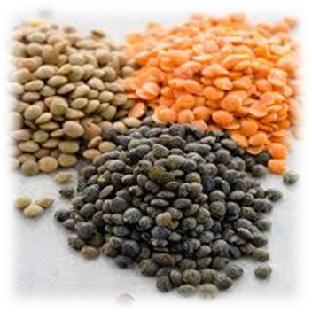
civil
pupil
pencil
weevil
evil
peril
7.nostril
8.basil
9.April
10.fossil
11.gerbil
12.anvil
13.utensil
14.tendril
15.lentil

Slide 18
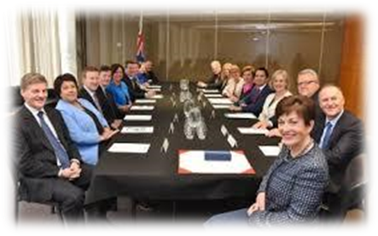
civil
pupil
pencil
weevil
evil
peril
7.nostril
8.basil
9.April
10.fossil
11.gerbil
12.anvil
13.utensil
14.tendril
15.lentil
16.council

Slide 19
civil
pupil
pencil
weevil
evil
peril
7.nostril
8.basil
9.April
10.fossil
11.gerbil
12.anvil
13.utensil
14.endril
15.lentil
16.council
17.stencil

Slide 20
civil
pupil
pencil
weevil
evil
peril
7.nostril
8.basil
9.April
10.fossil
11.gerbil
12.anvil
13.utensil
14.endril
15.lentil
16.council
17.stencil
18.tranquil

Slide 21
Punctuation

Slide 22
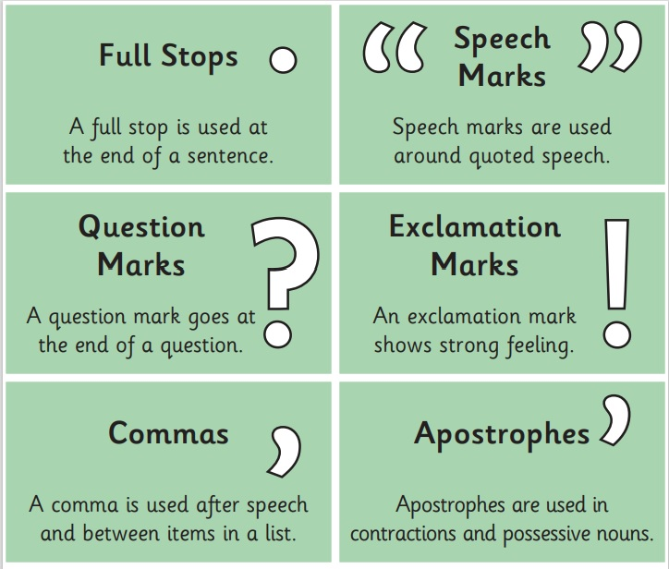

Slide 23
“Can I borrow your pencil?” asked the journalist.
The actor exclaimed, “You scoundrel!”
Parsley, basil, mint and rosemary are types of herb.
What is the final total?

Slide 24
Personal Pronouns

Slide 25
 | Singular | Plural
First Person | I | we
Second Person | you | you
Third Person | he/she/it | they

Slide 26
Singular
1st person 2nd person 3rd person
I you he
she
it
Plural
1st person 2nd person 3rd person
we you they

Slide 27
Activity Page
Parsing
Verbs

Slide 28
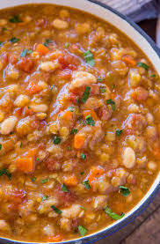
Identify the verb and subject in each sentence, and then parse the verb.
If the subject is a noun, think about which pronoun would replace it to help you choose the right answer.
s
She will cook a lentil stew.

Slide 29
Identify the verb and subject in each sentence, and then parse the verb.
If the subject is a noun, think about which pronoun would replace it to help you choose the right answer.
s
She will cook a lentil stew.
3rd person
singular

Slide 30
Identify the verb and subject in each sentence, and then parse the verb.
If the subject is a noun, think about which pronoun would replace it to help you choose the right answer.
s
She will cook a lentil stew.
3rd person
singular
simple
future

Slide 31
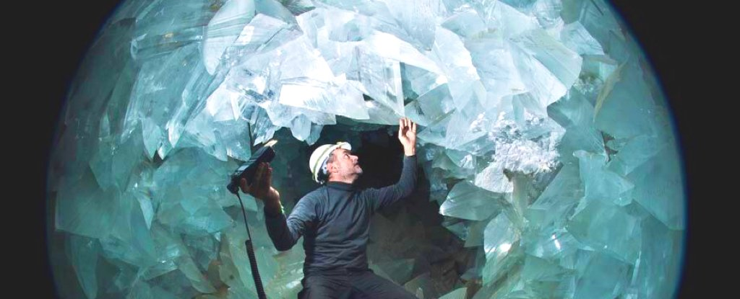
I explored the tranquil crystal cave.

Slide 32
I explored the tranquil crystal cave.
1st person
singular
simple
past

Slide 33
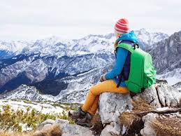
He travels abroad regularly in winter.

Slide 34
He travels abroad regularly in winter.
3rd person
singular
simple
present

Slide 35
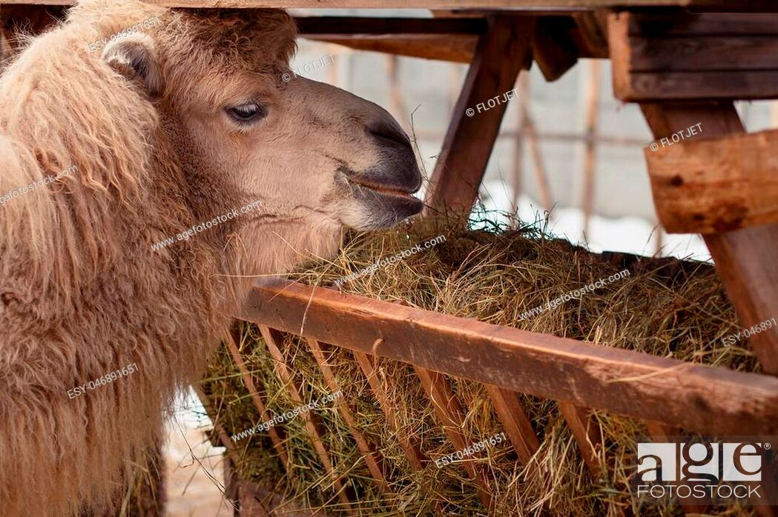
The camel was eating hay at the zoo.

Slide 36
The camel was eating hay at the zoo.
3rd person
singular
past
continuous

Slide 37
We were washing the utensils.

Slide 38
We were washing the utensils.
1st person
plural
past
continuous

Slide 39
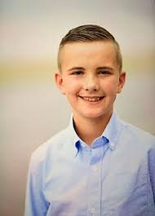
Zack sorted the books alphabetically.

Slide 40
Zack sorted the books alphabetically.
3rd person
singular
simple
past

Slide 41
They will cancel their next trip.

Slide 42
They will cancel their next trip.
3rd person
plural
simple
future

Slide 43
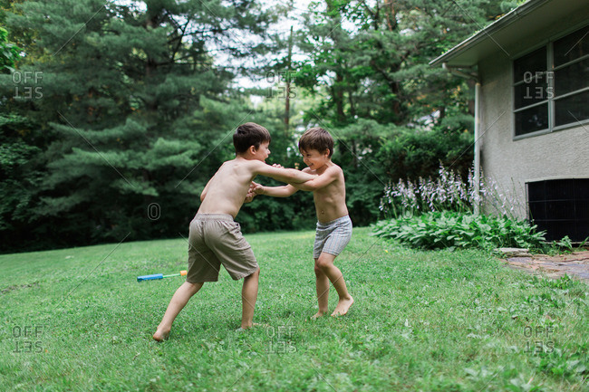
I am wrestling with my brother.

Slide 44
I am wrestling with my brother.
1st person
singular
present
continuous

Slide 45
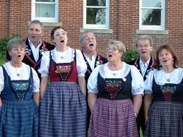
You yodel beautifully together.

Slide 46
You yodel beautifully together.
2nd person
plural
simple
present

Slide 47
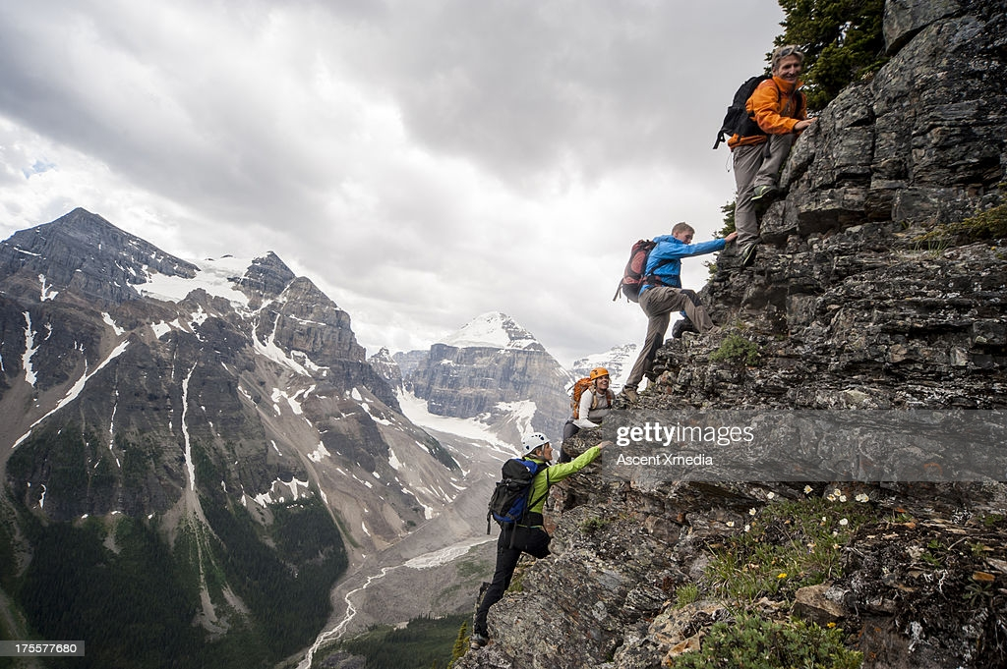
The climbers are ascending the cliff.

Slide 48
The climbers are ascending the cliff.
3rd person
plural
present
continuous

Slide 49
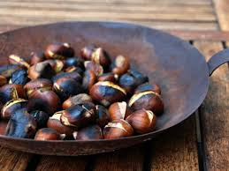
We will be roasting chestnuts.

Slide 50
We will be roasting chestnuts.
1st person
plural
future
continuous

Slide 51
Let’s Revise
Schwa

Slide 52
<le> /ool/
candle
simple
puzzle
<al><el><il> /ool/
total
camel
pencil

Slide 53
Activity Page
Schwa <-il>

Slide 54
Activity Page : Schwa <il>

Slide 55
Homework
Unscramble the letter and
add them to <il> on the pencils
to make words from the spelling list.
cemp
pencil
il

Slide 56
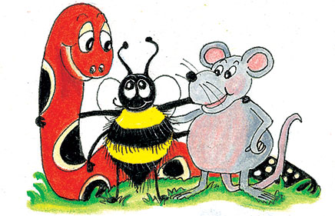
parsing

Slide 57
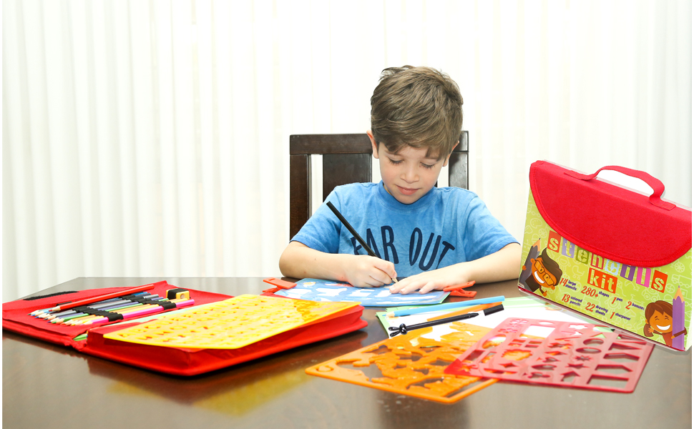
The pupil is drawing carefully inside the stencil with a green pencil.

Slide 58
The pupil is drawing carefully inside the stencil with a green pencil.

Slide 59
The pupil is drawing carefully inside the stencil with a green pencil.

Slide 60
The pupil is drawing carefully inside the stencil with a green pencil.

Slide 61
The pupil is drawing carefully inside the stencil with a green pencil.

Slide 62
The pupil is drawing carefully inside the stencil with a green pencil.

Slide 63
The pupil is drawing carefully inside the stencil with a green pencil.

Slide 64
The pupil is drawing carefully inside the stencil with a green pencil.

Slide 65
The pupil is drawing carefully inside the stencil with a green pencil.

Slide 66
The pupil is drawing carefully inside the stencil with a green pencil.
present continuous

Slide 67
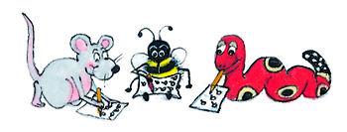
Dictation

Slide 69
The scientists examined a massive fossil.

Slide 70
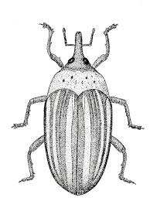

Slide 71
April drew an evil weevil.

Slide 72
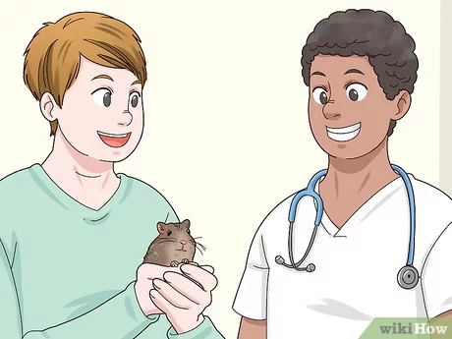
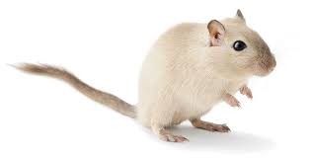

Slide 73
We took our gerbil to the animal hospital.

Slide 74
Thank you.
See you
next time!

