Slide 1
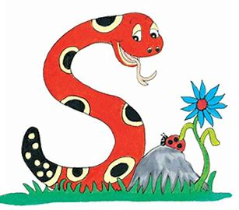
Jolly Grammar
4b-10

Slide 2
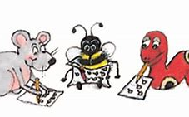
Spelling Test 23

Slide 3
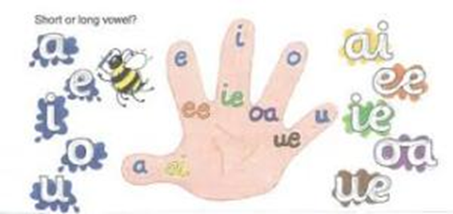
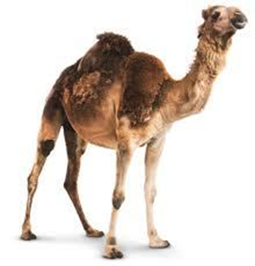
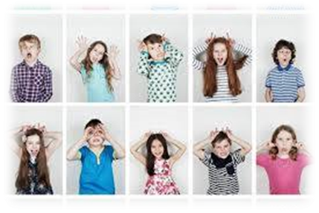
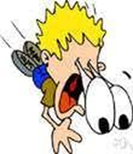
level vowel novel
camel model marvel

Slide 4
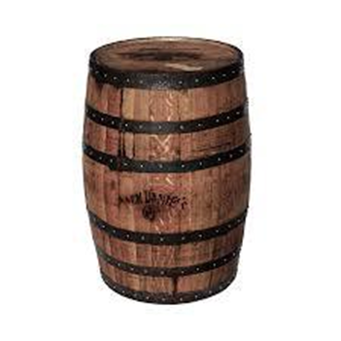
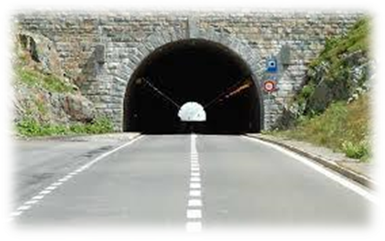
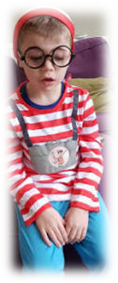
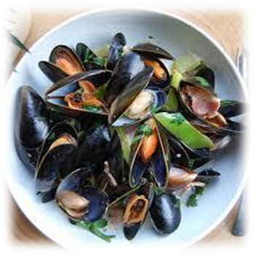
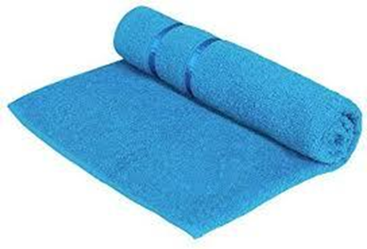
tunnel barrel travel
towel cancel mussel
Soft c

Slide 5
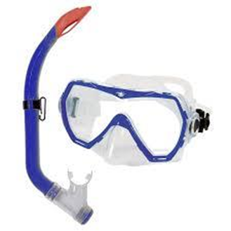
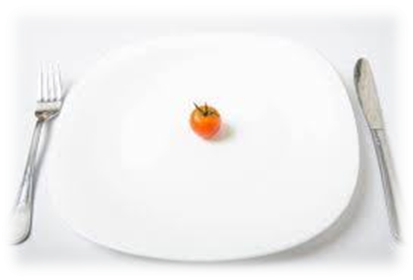
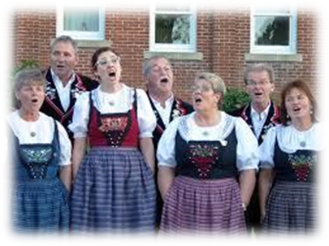
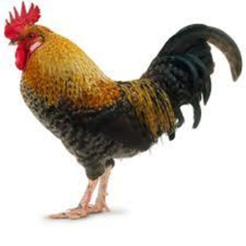
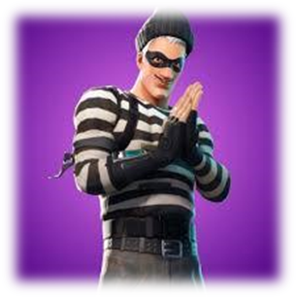
morsel snorkel sequel
yodel cockerel scoundrel

Slide 6
level

Slide 7
level
vowel

Slide 8
level
vowel
novel

Slide 9
level
vowel
novel
camel

Slide 10
level
vowel
novel
camel
model

Slide 11
level
vowel
novel
camel
model
marvel

Slide 12
level
vowel
novel
camel
model
marvel
7.tunnel

Slide 13
level
vowel
novel
camel
model
marvel
7.tunnel
8.barrel

Slide 14
level
vowel
novel
camel
model
marvel
7.tunnel
8.barrel
9.travel

Slide 15
level
vowel
novel
camel
model
marvel
7.tunnel
8.barrel
9.travel
10.towel

Slide 16
level
vowel
novel
camel
model
marvel
7.tunnel
8.barrel
9.travel
10.towel
11.cancel

Slide 17
level
vowel
novel
camel
model
marvel
7.tunnel
8.barrel
9.travel
10.towel
11.cancel
12.mussel

Slide 18
level
vowel
novel
camel
model
marvel
7.tunnel
8.barrel
9.travel
10.towel
11.cancel
12.mussel
13.morsel

Slide 19
level
vowel
novel
camel
model
marvel
7.tunnel
8.barrel
9.travel
10.towel
11.cancel
12.mussel
13.morsel
14.snorkel

Slide 20
level
vowel
novel
camel
model
marvel
7.tunnel
8.barrel
9.travel
10.towel
11.cancel
12.mussel
13.morsel
14.snorkel
15.sequel

Slide 21
level
vowel
novel
camel
model
marvel
7.tunnel
8.barrel
9.travel
10.towel
11.cancel
12.mussel
13.morsel
14.snorkel
15.sequel
16.yodel

Slide 22
level
vowel
novel
camel
model
marvel
7.tunnel
8.barrel
9.travel
10.towel
11.cancel
12.mussel
13.morsel
14.snorkel
15.sequel
16.yodel
17.cockerel

Slide 23
level
vowel
novel
camel
model
marvel
7.tunnel
8.barrel
9.travel
10.towel
11.cancel
12.mussel
13.morsel
14.snorkel
15.sequel
16.yodel
17.cockerel
18.scoundrel

Slide 24
Let’s revise
Pronouns.

Slide 25
 | Singular | Plural
First Person | I | we
Second Person | you | you
Third Person | he/she/it | they

Slide 26
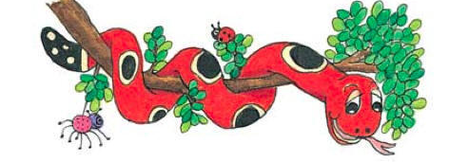
Activity Page : Changing
Grammatical Person

Slide 27
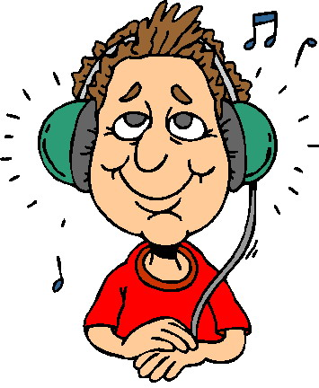
He listens carefully to the music.

Slide 28
He listens carefully to the music.
3rd person singular

Slide 29
1st person singular
I listen carefully to the music.

Slide 30
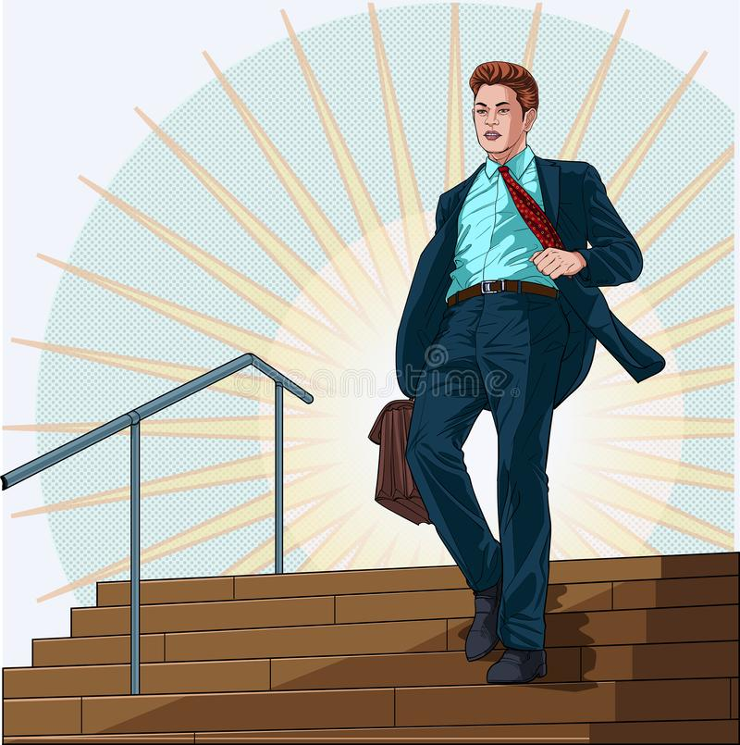
I descended the stairs gracefully.

Slide 31
I descended the stairs gracefully.
1st person singular

Slide 32
1st person plural
We descended the stairs gracefully.

Slide 33
It is historically important.

Slide 34
It is historically important.
3rd person singular

Slide 35
3rd person plural
They are historically important.

Slide 36
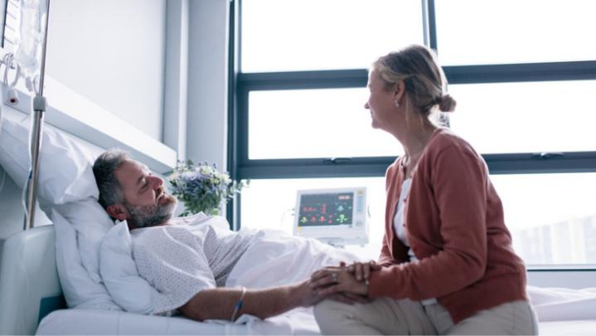
She will be visiting the hospital.

Slide 37
She will be visiting the hospital.
3rd person singular

Slide 38
3rd person plural
They will be visiting the hospital.

Slide 39
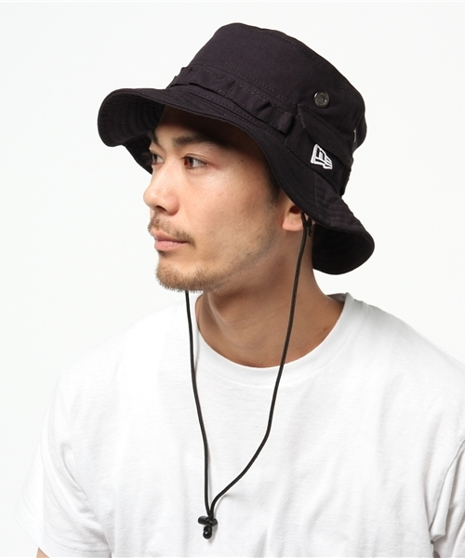
You are wearing a new hat.

Slide 40
You are wearing a new hat.
2nd person singular

Slide 41
3rd person singular
She/He/It is wearing a new hat.

Slide 42
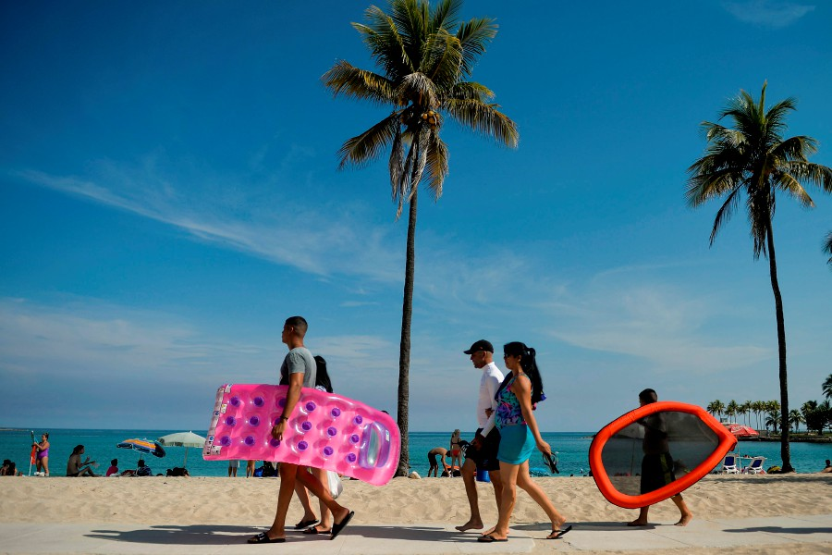
We are going to the beach.

Slide 43
We are going to the beach.
1st person plural

Slide 44
3rd person plural
They are going to the beach.

Slide 45
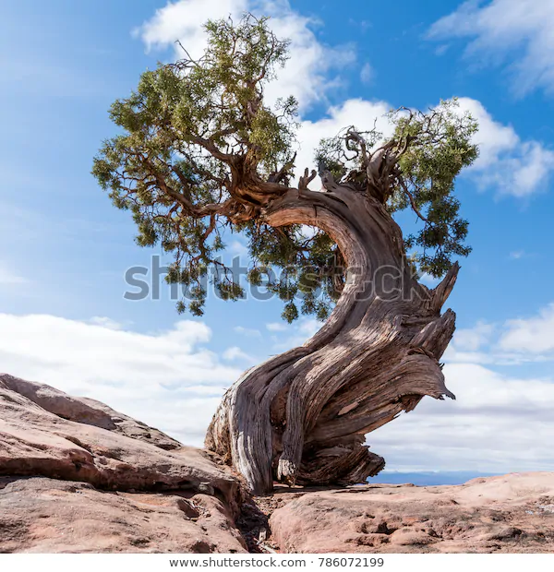
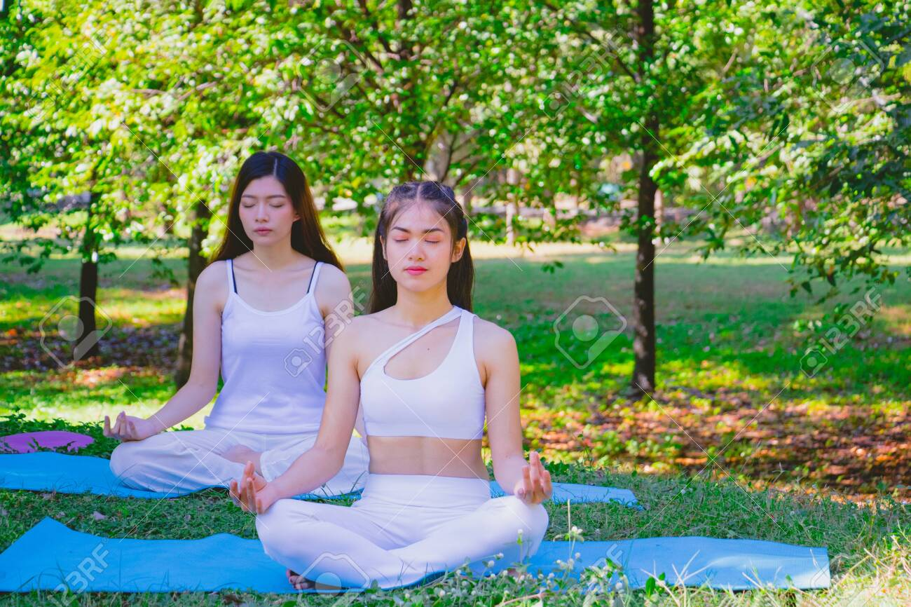
They were sitting under the gnarled tree.

Slide 46
They were sitting under the gnarled tree.
3rd person plural

Slide 47
3rd person singular
He/She/It is sitting under the gnarled tree.

Slide 48
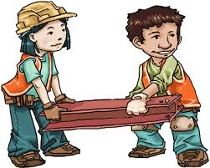
You will do the work yourselves.

Slide 49
You will do the work yourselves.
2nd person plural

Slide 50
2nd person singular
You will do the work yourself.

Slide 51
Thank you.
See you
next time!

