Slide 1
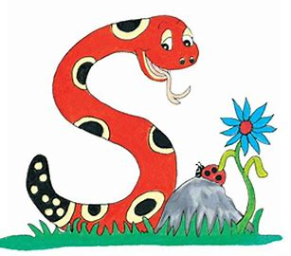
Jolly Grammar
4b-9

Slide 2
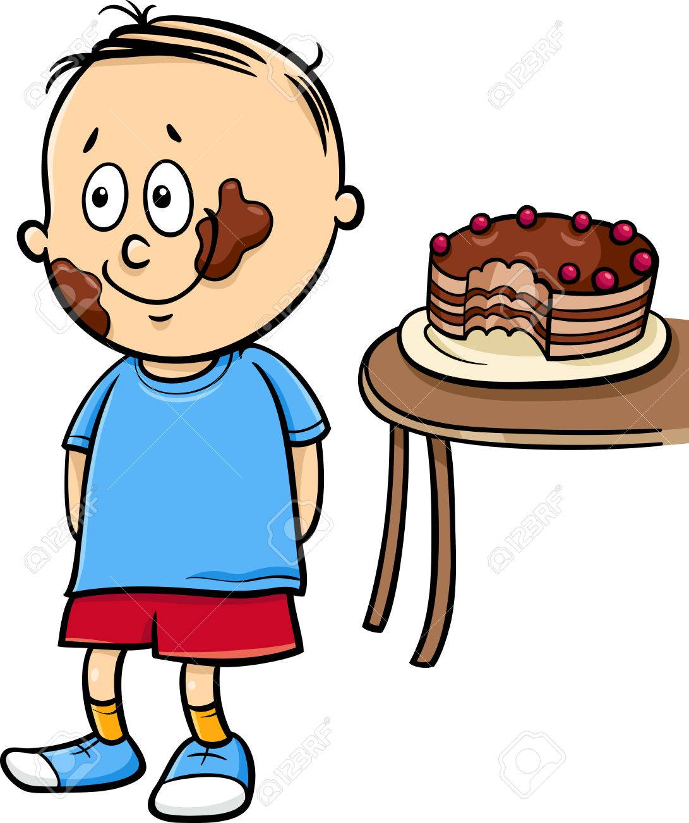
Zack ate the chocolate cake.
3rd person singular

Slide 3
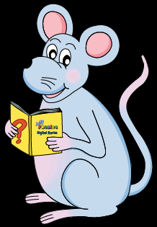
Let’s Revise
Schwa

Slide 4
<le> /ool/
candle
simple
puzzle
<al><el><il> /ool/
total
camel
pencil

Slide 5
Activity Page
Schwa <-el>

Slide 6
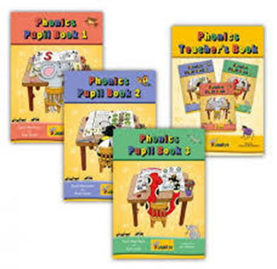
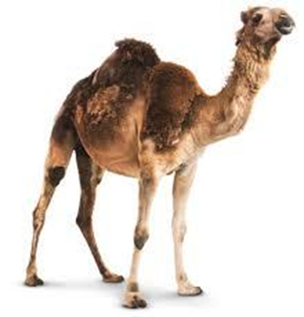
level vowel novel
camel model marvel

Slide 7
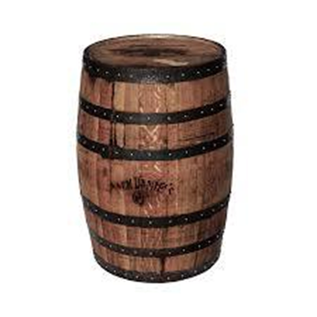
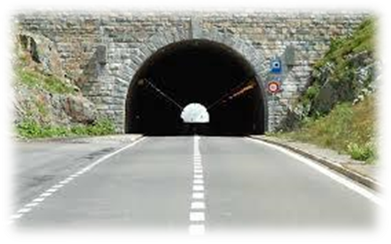
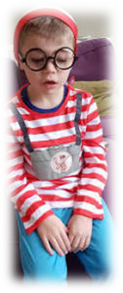
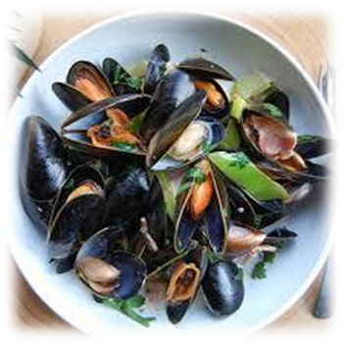
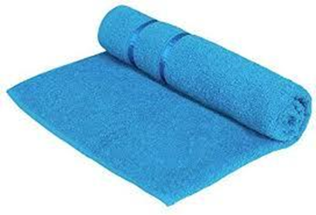
tunnel barrel travel
towel cancel mussel
Soft c

Slide 8
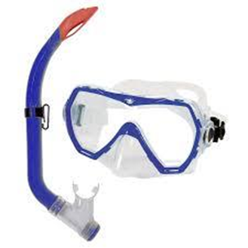
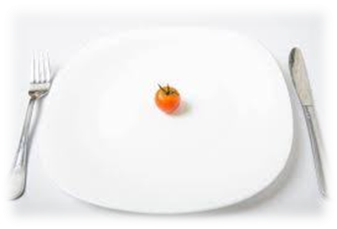
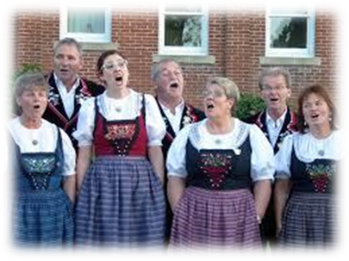
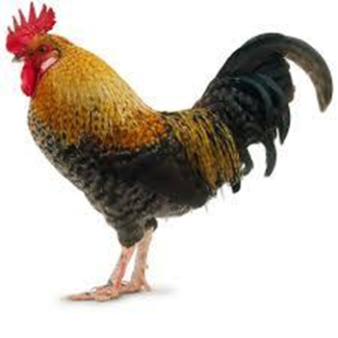
morsel snorkel sequel
yodel cockerel scoundrel

Slide 11
its or it’s?

Slide 12
its
it’s

Slide 13
its possessive pronoun or noun
The dog is wagging its tail.
it’s

Slide 14
its possessive pronoun
The dog is wagging its tail.
it’s contraction of it is
It’s a beautiful day.

Slide 15
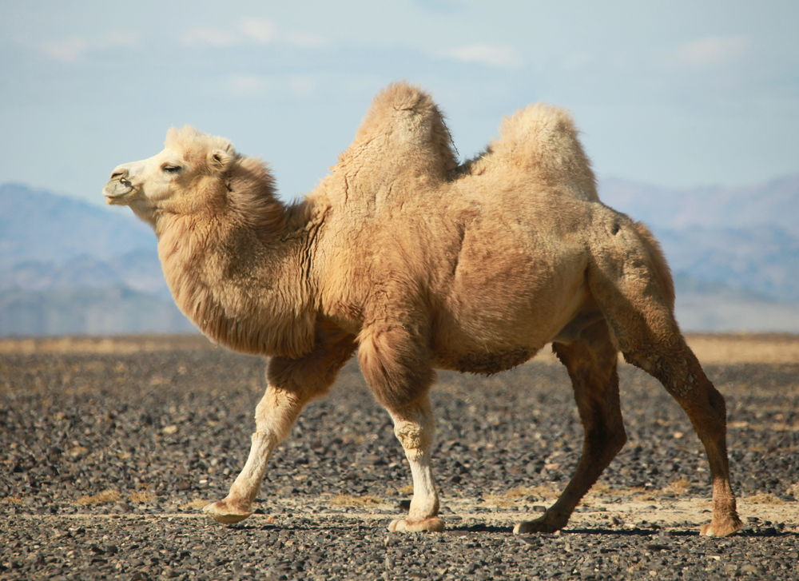
The camel has two humps
on back.

Slide 16
The camel has two humps
on its back.

Slide 17
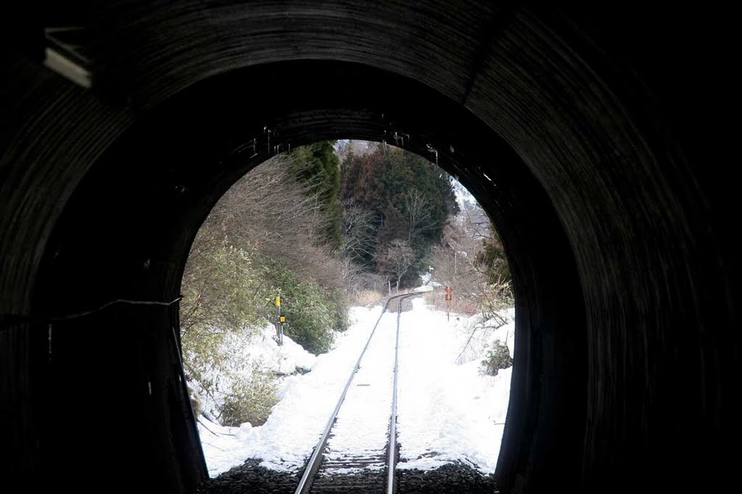
The narrow tunnel had warning signs at exit.

Slide 18
The narrow tunnel had warning signs at its exit.

Slide 19
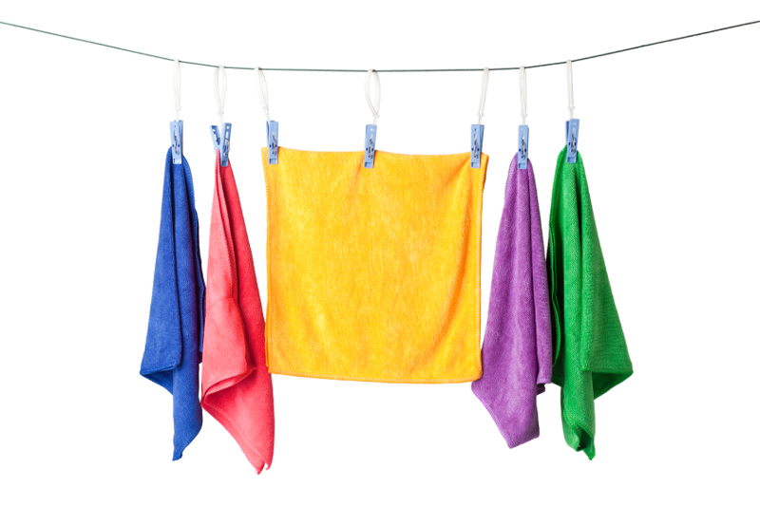
I washed my towel this morning. Do you think dry yet?

Slide 20
I washed my towel this morning. Do you think it’s dry yet?

Slide 21
“We must cancel the show. a great shame!”
said Neena.

Slide 22
“We must cancel the show.
It’s a great shame!”
said Neena.

Slide 23
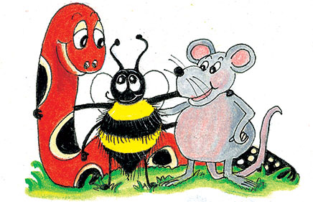
parsing

Slide 24
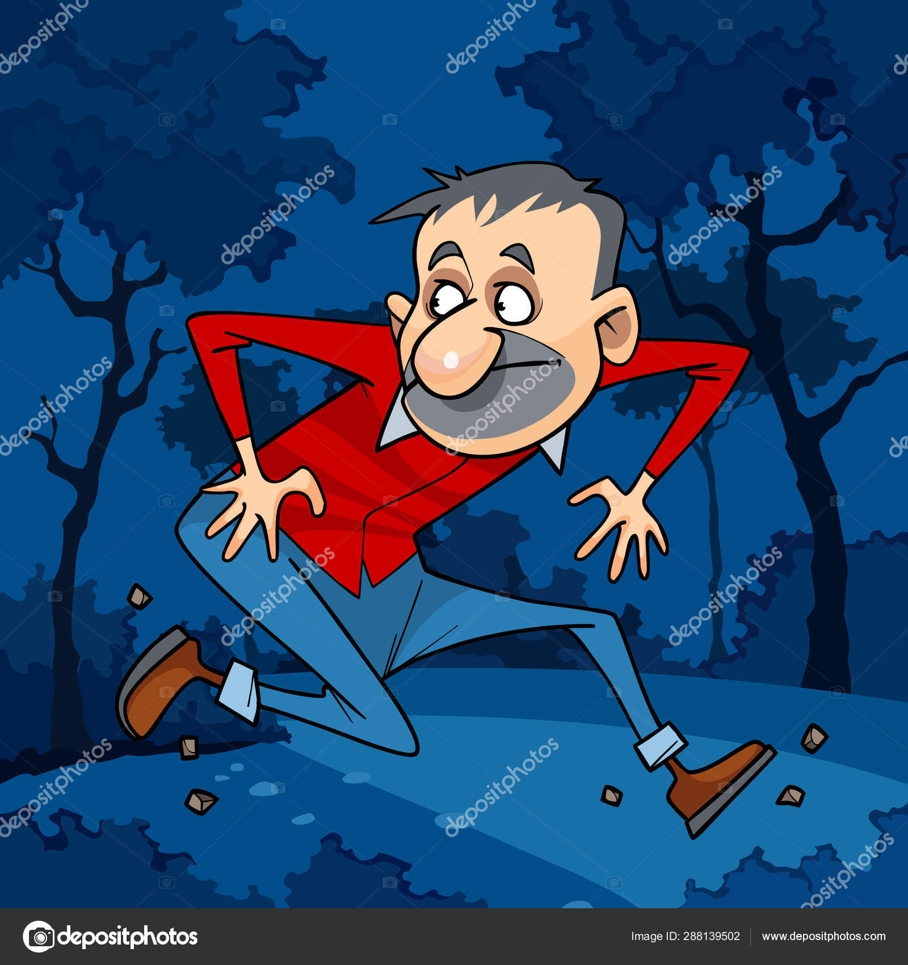
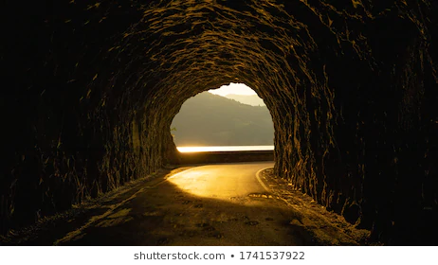
In the novel, a cruel scoundrel travels through a long dark tunnel.

Slide 25
In the novel, a cruel scoundrel travels through a long dark tunnel.

Slide 26
In the novel, a cruel scoundrel travels through a long dark tunnel.

Slide 27
In the novel, a cruel scoundrel travels through a long dark tunnel.

Slide 28
In the novel, a cruel scoundrel travels through a long dark tunnel.

Slide 29
In the novel, a cruel scoundrel travels through a long dark tunnel.

Slide 30
In the novel, a cruel scoundrel travels through a long dark tunnel.

Slide 31
In the novel, a cruel scoundrel travels through a long dark tunnel.

Slide 32
In the novel, a cruel scoundrel travels through a long dark tunnel.

Slide 33
In the novel, a cruel scoundrel travels through a long dark tunnel.

Slide 34
simple
present
In the novel, a cruel scoundrel travels through a long dark tunnel.

Slide 35
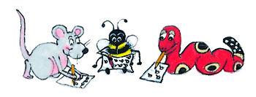
Dictation

Slide 36
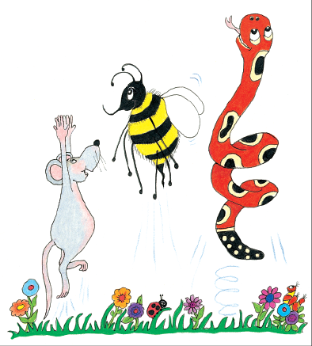
Dictation
1.
2.
3.

Slide 37
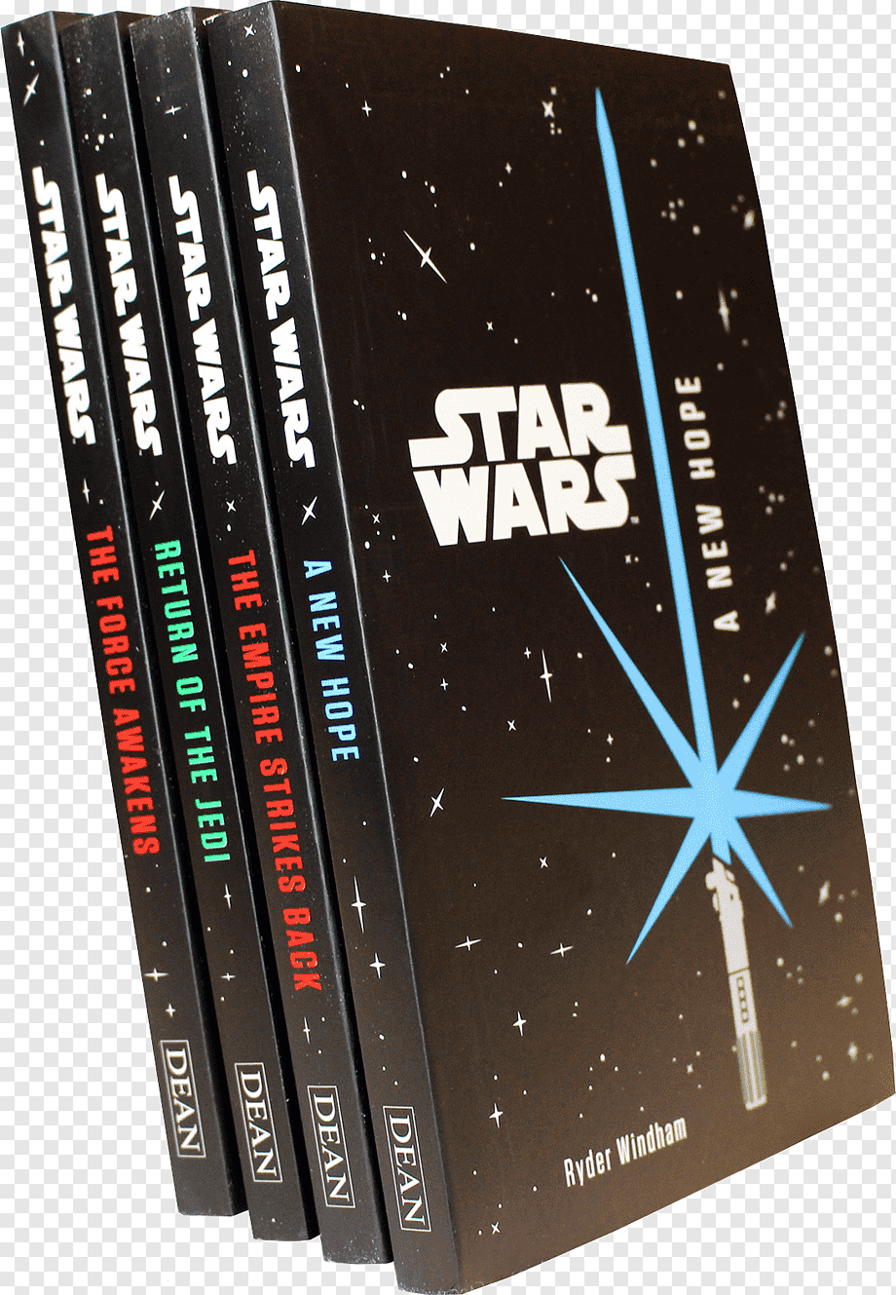
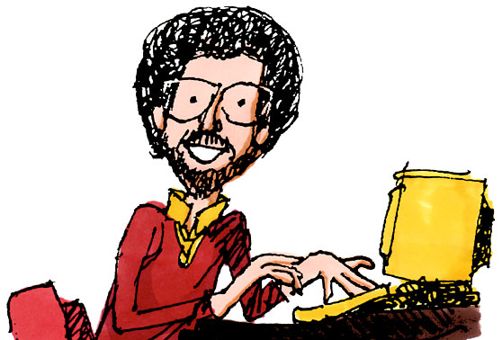

Slide 38
The author wrote a sequel to her novel.

Slide 39
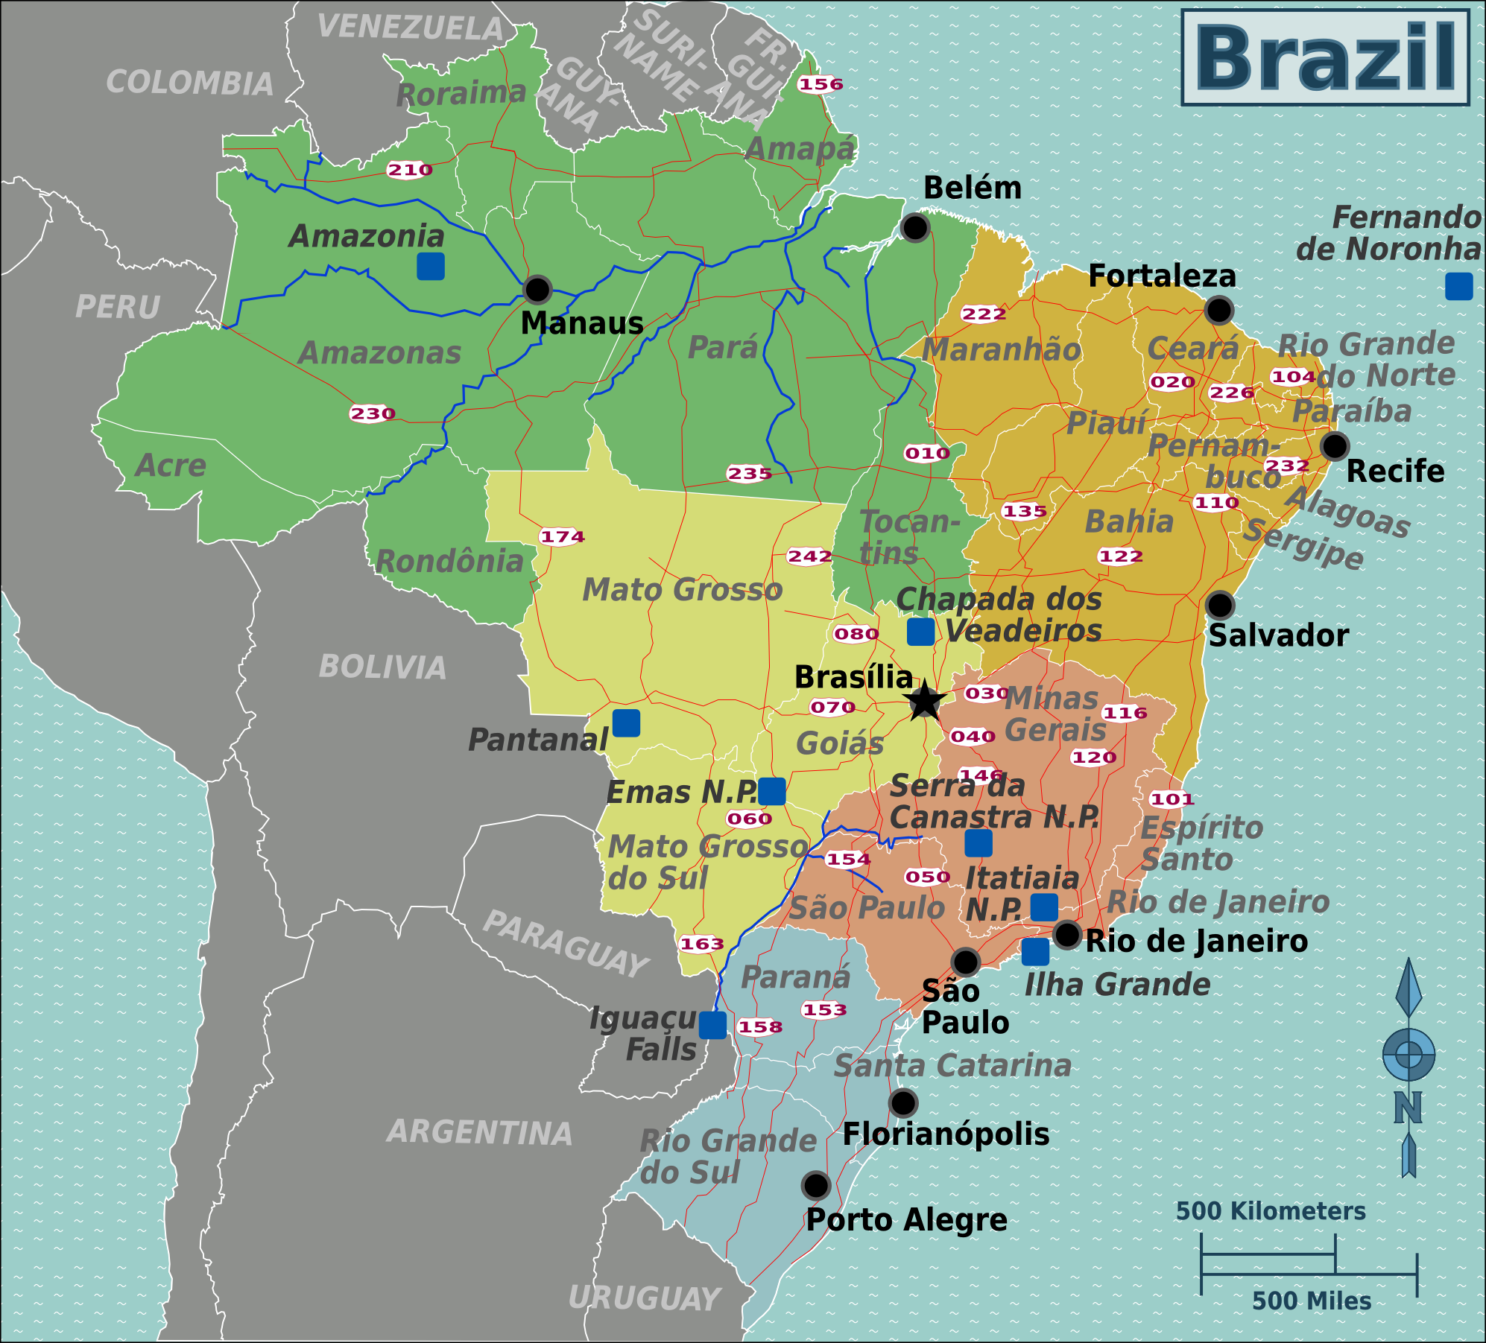

Slide 40
“I kept a travel journal in Brazil,” said Rachel.

Slide 41
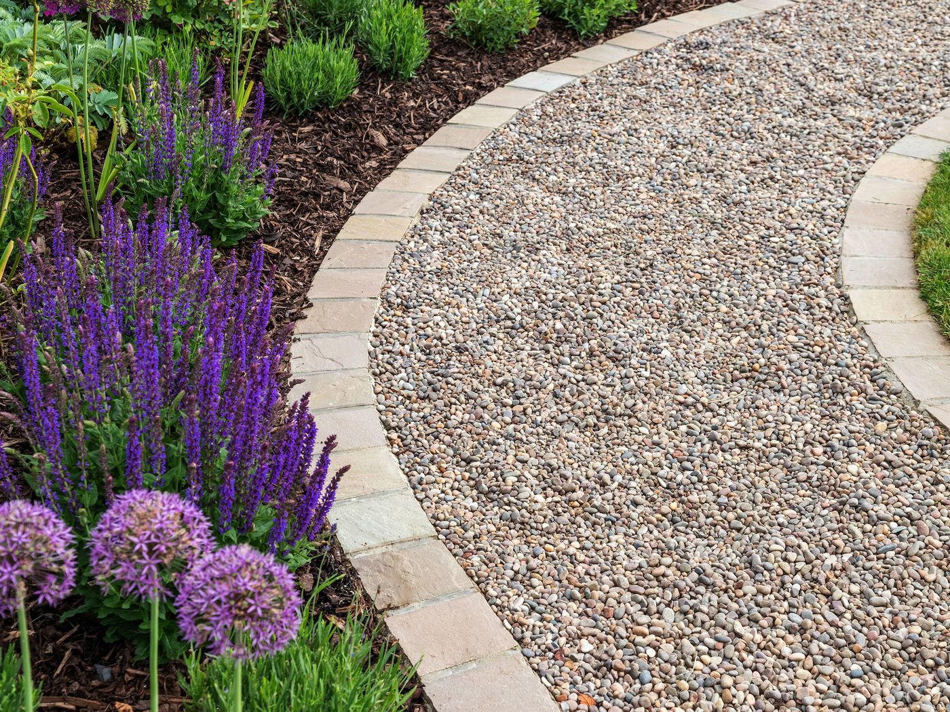
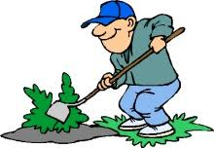

Slide 42
We covered the path with gravel.

Slide 43
Thank you.
See you
next time!

