Slide 1
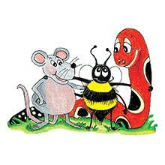
Jolly Grammar 3b-17

Slide 2
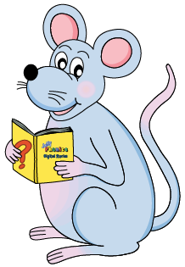
Let’s review
Subject & object.

Slide 3
subject
verb
object
s
o
The cat chased a mouse.

Slide 4
Subject and Object Pronouns

Slide 5
Spelling List
Spelling
The <y> Spelling of the /i/ Sound

Slide 6
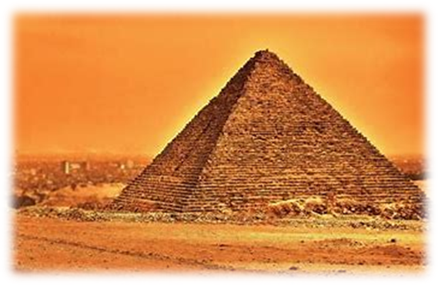
pyramid
/ee/

Slide 7
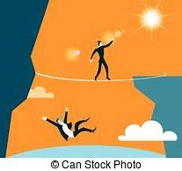
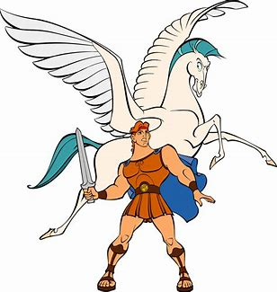
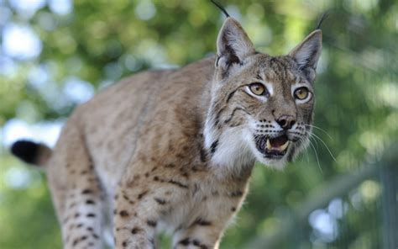
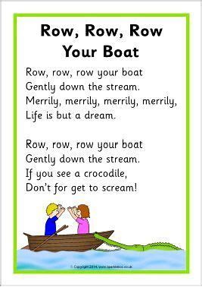
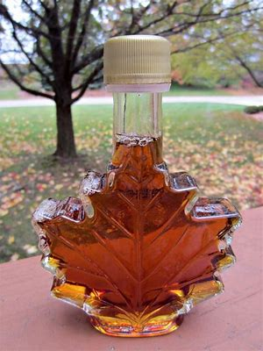
abyss myth lynx
lyrics syrup idyllic

Slide 8
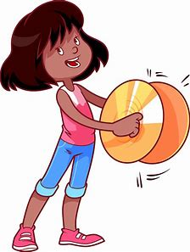
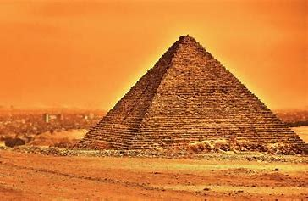
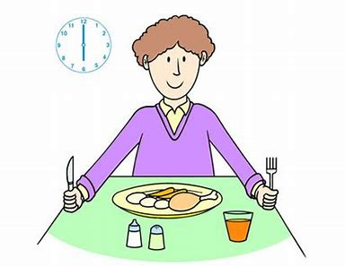
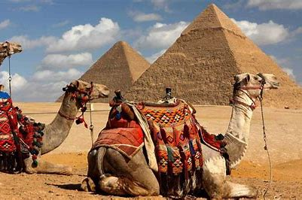
pyramid symbol cymbal
system Egypt typical

Slide 9
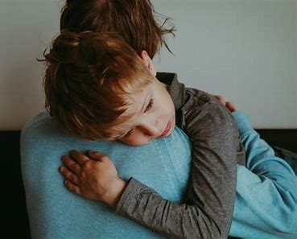
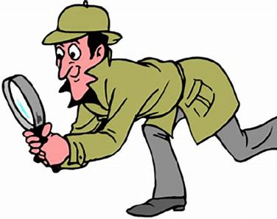
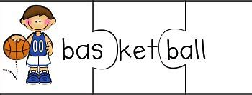
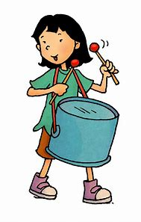
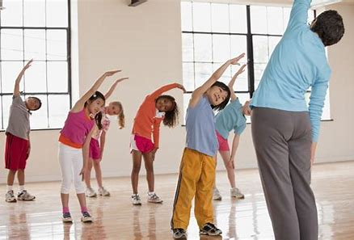
syllable sympathy mystery
rhythm acrylic physical

Slide 10
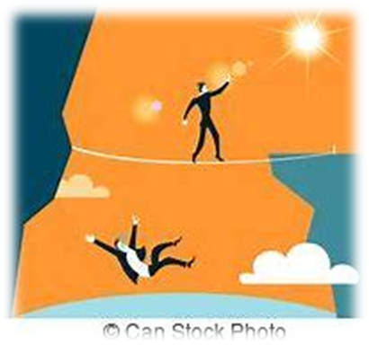
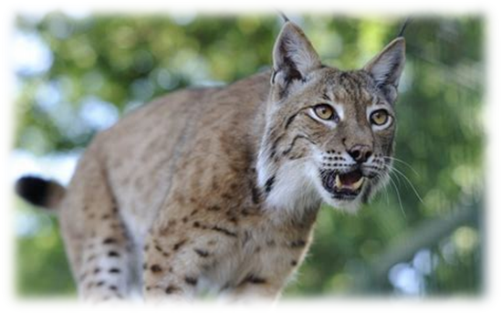
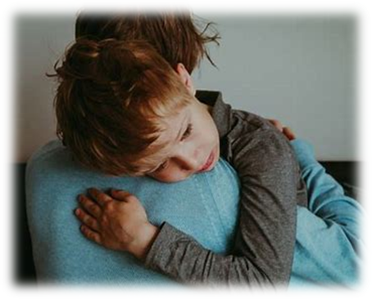

Slide 11
Activity page

Slide 12
Let’s review
syllables.

Slide 13
Olympic
cygnet
system
hymn
pygmy

Slide 14
Let’s parse
sentences.

Slide 15
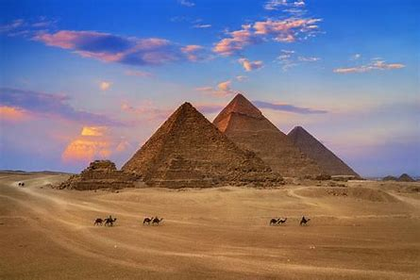
Parse these sentences.
She will be learning the lyrics
for her new song.
We heard mysterious myths about
the Egyptian pyramids.

Slide 16
Parse these sentences.
She will be learning the lyrics
for her new song.
We heard mysterious myths about
the Egyptian pyramids.

Slide 17
Parse these sentences.
She will be learning the lyrics
for her new song.
We heard mysterious myths about
the Egyptian pyramids.

Slide 18
Parse these sentences.
She will be learning the lyrics
for her new song.
We heard mysterious myths about
the Egyptian pyramids.

Slide 19
Parse these sentences.
She will be learning the lyrics
for her new song.
We heard mysterious myths about
the Egyptian pyramids.

Slide 20
Parse these sentences.
She will be learning the lyrics
for her new song.
We heard mysterious myths about
the Egyptian pyramids.

Slide 21
Parse these sentences.
She will be learning the lyrics
for her new song.
We heard mysterious myths about
the Egyptian pyramids.

Slide 22
Parse these sentences.
She will be learning the lyrics
for her new song.
We heard mysterious myths about
the the Egyptian pyramids.

Slide 23
Parse these sentences.
She will be learning the lyrics
for her new song.
We heard mysterious myths about
the Egyptian pyramids.

Slide 24
Parse these sentences.
She will be learning the lyrics
for her new song.
We heard mysterious myths about
the Egyptian pyramids.

Slide 25
Parse these sentences.
She will be learning the lyrics
for her new song.
We heard mysterious myths about
the Egyptian pyramids.

Slide 26
Parse these sentences.
She will be learning the lyrics
for her new song.
We heard mysterious myths about
the Egyptian pyramids.

Slide 27
Parse these sentences.
She will be learning the lyrics
for her new song.
We heard mysterious myths about
the Egyptian pyramids.

Slide 28
Parse these sentences.
She will be learning the lyrics
for her new song.
We heard mysterious myths about
the Egyptian pyramids.

Slide 29
Parse these sentences.
She will be learning the lyrics
for her new song.
We heard mysterious myths about
the Egyptian pyramids.

Slide 30
Dictation

Slide 31
Dictation
1.
2.
3.

Slide 32
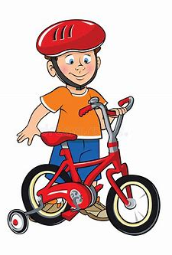

Slide 33
He was given a new bicycle.

Slide 34
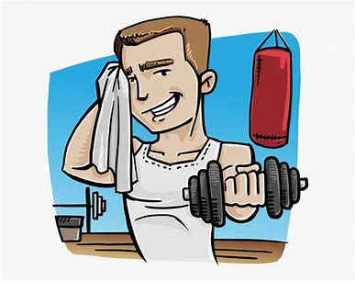

Slide 35
“I will be using the new gym when it opens,” enthused Nick.

Slide 36
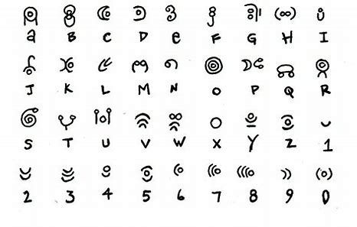

Slide 37
The secret code had symbols instead of letters.

Slide 38
Thank you!

