Slide 1
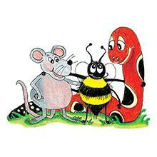
Jolly Grammar 3b-16

Slide 2
Spelling Test 26

Slide 3
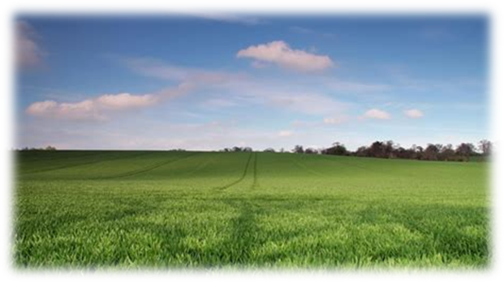
field

Slide 4
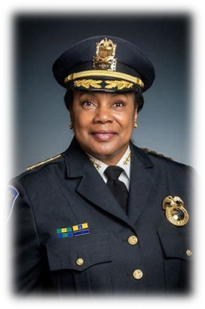
field
chief

Slide 5
field
chief
piece

Slide 6
field
chief
piece
brief

Slide 7
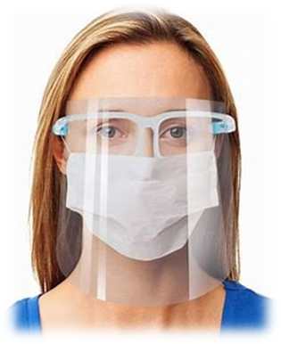
field
chief
piece
brief
shield

Slide 8
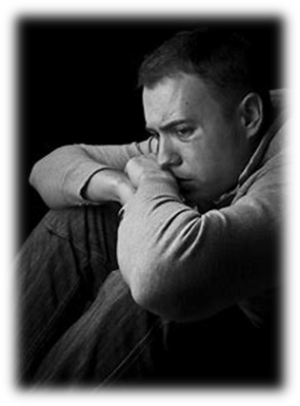
field
chief
piece
brief
shield
grief

Slide 9
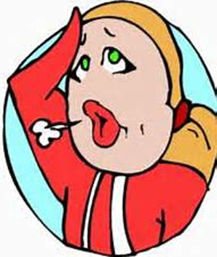
field
chief
piece
brief
shield
grief
7. relief

Slide 10
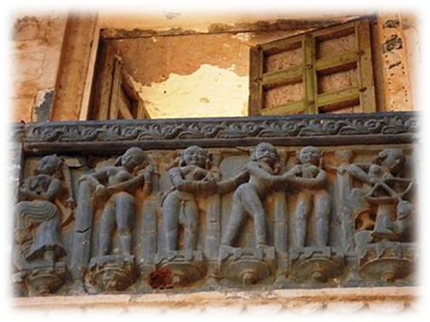
field
chief
piece
brief
shield
grief
7. relief
8. frieze

Slide 11
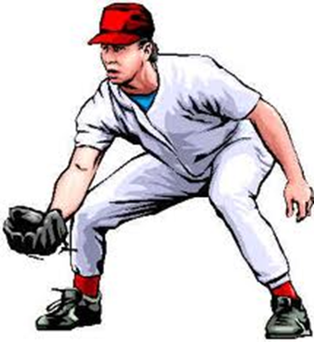
field
chief
piece
brief
shield
grief
7. relief
8. frieze
9. fielder

Slide 12
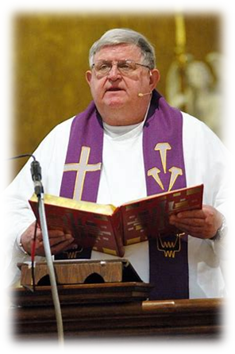
field
chief
piece
brief
shield
grief
7. relief
8. frieze
9. fielder
10. priest

Slide 13
field
chief
piece
brief
shield
grief
7. relief
8. frieze
9. fielder
10. priest
11. believe

Slide 14
field
chief
piece
brief
shield
grief
7. relief
8. frieze
9. fielder
10. priest
11. believe
12. achieve

Slide 15
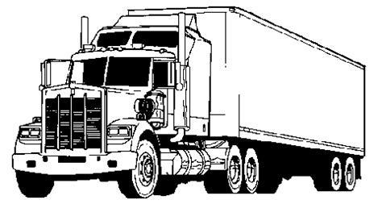
field
chief
piece
brief
shield
grief
7. relief
8. frieze
9. fielder
10. priest
11. believe
12. achieve
13. diesel

Slide 16
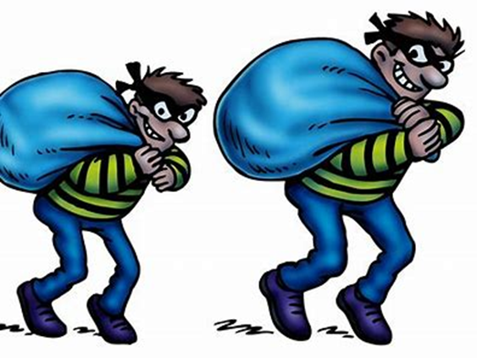
field
chief
piece
brief
shield
grief
7. relief
8. frieze
9. fielder
10. priest
11. believe
12. achieve
13. diesel
14. thieves

Slide 17
field
chief
piece
brief
shield
grief
7. relief
8. frieze
9. fielder
10. priest
11. believe
12. achieve
13. diesel
14. thieves
15. besiege

Slide 18
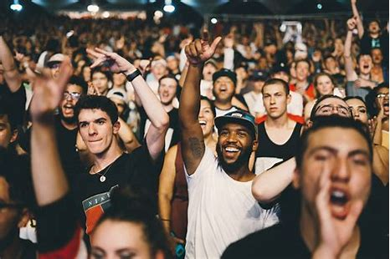
field
chief
piece
brief
shield
grief
7. relief
8. frieze
9. fielder
10. priest
11. believe
12. achieve
13. diesel
14. thieves
15. besiege
16. audience

Slide 19
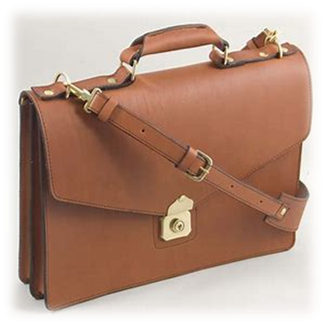
field
chief
piece
brief
shield
grief
7. relief
8. frieze
9. fielder
10. priest
11. believe
12. achieve
13. diesel
14. thieves
15. besiege
16. audience
17. briefcase

Slide 20
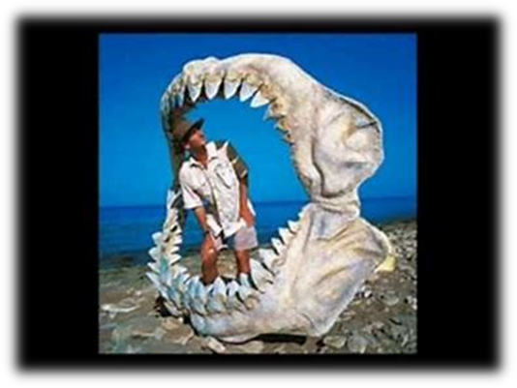
field
chief
piece
brief
shield
grief
7. relief
8. frieze
9. fielder
10. priest
11. believe
12. achieve
13. diesel
14. thieves
15. besiege
16. audience
17. briefcase
18. unbelievable

Slide 21
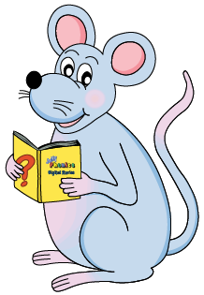
Let’s review
subject.

Slide 22
The giant orange pumpkin grow in the garden.
It needs to make sense.
It needs to start with a capital letter.
It needs to end with the correct punctuation.
It needs a verb.

Slide 23
The farmer grows vegetables in the garden.

Slide 24
The farmer grows vegetables in the garden.

Slide 25
subject
The farmer grows vegetables in the garden.

Slide 26
noun or
pronoun
subject
s
The farmer grows vegetables in the garden.
simple subject

Slide 27
The object of
a sentence

Slide 28
The cat chased a mouse.

Slide 29
The cat chased a mouse.

Slide 30
s
The cat chased a mouse.

Slide 31
s
The cat chased a mouse.

Slide 32
object
s
o
The cat chased a mouse.

Slide 33
subject
verb
object
s
o
The cat chased a mouse.

Slide 34
Activity page

Slide 35
subject
verb
object
s
o
The cat chased a mouse.

Slide 36
s
o
The rancher lassoed the cow.

Slide 37
s
o
I made a cake today.

Slide 38
s
o
Seth kicked the ball.

Slide 39
s
o
The lady wrote a letter.

Slide 40
s
o
The boy is reading a comic.

Slide 41
s
o
The artist painted a portrait.

Slide 42
s
o
The dog ate the bone.

Slide 43
s
o
He shut the drawer.

Slide 44
s
o
Megan open the door.

Slide 45
s
o
Grandma knitted a scarf.

Slide 46
s
o
We prepared the salad for lunch.

Slide 47
s
o
She played the flute beautifully.

Slide 48
s
o
Joe chased the puppy.

Slide 49
s
o
The puppy chased Joe.

Slide 50
s
o
I shall be learning a poem for the concert.

Slide 51
Thank you!

