Slide 1
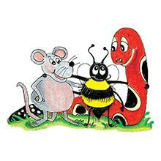
Jolly Grammar 3b-13

Slide 2
Spelling List
Spelling
The <a> Spelling of the /ar/ Sound

Slide 3
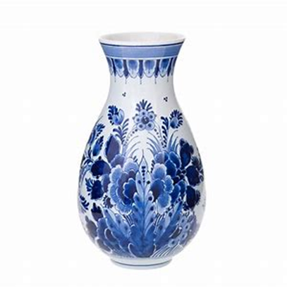
vase
/ar/

Slide 4
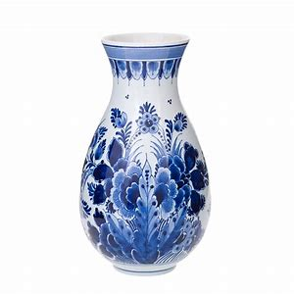
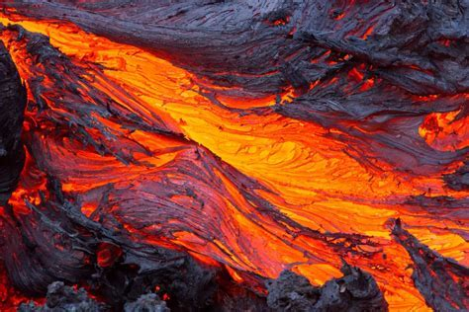
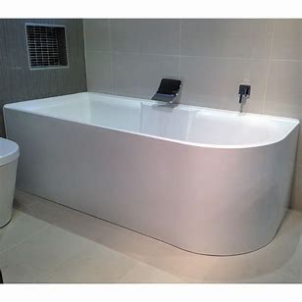
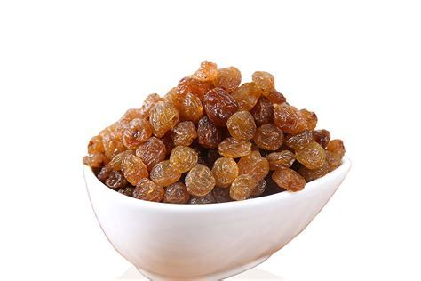
ask vase lava
bath nasty sultana

Slide 5
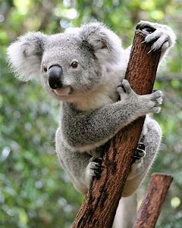
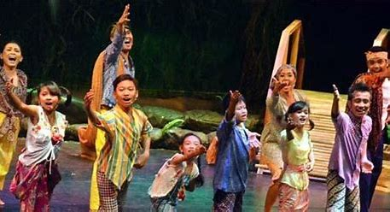
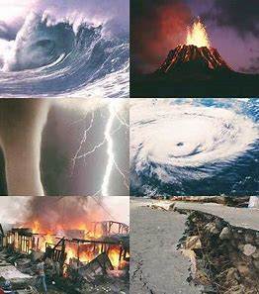
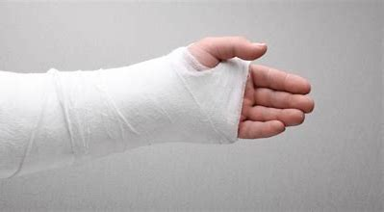
chance koala drama
plaster pyjamas disaster

Slide 6
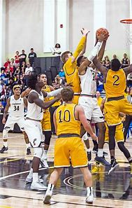
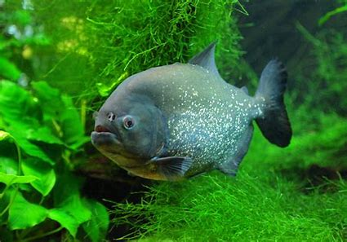
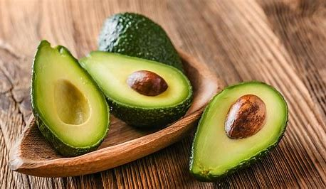
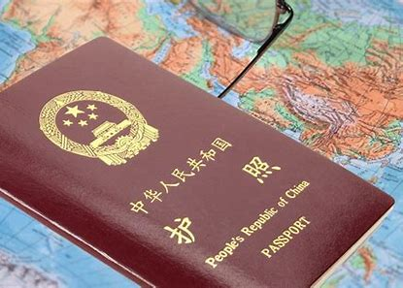
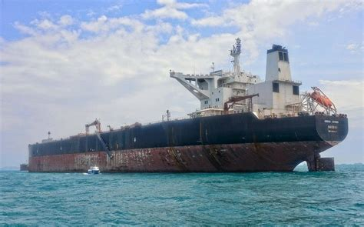
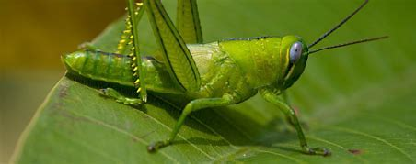
piranha basketball avocado
armada passport grasshopper

Slide 7
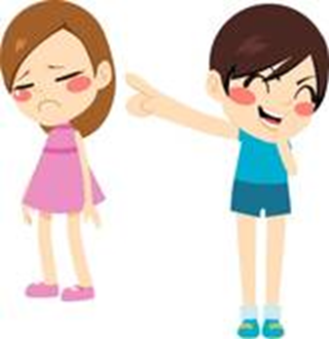
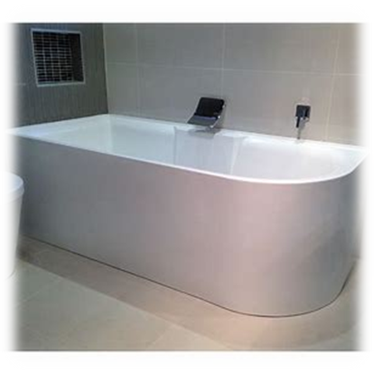
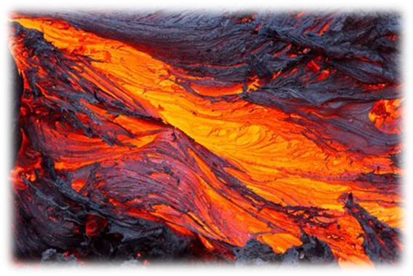
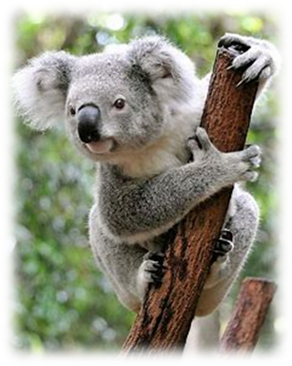
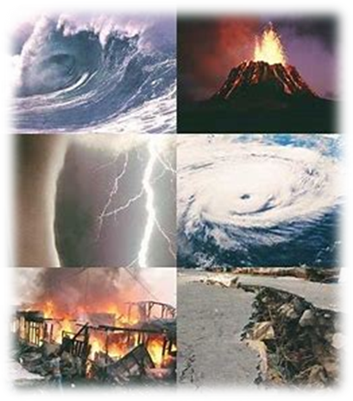
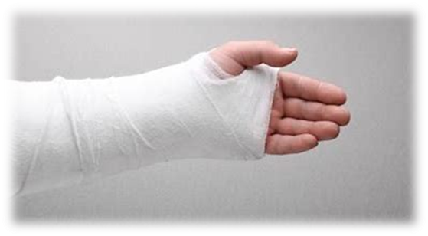
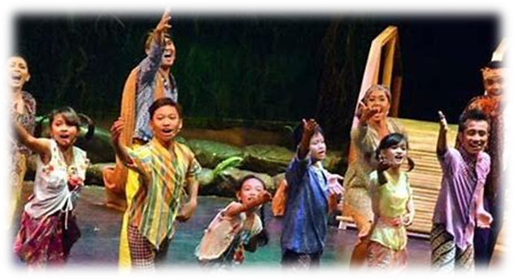
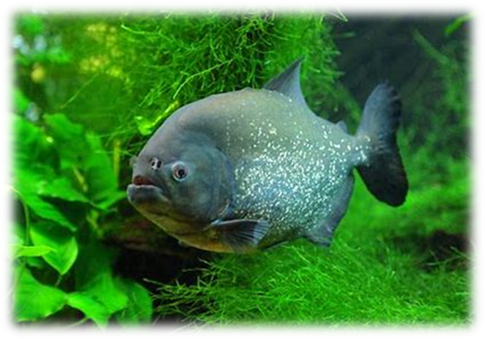
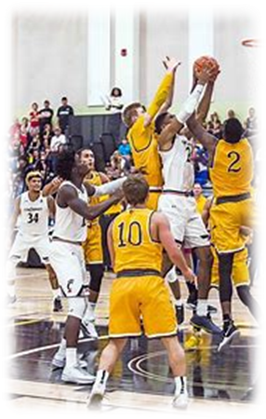
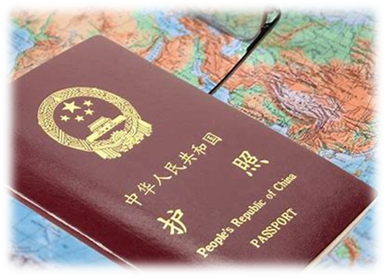
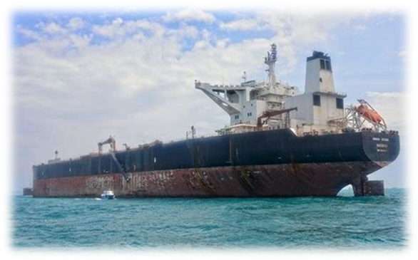
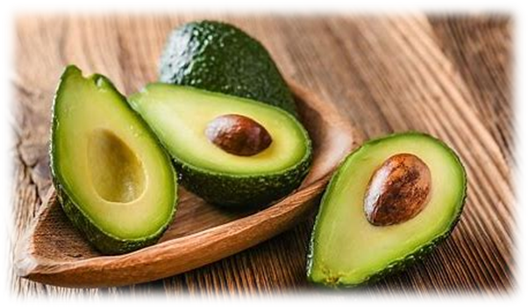
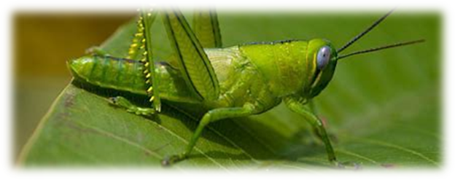

Slide 8
Activity page

Slide 9
Let’s review
syllables.

Slide 10
sultana
demand
grasshopper
origami
father

Slide 11
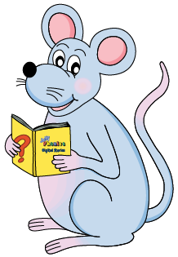
Let’s parse
sentences.

Slide 12
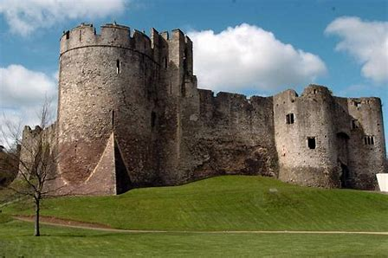
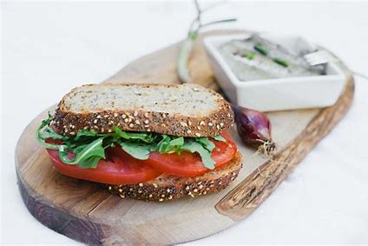
Parse these sentences.
I will be visiting Welsh castles
in the holidays.
My father ate a delicious tomato sandwich for lunch.

Slide 13
Parse these sentences.
I will be visiting Welsh castles
in the holidays.
My father ate a delicious tomato sandwich for lunch.

Slide 14
Parse these sentences.
I will be visiting Welsh castles
in the holidays.
My father ate a delicious tomato sandwich for lunch.

Slide 15
Parse these sentences.
I will be visiting Welsh castles
in the holidays.
My father ate a delicious tomato sandwich for lunch.

Slide 16
Parse these sentences.
I will be visiting Welsh castles
in the holidays.
My father ate a delicious tomato sandwich for lunch.

Slide 17
Parse these sentences.
I will be visiting Welsh castles
in the holidays.
My father ate a delicious tomato sandwich for lunch.

Slide 18
Parse these sentences.
I will be visiting Welsh castles
in the holidays.
My father ate a delicious tomato sandwich for lunch.

Slide 19
Parse these sentences.
I will be visiting Welsh castles
in the holidays.
My father ate a delicious tomato sandwich for lunch.

Slide 20
Parse these sentences.
I will be visiting Welsh castles
in the holidays.
My father ate a delicious tomato sandwich for lunch.

Slide 21
Parse these sentences.
I will be visiting Welsh castles
in the holidays.
My father ate a delicious tomato sandwich for lunch.

Slide 22
Parse these sentences.
I will be visiting Welsh castles
in the holidays.
My father ate a delicious tomato sandwich for lunch.

Slide 23
Parse these sentences.
I will be visiting Welsh castles
in the holidays.
My father ate a delicious tomato sandwich for lunch.

Slide 24
Parse these sentences.
I will be visiting Welsh castles
in the holidays.
My father ate a delicious tomato sandwich for lunch.

Slide 25
Parse these sentences.
I will be visiting Welsh castles
in the holidays.
My father ate a delicious tomato sandwich for lunch.

Slide 26
Parse these sentences.
I will be visiting Welsh castles
in the holidays.
My father ate a delicious tomato sandwich for lunch.

Slide 27
Dictation

Slide 28
Dictation
1.
2.
3.

Slide 29
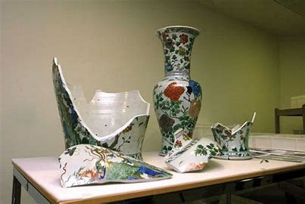

Slide 30
The priceless China vase fell and smashed into hundreds of pieces.

Slide 31
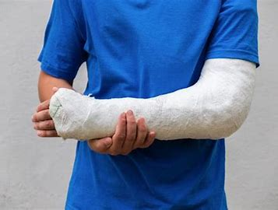

Slide 32
He broke his arm and needed a plaster cast.

Slide 33
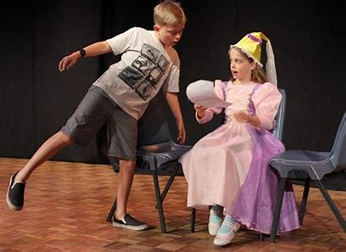

Slide 34
“My class has drama next,”
explained Kim quicky.

Slide 35
Homework

