Slide 1
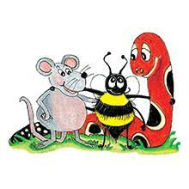
Jolly Grammar 3b-11

Slide 2
There are many clouds in the sky.
The sky is cloudy.

Slide 3
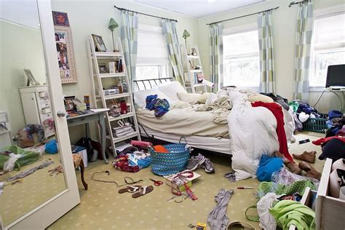
My bedroom is in a mess.
My bedroom is messy.

Slide 4
Spelling List
Spelling
The <u> Spelling of the /ue/ Sound

Slide 5
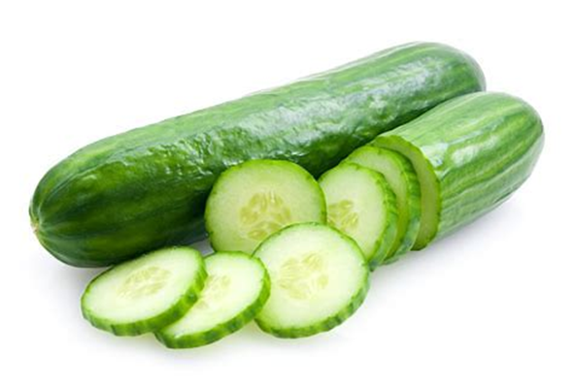
cucumber
/ue/

Slide 6
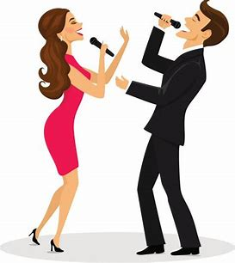
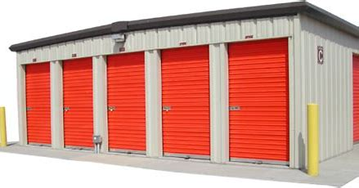
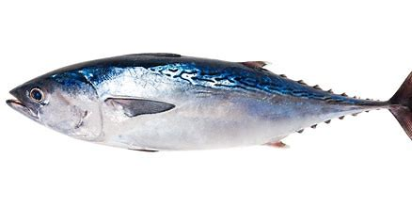
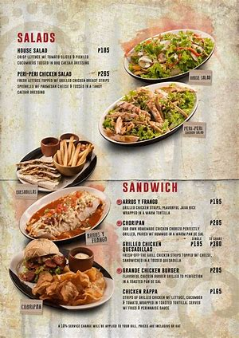
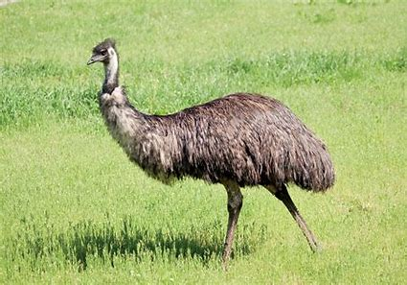
unit tuna duet
menu tulip emu

Slide 7
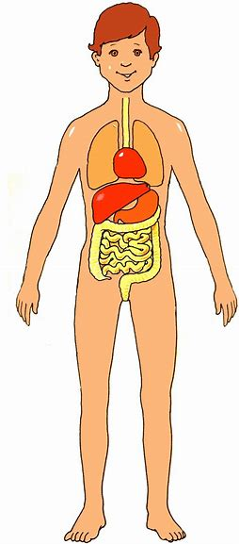
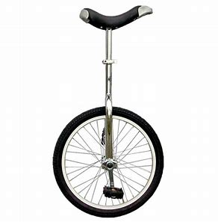
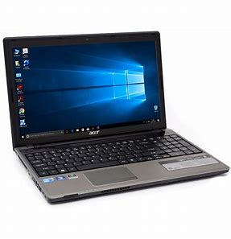
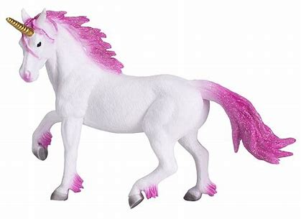
human music usual
computer unicorn unicycle

Slide 8
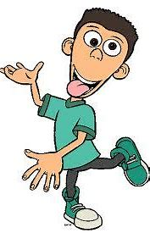
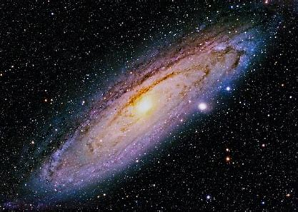
peculiar cucumber unique
universe communicate solution

Slide 9
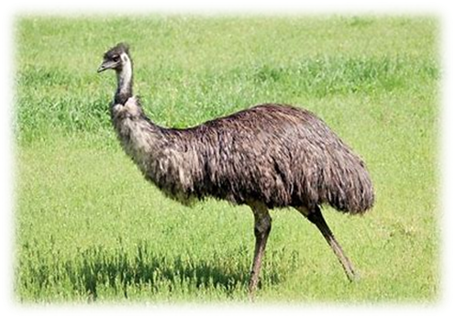
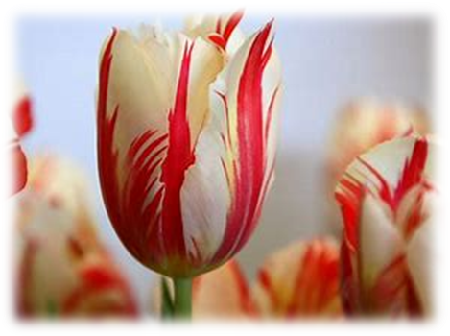
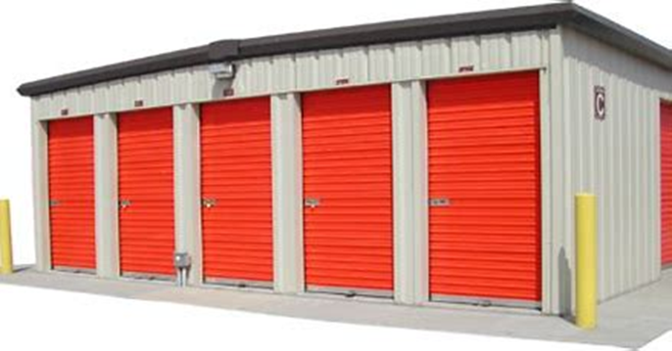
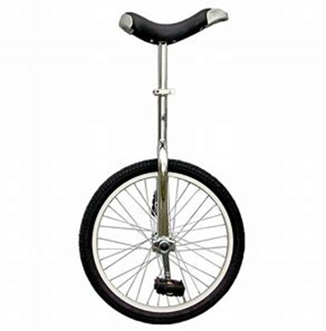
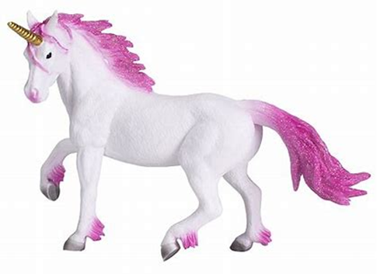
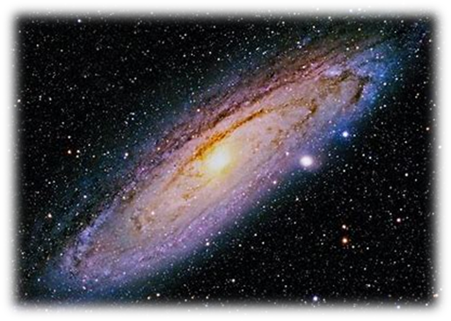
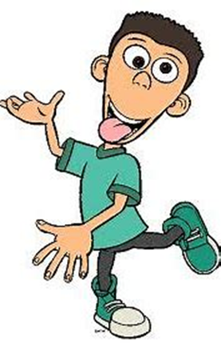

Slide 10
Activity page

Slide 11
Let’s review
syllables.

Slide 12
duet
emu
unique
cucumber
computer

Slide 13
duet
emu
unique
cucumber
computer

Slide 14
duet
emu
unique
cucumber
computer

Slide 15
duet
emu
unique
cucumber
computer

Slide 16
duet
emu
unique
cucumber
computer

Slide 17
duet
emu
unique
cucumber
computer

Slide 18
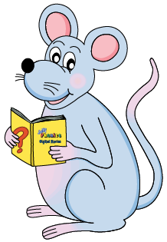
Let’s parse
sentences.

Slide 19
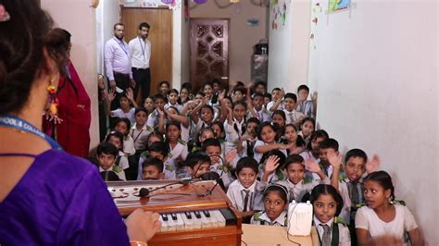
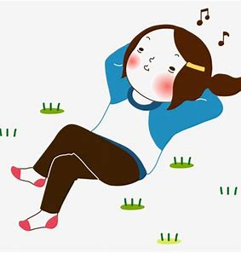
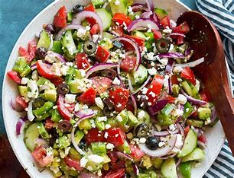
Parse these sentences.
She continuously hummed
the school song.
He will cut the cucumber and
put it in the Greek salad.

Slide 20
Parse these sentences.
She continuously hummed
the school song.
He will cut the cucumber and
put it in the Greek salad.

Slide 21
Parse these sentences.
She continuously hummed
the school song.
He will cut the cucumber and
put it in the Greek salad.

Slide 22
Parse these sentences.
She continuously hummed
the school song.
He will cut the cucumber and
put it in the Greek salad.

Slide 23
Parse these sentences.
She continuously hummed
the school song.
He will cut the cucumber and
put it in the Greek salad.

Slide 24
Parse these sentences.
She continuously hummed
the school song.
He will cut the cucumber and
put it in the Greek salad.

Slide 25
Parse these sentences.
She continuously hummed
the school song.
He will cut the cucumber and
put it in the Greek salad.

Slide 26
Parse these sentences.
She continuously hummed
the school song.
He will cut the cucumber and
put it in the Greek salad.

Slide 27
Parse these sentences.
She continuously hummed
the school song.
He will cut the cucumber and
put it in the Greek salad.

Slide 28
Parse these sentences.
She continuously hummed
the school song.
He will cut the cucumber and
put it in the Greek salad.

Slide 29
Parse these sentences.
She continuously hummed
the school song.
He will cut the cucumber and
put it in the Greek salad.

Slide 30
Parse these sentences.
She continuously hummed
the school song.
He will cut the cucumber and
put it in the Greek salad.

Slide 31
Parse these sentences.
She continuously hummed
the school song.
He will cut the cucumber and
put it in the Greek salad.

Slide 32
Parse these sentences.
She continuously hummed
the school song.
He will cut the cucumber and
put it in the Greek salad.

Slide 33
Parse these sentences.
She continuously hummed
the school song.
He will cut the cucumber and
put it in the Greek salad.

Slide 34
Dictation

Slide 36
“I sent an email on my computer,” Granny said proudly.

Slide 37
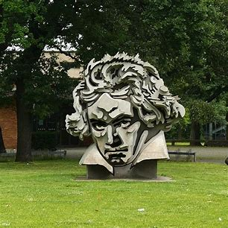

Slide 38
We saw an unusual monument.

Slide 39
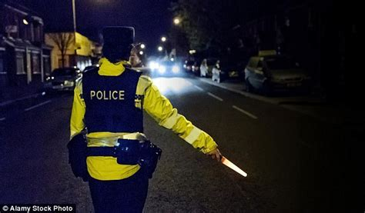

Slide 40
The policeman was on duty all night.

Slide 41
Homework

