Slide 1
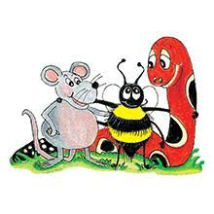
Jolly Grammar 3b-9

Slide 2
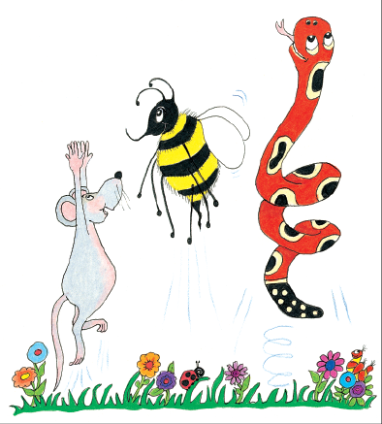
Let’s review
Nouns acting as
Adjectives.

Slide 3
The carrot cake tasted lovely.
She cleaned out the rabbit cage.
Sam has a mountain bike.
I planted tulip bulbs.
She wore a diamond ring. emerald
We cut down the old apple tree.
I like cheese and tomato sandwich.
lettuce, fruit, jam, chicken cutlet
cream, ham, tuna, egg

Slide 4
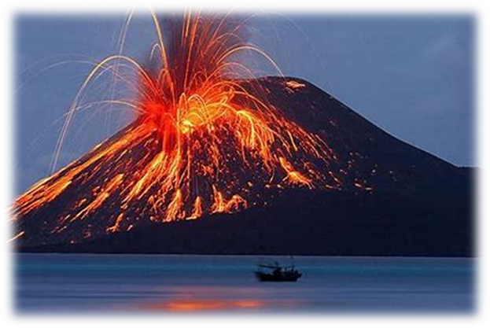
volcano

Slide 5
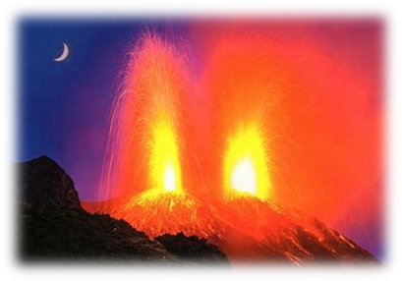
volcano

Slide 6
volcano
volcanoes

Slide 7
Spelling List
Spelling
The <-o> Spelling of the /oa/ Sound

Slide 8
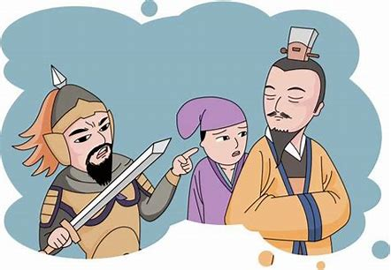
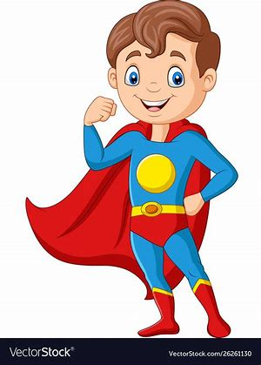
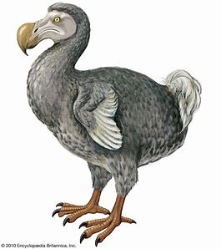
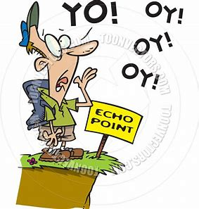
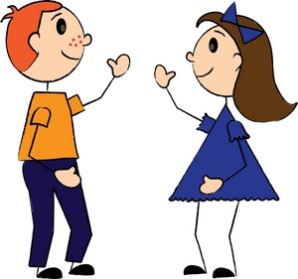
ago hero dodo
zero echo hello

Slide 9
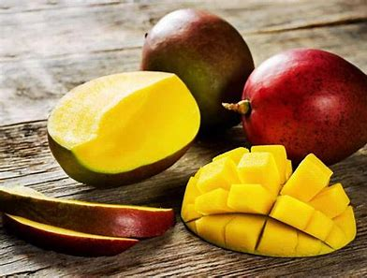
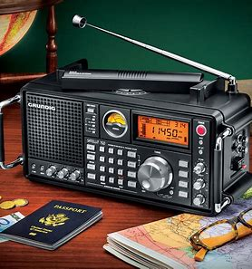
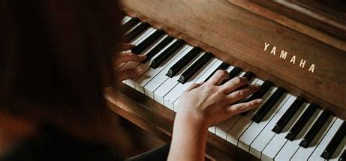
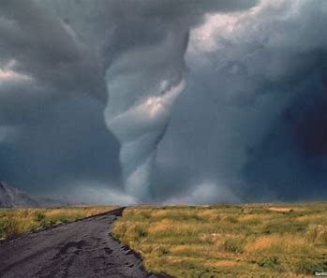
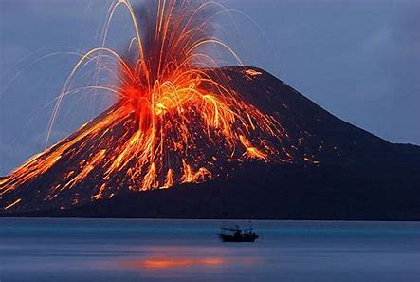
mango pianos radios
videos tornado volcano

Slide 10
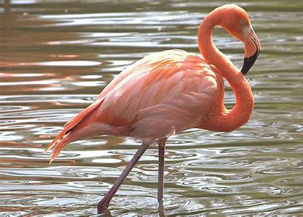
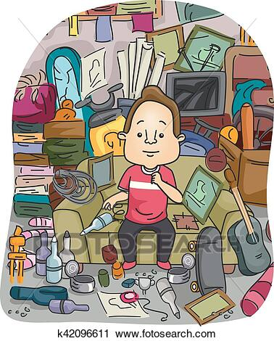
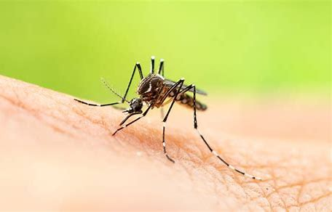
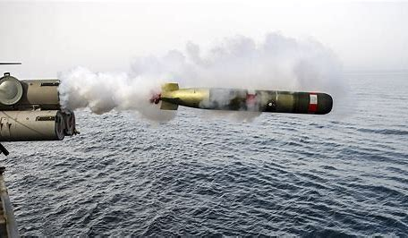
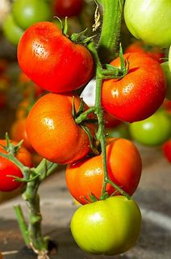
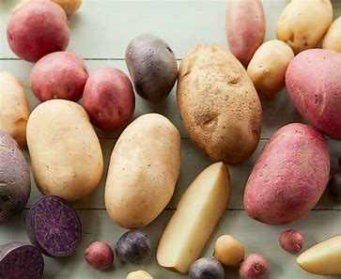
flamingo memento mosquito
torpedoes tomatoes potatoes

Slide 11
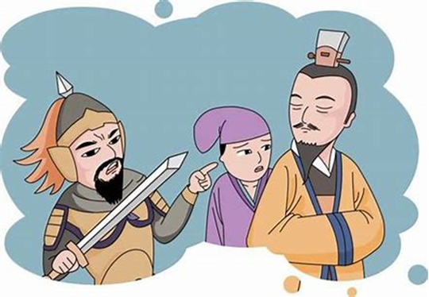
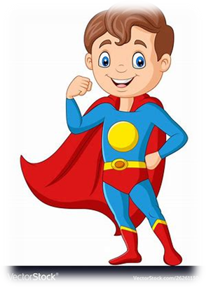
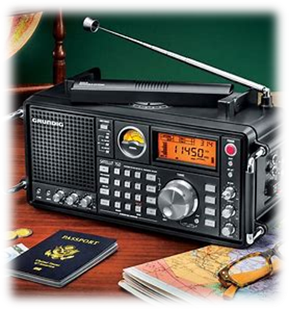
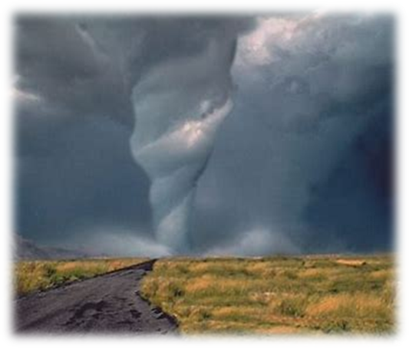
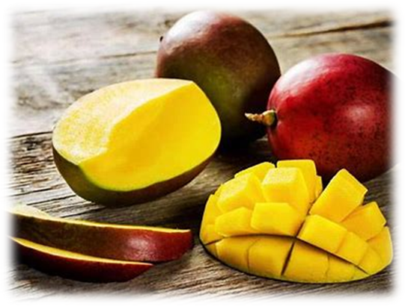
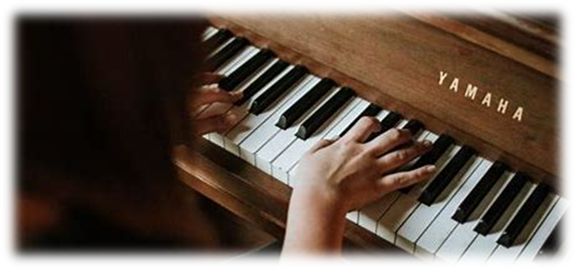
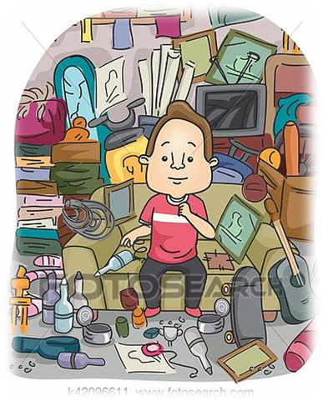
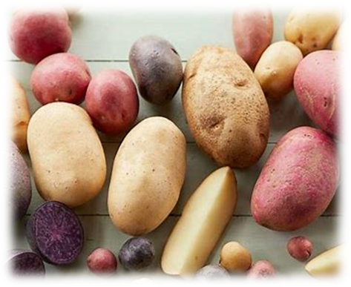
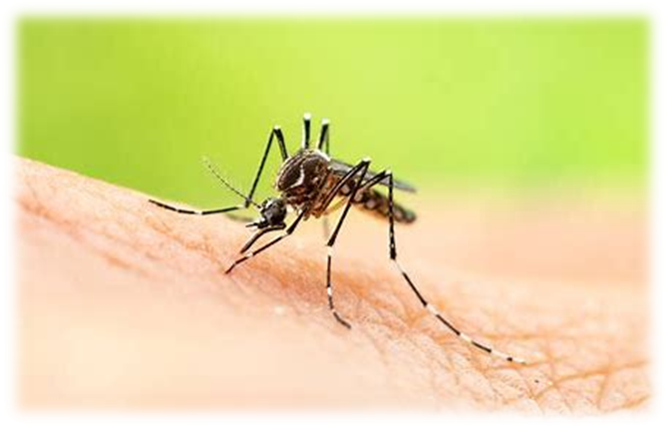
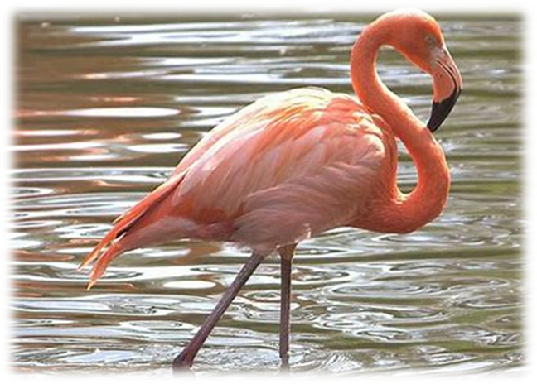
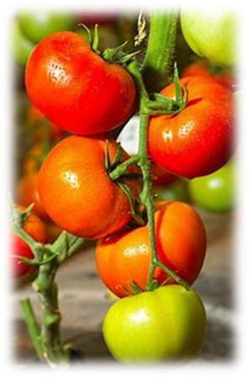
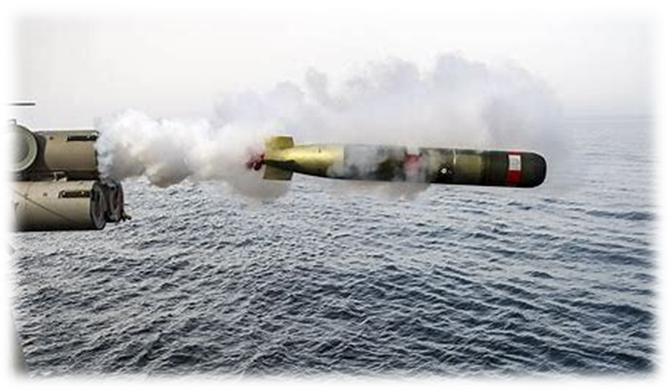

Slide 12
Activity page

Slide 13
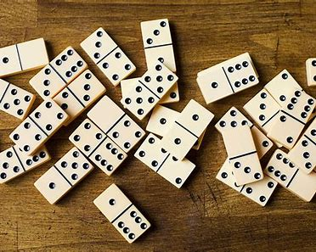
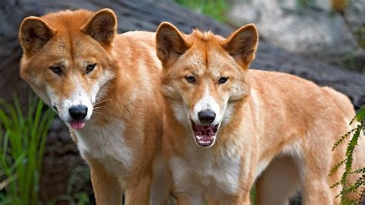
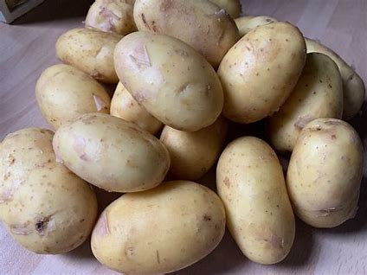
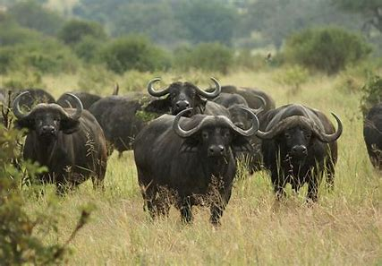
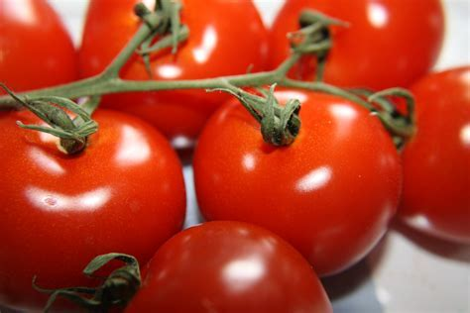
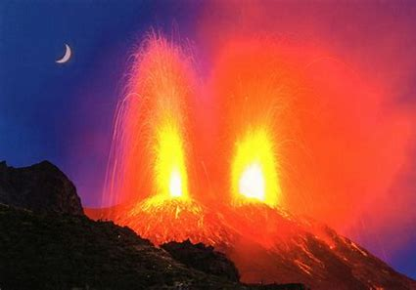
dingoes dominoes
buffaloes potatoes
tomatoes volcanoes

Slide 14
Let’s review
syllables.

Slide 15
disco
photo
mango
torpedo
mosquito

Slide 16
disco
photo
mango
torpedo
mosquito

Slide 17
disco
photo
mango
torpedo
mosquito

Slide 18
disco
photo
mango
torpedo
mosquito

Slide 19
disco
photo
mango
torpedo
mosquito

Slide 20
disco
photo
mango
torpedo
mosquito

Slide 21
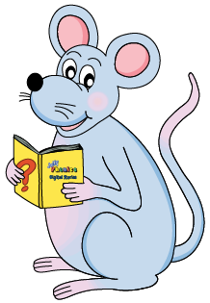
Let’s parse
sentences.

Slide 22
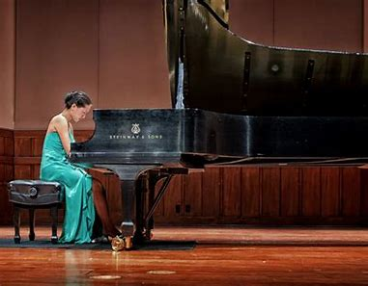
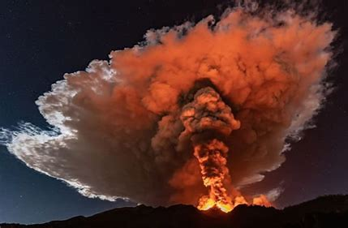
Parse these sentences.
She will be playing a piano concert.
The volcano exploded violently.

Slide 23
Parse these sentences.
She will be playing a piano concert.
The volcano exploded violently.

Slide 24
Parse these sentences.
She will be playing a piano concert.
The volcano exploded violently.

Slide 25
Parse these sentences.
She will be playing a piano concert.
The volcano exploded violently.

Slide 26
Parse these sentences.
She will be playing a piano concert.
The volcano exploded violently.

Slide 27
Parse these sentences.
She will be playing a piano concert.
The volcano exploded violently.

Slide 28
Parse these sentences.
She will be playing a piano concert.
The volcano exploded violently.

Slide 29
Parse these sentences.
She will be playing a piano concert.
The volcano exploded violently.

Slide 30
Dictation

Slide 31
Dictation
1.
2.
3.

Slide 32
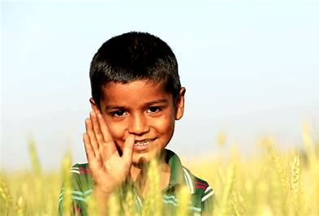

Slide 33
“Hello,” said the little boy.

Slide 34
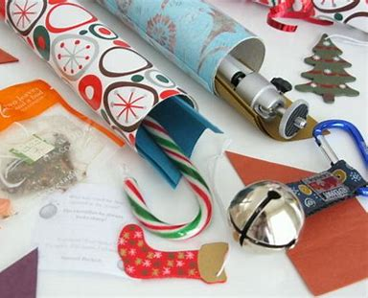
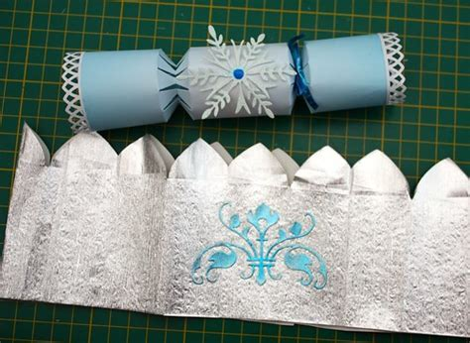
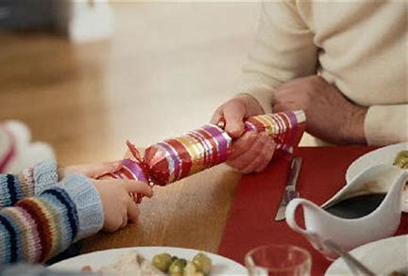

Slide 35
The cracker had a hat and a motto in it.

Slide 36
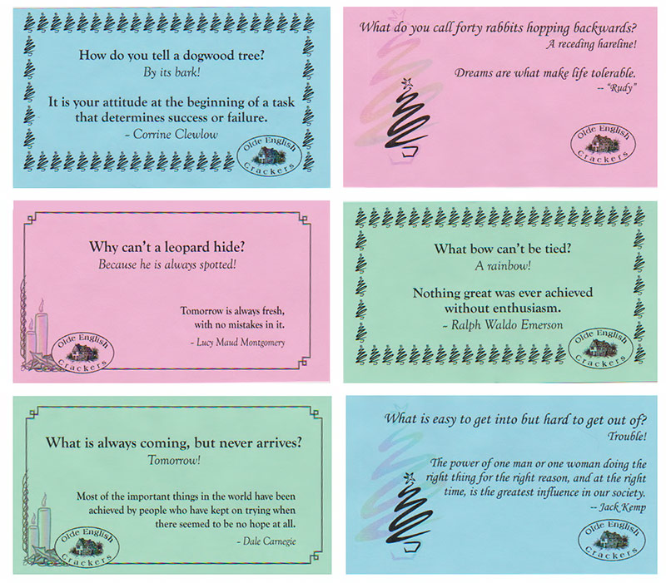

Slide 37
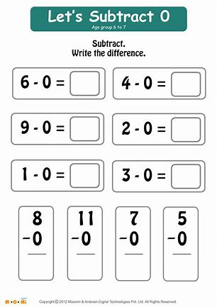

Slide 38
Twelve minus zero equals twelve.

Slide 39
Thank you!
See you next time.

