Slide 1
Jolly Grammar 3b-8

Slide 2
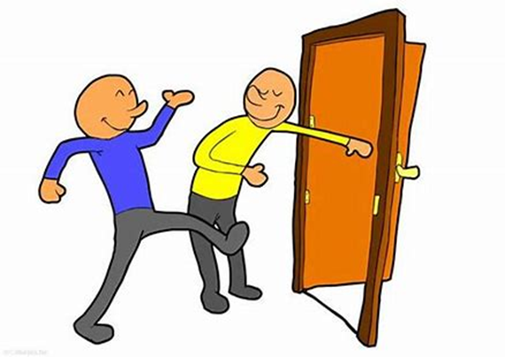
open

Slide 3
open
oval

Slide 4
open
oval
only

Slide 5
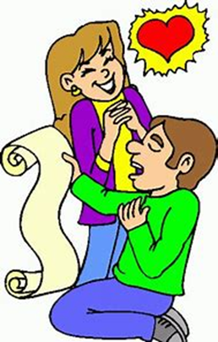
open
oval
only
poem

Slide 6
open
oval
only
poem
total

Slide 7
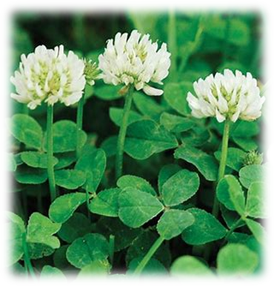
open
oval
only
poem
total
clover

Slide 8
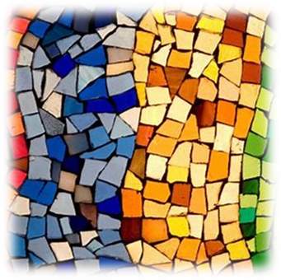
open
oval
only
poem
total
clover
7. mosaic

Slide 9
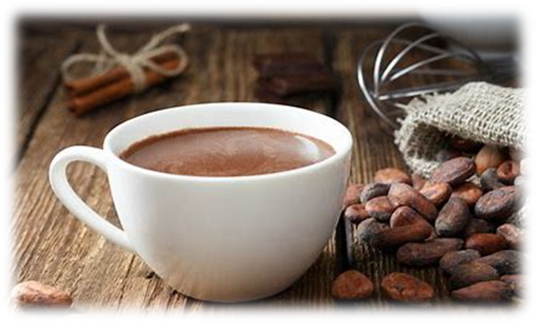
open
oval
only
poem
total
clover
7. mosaic
8. cocoa

Slide 10
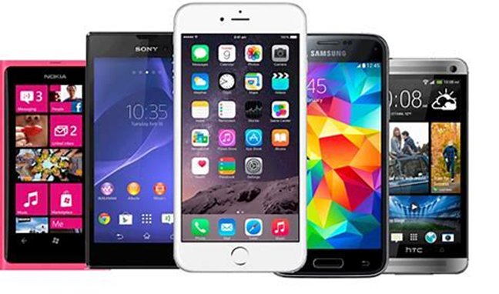
open
oval
only
poem
total
clover
7. mosaic
8. cocoa
9. mobile

Slide 11
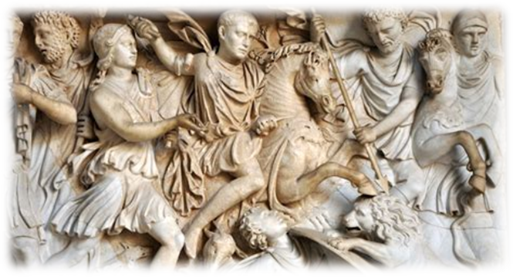
open
oval
only
poem
total
clover
7. mosaic
8. cocoa
9. mobile
10. Roman

Slide 12
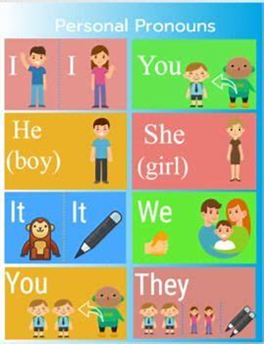
open
oval
only
poem
total
clover
7. mosaic
8. cocoa
9. mobile
10. Roman
11. pronoun

Slide 13
open
oval
only
poem
total
clover
7. mosaic
8. cocoa
9. mobile
10. Roman
11. pronoun
12. moment

Slide 14
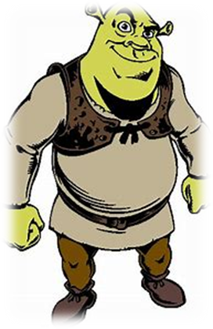
open
oval
only
poem
total
clover
7. mosaic
8. cocoa
9. mobile
10. Roman
11. pronoun
12. moment
13. ogre

Slide 15
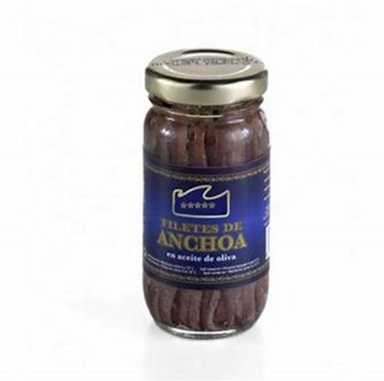
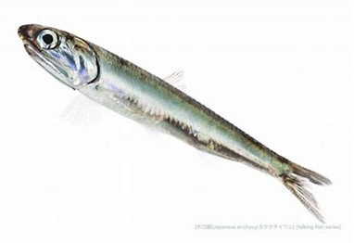
open
oval
only
poem
total
clover
7. mosaic
8. cocoa
9. mobile
10. Roman
11. pronoun
12. moment
13. ogre
14. anchovy

Slide 16
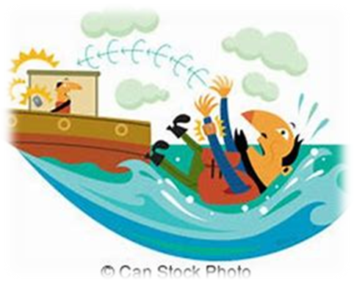
open
oval
only
poem
total
clover
7. mosaic
8. cocoa
9. mobile
10. Roman
11. pronoun
12. moment
13. ogre
14. anchovy
15. overboard

Slide 17
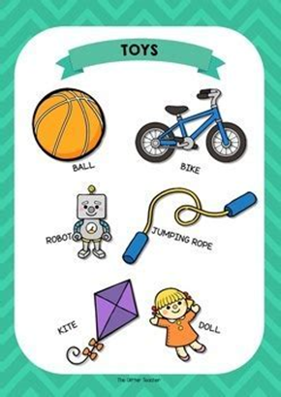
open
oval
only
poem
total
clover
7. mosaic
8. cocoa
9. mobile
10. Roman
11. pronoun
12. moment
13. ogre
14. anchovy
15. overboard
16. vocabulary

Slide 18
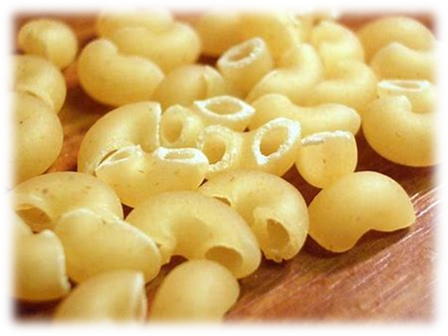
open
oval
only
poem
total
clover
7. mosaic
8. cocoa
9. mobile
10. Roman
11. pronoun
12. moment
13. ogre
14. anchovy
15. overboard
16. vocabulary
17. macaroni

Slide 19
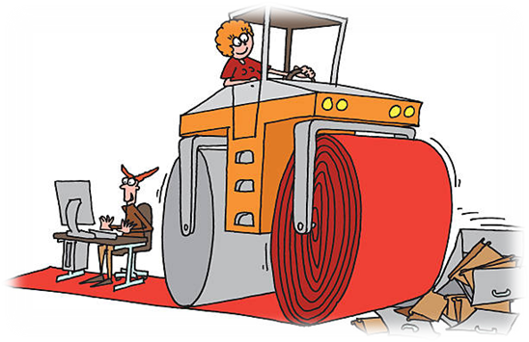
open
oval
only
poem
total
clover
7. mosaic
8. cocoa
9. mobile
10. Roman
11. pronoun
12. moment
13. ogre
14. anchovy
15. overboard
16. vocabulary
17. macaroni
18. steamroller

Slide 20
Nouns Acting as Adjectives

Slide 21
black ＋ bird
star ＋ fish
foot ＋ ball
toad ＋ stool
tooth ＋ brush
sea ＋ horse
butter ＋ fly
light ＋ house
Compound words

Slide 22
chocolate cake
fruit cake
ice-cream cake

Slide 23
The carrot cake tasted lovely.

Slide 24
The carrot cake tasted lovely.
She cleaned out the rabbit cage.

Slide 25
The carrot cake tasted lovely.
She cleaned out the rabbit cage.
Sam has a mountain bike.

Slide 26
The carrot cake tasted lovely.
She cleaned out the rabbit cage.
Sam has a mountain bike.
I planted tulip bulbs.

Slide 27
The carrot cake tasted lovely.
She cleaned out the rabbit cage.
Sam has a mountain bike.
I planted tulip bulbs.
She wore a diamond ring. emerald

Slide 28
The carrot cake tasted lovely.
She cleaned out the rabbit cage.
Sam has a mountain bike.
I planted tulip bulbs.
She wore a diamond ring. emerald
We cut down the old apple tree.

Slide 29
The carrot cake tasted lovely.
She cleaned out the rabbit cage.
Sam has a mountain bike.
I planted tulip bulbs.
She wore a diamond ring. emerald
We cut down the old apple tree.
I like cheese and tomato sandwich.

Slide 30
The carrot cake tasted lovely.
She cleaned out the rabbit cage.
Sam has a mountain bike.
I planted tulip bulbs.
She wore a diamond ring. emerald
We cut down the old apple tree.
I like cheese and tomato sandwich.
lettuce, fruit, jam, chicken cutlet
cream, ham, tuna, egg

