Slide 1
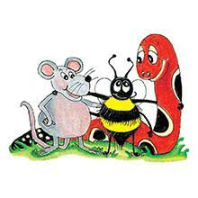
Jolly Grammar 3b-7

Slide 2
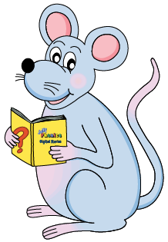
Let’s review adverbs

Slide 3
Make sentences.
The turtle moves slowly.
The sloth walks slowly.
Mr. Hirayama lives silently.
Mr. Ikeda plays silently.
I can carry this book easily.

Slide 4
Spelling List
Spelling
The <o> Spelling of the /oa/ Sound

Slide 5
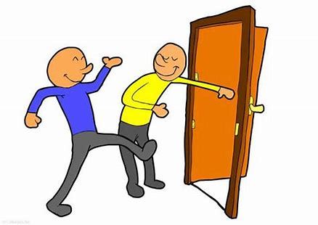
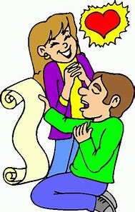
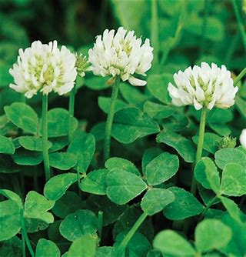
open oval only
poem total clover

Slide 6
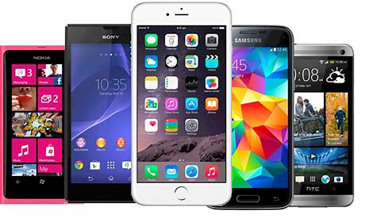
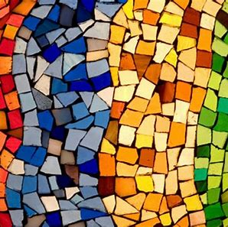
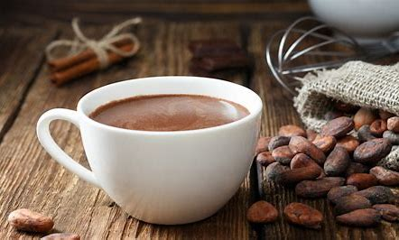
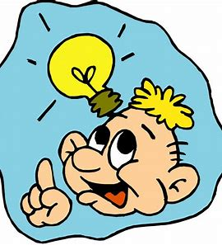
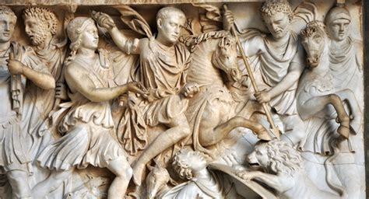
mosaic cocoa mobile
Roman pronoun moment

Slide 7
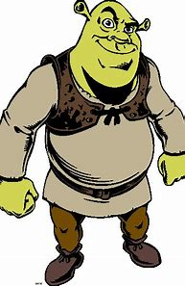
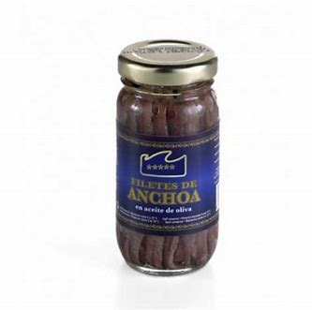
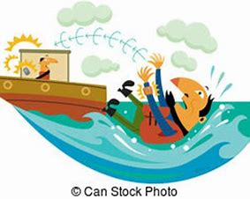
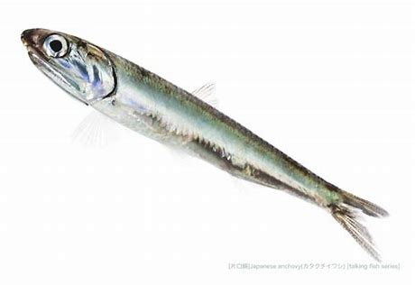
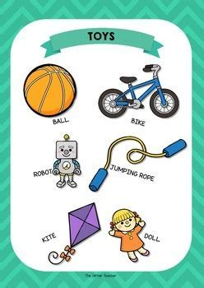
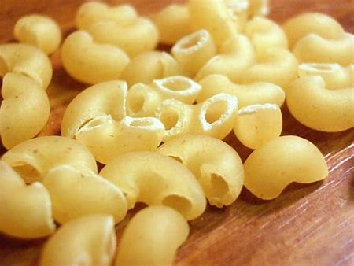
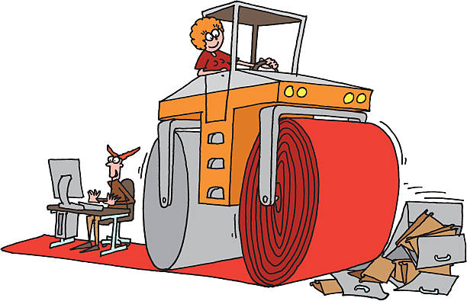
ogre anchovy overboard
vocabulary macaroni steamroller

Slide 8
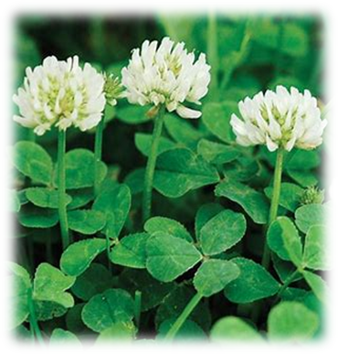
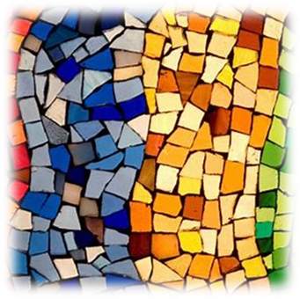
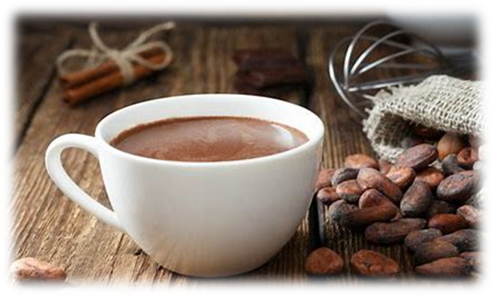
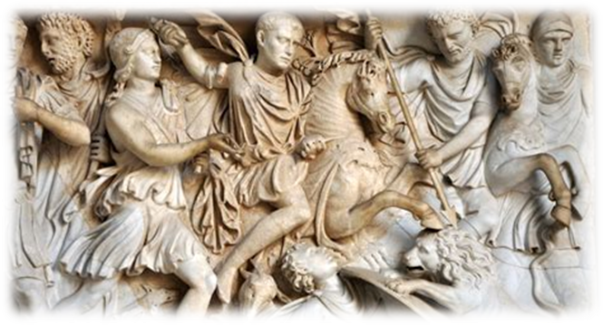
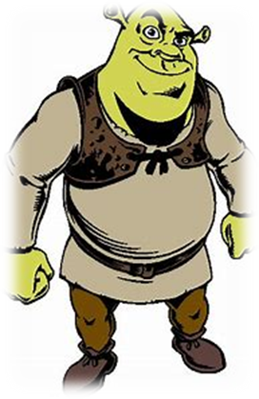
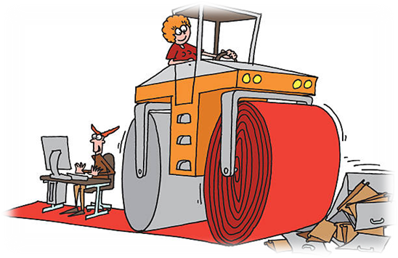
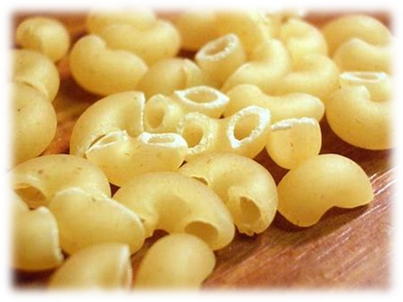
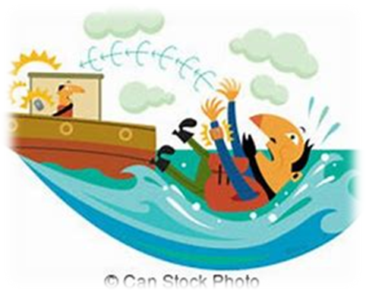

Slide 9
Activity page

Slide 10
Let’s review
syllables.

Slide 11
robot
okay
overboard
coconut
October

Slide 12
Let’s parse
sentences.

Slide 13
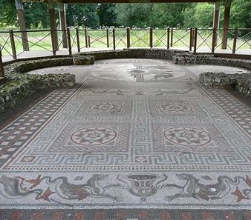
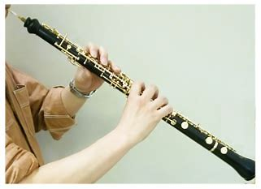
Parse these sentences.
They uncovered a Roman mosaic in the villa.
The oboe is a musical instrument.

Slide 14
Parse these sentences.
They uncovered a Roman mosaic in the villa.
The oboe is a musical instrument.

Slide 15
Parse these sentences.
They uncovered a Roman mosaic in the villa.
The oboe is a musical instrument.

Slide 16
Parse these sentences.
They uncovered a Roman mosaic in the villa.
The oboe is a musical instrument.

Slide 17
Parse these sentences.
They uncovered a Roman mosaic in the villa.
The oboe is a musical instrument.

Slide 18
Parse these sentences.
They uncovered a Roman mosaic in the villa.
The oboe is a musical instrument.

Slide 19
Parse these sentences.
They uncovered a Roman mosaic in the villa.
The oboe is a musical instrument.

Slide 20
Parse these sentences.
They uncovered a Roman mosaic in the villa.
The oboe is a musical instrument.

Slide 21
Parse these sentences.
They uncovered a Roman mosaic in the villa.
The oboe is a musical instrument.

Slide 22
Parse these sentences.
They uncovered a Roman mosaic in the villa.
The oboe is a musical instrument.

Slide 23
Parse these sentences.
They uncovered a Roman mosaic in the villa.
The oboe is a musical instrument.

Slide 24
Dictation

Slide 25
Dictation
1.
2.
3.

Slide 26
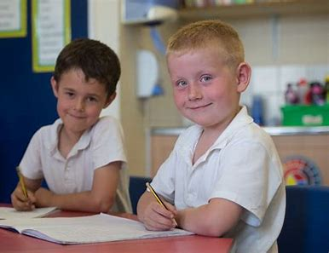
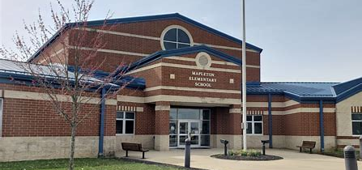

Slide 27
They both went to the local school.

Slide 28
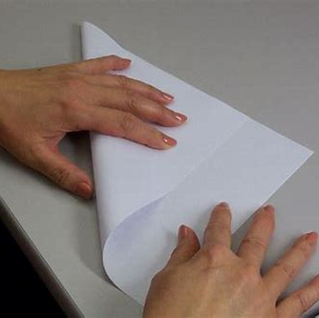

Slide 29
He folded the paper over.

Slide 30
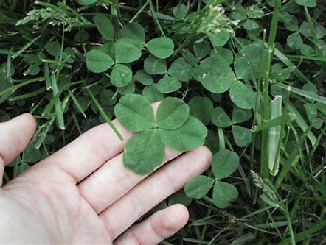

Slide 31
She was hoping to find some clover.

Slide 32
See you next time

