Slide 1
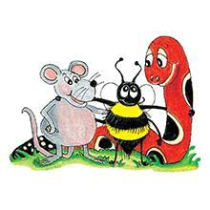
Jolly Grammar 3b-6

Slide 2
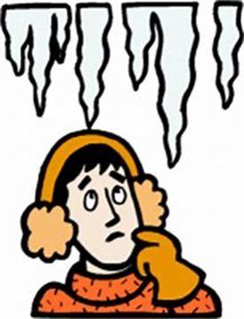
icy

Slide 3
icy
icon

Slide 4
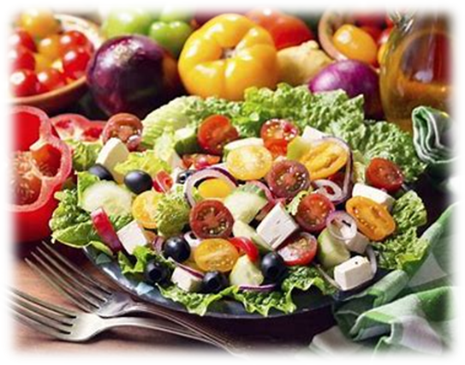
icy
icon
diet

Slide 5
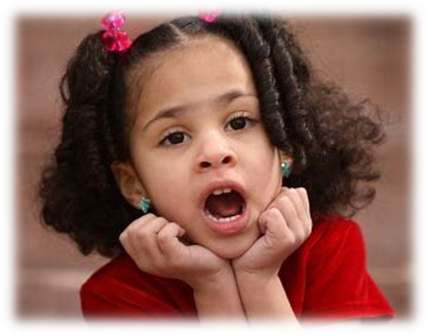
icy
icon
diet
child

Slide 6
icy
icon
diet
child
idea

Slide 7
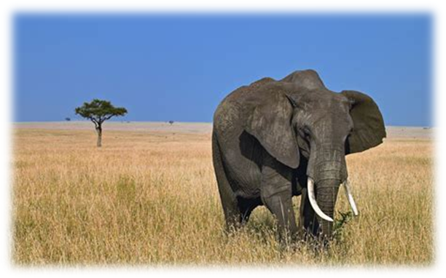
icy
icon
diet
child
idea
wild

Slide 8
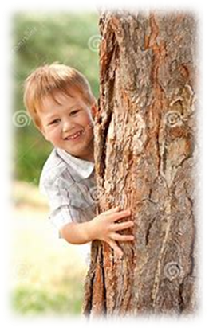
icy
icon
diet
child
idea
wild
7. behind

Slide 9
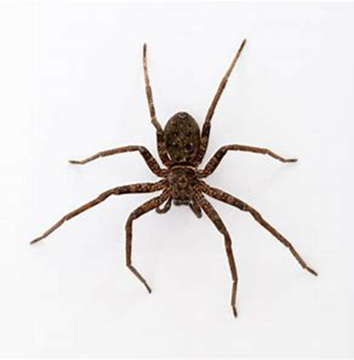
icy
icon
diet
child
idea
wild
7. behind
8. spider

Slide 10
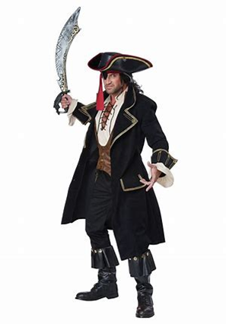
icy
icon
diet
child
idea
wild
7. behind
8. spider
9. pirate

Slide 11
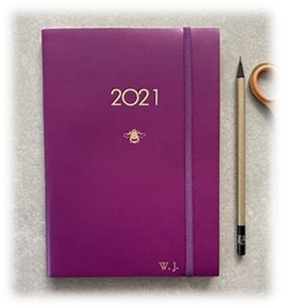
icy
icon
diet
child
idea
wild
7. behind
8. spider
9. pirate
10. diary

Slide 12
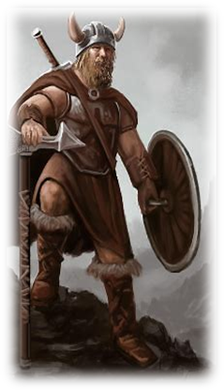
icy
icon
diet
child
idea
wild
7. behind
8. spider
9. pirate
10. diary
11. Viking

Slide 13
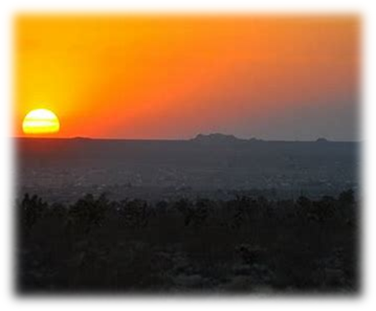
icy
icon
diet
child
idea
wild
7. behind
8. spider
9. pirate
10. diary
11. Viking
12. horizon

Slide 14
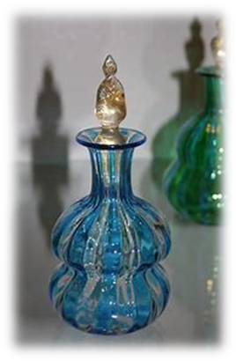
icy
icon
diet
child
idea
wild
7. behind
8. spider
9. pirate
10. diary
11. Viking
12. horizon
13. phial

Slide 15
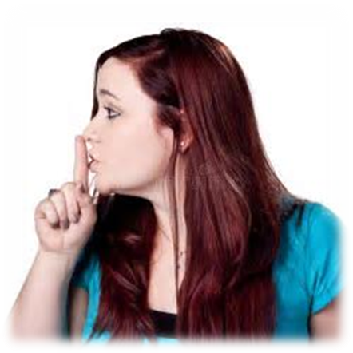
icy
icon
diet
child
idea
wild
7. behind
8. spider
9. pirate
10. diary
11. Viking
12. horizon
13. phial
14. quiet

Slide 16
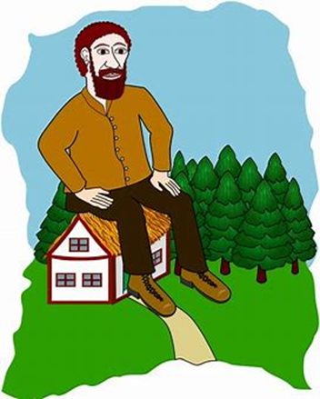
icy
icon
diet
child
idea
wild
7. behind
8. spider
9. pirate
10. diary
11. Viking
12. horizon
13. phial
14. quiet
15. gigantic

Slide 17
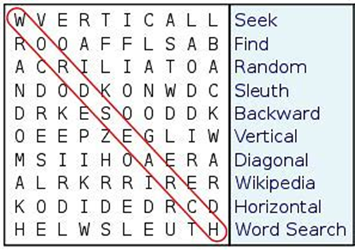
icy
icon
diet
child
idea
wild
7. behind
8. spider
9. pirate
10. diary
11. Viking
12. horizon
13. phial
14. quiet
15. gigantic
16. diagonal

Slide 18
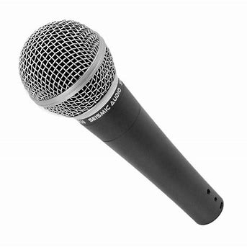
icy
icon
diet
child
idea
wild
7. behind
8. spider
9. pirate
10. diary
11. Viking
12. horizon
13. phial
14. quiet
15. gigantic
16. diagonal
17. microphone

Slide 19
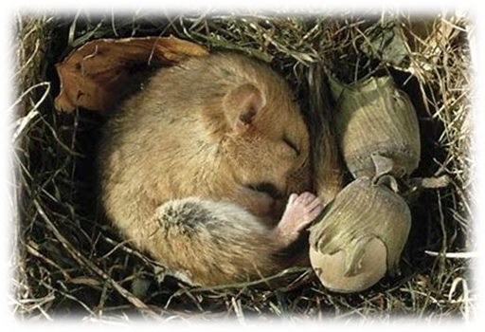
icy
icon
diet
child
idea
wild
7. behind
8. spider
9. pirate
10. diary
11. Viking
12. horizon
13. phial
14. quiet
15. gigantic
16. diagonal
17. microphone
18. hibernate

Slide 20
Adverbs

Slide 21
This is a slow train.

Slide 22
This is a slow train.
The train moves slowly.

Slide 23
odd
patient
regular
regular
special
fluent
sweet
nervous
perfect

Slide 24
odd
patient
regular
regular
special
fluent
sweet
nervous
perfect
oddly
patiently
regularly
regularly
specially
fluently
sweetly
nervously
perfectly

Slide 25
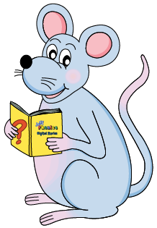
Adverbs made by adding <-ly> to adjectives

Slide 26
happy
heavy
easy
messy
happily
heavily
easily
messily

Slide 27
happy
heavy
easy
messy
simple
idle
gentle
reasonable
happily
heavily
easily
messily
simply
idly
gently
reasonably

Slide 28
happy
heavy
easy
messy
simple
idle
gentle
reasonable
frantic
dramatic
specific
happily
heavily
easily
messily
simply
idly
gently
reasonably
frantically
dramatically
specifically

Slide 29
friendly
lively
elderly
lonely
silly
lovely
high
late
soon
always
well

Slide 30
Adverbs

Slide 31
heavy selfish quiet angry bad

Slide 32
heavy selfish quiet angry bad
heavily selfishly quietly angrily badly

Slide 33
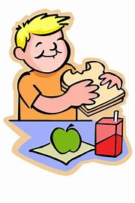
The boy had a quick snack.
He ate his snack quickly.

Slide 34
The boy had a quick snack.
He ate his snack quickly.

Slide 35
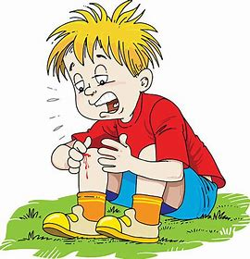
He had a serious injury.
He injured himself seriously.

Slide 36
He had a serious injury.
He injured himself seriously.

Slide 37
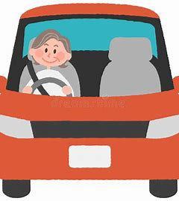
I am a careful drive.
I drive carefully.

Slide 38
I am a careful drive.
I drive carefully.

Slide 39
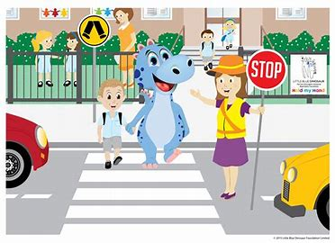
It is a safe place to cross.
You can cross safely.

Slide 40
It is a safe place to cross.
You can cross safely.

Slide 41
She was a happy child.
The child lived happily.

Slide 42
She was a happy child.
The child lived happily.

Slide 43
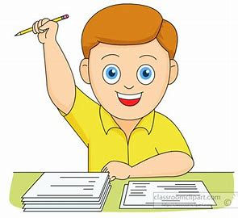
It was an easy test to pass.
I passed the test easily.

Slide 44
It was an easy test to pass.
I passed the test easily.

Slide 45
Make sentences.
The turtle moves slowly.
The sloth walks slowly.
Mr. Hirayama lives silently.
Mr. Ikeda plays silently.
I can carry this book lightly.

Slide 46
See you next time.

