Slide 1
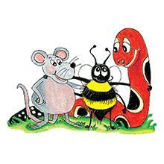
Jolly Grammar 3b-5

Slide 2
Sound
Revision

Slide 3
life
high
sty
tied
reply
right
fire
fly
flies
asylum

Slide 4
Spelling List
Spelling
The <i> Spelling of the /ie/ Sound

Slide 5
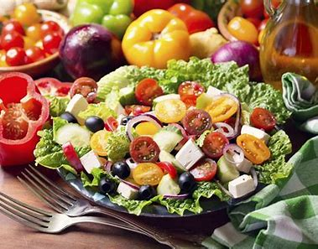
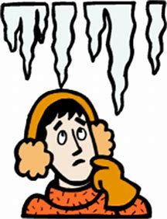
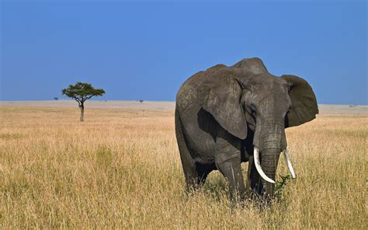
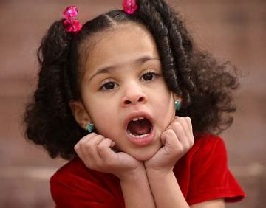
icy icon diet
child idea wild

Slide 6
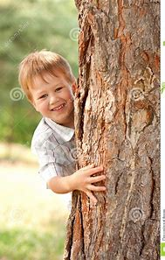
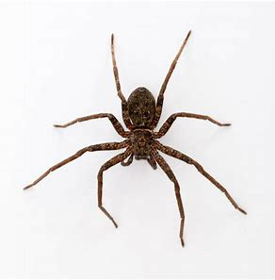
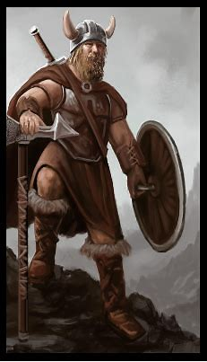
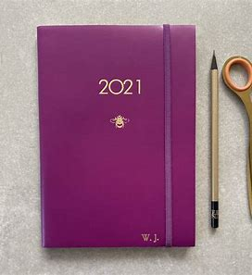
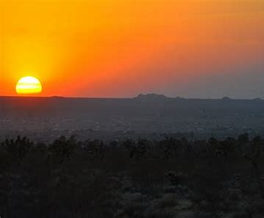
behind spider pirate
diary Viking horizon

Slide 7
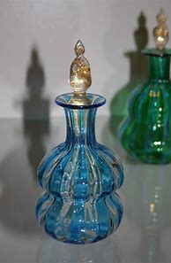
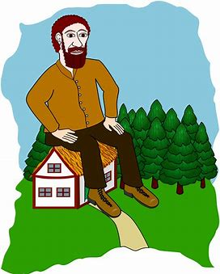
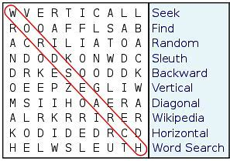
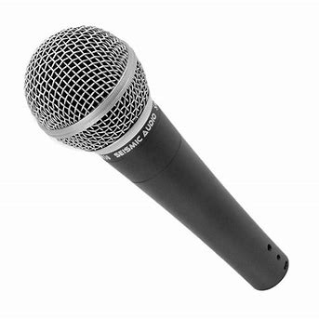
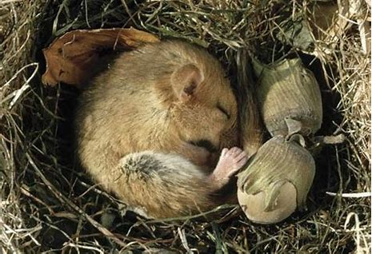
phial quiet gigantic
diagonal microphone hibernate

Slide 9
Activity page:
Find the words.
What’s missing?

Slide 10
Let’s review
syllables.

Slide 11
final
find
tiger
hijack
microwave

Slide 12
final
find
tiger
hijack
microwave

Slide 13
final
find
tiger
hijack
microwave

Slide 14
final
find
tiger
hijack
microwave

Slide 15
final
find
tiger
hijack
microwave

Slide 16
Let’s parse
sentences.

Slide 17
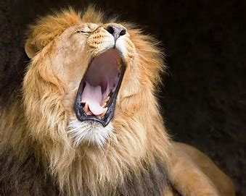
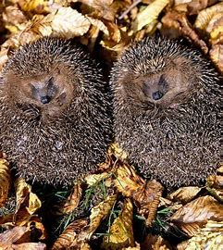
Parse these sentences.
The fiercest African lion was roaring loudly.
Hedgehogs hibernate in winter.

Slide 18
Parse these sentences.
The fiercest African lion was roaring loudly.
Hedgehogs hibernate in winter.

Slide 19
Parse these sentences.
The fiercest African lion was roaring loudly.
Hedgehogs hibernate in winter.

Slide 20
Parse these sentences.
The fiercest African lion was roaring loudly.
Hedgehogs hibernate in winter.

Slide 21
Parse these sentences.
The fiercest African lion was roaring loudly.
Hedgehogs hibernate in winter.

Slide 22
Parse these sentences.
The fiercest African lion was roaring loudly.
Hedgehogs hibernate in winter.

Slide 23
Parse these sentences.
The fiercest African lion was roaring loudly.
Hedgehogs hibernate in winter.

Slide 24
Parse these sentences.
The fiercest African lion was roaring loudly.
Hedgehogs hibernate in winter.

Slide 25
Parse these sentences.
The fiercest African lion was roaring loudly.
Hedgehogs hibernate in winter.

Slide 26
Parse these sentences.
The fiercest African lion was roaring loudly.
Hedgehogs hibernate in winter.

Slide 27
Dictation

Slide 28
Dictation
1.
2.
3.

Slide 29
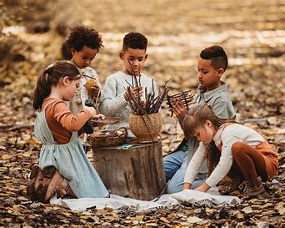

Slide 30
“I had a wild time,” yelled the child.

Slide 31
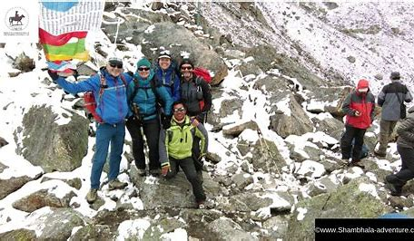

Slide 32
They went climbing in the Tibetan mountains.

Slide 33
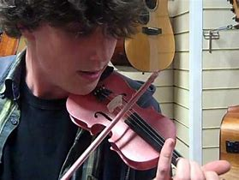

Slide 34
The giant was playing a violin.

Slide 35
See you next time.

