Slide 1
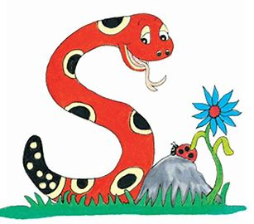
Jolly Grammar
4b-7

Slide 2
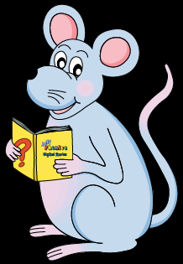
Let’s Revise
Schwa

Slide 3
<le> /ool/
candle
simple
puzzle
<al><el><il> /ool/
total
camel
pencil

Slide 4
Activity Page
Schwa <-al>

Slide 5
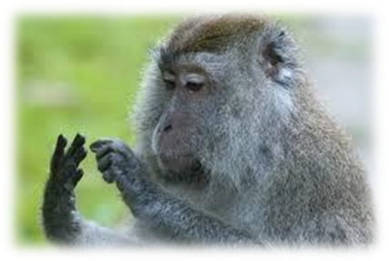
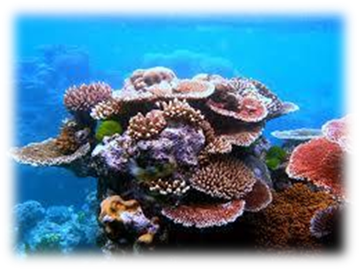
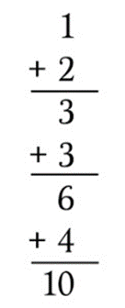
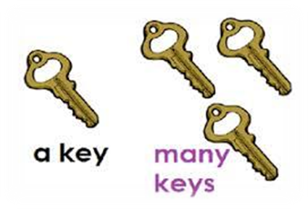
animal coral special
Soft c
plural total equal

Slide 6
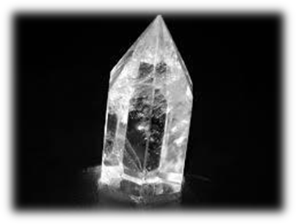
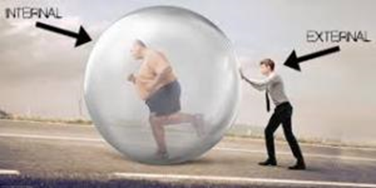
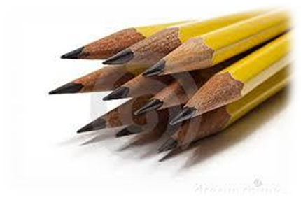
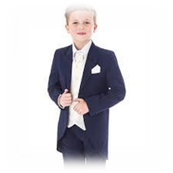
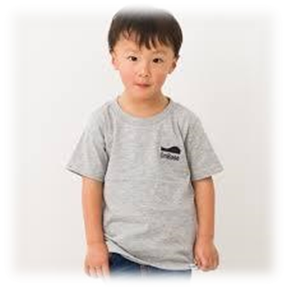
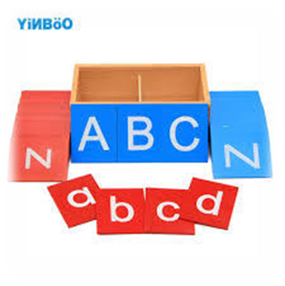
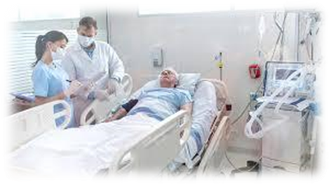
external several crystal
/i/
casual capital hospital

Slide 7
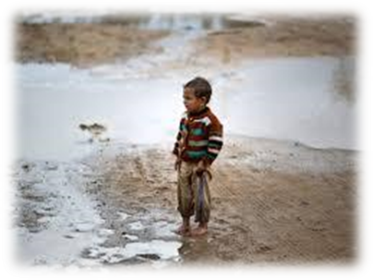
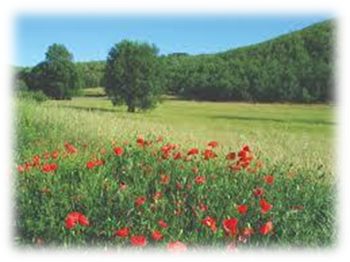
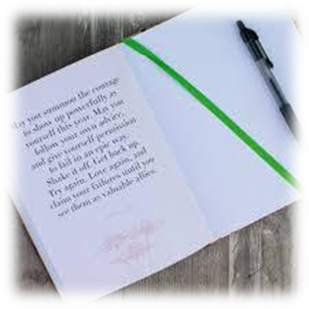
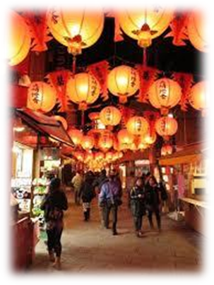
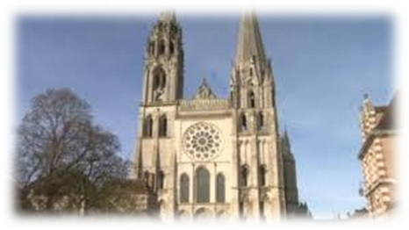
abysmal natural journal
/i/
/z/
/er/
festival material cathedral
/ear/
/ee/

Slide 9
Activity Page
Write twelve senetnces.

Slide 10
Let’s revise
Possessive Nouns.

Slide 11
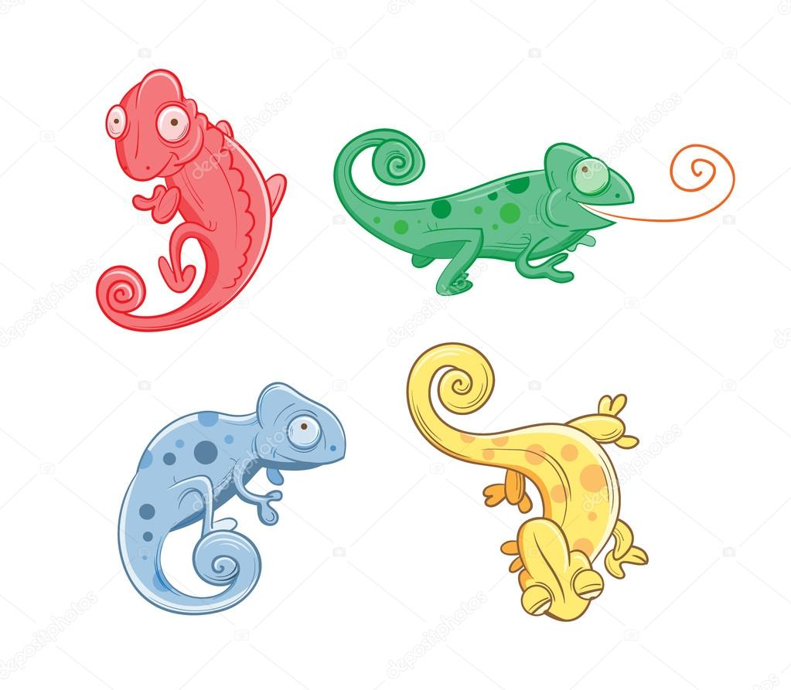
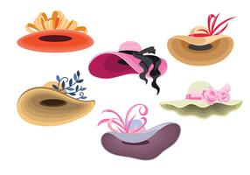
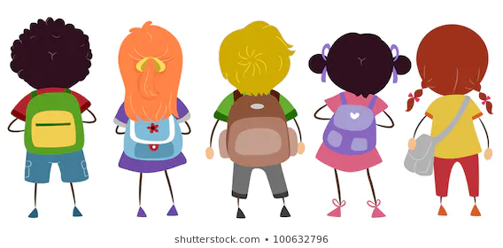
Chameleons’ skins can change colors.
All the ladies’ hats were beautiful.
Some of the children’s bags were left on the school bus.

Slide 12
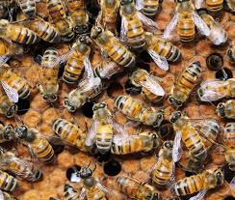
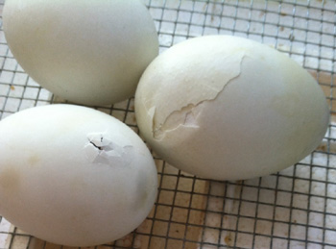
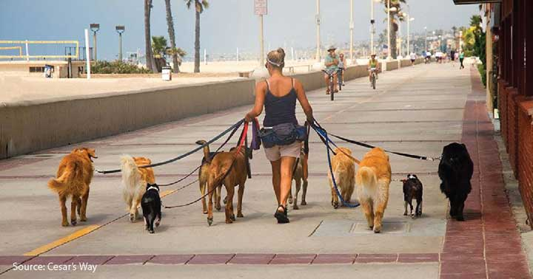
The bees’ hive was overcrowded.
Soon, the bird’s eggs will be ready to hatch.
The dogs’ owner walks them every day.

Slide 13
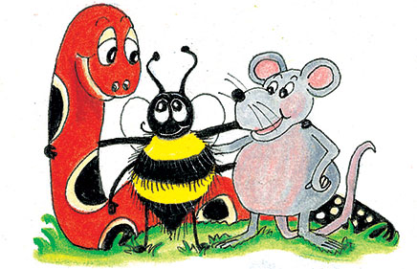
parsing

Slide 14
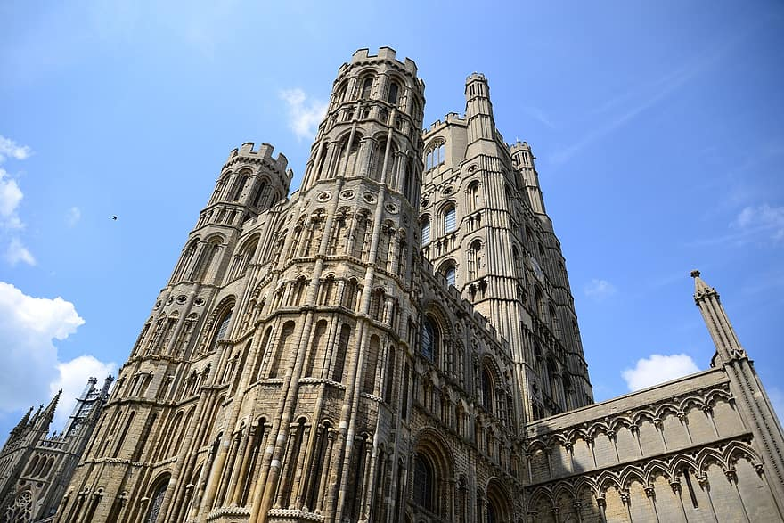
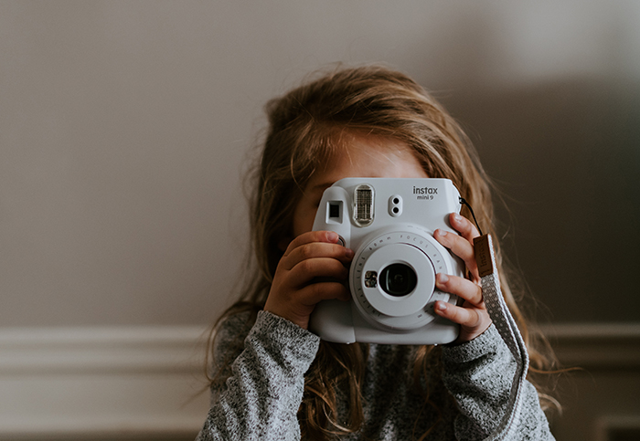
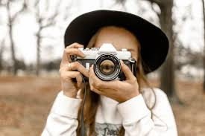
They will be taking photos of the colossal and monumental cathedral.

Slide 15
They will be taking photos of the colossal and monumental cathedral.

Slide 16
They will be taking photos of the colossal and monumental cathedral.

Slide 17
They will be taking photos of the colossal and monumental cathedral.

Slide 18
They will be taking photos of the colossal and monumental cathedral.

Slide 19
They will be taking photos of the colossal and monumental cathedral.

Slide 20
They will be taking photos of the colossal and monumental cathedral.

Slide 21
They will be taking photos of the colossal and monumental cathedral.

Slide 22
They will be taking photos of the colossal and monumental cathedral.

Slide 23
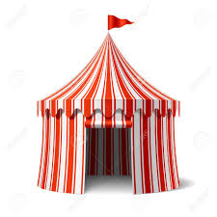
They will be taking photos of the colossal and monumental cathedral.
future continuous

Slide 24
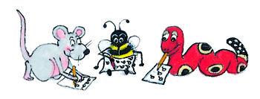
Dictation

Slide 25
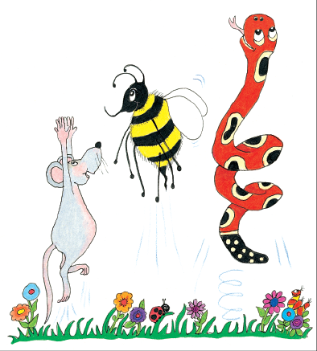
Dictation
1.
2.
3.

Slide 26
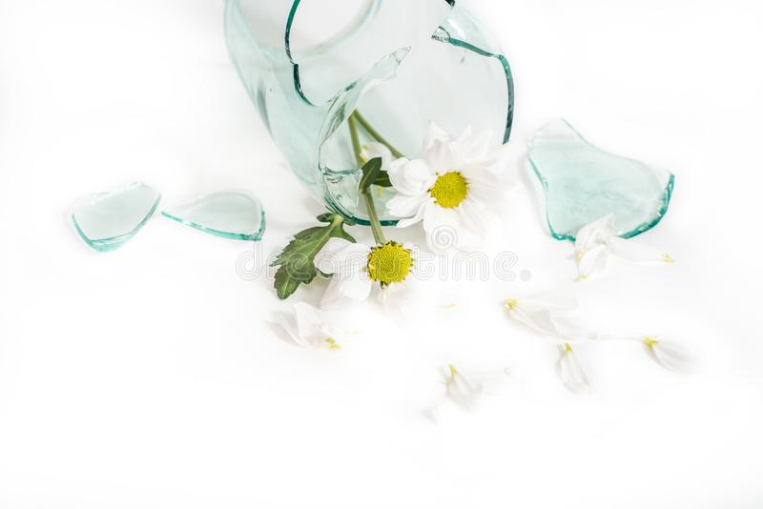
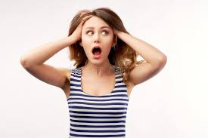

Slide 27
She accidentally broke the crystal vase.

Slide 28
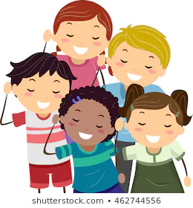
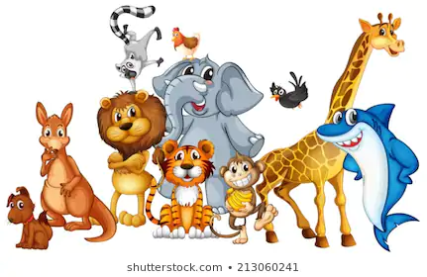

Slide 29
They listened for the animals in total silence.

Slide 30
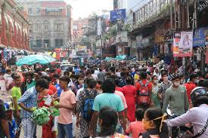
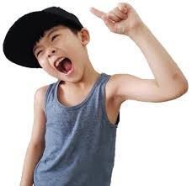

Slide 31
“The festival was terrifically busy!” exclaimed Ray.

Slide 32
Thank you.
See you
next time!

