Slide 1
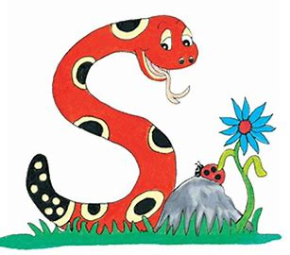
Jolly Grammar
4b-5

Slide 2
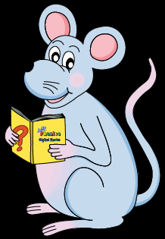
Activity Page
<-ically>

Slide 3
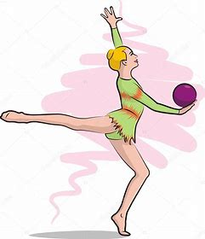

Slide 4
rhythmic

Slide 5
rhythmic
rhythmical

Slide 6
rhythmic
rhythmical
rhythmically

Slide 7
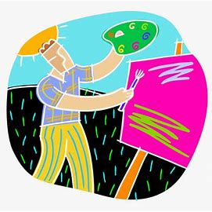
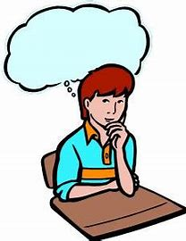
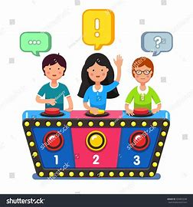
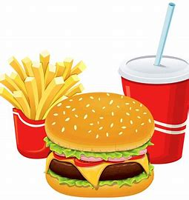
artistically critically logically
quizzically basically vertically

Slide 8
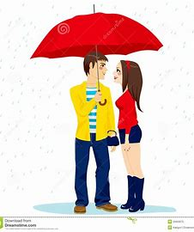
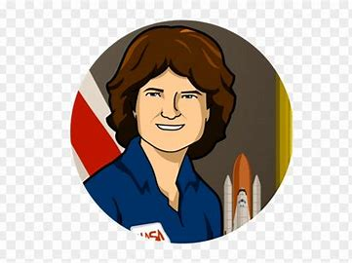
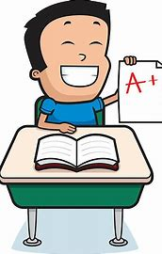
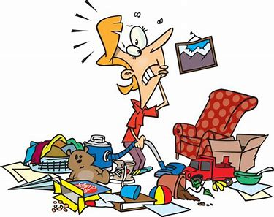
historically politically romantically
technically typically chaotically

Slide 9
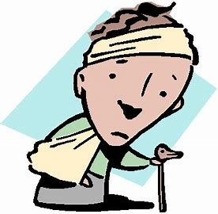
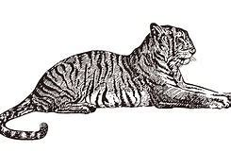
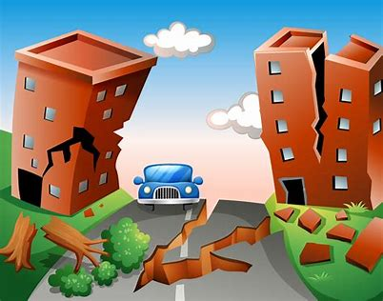
alphabetically traumatically majestically
rhythmically sarcastically catastrophically

Slide 11
Nouns
Adjectives
Adverbs
logic
artist
quiz
critic
technique
chaos
type
romance

Slide 12
Nouns
Adjectives
Adverbs
logic
artist
quiz
critic
technique
chaos
type
romance
logical
artistic
quizzical
critical
technical
chaotic
typical
romantic

Slide 13
Nouns
Adjectives
Adverbs
logic
artist
quiz
critic
technique
chaos
type
romance
logical
artistic
quizzical
critical
technical
chaotic
typical
romantic
logically
artistically
quizzically
critically
technically
chaotically
typically
romantically

Slide 14
Nouns
Adjectives
Adverbs
majesty
sarcasm
trauma
rhythm
base
nature
alphabet
accident

Slide 15
Nouns
Adjectives
Adverbs
majesty
sarcasm
trauma
rhythm
base
nature
alphabet
accident
majestic
sarcastic
traumatic
rhythmic
basic
natural
alphabetic(al)
accidental

Slide 16
Nouns
Adjectives
Adverbs
majesty
sarcasm
trauma
rhythm
base
nature
alphabet
accident
majestic
sarcastic
traumatic
rhythmic
basic
natural
alphabetic(al)
accidental
majestically
sarcastically
traumatically
rhythmically
basically
naturally
alphabetically
accidentally

Slide 17
Activity Page
where
wear
were

Slide 18
We were all going to a nice restaurant for Dad’s birthday.
Edward asked me where I was going.
She is going to wear her smart shoes in the interview.

Slide 19
We were all going to a nice restaurant for Dad’s birthday.
Edward asked me where I was going.
She is going to wear her smart shoes in the interview.

Slide 20
We were all going to a nice restaurant for Dad’s birthday.
Edward asked me where I was going.
She is going to wear her smart shoes in the interview.

Slide 21
We were all going to a nice restaurant for Dad’s birthday.
Edward asked me where I was going.
She is going to wear her smart shoes in the interview.

Slide 22
parsing

Slide 23
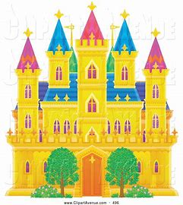
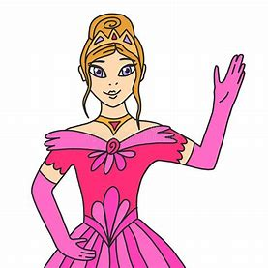
The queen waved majestically from the highest castle window.

Slide 24
The queen waved majestically from the highest castle window.

Slide 25
The queen waved majestically from the highest castle window.

Slide 26
The queen waved majestically from the highest castle window.

Slide 27
The queen waved majestically from the highest castle window.

Slide 28
The queen waved majestically from the highest castle window.

Slide 29
The queen waved majestically from the highest castle window.

Slide 30
The queen waved majestically from the highest castle window.

Slide 31
The queen waved majestically from the highest castle window.
simple
past

Slide 32
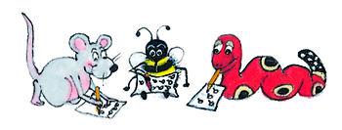
Dictation

Slide 33
Dictation
1.
2.
3.

Slide 34
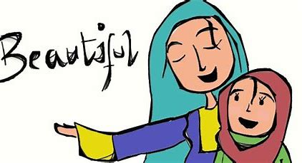

Slide 35
She spoke poetically about her homeland.

Slide 36
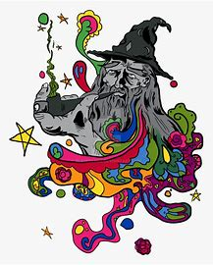

Slide 37
The wizard vanished magically in a puff of smoke.

Slide 38
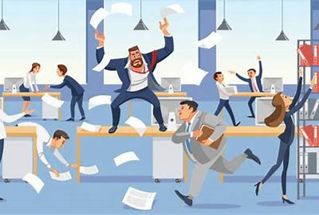
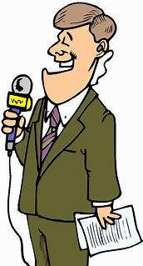

Slide 39
“The meeting ended chaotically,” said the reporter.

Slide 40
Thank you.
See you
next time!

