Slide 1
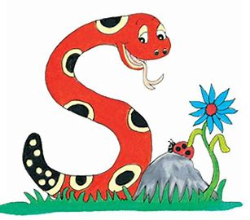
Jolly Grammar
4-20

Slide 2
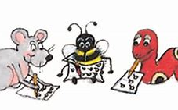
Spelling Test 20

Slide 3
whirl

Slide 4
whirl
wreck

Slide 5
whirl
wreck
kneel

Slide 6
whirl
wreck
kneel
crumb

Slide 7
whirl
wreck
kneel
crumb
ascend

Slide 8
whirl
wreck
kneel
crumb
ascend
descend

Slide 9
whirl
wreck
kneel
crumb
ascend
descend
7.wrangle

Slide 10
whirl
wreck
kneel
crumb
ascend
descend
7.wrangle
8.knuckle

Slide 11
whirl
wreck
kneel
crumb
ascend
descend
7.wrangle
8.knuckle
9.limb

Slide 12
whirl
wreck
kneel
crumb
ascend
descend
7.wrangle
8.knuckle
9.limb
10.gnarled

Slide 13
whirl
wreck
kneel
crumb
ascend
descend
7.wrangle
8.knuckle
9.limb
10.gnarled
11.plumbing

Slide 14
whirl
wreck
kneel
crumb
ascend
descend
7.wrangle
8.knuckle
9.limb
10.gnarled
11.plumbing
12.elsewhere

Slide 15
whirl
wreck
kneel
crumb
ascend
descend
7.wrangle
8.knuckle
9.limb
10.gnarled
11.plumbing
12.elsewhere
13.ghoulish

Slide 16
whirl
wreck
kneel
crumb
ascend
descend
7.wrangle
8.knuckle
9.limb
10.gnarled
11.plumbing
12.elsewhere
13.ghoulish
14.succumb

Slide 17
whirl
wreck
kneel
crumb
ascend
descend
7.wrangle
8.knuckle
9.limb
10.gnarled
11.plumbing
12.elsewhere
13.ghoulish
14.succumb
15.fascinate

Slide 18
whirl
wreck
kneel
crumb
ascend
descend
7.wrangle
8.knuckle
9.limb
10.gnarled
11.plumbing
12.elsewhere
13.ghoulish
14.succumb
15.fascinate
16.wrinkliest

Slide 19
whirl
wreck
kneel
crumb
ascend
descend
7.wrangle
8.knuckle
9.limb
10.gnarled
11.plumbing
12.elsewhere
13.ghoulish
14.succumb
15.fascinate
16.wrinkliest
17.overwhelm

Slide 20
whirl
wreck
kneel
crumb
ascend
descend
7.wrangle
8.knuckle
9.limb
10.gnarled
11.plumbing
12.elsewhere
13.ghoulish
14.succumb
15.fascinate
16.wrinkliest
17.overwhelm
18.dumbfounded

Slide 21
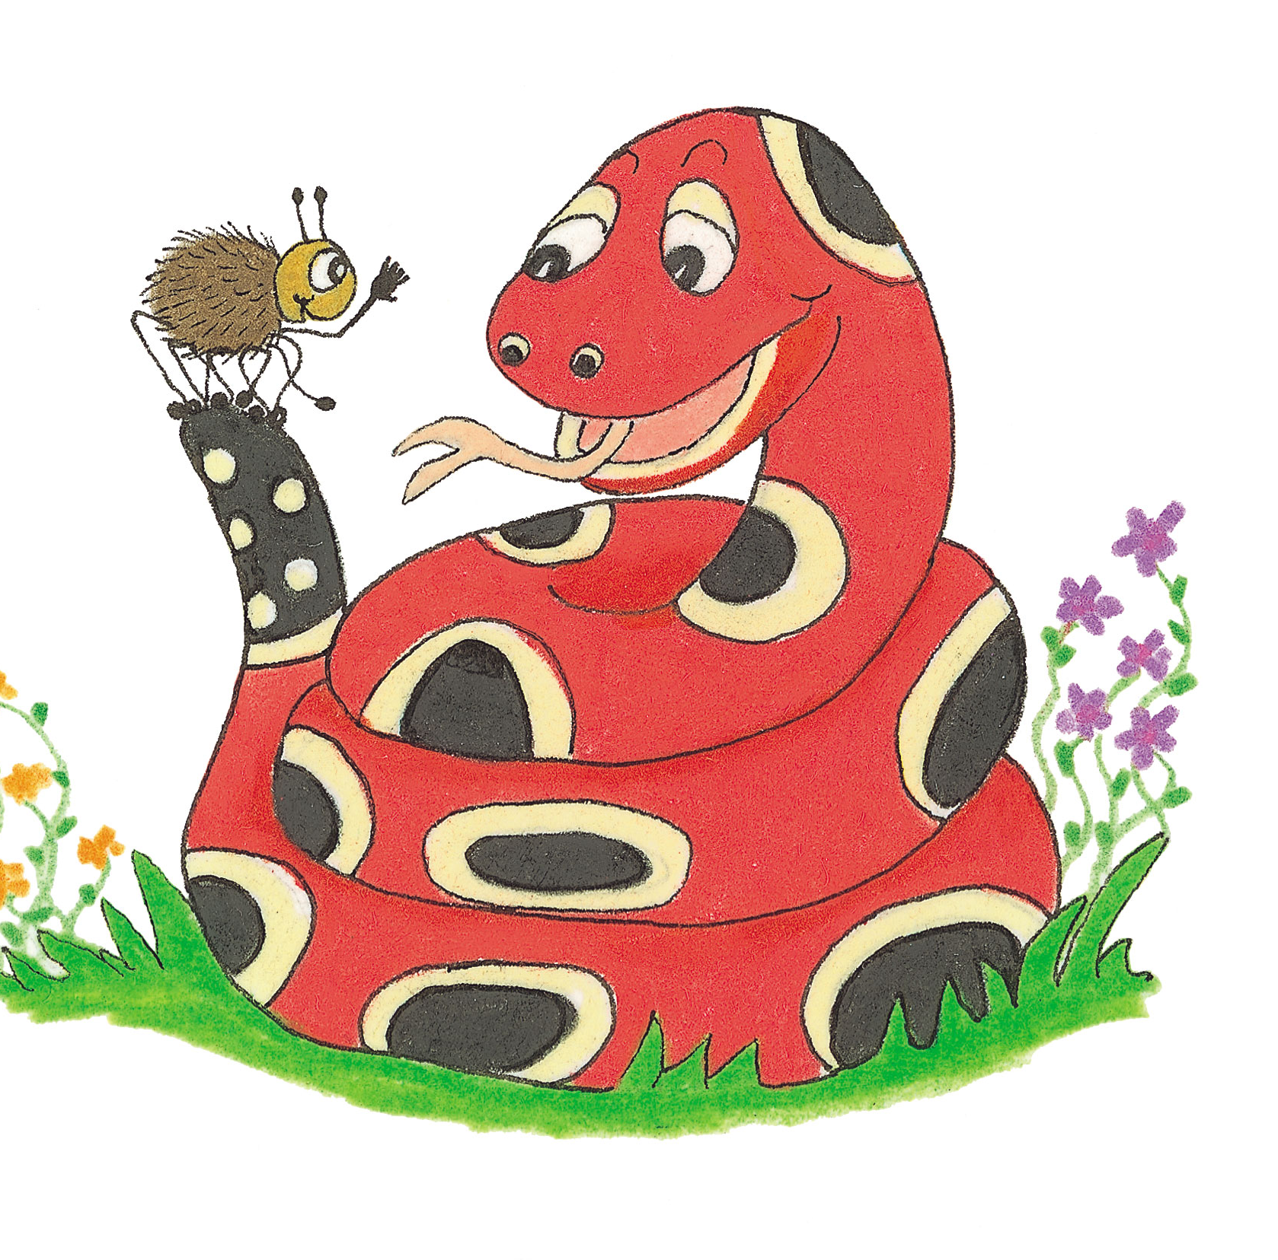
Let’s Revise Possessive Nouns

Slide 22
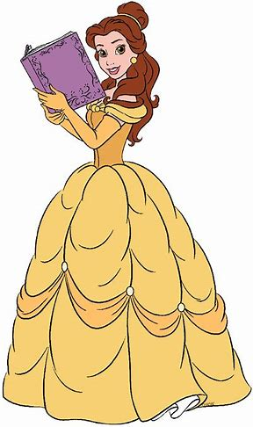
This is Mao’s book.

Slide 23
Let’s Revise Plurals

Slide 24
hill
glass
tomato
studio
key
teddy
wife
deer
tooth
child

Slide 25
hill
glass
tomato
studio
key
teddy
wife
deer
tooth
child
hills

Slide 26
hill
glass
tomato
studio
key
teddy
wife
deer
tooth
child
hills
glasses

Slide 27
hill
glass
tomato
studio
key
teddy
wife
deer
tooth
child
hills
glasses
tomatoes

Slide 28
hill
glass
tomato
studio
key
teddy
wife
deer
tooth
child
hills
glasses
tomatoes
studios

Slide 29
hill
glass
tomato
studio
key
teddy
wife
deer
tooth
child
hills
glasses
tomatoes
studios
keys

Slide 30
hill
glass
tomato
studio
key
teddy
wife
deer
tooth
child
hills
glasses
tomatoes
studios
keys
teddies

Slide 31
hill
glass
tomato
studio
key
teddy
wife
deer
tooth
child
hills
glasses
tomatoes
studios
keys
teddies
wives

Slide 32
hill
glass
tomato
studio
key
teddy
wife
deer
tooth
child
hills
glasses
tomatoes
studios
keys
teddies
wives
deer

Slide 33
hill
glass
tomato
studio
key
teddy
wife
deer
tooth
child
hills
glasses
tomatoes
studios
keys
teddies
wives
deer
teeth

Slide 34
hill
glass
tomato
studio
key
teddy
wife
deer
tooth
child
hills
glasses
tomatoes
studios
keys
teddies
wives
deer
teeth
children

Slide 35
trees tree’s
plural possessive

Slide 36
The trees in the forest are very old.
The tree’s leaves turned red.
Many trees’s leaves turned red.
??

Slide 37
The trees in the forest are very old.
The tree’s leaves turned red.
Many trees’ leaves turned red. 〇

Slide 38
The trees in the forest are very old.
The tree’s leaves turned red.
Many trees’ leaves turned red. 〇
the child’s toy

Slide 39
The trees in the forest are very old.
The tree’s leaves turned red.
Many trees’ leaves turned red. 〇
the child’s toy
the children’s toys

Slide 40
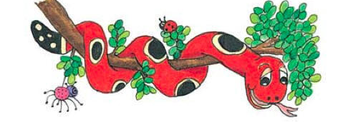
Activity Page:
Plural Possessive Nouns

Slide 41
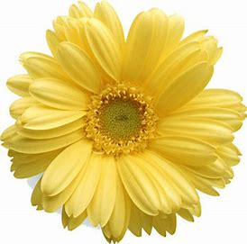
car pony bus hero calf man

Slide 42
car pony bus hero calf man
cars
cars’

Slide 43
car pony bus hero calf man
cars ponies buses heroes calves men
cars’ ponies’ buses’ heroes’ calves’ men’s

Slide 44
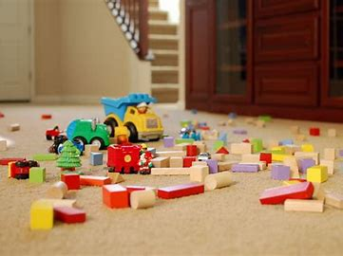
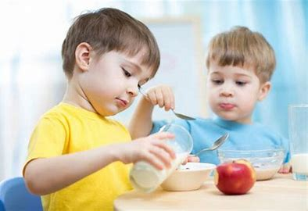
The babies’ toys were all over the floor.
In the afternoon, the babies had their snack.

Slide 45
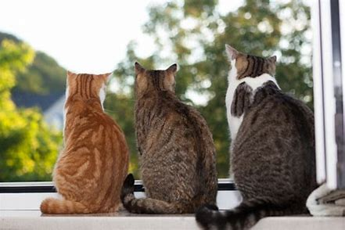
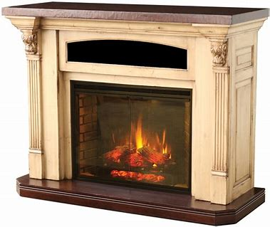
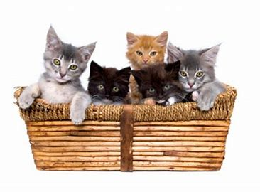
The three cats were sitting in the window .
She put the cats’ baskets in front of the fire.

Slide 46
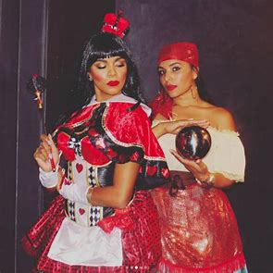
He made the actresses’ costumes
for the play.
The actresses on stage were very talented.

Slide 47
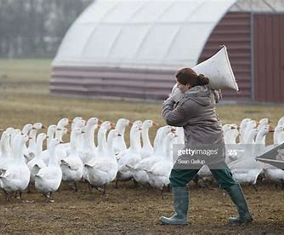
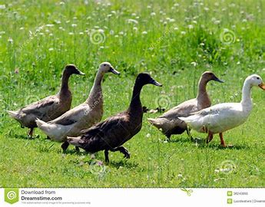
The geese’s feed is stored in a large sack.
We keep five geese in the field.

Slide 48
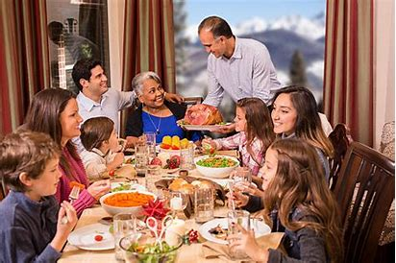
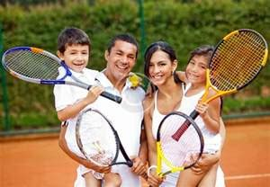
They went to the Smith’s house for dinner.
The Smiths like to play tennis in the summer.

Slide 49
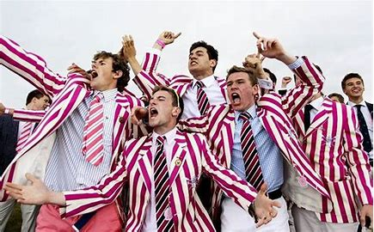
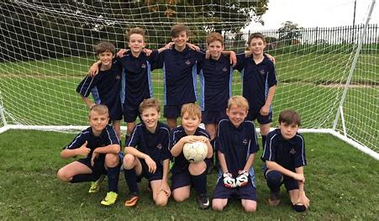
At our school, the boys’ ties are stripy.
All the boys at school like to play football.

Slide 50
Thank you.
See you
next time!

