Slide 1
Jolly Grammar 3b-4

Slide 2
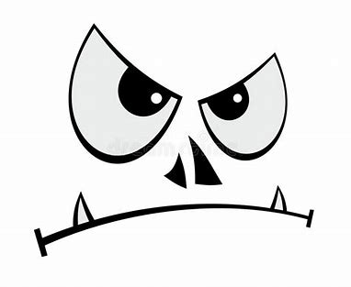
evil

Slide 3
evil
email

Slide 4
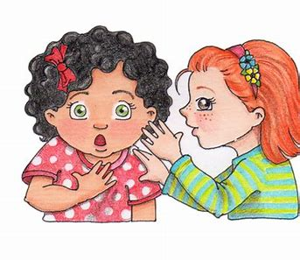
evil
email
secret

Slide 5
evil
email
secret
legal

Slide 6
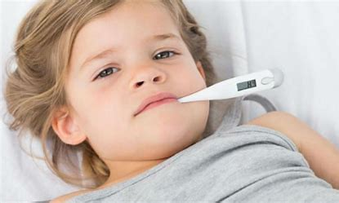
evil
email
secret
legal
fever

Slide 7
evil
email
secret
legal
fever
regal

Slide 8
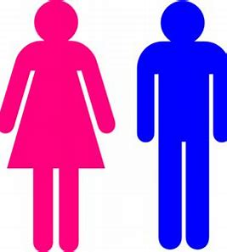
evil
email
secret
legal
fever
regal
7. female

Slide 9
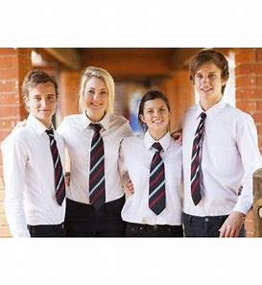
evil
email
secret
legal
fever
regal
7. female
8. prefect

Slide 10
evil
email
secret
legal
fever
regal
7. female
8. prefect
9. recent

Slide 11
evil
email
secret
legal
fever
regal
7. female
8. prefect
9. recent
10. media

Slide 12
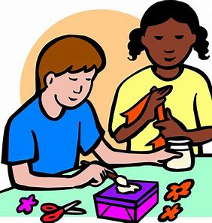
evil
email
secret
legal
fever
regal
7. female
8. prefect
9. recent
10. media
11. create

Slide 13
evil
email
secret
legal
fever
regal
7. female
8. prefect
9. recent
10. media
11. create
12. medium

Slide 14
evil
email
secret
legal
fever
regal
7. female
8. prefect
9. recent
10. media
11. create
12. medium
13. frequent

Slide 15
evil
email
secret
legal
fever
regal
7. female
8. prefect
9. recent
10. media
11. create
12. medium
13. frequent
14. adhesive

Slide 16
evil
email
secret
legal
fever
regal
7. female
8. prefect
9. recent
10. media
11. create
12. medium
13. frequent
14. adhesive
15. medieval

Slide 17
evil
email
secret
legal
fever
regal
7. female
8. prefect
9. recent
10. media
11. create
12. medium
13. frequent
14. adhesive
15. medieval
16. chameleon

Slide 18
evil
email
secret
legal
fever
regal
7. female
8. prefect
9. recent
10. media
11. create
12. medium
13. frequent
14. adhesive
15. medieval
16. chameleon
17. immediate

Slide 19
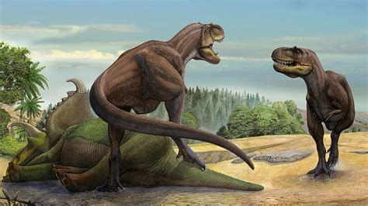
evil
email
secret
legal
fever
regal
7. female
8. prefect
9. recent
10. media
11. create
12. medium
13. frequent
14. adhesive
15. medieval
16. chameleon
17. immediate
18. prehistoric

Slide 20
Activity Page:
Comparatives and Superlatives

Slide 21
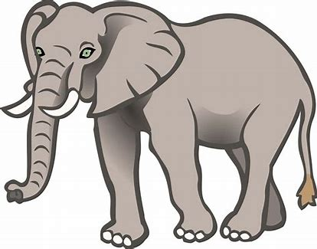

Slide 22
This elephant is big.

Slide 23
This elephant is big.

Slide 24
This elephant is big.
This elephant is bigger.

Slide 25
This elephant is big.
This elephant is bigger.

Slide 26
This elephant is big.
This elephant is bigger.
This elephant is the biggest.

Slide 27
This elephant is big.
This elephant is bigger. comparative
This elephant is the biggest.

Slide 28
This elephant is big.
This elephant is bigger. comparative
This elephant is the biggest. superlative

Slide 29
That mouse is small.
That mouse is smaller.
That mouse is the smallest.

Slide 30
That mouse is small.
That mouse is smaller.
That mouse is the smallest.
The monster had a loud voice.
The monster had a louder voice.
The monster had the loudest voice.

Slide 31
He is a tall man.
He is a taller man.
He is the tallest man.

Slide 32
He is a tall man.
He is a taller man.
He is the tallest man.
This is a wise owl.
This is a wiser owl.
This is the wisest owl.

Slide 33
Which clown was funny?
Which clown was funnier?
Which clown was the funniest?

Slide 34
Which clown was funny?
Which clown was funnier?
Which clown was the funniest?
Those elephants are grey.
Those elephants are greyer.
Those elephants are the greyest.

Slide 35
See you next time.

