Slide 1
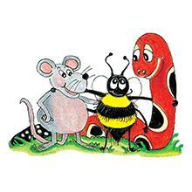
Jolly Grammar 3b-3

Slide 2
Spelling List
Spelling
The <e> Spelling of the /ee/ Sound

Slide 3
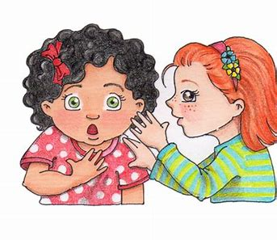
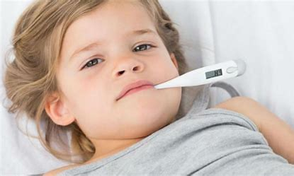
evil email secret
legal fever regal

Slide 4
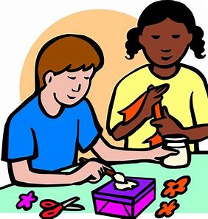
female prefect recent
media create medium

Slide 5
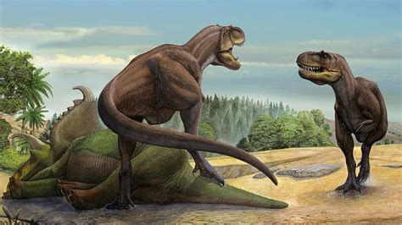
frequent adhesive medieval
chameleon immediate prehistoric

Slide 6
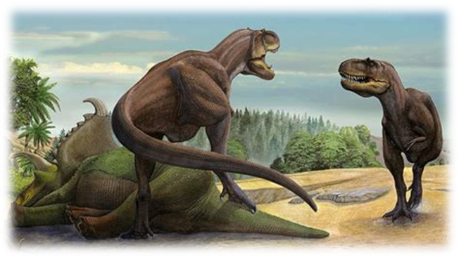

Slide 7
Activity page:
Alphabetical order

Slide 8
Let’s review
syllables.

Slide 9
reflex
email
female
genius
frequent

Slide 10
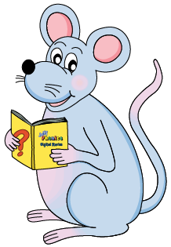
Let’s parse
sentences.

Slide 11
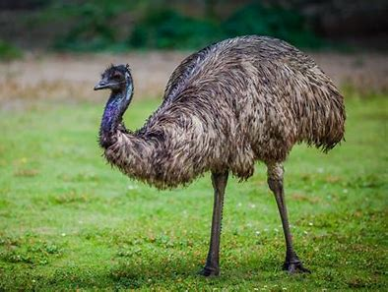
Parse these sentences.
She will be visiting her grandparents.
An emu is a large Australian bird.

Slide 12
Parse these sentences.
She will be visiting her grandparents.
An emu is a large Australian bird.

Slide 13
Parse these sentences.
She will be visiting her grandparents.
An emu is a large Australian bird.

Slide 14
Parse these sentences.
She will be visiting her grandparents.
An emu is a large Australian bird.

Slide 15
Parse these sentences.
She will be visiting her grandparents.
An emu is a large Australian bird.

Slide 16
Parse these sentences.
She will be visiting her grandparents.
An emu is a large Australian bird.

Slide 17
Parse these sentences.
She will be visiting her grandparents.
An emu is a large Australian bird.

Slide 18
Parse these sentences.
She will be visiting her grandparents.
An emu is a large Australian bird.

Slide 19
Parse these sentences.
She will be visiting her grandparents.
An emu is a large Australian bird.

Slide 20
Parse these sentences.
She will be visiting her grandparents.
An emu is a large Australian bird.

Slide 21
Dictation

Slide 22
Dictation
1.
2.
3.

Slide 23
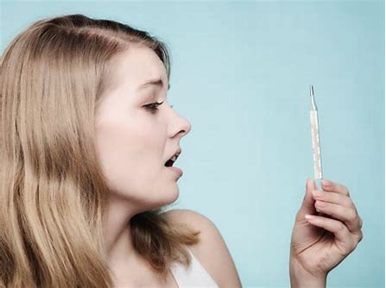
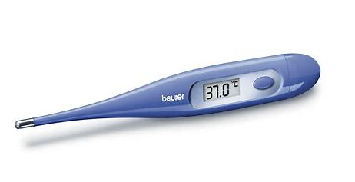

Slide 24
“I think I have a fever,” she said.

Slide 25
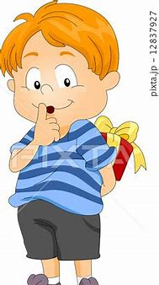

Slide 26
They kept his birthday present a secret.

Slide 28
He will be sending an email to his friend.

Slide 29
See you next time.

