Slide 1
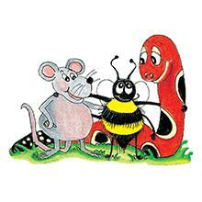
Jolly Grammar 3b-1

Slide 2
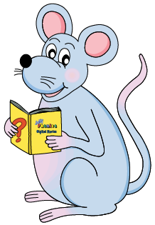
painful
painless

Slide 3
Mr. Keito is powerful.
Shizu is powerless.
2. King Cobra is harmful.
Elephants are harmless.
3. My future is hopeful.
No one’s future is hopeless.
4. Soshiro is careful.
Keito is careless.
5. Masato has a lot of useful pens.
There are a few useless markers.
6. Playing badminton is painful.
Playing the piano is painless.

Slide 4
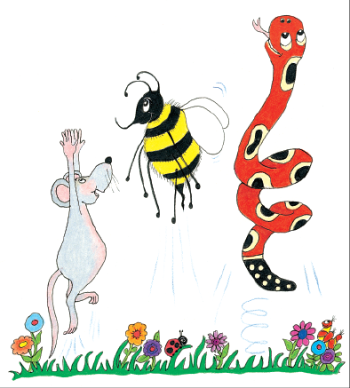
Let’s Review
the /ai/ Sound

Slide 5
stay
tail
male
crayon
escape
mainly
day
waiting
animate
praying
reindeer
eight

Slide 6
Spelling List
Spelling
The <a> Spelling of the /ai/ Sound

Slide 7
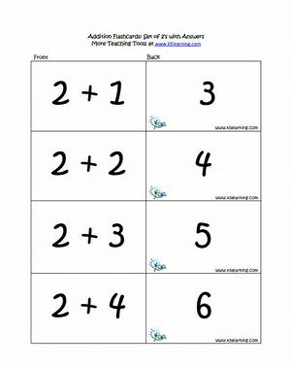
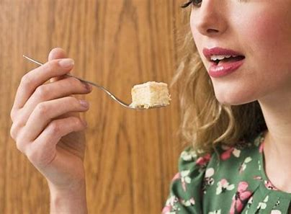
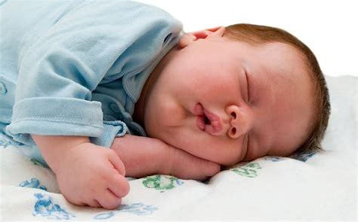
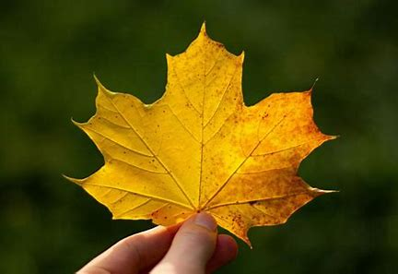
crazy taste basic
baby haste maple

Slide 8
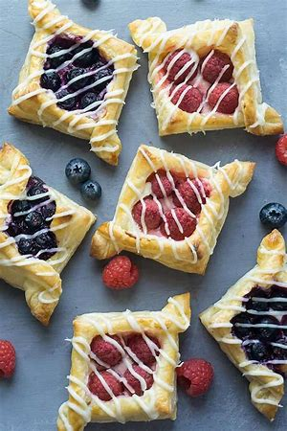
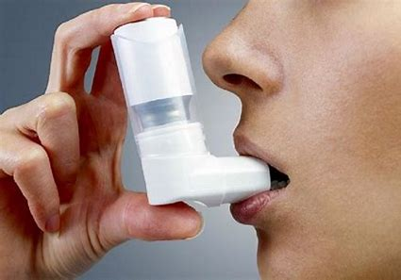
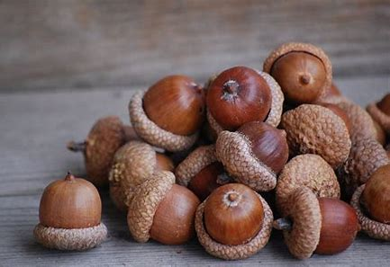
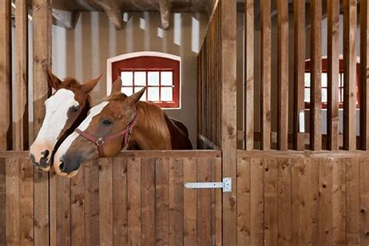
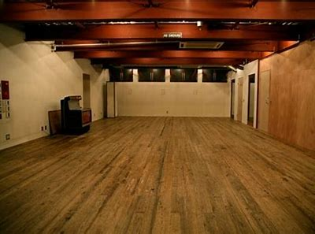
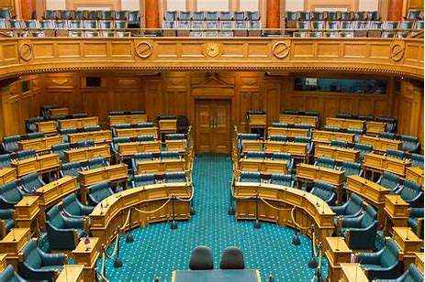
inhaler pastry acorn
stable vacant chamber

Slide 9
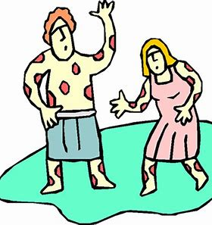
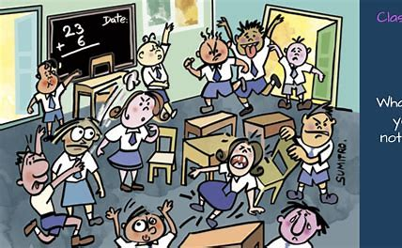
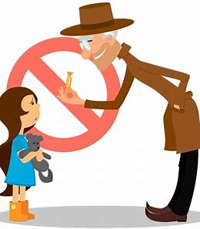
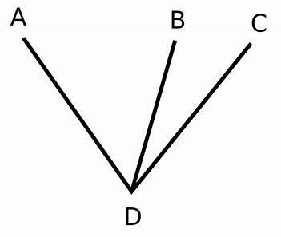
plague chaotic stranger
adjacent newspaper conversation

Slide 10
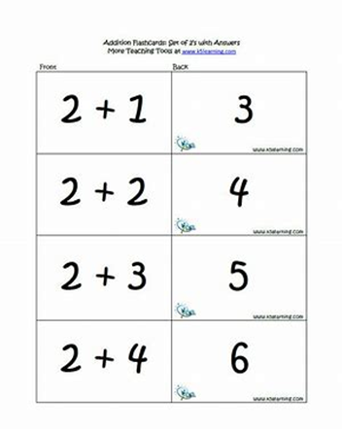
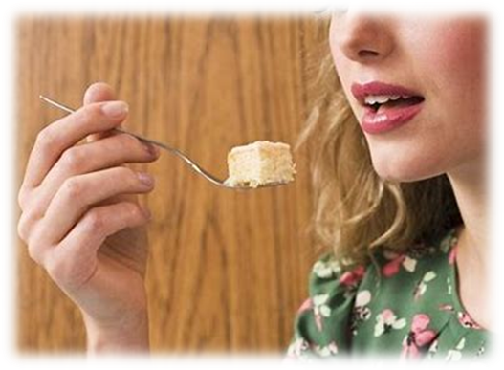
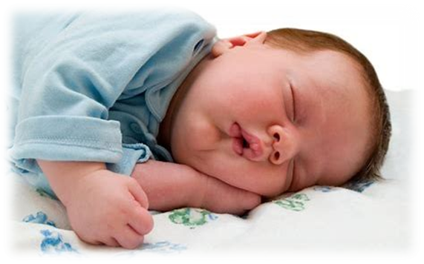
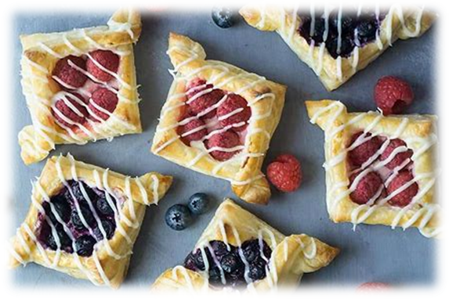
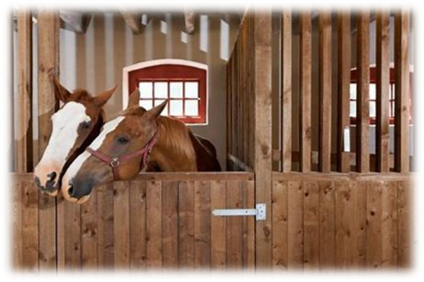
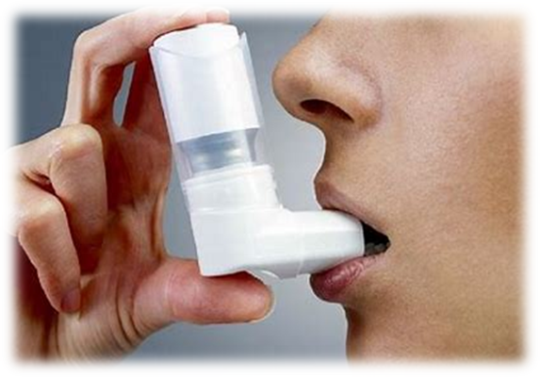
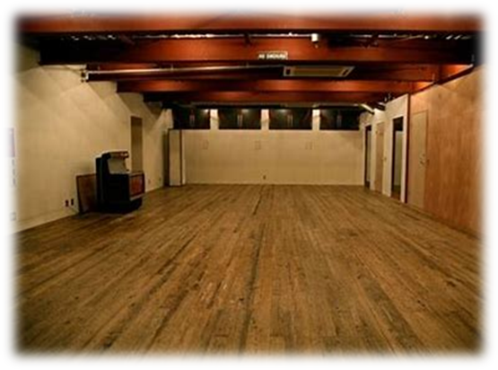
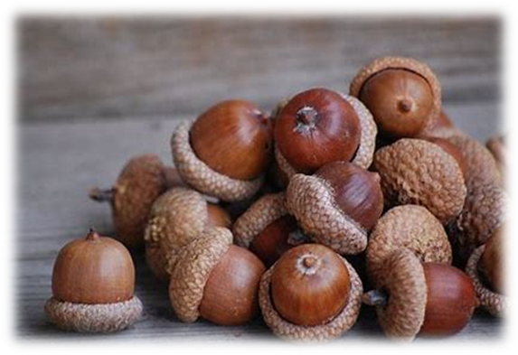
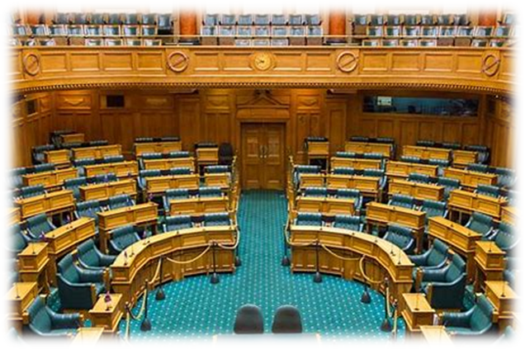
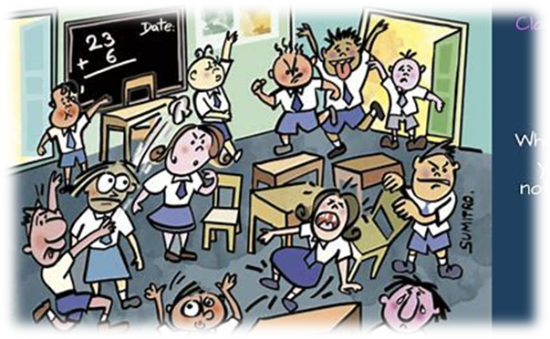
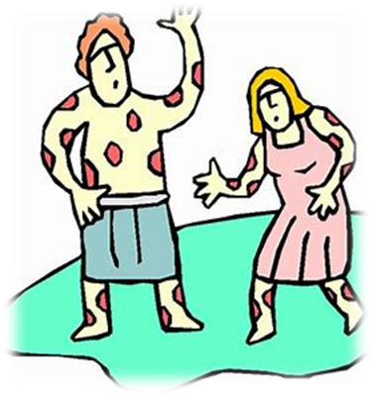

Slide 11
Activity page

Slide 12
Read each word and draw.

Slide 13
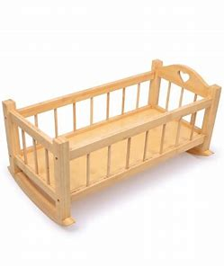
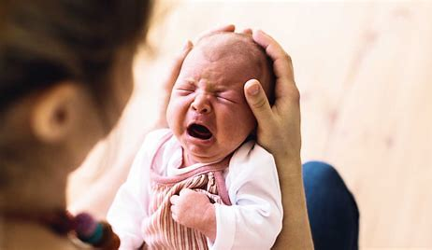
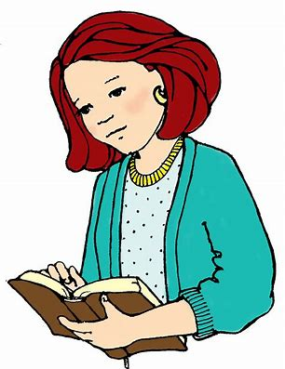
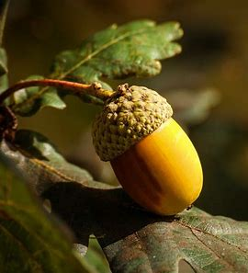
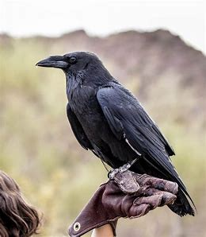
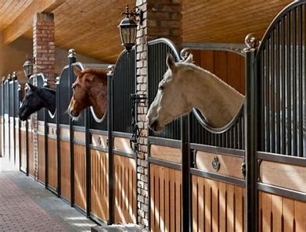
cradle
lady
raven
baby
acorn
stable

Slide 14
Let’s review
syllables.

Slide 15
basic

Slide 16
basic
lazy

Slide 17
basic
lazy
vacant

Slide 18
basic
lazy
vacant
newspaper

Slide 19
basic
lazy
vacant
newspaper
conversation

Slide 20
Let’s parse
sentences.

Slide 21
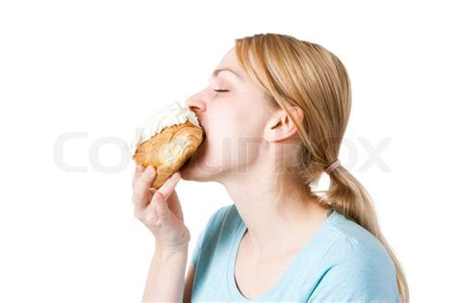
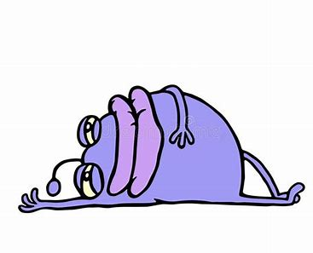
Parse these sentences.
The beautiful lady ate a tasty pastry.
The lazy alien is lying in the lunar crater.

Slide 22
Parse these sentences.
The beautiful lady ate a tasty pastry.
The lazy alien is lying in the lunar crater.

Slide 23
Parse these sentences.
The beautiful lady ate a tasty pastry.
The lazy alien is lying in the lunar crater.

Slide 24
Parse these sentences.
The beautiful lady ate a tasty pastry.
The lazy alien is lying in the lunar crater.

Slide 25
Parse these sentences.
The beautiful lady ate a tasty pastry.
The lazy alien is lying in the lunar crater.

Slide 26
Parse these sentences.
The beautiful lady ate a tasty pastry.
The lazy alien is lying in the lunar crater.

Slide 27
Parse these sentences.
The beautiful lady ate a tasty pastry.
The lazy alien is lying in the lunar crater.

Slide 28
Parse these sentences.
The beautiful lady ate a tasty pastry.
The lazy alien is lying in the lunar crater.

Slide 29
Parse these sentences.
The beautiful lady ate a tasty pastry.
The lazy alien is lying in the lunar crater.

Slide 30
Parse these sentences.
The beautiful lady ate a tasty pastry.
The lazy alien is lying in the lunar crater.

Slide 31
Parse these sentences.
The beautiful lady ate a tasty pastry.
The lazy alien is lying in the lunar crater.

Slide 32
Parse these sentences.
The beautiful lady ate a tasty pastry.
The lazy alien is lying in the lunar crater.

Slide 33
Dictation

Slide 34
Dictation
1.
2.
3.

Slide 35
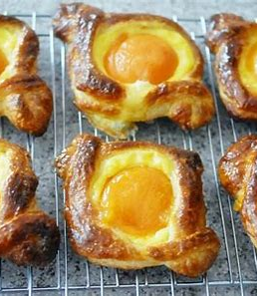

Slide 36
We had an apricot pastry for dessert.

Slide 37
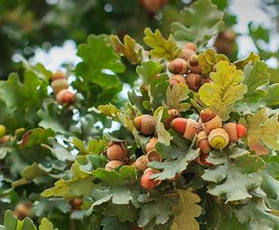

Slide 38
Is the oak tree full of acorns?

Slide 39
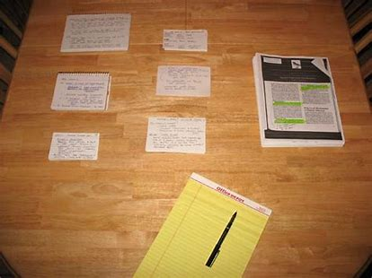

Slide 40
“Put the paper on the table,” said Dad.

Slide 41
Homework

