Slide 1
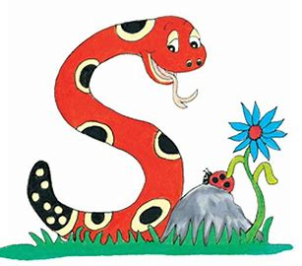
Jolly Grammar
4b-3

Slide 2
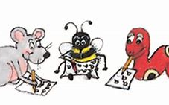
Let’s review <-al>

Slide 3
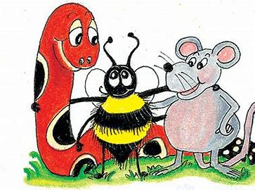
Suffix <-al> Making Noun into Adjectives
Adjectives
floral
accidental
logical
intentional
critical
coastal
Nouns
flower
accident
logic
intention
critic
coast

Slide 4
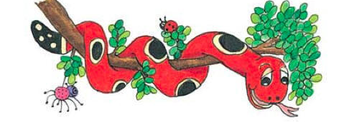
Activity Page:
Silent Letters

Slide 5
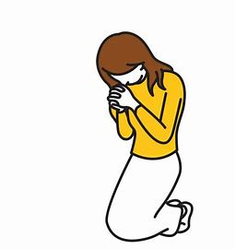
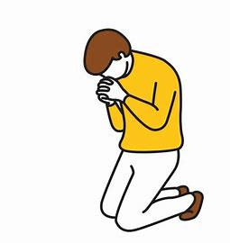
kneel

Slide 6
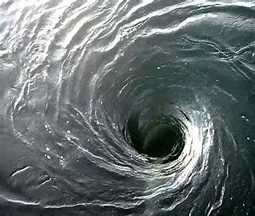
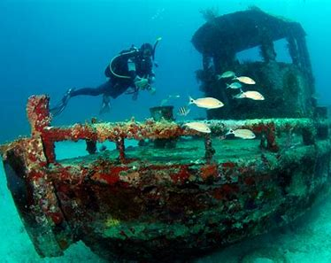
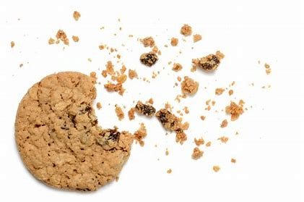
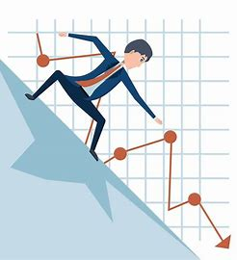
whirl wreck kneel
crumb ascend descend

Slide 7
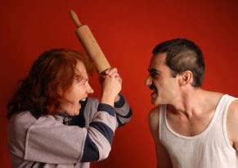
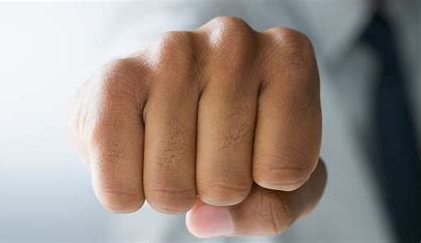
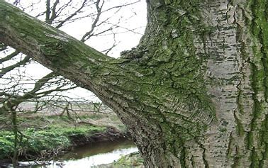
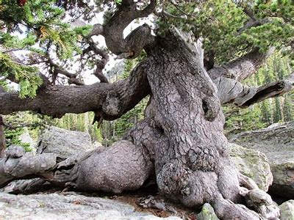
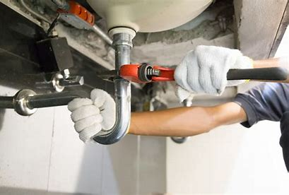
wrangle knuckle limb
gnarled plumbing elsewhere

Slide 8
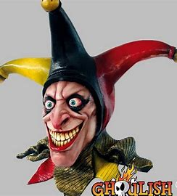
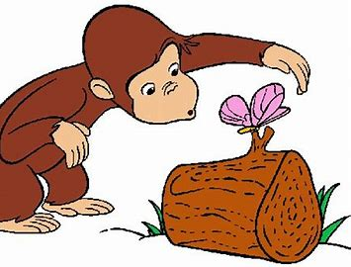
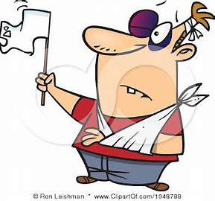
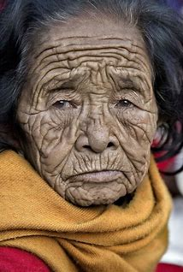
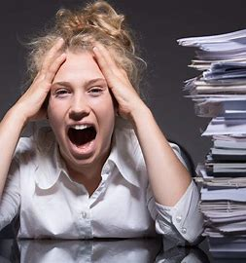
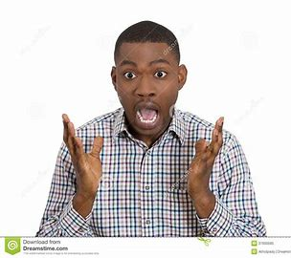
ghoulish succumb fascinate
wrinkliest overwhelm dumbfounded

Slide 11
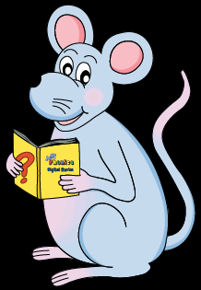
Activity Page
Silent Letter

Slide 12
parsing

Slide 13
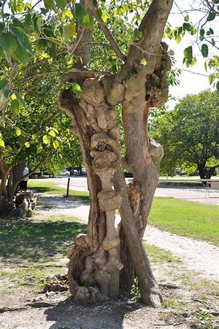
The knotty limbs of the gnarled tree were growing in fantastic shapes.

Slide 14
The knotty limbs of the gnarled tree were growing in fantastic shapes.

Slide 15
The knotty limbs of the gnarled tree were growing in fantastic shapes.

Slide 16
The knotty limbs of the gnarled tree were growing in fantastic shapes.

Slide 17
The knotty limbs of the gnarled tree were growing in fantastic shapes.

Slide 18
The knotty limbs of the gnarled tree were growing in fantastic shapes.

Slide 19
The knotty limbs of the gnarled tree were growing in fantastic shapes.

Slide 20
The knotty limbs of the gnarled tree were growing in fantastic shapes.

Slide 21
The knotty limbs of the gnarled tree were growing in fantastic shapes.

Slide 22
The knotty limbs of the gnarled tree were growing in fantastic shapes.

Slide 23
The knotty limbs of the gnarled tree were growing in fantastic shapes.
past continuous

Slide 24
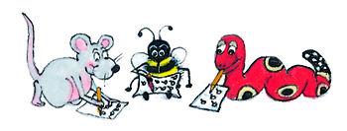
Dictation

Slide 25
Dictation
1.
2.
3.

Slide 26
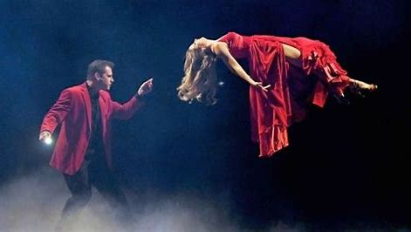
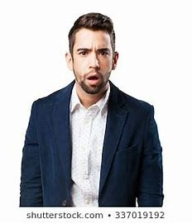

Slide 27
They were dumbfounded by the magic show.

Slide 28
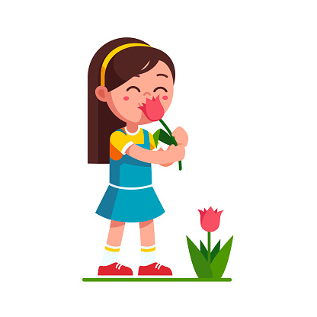
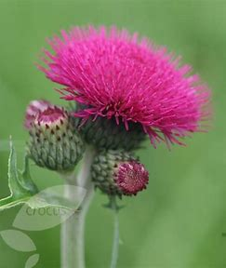

Slide 29
The thistle does not have any scent.

Slide 30
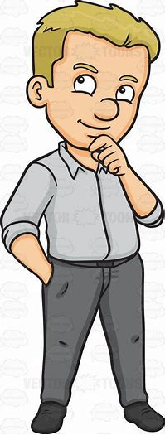

Slide 31
“I ought to fix the plumbing,” said Roy.

Slide 32
Thank you.
See you
next time!

