Slide 1
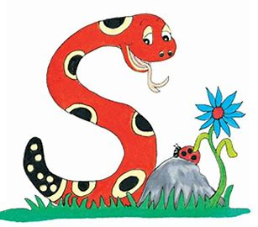
Jolly Grammar
4b-1

Slide 2
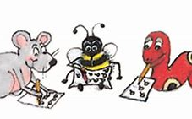
Let’s review homophones.

Slide 3
where＝question word
Where is your brother?
wear＝verb
I wear my favorite shoes everyday.
were＝ past tense of the verb to be
We were good friends in Japan.

Slide 4
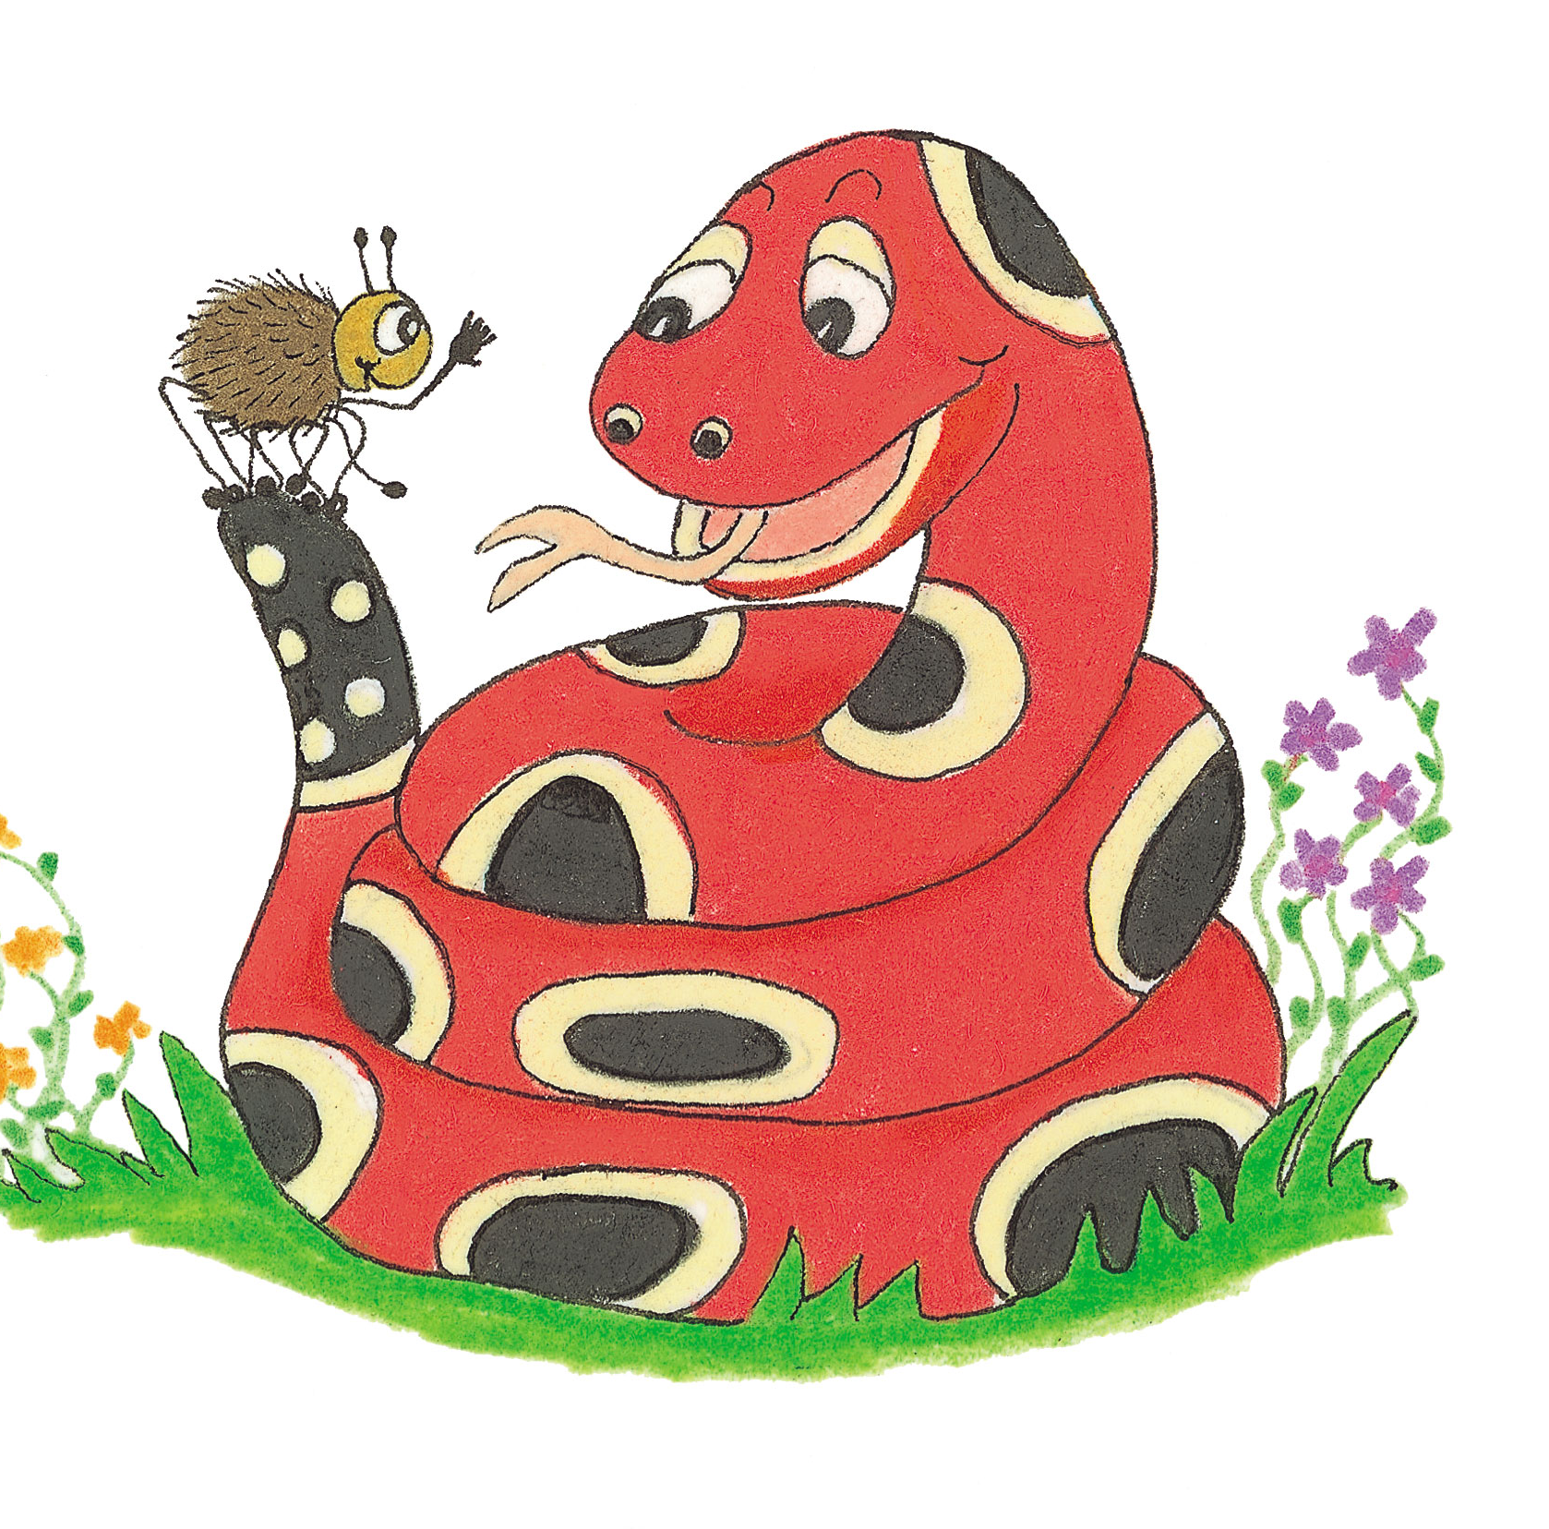
Let’s Revise Silent letters.

Slide 5
thumb
wrap
knot
whip
rhino
who
scent
gnaw

Slide 6
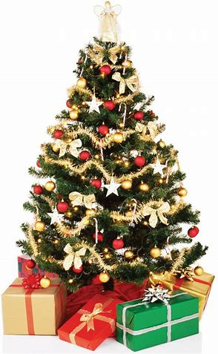
Christmas
/s/

Slide 7
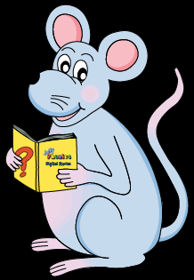
Activity Page
<st> saying<s>

Slide 8
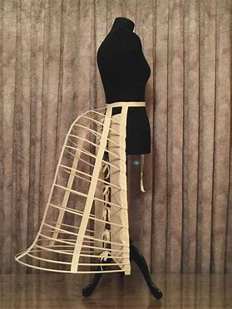
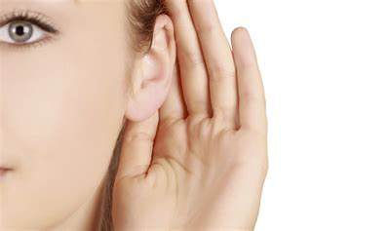
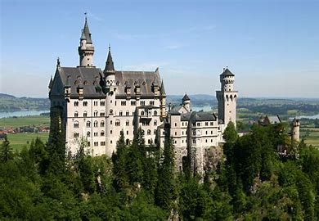
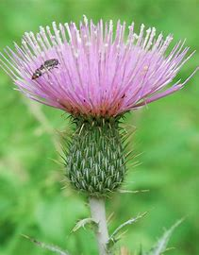
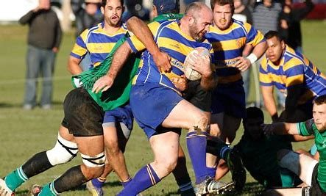
castle bustle listen
thistle jostle glisten

Slide 9
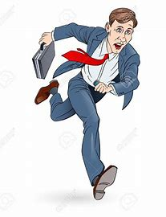
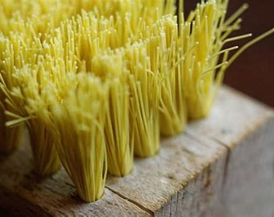
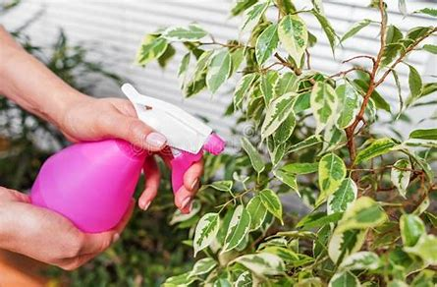
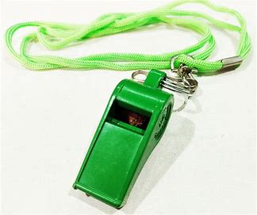
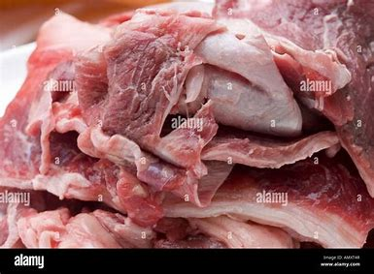
bristle fasten hasten
moisten whistle gristle

Slide 10
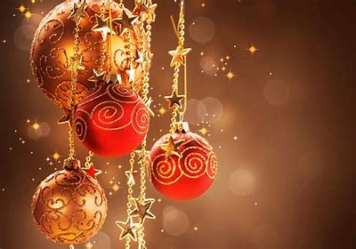
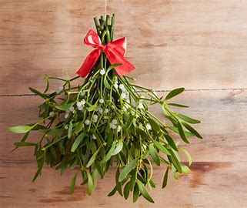
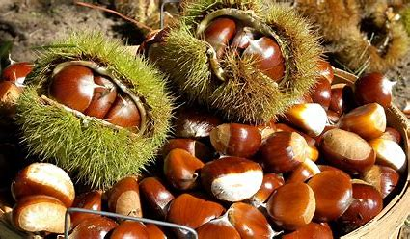
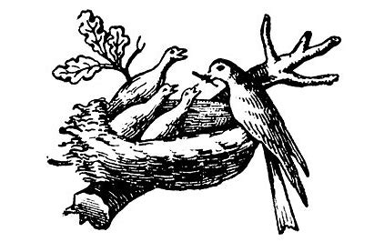
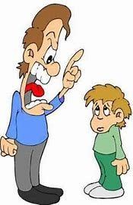
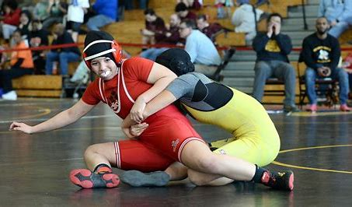
Christmas mistletoe chestnut
nestle wrestle chasten

Slide 12
Alphabetical Order

Slide 13
castle
bustle
listen
thistle
jostle
glisten
bristle
fasten
hasten
moisten
whistle
gristle
Christmas
mistletoe
chestnut
nestle
wrestle
chasten

Slide 14
bristle
bustle
castle
chasten
chestnut
Christmas
fasten
glisten
gristle
10.hasten
11.jostle
12.listen
13.mistletoe
14.moisten
15.nestle
16.thiste
17.whistle
18.wrestle

Slide 15
Silent letters

Slide 16
knuckle
kneel
wriggle
limb
design
whisk
whole
ascend
crumb
descend
wrap
gnaw
rhyme
wrong
rhino

Slide 17
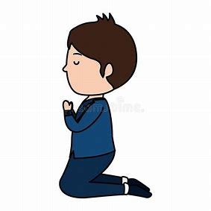
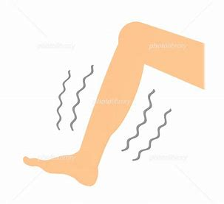
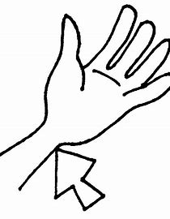
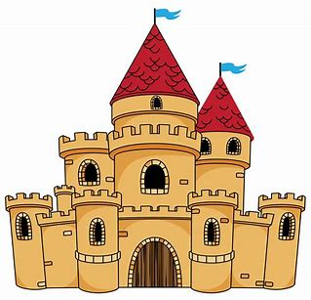
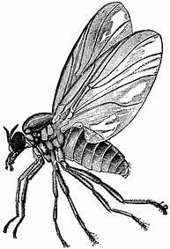
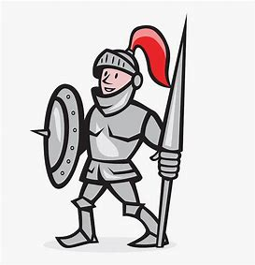
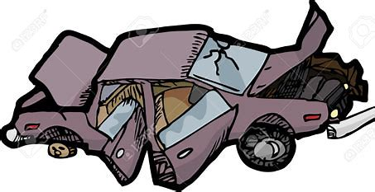
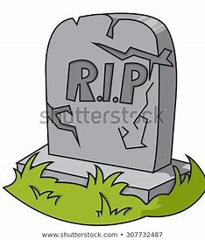
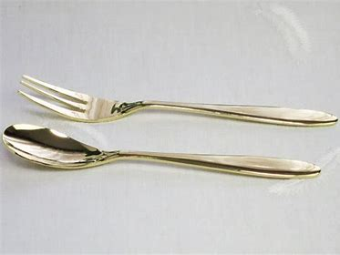
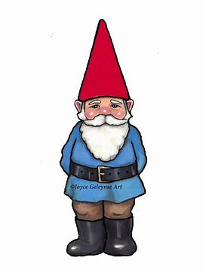
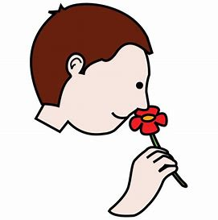
knelt
wreck
scent
wrist
castle
tomb
numb
gnat
glisten
scene
thumb
gnome
sign
knight
wrong

Slide 18
parsing

Slide 19
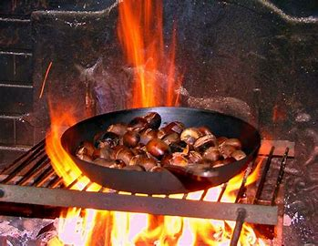
I will roast chestnuts on the fire at Christmas.

Slide 20
I will roast chestnuts on the fire at Christmas.

Slide 21
I will roast chestnuts on the fire at Christmas.

Slide 22
I will roast chestnuts on the fire at Christmas.

Slide 23
I will roast chestnuts on the fire at Christmas.

Slide 24
I will roast chestnuts on the fire at Christmas.

Slide 25
I will roast chestnuts on the fire at Christmas.

Slide 26
I will roast chestnuts on the fire at Christmas.

Slide 27
I will roast chestnuts on the fire at Christmas.
simple future

Slide 28
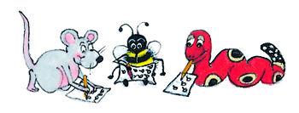
Dictation

Slide 29
Dictation
1.
2.
3.

Slide 30
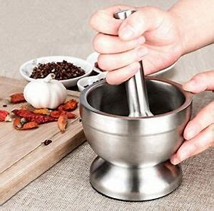

Slide 31
She ground the spices in the mortar and pestle.

Slide 32
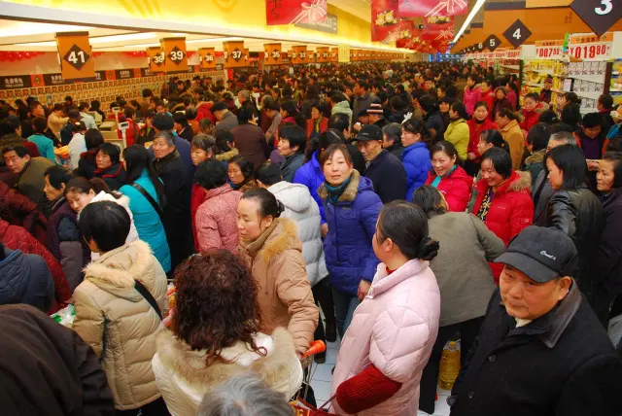

Slide 33
“I was jostled in the hustle and bustle,” said Bob.

Slide 34
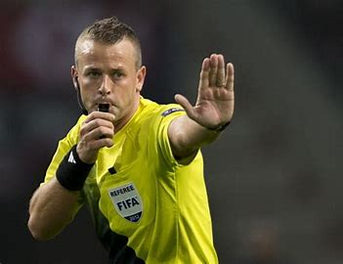

Slide 35
They listened for the referee to blow his whistle.

Slide 36
Thank you.
See you
next time!

