Slide 1
Jolly Grammar
5b-36

Slide 2
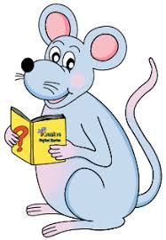
Spelling Test 36

Slide 3
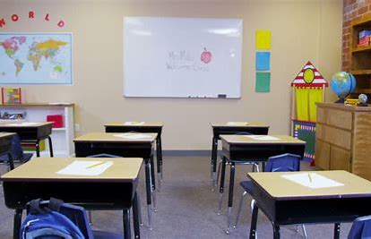
school

Slide 4
school
scholar

Slide 5
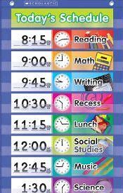
school
scholar
schedule

Slide 6
school
scholar
schedule
schwa

Slide 7
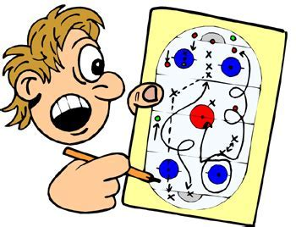
school
scholar
schedule
schwa
scheme

Slide 8
school
scholar
schedule
schwa
scheme
scholarship

Slide 9
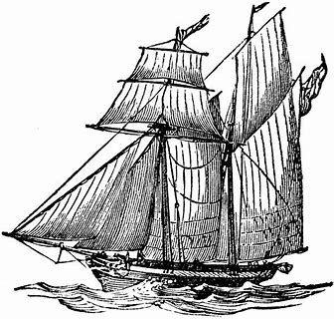
school
scholar
schedule
schwa
scheme
scholarship
schooner

Slide 10
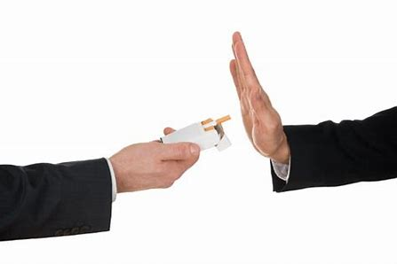
school
scholar
schedule
schwa
scheme
scholarship
schooner
eschew

Slide 11
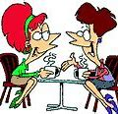
school
scholar
schedule
schwa
scheme
scholarship
schooner
eschew
schmooze

Slide 12
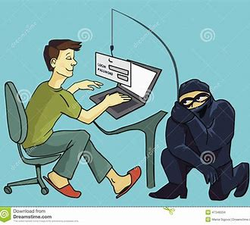
school
scholar
schedule
schwa
scheme
scholarship
schooner
eschew
schmooze
10. schemer

Slide 13
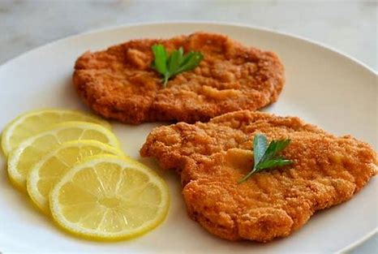
school
scholar
schedule
schwa
scheme
scholarship
schooner
eschew
schmooze
10. schemer
11. schnitzel

Slide 14
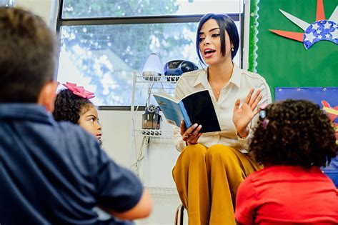
school
scholar
schedule
schwa
scheme
scholarship
schooner
eschew
schmooze
10. schemer
11. schnitzel
12. schoolteacher

Slide 15
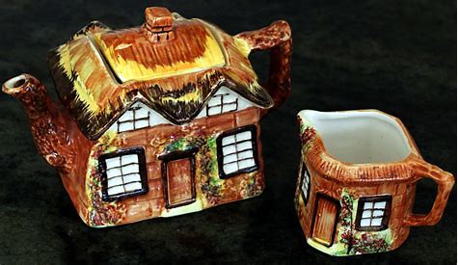
school
scholar
schedule
schwa
scheme
scholarship
schooner
eschew
schmooze
10. schemer
11. schnitzel
12. schoolteacher
13. kitsch

Slide 16
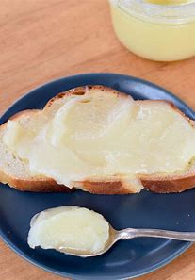
school
scholar
schedule
schwa
scheme
scholarship
schooner
eschew
schmooze
10. schemer
11. schnitzel
12. schoolteacher
13. kitsch
14. schmaltz

Slide 17
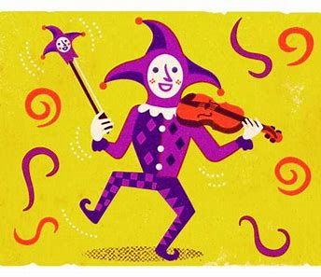
school
scholar
schedule
schwa
scheme
scholarship
schooner
eschew
schmooze
10. schemer
11. schnitzel
12. schoolteacher
13. kitsch
14. schmaltz
15. scherzo

Slide 18
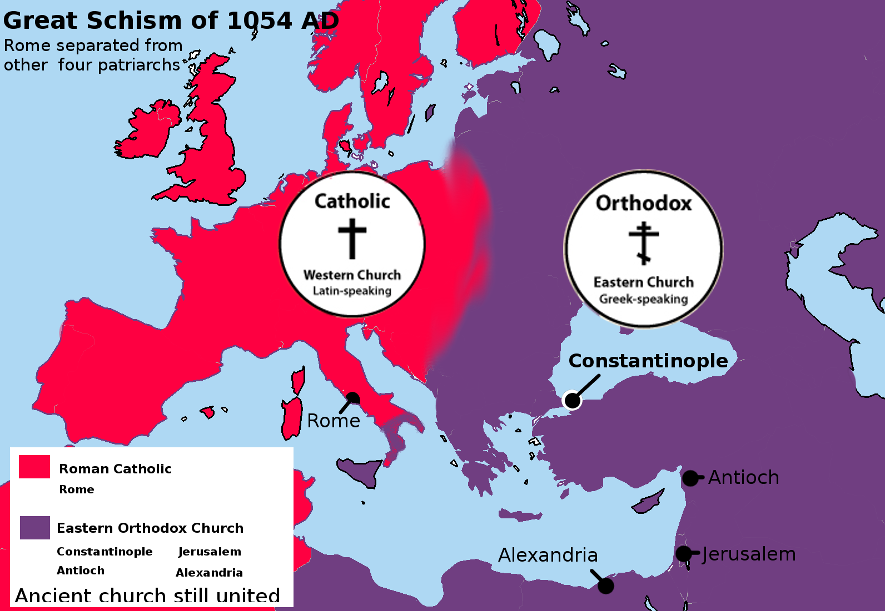
school
scholar
schedule
schwa
scheme
scholarship
schooner
eschew
schmooze
10. schemer
11. schnitzel
12. schoolteacher
13. kitsch
14. schmaltz
15. scherzo
16. schism

Slide 19
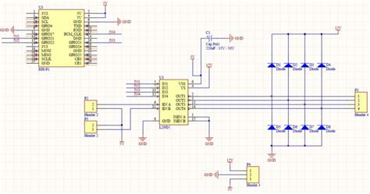
school
scholar
schedule
schwa
scheme
scholarship
schooner
eschew
schmooze
10. schemer
11. schnitzel
12. schoolteacher
13. kitsch
14. schmaltz
15. scherzo
16. schism
17. schematic

Slide 20
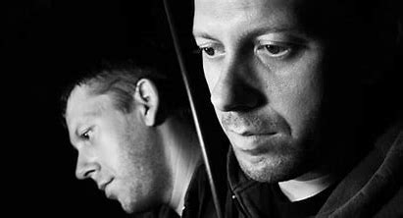
school
scholar
schedule
schwa
scheme
scholarship
schooner
eschew
schmooze
10. schemer
11. schnitzel
12. schoolteacher
13. kitsch
14. schmaltz
15. scherzo
16. schism
17. schematic
18. schizophrenic

Slide 21
Let’s revise
Homophones and Homographs.

Slide 22
Let’s revise
Synonyms and Antonyms.

Slide 23
Synonyms:
Antonyms:

Slide 24
Synonyms:
Words with the same or similar meaning
Antonyms:

Slide 25
Synonyms:
Words with the same or similar meaning
Antonyms:
Words with an opposite meaning

Slide 26
Synonyms:
Words with the same or similar meaning
Antonyms:
Words with an opposite meaning

Slide 27
Synonyms:
Words with the same or similar meaning
Antonyms:
Words with an opposite meaning
large
heavy
right
worse
legal
painful

Slide 28
Synonyms:
Words with the same or similar meaning
Antonyms:
Words with an opposite meaning
large
heavy
right
worse
legal
painful
small

Slide 29
Synonyms:
Words with the same or similar meaning
Antonyms:
Words with an opposite meaning
large
heavy
right
worse
legal
painful
small
light

Slide 30
Synonyms:
Words with the same or similar meaning
Antonyms:
Words with an opposite meaning
large
heavy
right
worse
legal
painful
small
light
left

Slide 31
Synonyms:
Words with the same or similar meaning
Antonyms:
Words with an opposite meaning
large
heavy
right
worse
legal
painful
small
light
left
better

Slide 32
Synonyms:
Words with the same or similar meaning
Antonyms:
Words with an opposite meaning
large
heavy
right
worse
legal
painful
small
light
left
better
illegal

Slide 33
Synonyms:
Words with the same or similar meaning
Antonyms:
Words with an opposite meaning
large
heavy
right
worse
legal
painful
small
light
left
better
illegal
painless

Slide 34
Synonyms or Antonyms?
giant / huge
awake / asleep
broad / narrow
journal / diary
dry / wet
answer / reply
love / hate
hall / corridor
last / final
friend / enemy

Slide 35
Synonyms or Antonyms?
giant / huge
awake / asleep
broad / narrow
journal / diary
dry / wet
answer / reply
love / hate
hall / corridor
last / final
friend / enemy
synonyms

Slide 36
Synonyms or Antonyms?
giant / huge
awake / asleep
broad / narrow
journal / diary
dry / wet
answer / reply
love / hate
hall / corridor
last / final
friend / enemy
synonyms
antonyms

Slide 37
Synonyms or Antonyms?
giant / huge
awake / asleep
broad / narrow
journal / diary
dry / wet
answer / reply
love / hate
hall / corridor
last / final
friend / enemy
synonyms
antonyms
antonyms

Slide 38
Synonyms or Antonyms?
giant / huge
awake / asleep
broad / narrow
journal / diary
dry / wet
answer / reply
love / hate
hall / corridor
last / final
friend / enemy
synonyms
antonyms
antonyms
synonyms

Slide 39
Synonyms or Antonyms?
giant / huge
awake / asleep
broad / narrow
journal / diary
dry / wet
answer / reply
love / hate
hall / corridor
last / final
friend / enemy
synonyms
antonyms
antonyms
synonyms
antonyms

Slide 40
Synonyms or Antonyms?
giant / huge
awake / asleep
broad / narrow
journal / diary
dry / wet
answer / reply
love / hate
hall / corridor
last / final
friend / enemy
synonyms
antonyms
antonyms
synonyms
antonyms
synonyms

Slide 41
Synonyms or Antonyms?
giant / huge
awake / asleep
broad / narrow
journal / diary
dry / wet
answer / reply
love / hate
hall / corridor
last / final
friend / enemy
synonyms
antonyms
antonyms
synonyms
antonyms
synonyms
antonyms

Slide 42
Synonyms or Antonyms?
giant / huge
awake / asleep
broad / narrow
journal / diary
dry / wet
answer / reply
love / hate
hall / corridor
last / final
friend / enemy
synonyms
antonyms
antonyms
synonyms
antonyms
synonyms
antonyms
synonyms

Slide 43
Synonyms or Antonyms?
giant / huge
awake / asleep
broad / narrow
journal / diary
dry / wet
answer / reply
love / hate
hall / corridor
last / final
friend / enemy
synonyms
antonyms
antonyms
synonyms
antonyms
synonyms
antonyms
synonyms
synonyms

Slide 44
Synonyms or Antonyms?
giant / huge
awake / asleep
broad / narrow
journal / diary
dry / wet
answer / reply
love / hate
hall / corridor
last / final
friend / enemy
synonyms
antonyms
antonyms
synonyms
antonyms
synonyms
antonyms
synonyms
synonyms
antonyms

Slide 45
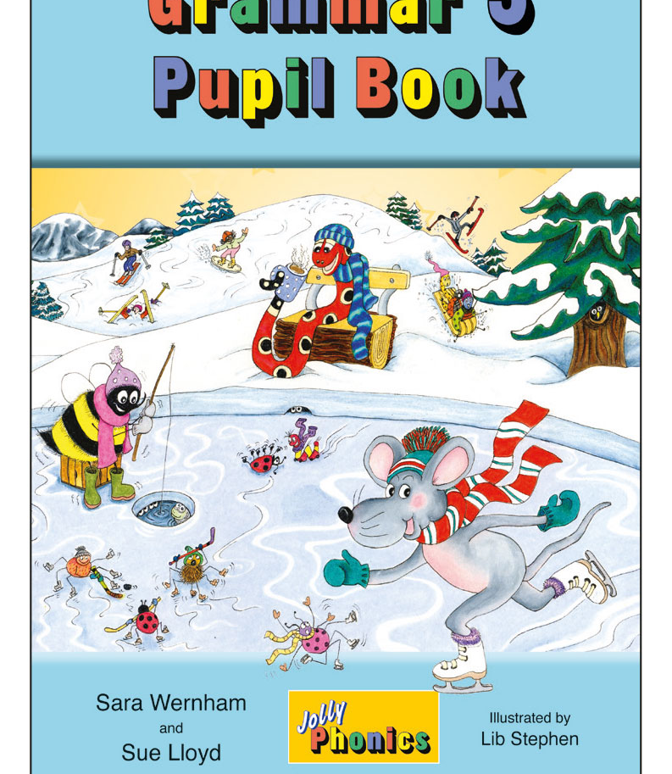
Activity Page
Antonyms and Synonyms

Slide 46
Write an antonym for each of the words below.
forward
agreement
awkward
Write a synonym for each of the words below.
ailment
argument
afterwards

Slide 47
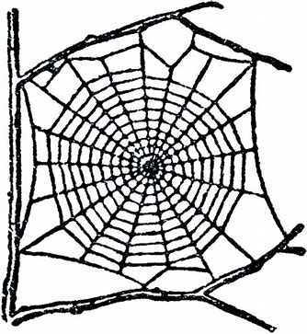
Write an antonym for each of the words below.
forward
backward
agreement
awkward
Write a synonym for each of the words below.
ailment
argument
afterwards

Slide 48
Write an antonym for each of the words below.
forward
backward
agreement
disagreement
awkward
Write a synonym for each of the words below.
ailment
argument
afterwards

Slide 49
Write an antonym for each of the words below.
forward
backward
agreement
disagreement
awkward
graceful
Write a synonym for each of the words below.
ailment
argument
afterwards

Slide 50
Write an antonym for each of the words below.
forward
backward
agreement
disagreement
awkward
graceful
Write a synonym for each of the words below.
ailment
illness
sickness
disease
argument
afterwards

Slide 51
Write an antonym for each of the words below.
forward
backward
agreement
disagreement
awkward
graceful
Write a synonym for each of the words below.
ailment
illness
sickness
disease
argument
fight
quarrel
disagreement
afterwards

Slide 52
Write an antonym for each of the words below.
forward
backward
agreement
disagreement
awkward
graceful
Write a synonym for each of the words below.
ailment
illness
sickness
disease
argument
fight
quarrel
disagreement
afterwards
later
next
then

Slide 53
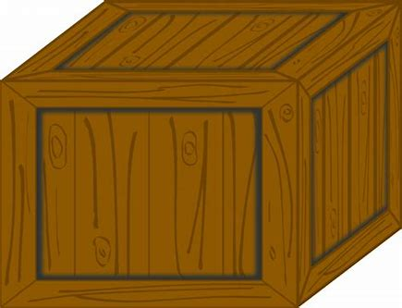
superb
great
fantastic
excellent

Slide 54
superb
great
fantastic
excellent
poor
awful
terrible

Slide 55
superb
great
fantastic
excellent
poor
awful
terrible
brave
bold
heroic
fearless

Slide 56
superb
great
fantastic
excellent
poor
awful
terrible
brave
bold
heroic
fearless
cowardly
timid
fearful

Slide 57
superb
great
fantastic
excellent
poor
awful
terrible
brave
bold
heroic
fearless
cowardly
timid
fearful
horrible
nasty
horrid
unpleasant

Slide 58
superb
great
fantastic
excellent
poor
awful
terrible
brave
bold
heroic
fearless
cowardly
timid
fearful
horrible
nasty
horrid
unpleasant
nice
pleasant
lovely

Slide 59
superb
great
fantastic
excellent
poor
awful
terrible
brave
bold
heroic
fearless
cowardly
timid
fearful
horrible
nasty
horrid
unpleasant
nice
pleasant
lovely
dangerous
risky
unsafe
hazardous

Slide 60
superb
great
fantastic
excellent
poor
awful
terrible
brave
bold
heroic
fearless
cowardly
timid
fearful
horrible
nasty
horrid
unpleasant
nice
pleasant
lovely
dangerous
risky
unsafe
hazardous
safe
secure
protected

Slide 61
superb
great
fantastic
excellent
poor
awful
terrible
brave
bold
heroic
fearless
cowardly
timid
fearful
horrible
nasty
horrid
unpleasant
nice
pleasant
lovely
dangerous
risky
unsafe
hazardous
safe
secure
protected
miniature
tiny
small
little

Slide 62
superb
great
fantastic
excellent
poor
awful
terrible
brave
bold
heroic
fearless
cowardly
timid
fearful
horrible
nasty
horrid
unpleasant
nice
pleasant
lovely
dangerous
risky
unsafe
hazardous
safe
secure
protected
miniature
tiny
small
little
big
large
huge

Slide 63
superb
great
fantastic
excellent
poor
awful
terrible
brave
bold
heroic
fearless
cowardly
timid
fearful
horrible
nasty
horrid
unpleasant
nice
pleasant
lovely
dangerous
risky
unsafe
hazardous
safe
secure
protected
miniature
tiny
small
little
big
large
huge
complicated
confusing
difficult
involved

Slide 64
superb
great
fantastic
excellent
poor
awful
terrible
brave
bold
heroic
fearless
cowardly
timid
fearful
horrible
nasty
horrid
unpleasant
nice
pleasant
lovely
dangerous
risky
unsafe
hazardous
safe
secure
protected
miniature
tiny
small
little
big
large
huge
complicated
confusing
difficult
involved
easy
simple
straightforward

Slide 65
See you
next time!

