Slide 1
Jolly Grammar
5b-35

Slide 2
Let’s revise
Homophones and Homographs.

Slide 3
Homograph
Same spelling,
different meaning
Homophone
Same
pronunciation,
Different
spelling and
meaning
too/two
Homonym
Different
meaning
bat
bat
Heteronym
Different
pronunciation and
meaning
bow
bow

Slide 4
Activity Page
Let’s write the meanings

Slide 5
Write the meanings for these pairs of heteronyms.
row /row/: a line of people or things
/rou/: a noisy argument with someone

Slide 6
Write the meanings for these pairs of heteronyms.
row /row/: a line of people or things
/rou/: a noisy argument with someone
wound /wound/: past tense of wind
/woond/: damage that is done to a part of someone’s body

Slide 7
Write the meanings for these pairs of heteronyms.
row /row/: a line of people or things
/rou/: a noisy argument with someone
wound /wound/: past tense of wind
/woond/: damage that is done to a part of someone’s body
object /object/: a thing that you can touch
/object/: to disagree with something

Slide 8
Write the meanings for these pairs of heteronyms.
row /row/: a line of people or things
/rou/: a noisy argument with someone
wound /wound/: past tense of wind
/woond/: damage that is done to a part of someone’s body
object /object/: a thing that you can touch
/object/: to disagree with something
content /content/: whatever is held or contained in something
/content/: wanting no more than what one has, or satisfied

Slide 9
Let’s learn
Spelling
<sch>.

Slide 10
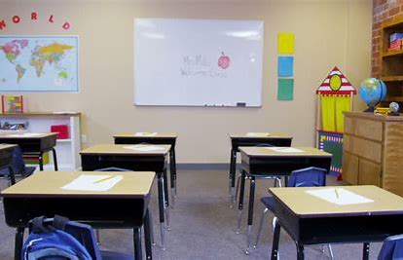
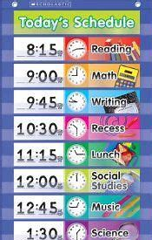
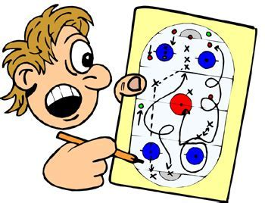
school schol ar sched ule
schwa scheme schol ar ship

Slide 11
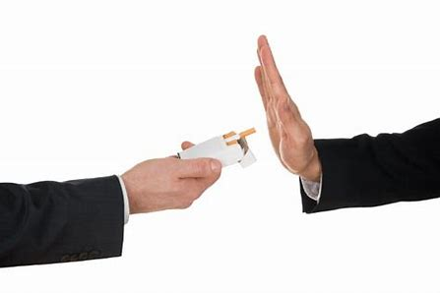
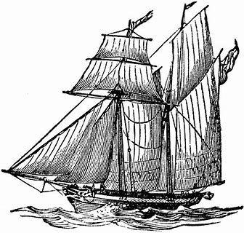
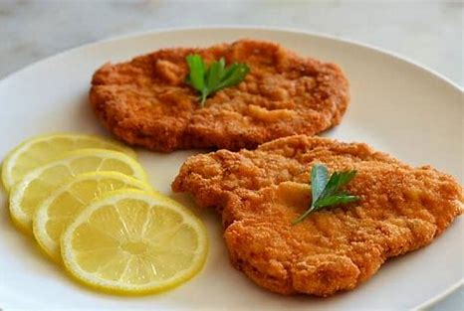
schoon er es chew schmooze
schem er schnit zel school teach er

Slide 12
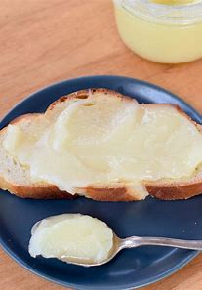
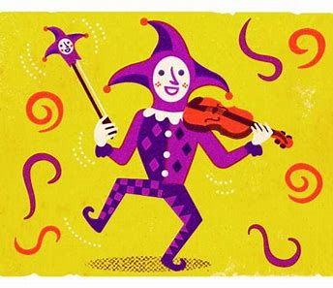
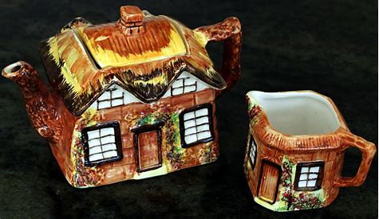
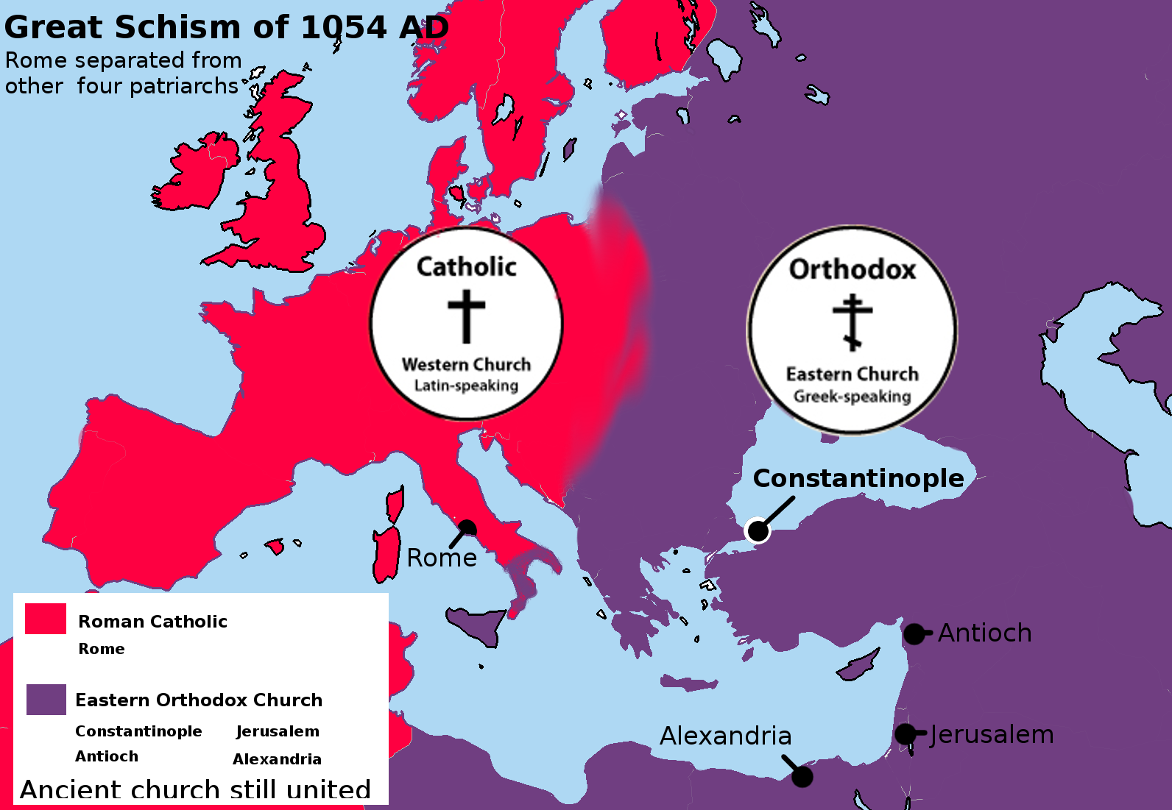
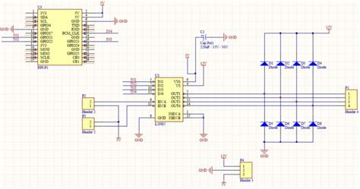
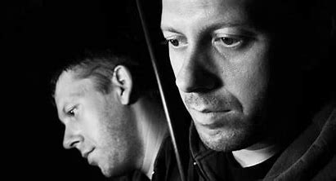
kitsch schmaltz scher zo
schis m sche mat ic schiz o phren ic

Slide 15
Activity Page
Match the words

Slide 16
Parsing and Sentence Wall.

Slide 17
The magnificent schooner made its hazardous journey across the ocean.
Subject
schooner
The magnificent
Verb
made
across the ocean
Object
journey
its
hazardous
(transitive)

Slide 18
Activity Page
Spelling<sch>

Slide 19
Dictation

Slide 20
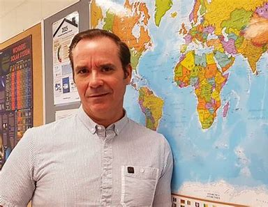

Slide 21
The new school master will teach geography.

Slide 22
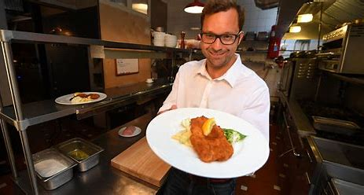

Slide 23
“The schnitzel is delicious,” declared the chef.

Slide 24
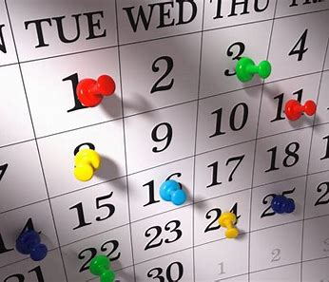

Slide 25
It is impossible to fit everything into my busy schedule.

Slide 26
See you
next time!

