Slide 1
Jolly Grammar
5b-34

Slide 2
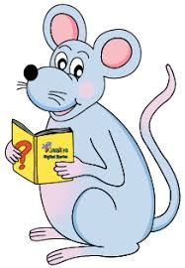
Spelling Test 35

Slide 3
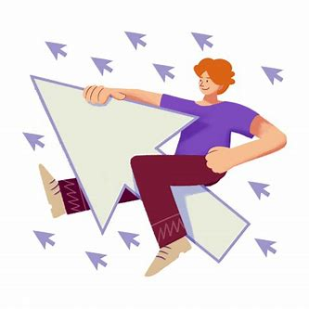
onward

Slide 4
onward
forward

Slide 5
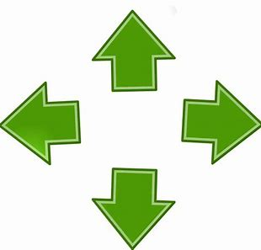
onward
forward
outward

Slide 6
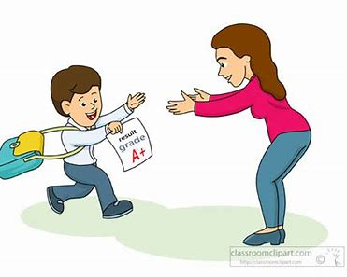
onward
forward
outward
towards

Slide 7
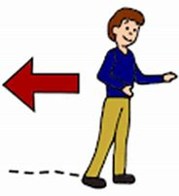
onward
forward
outward
towards
backward

Slide 8
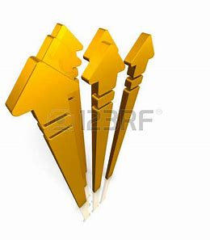
onward
forward
outward
towards
backward
skyward

Slide 9
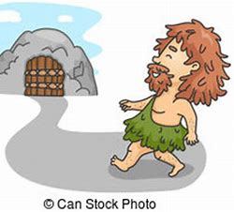
onward
forward
outward
towards
backward
skyward
homeward

Slide 10
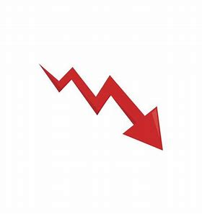
onward
forward
outward
towards
backward
skyward
homeward
downward

Slide 11
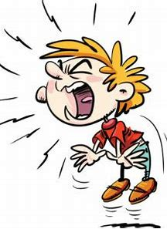
onward
forward
outward
towards
backward
skyward
homeward
downward
wayward

Slide 12
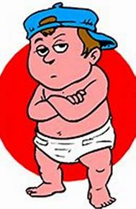
onward
forward
outward
towards
backward
skyward
homeward
downward
wayward
10. untoward

Slide 13
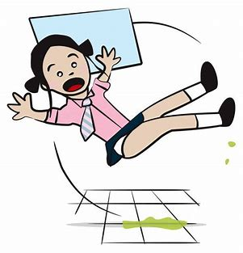
onward
forward
outward
towards
backward
skyward
homeward
downward
wayward
10. untoward
11. awkward

Slide 14
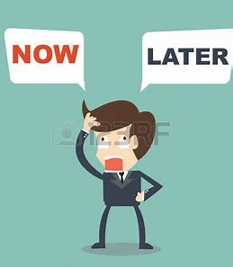
onward
forward
outward
towards
backward
skyward
homeward
downward
wayward
10. untoward
11. awkward
12. afterwards

Slide 15
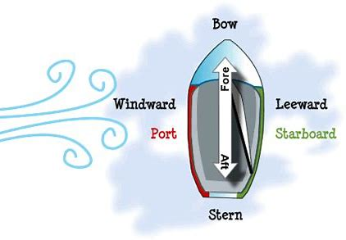
onward
forward
outward
towards
backward
skyward
homeward
downward
wayward
10. untoward
11. awkward
12. afterwards
13. leeward

Slide 16
onward
forward
outward
towards
backward
skyward
homeward
downward
wayward
10. untoward
11. awkward
12. afterwards
13. leeward
14. straightforward

Slide 17
onward
forward
outward
towards
backward
skyward
homeward
downward
wayward
10. untoward
11. awkward
12. afterwards
13. leeward
14. straightforward
15. henceforward

Slide 18
onward
forward
outward
towards
backward
skyward
homeward
downward
wayward
10. untoward
11. awkward
12. afterwards
13. leeward
14. straightforward
15. henceforward
16. windward

Slide 19
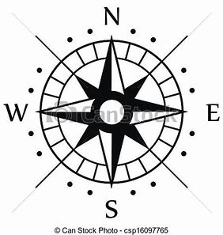
onward
forward
outward
towards
backward
skyward
homeward
downward
wayward
10. untoward
11. awkward
12. afterwards
13. leeward
14. straightforward
15. henceforward
16. windward
17. southeastward

Slide 20
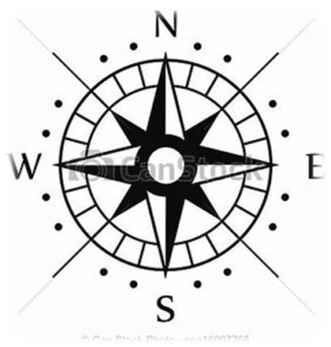
onward
forward
outward
towards
backward
skyward
homeward
downward
wayward
10. untoward
11. awkward
12. afterwards
13. leeward
14. straightforward
15. henceforward
16. windward
17. southeastward
18. northwestward

Slide 21
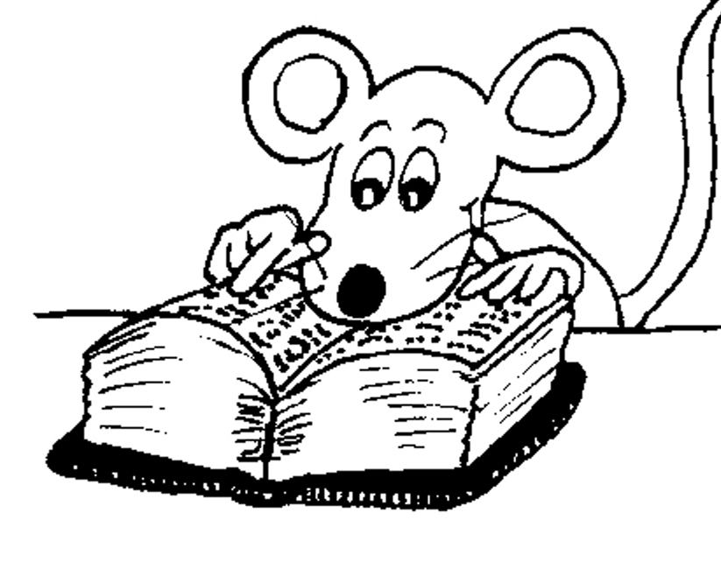
Let’s Revise
homophones.

Slide 22
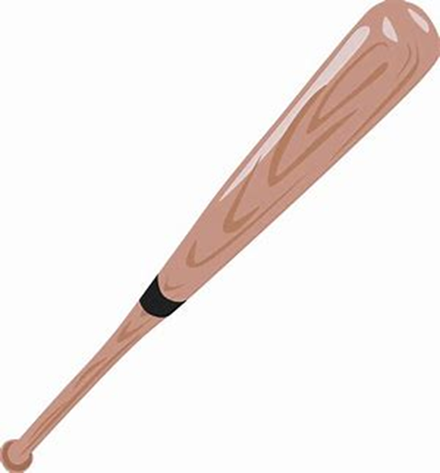
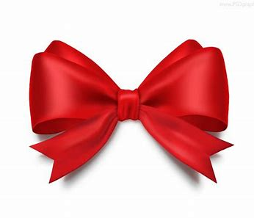
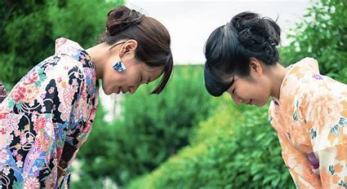
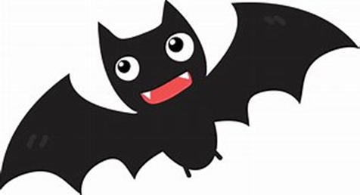
Homographs are words that share spelling, but have a different meaning.
Homographs that look the same but sound different are called heteronyms.
bat
bow
/boa/ /bou/

Slide 23
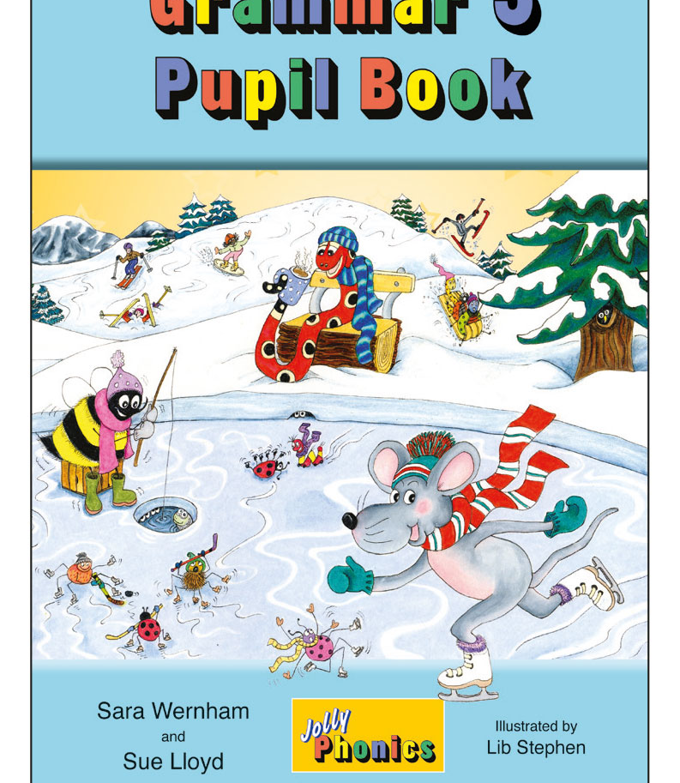
Activity Page
Homographs and Homonyms

Slide 24
bow
/boa/ /bou/
wind
/wind/ /wiend/
close
/cloas/ /cloaz/
A knot of something like ribbon or string with two loops in it
To bend your head or body forward to show respect when greeting an important person
The air that blows that you can feel on your body
To put something around something else, or to put things around each other lots of times
Not far away
To make something not open any more
tear
/tier/ /teer/
present
/prezent/ /prezent/
minute
/minit/ /mienuet/
Drops of liquid that come from your eyes when you cry
To pull something and make it go into separate pieces, or make a hole in it
Something that someone give to you, usually for a special occasion like a birthday
A part of an hour
Extremely small
To show someone something

Slide 25
bat
wave

Slide 26
bat
wave

Slide 27
bat
wave

Slide 28
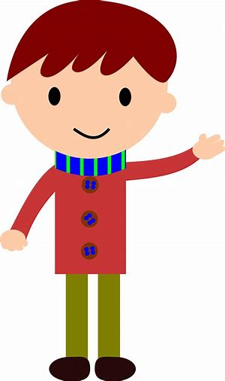
bat
wave

Slide 29
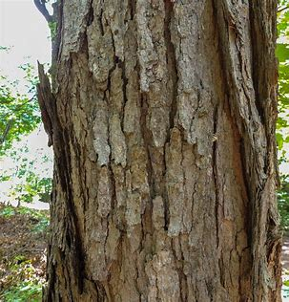
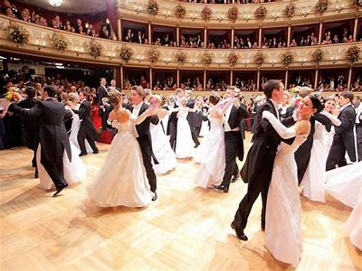
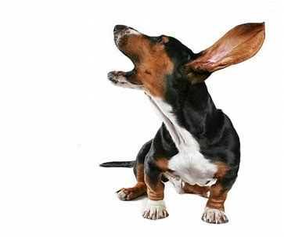
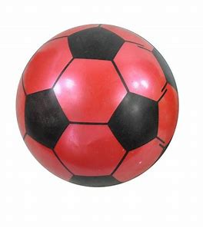
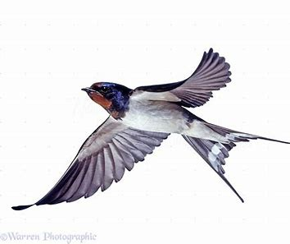
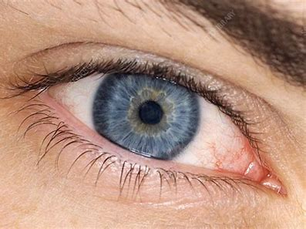
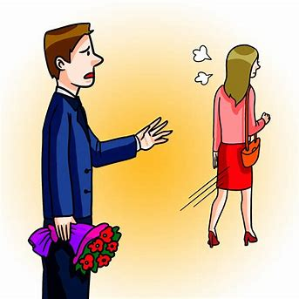
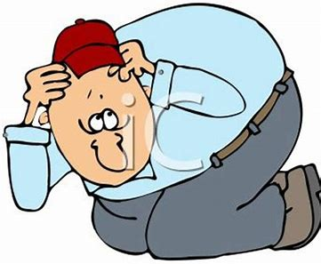
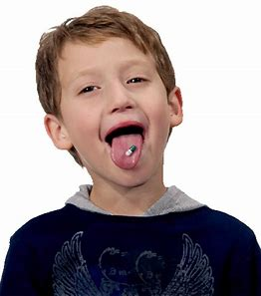
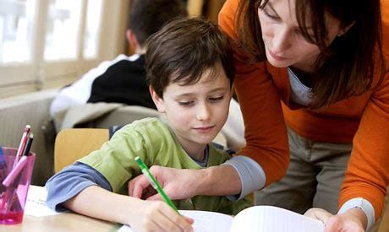
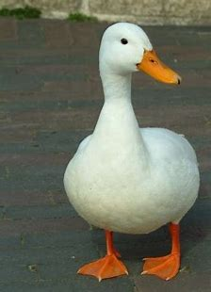
Can you think of a word that can mean both of these things?

Slide 30
Can you think of a word that can mean both of these things?
bark

Slide 31
Can you think of a word that can mean both of these things?
bark
ball

Slide 32
Can you think of a word that can mean both of these things?
bark
ball
navy

Slide 33
Can you think of a word that can mean both of these things?
bark
ball
navy
left

Slide 34
Can you think of a word that can mean both of these things?
bark
ball
navy
swallow
left

Slide 35
Can you think of a word that can mean both of these things?
bark
ball
navy
swallow
left
pupil

Slide 36
Can you think of a word that can mean both of these things?
bark
ball
navy
swallow
duck
left
pupil

Slide 37
See you
next time!

