Slide 1
Jolly Grammar
5b-33

Slide 2
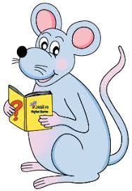
Let’s review homographs and homonyms.

Slide 3
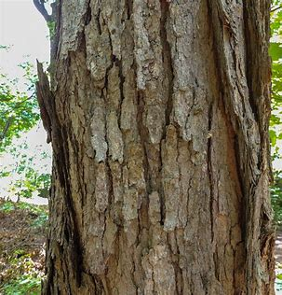
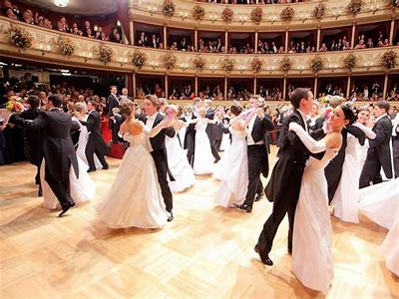
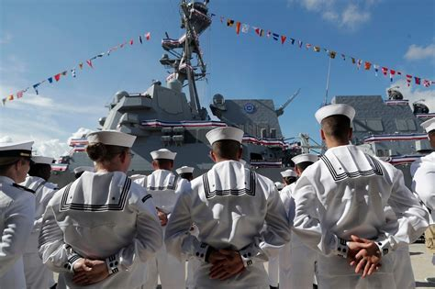
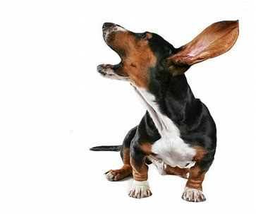
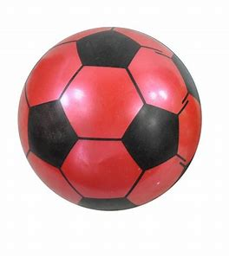
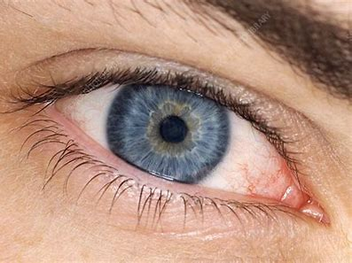
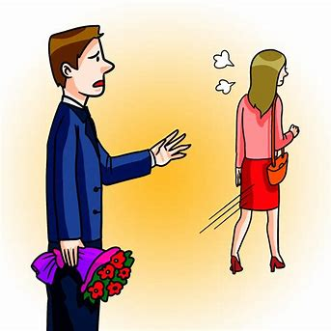
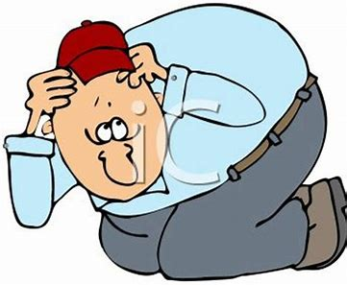
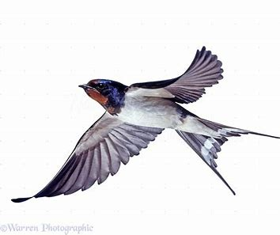
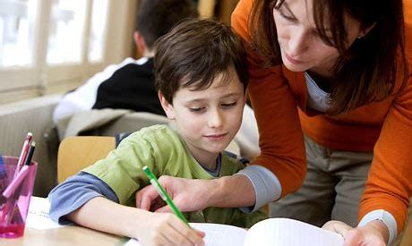
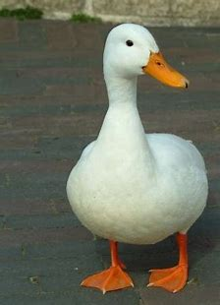
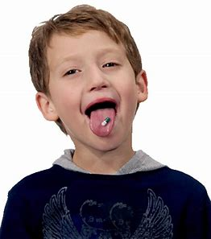
Can you think of a word that can mean both of these things?
bark
ball
navy
swallow
duck
left
pupil

Slide 4
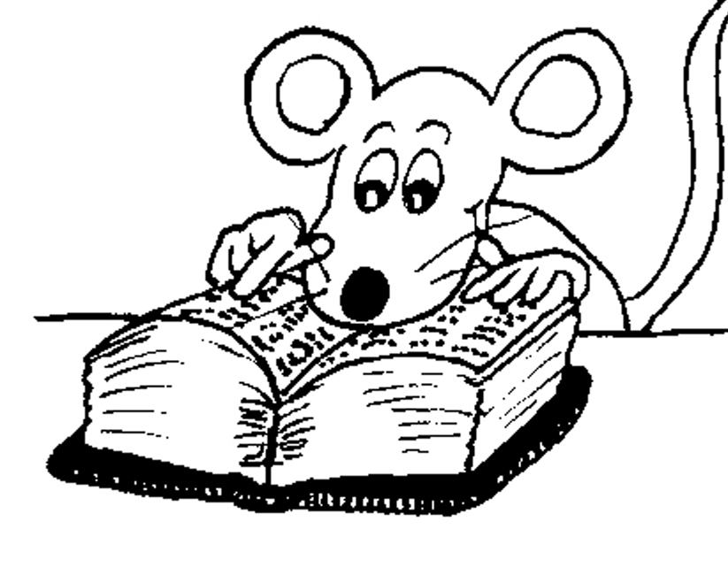
Let’s review
Sounds.

Slide 5
fissure
literature
possible
chute
chalet
cliché

Slide 6
Let’s learn
Spelling
<-ward>.

Slide 7
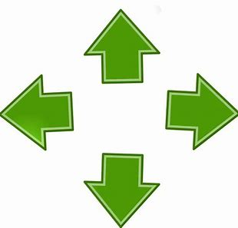
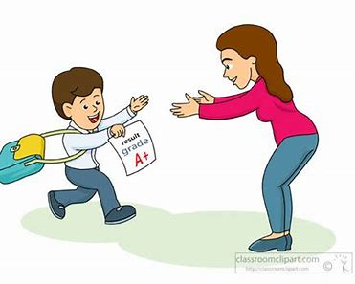
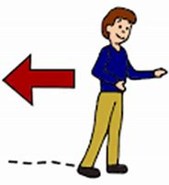
on ward for ward out ward
to wards back ward sky ward

Slide 8
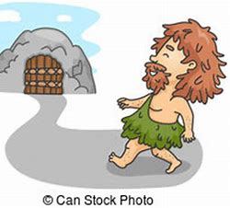
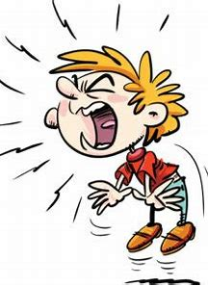
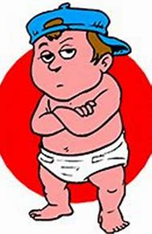
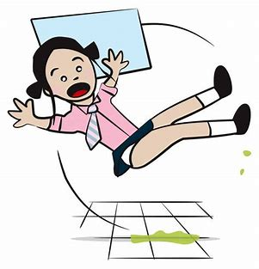
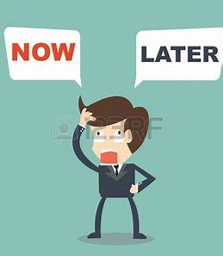
home ward down ward way ward
un to ward awk ward af ter wards

Slide 9
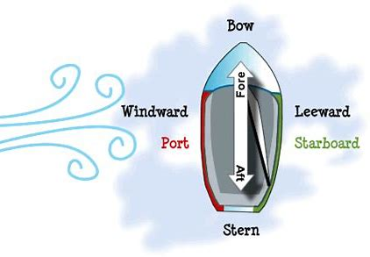
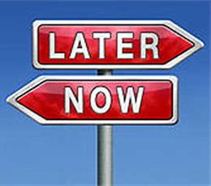
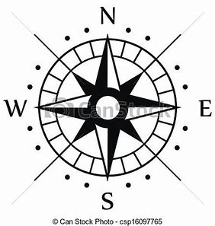
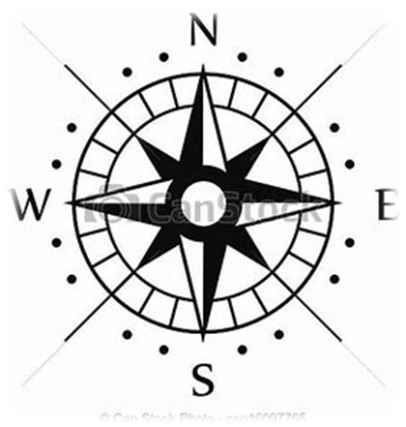
lee ward straight for ward hence for ward
wind ward south east ward north west ward

Slide 12
Activity Page
Spelling<-ward>

Slide 13
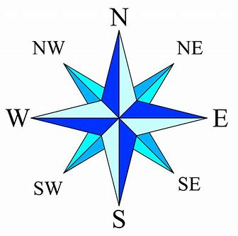
north
northwest
northeast
west
east
southwest
southeast
south

Slide 14
The ship’s captain was steadily sailing a souhwestward course.
Subject
captain
The ship’s
Verb
was sailing
steadily
Object
course
a southwestward
(transitive)

Slide 15
Dictation

Slide 16
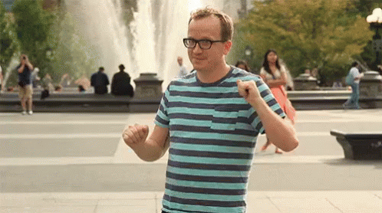

Slide 17
Dad always looked awkward when he tried to dance.

Slide 18
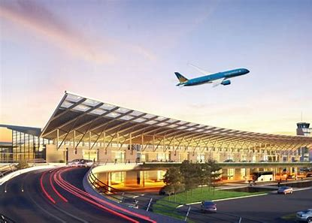
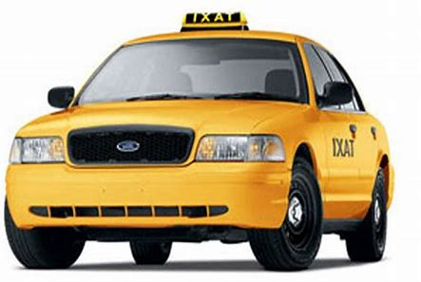

Slide 19
Afterwards, the taxi left and drove towards the airport.

Slide 20
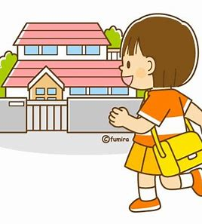

Slide 21
She said, “I’m looking forward to going home now.”

Slide 22
See you
next time!

