Slide 1
Jolly Grammar
5b-32

Slide 2
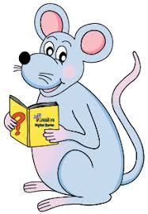
Spelling Test 34

Slide 3
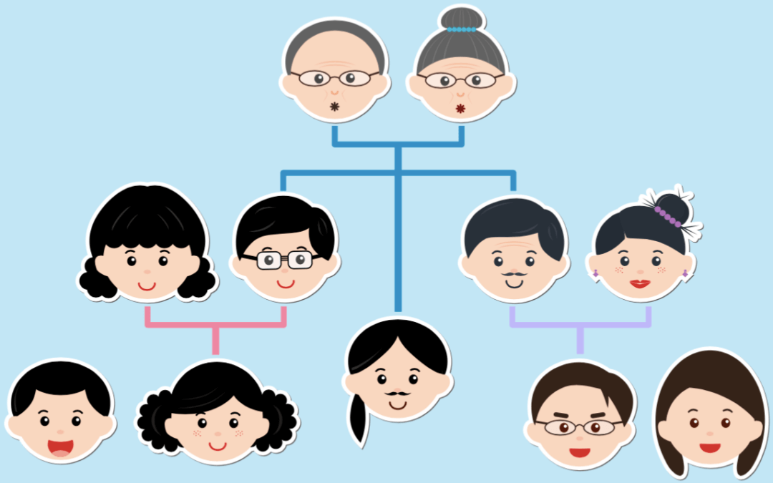
kinship

Slide 4
kinship
hardship

Slide 5
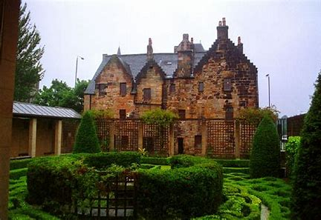
kinship
hardship
lordship

Slide 6
kinship
hardship
lordship
worship

Slide 7
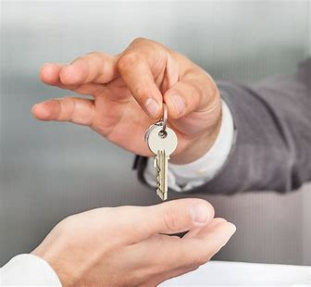
kinship
hardship
lordship
worship
ownership

Slide 8
kinship
hardship
lordship
worship
ownership
membership

Slide 9
kinship
hardship
lordship
worship
ownership
membership
partnership

Slide 10
kinship
hardship
lordship
worship
ownership
membership
partnership
friendship

Slide 11
kinship
hardship
lordship
worship
ownership
membership
partnership
friendship
sponsorship

Slide 12
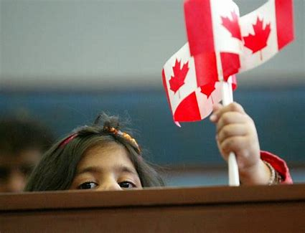
kinship
hardship
lordship
worship
ownership
membership
partnership
friendship
sponsorship
10. citizenship

Slide 13
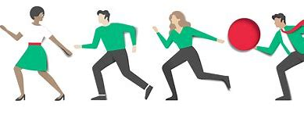
kinship
hardship
lordship
worship
ownership
membership
partnership
friendship
sponsorship
10. citizenship
11. fellowship

Slide 14
kinship
hardship
lordship
worship
ownership
membership
partnership
friendship
sponsorship
10. citizenship
11. fellowship
12. relationship

Slide 15
kinship
hardship
lordship
worship
ownership
membership
partnership
friendship
sponsorship
10. citizenship
11. fellowship
12. relationship
13. craftsmanship

Slide 16
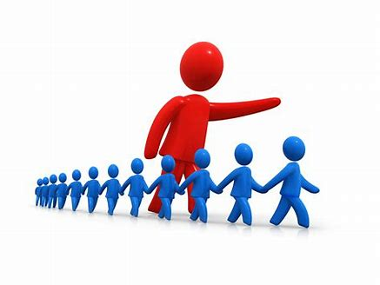
kinship
hardship
lordship
worship
ownership
membership
partnership
friendship
sponsorship
10. citizenship
11. fellowship
12. relationship
13. craftsmanship
14. leadership

Slide 17
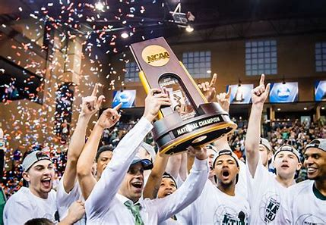
kinship
hardship
lordship
worship
ownership
membership
partnership
friendship
sponsorship
10. citizenship
11. fellowship
12. relationship
13. craftsmanship
14. leadership
15. championship

Slide 18
kinship
hardship
lordship
worship
ownership
membership
partnership
friendship
sponsorship
10. citizenship
11. fellowship
12. relationship
13. craftsmanship
14. leadership
15. championship
16. companionship

Slide 19
kinship
hardship
lordship
worship
ownership
membership
partnership
friendship
sponsorship
10. citizenship
11. fellowship
12. relationship
13. craftsmanship
14. leadership
15. championship
16. companionship
17. apprenticeship

Slide 20
kinship
hardship
lordship
worship
ownership
membership
partnership
friendship
sponsorship
10. citizenship
11. fellowship
12. relationship
13. craftsmanship
14. leadership
15. championship
16. companionship
17. apprenticeship
18. censorship

Slide 21
Let’s Revise
homophones.

Slide 22
Activity Page
Homographs and Homonyms

Slide 23
bat
wave

Slide 24
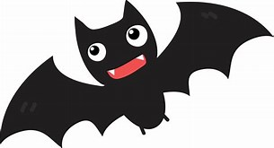
bat
wave

Slide 25
bat
wave

Slide 26
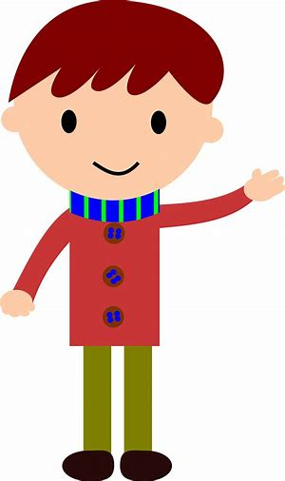
bat
wave

Slide 27
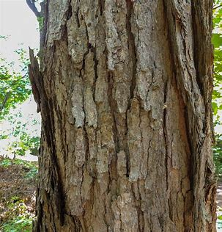
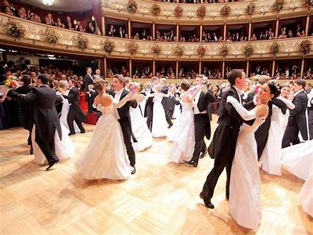
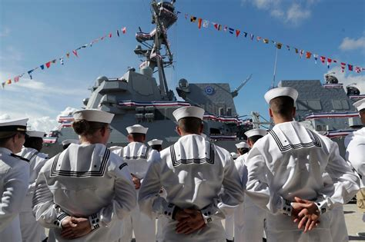
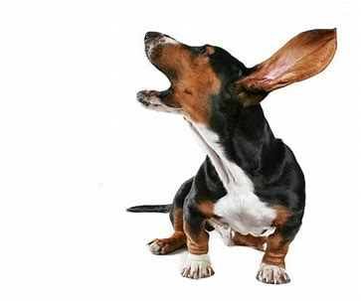
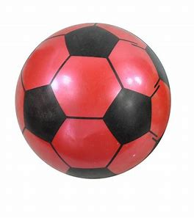
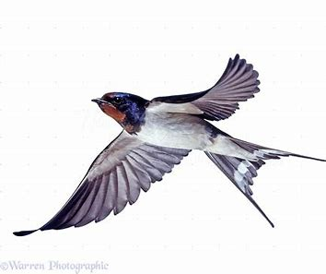
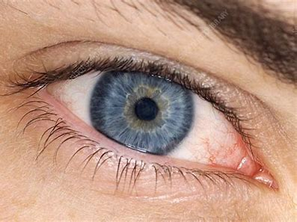
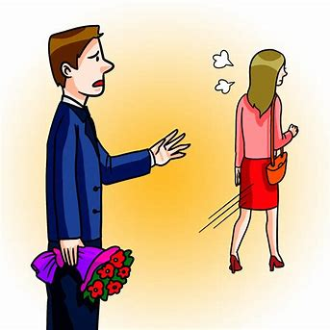
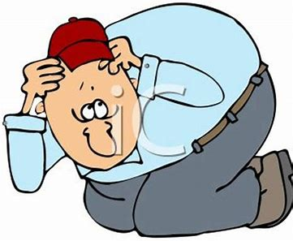
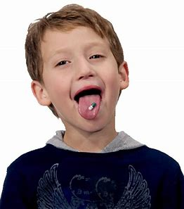
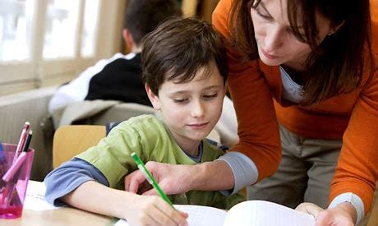
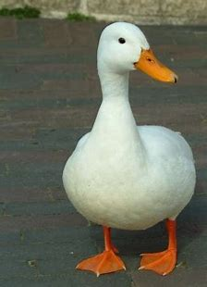
Can you think of a word that can mean both of these things?

Slide 28
Can you think of a word that can mean both of these things?
bark

Slide 29
Can you think of a word that can mean both of these things?
bark
ball

Slide 30
Can you think of a word that can mean both of these things?
bark
ball
navy

Slide 31
Can you think of a word that can mean both of these things?
bark
ball
navy
left

Slide 32
Can you think of a word that can mean both of these things?
bark
ball
navy
swallow
left

Slide 33
Can you think of a word that can mean both of these things?
bark
ball
navy
swallow
left
pupil

Slide 34
Can you think of a word that can mean both of these things?
bark
ball
navy
swallow
duck
left
pupil

Slide 35
See you
next time!

