Slide 1
Jolly Grammar
5b-31

Slide 2
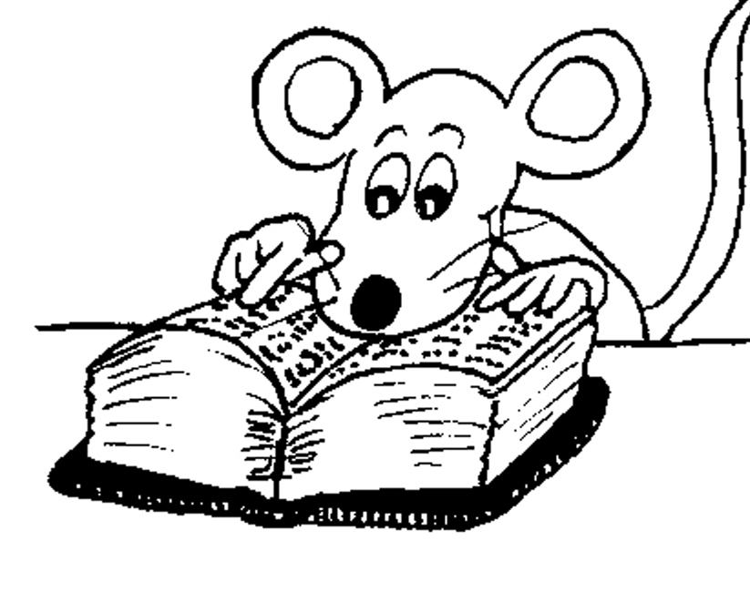
Let’s Revise
homophones.

Slide 3
doe: an adult female deer
dough: a thick mixture of flour or meat and
liquid for baking.

Slide 4
doe: an adult female deer
dough: a thick mixture of flour or meal and
liquid for baking.
feet: plural of foot
feat: an act or achievement that shows courage,
strength, or skill.

Slide 5
doe: an adult female deer
dough: a thick mixture of flour or meal and
liquid for baking.
feet: plural of foot
feat: an act or achievement that shows courage,
strength, or skill.
poor: without money, possessions, or other needs.
pour: to cause to flow in a steady stream.

Slide 6
doe: an adult female deer
dough: a thick mixture of flour or meal and
liquid for baking.
feet: plural of foot
feat: an act or achievement that shows courage,
strength, or skill.
poor: without money, possessions, or other needs.
pour: to cause to flow in a steady stream.
wail: to make a long, loud cry out of sadness or pain
whale: a very large mammal that lives in the water.

Slide 7
Let’s Revise
Sounds.

Slide 8
position
tension
impression
politician
operation

Slide 9
Let’s learn
Spelling
<-ship>.

Slide 10
leadership
hardship
lordship
friendship
craftsmanship
membership
position
tension
impression
politician
operation

Slide 11
Activity Page
Spelling: <-ship>

Slide 12
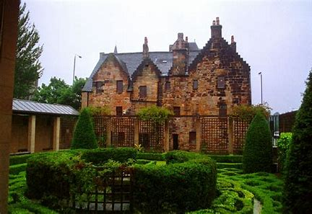
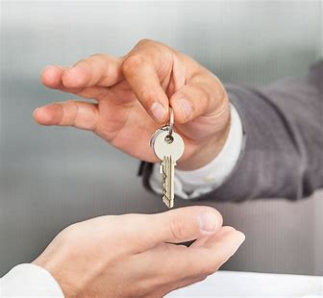
kin ship hard ship lord ship
wor ship own er ship mem ber ship

Slide 13
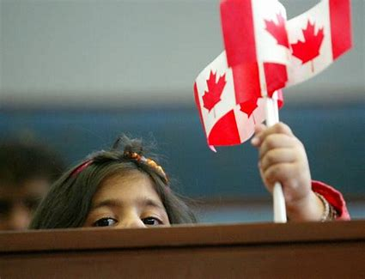
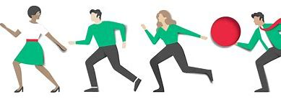
part ner ship friend ship spon sor ship
cit i zen ship fel low ship re la tion ship

Slide 14
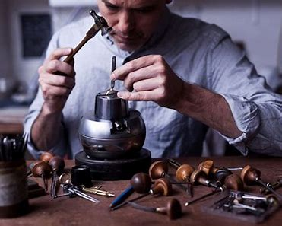
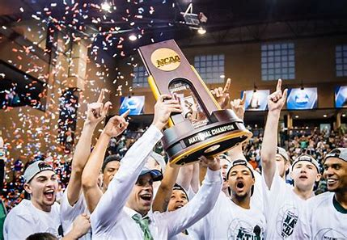
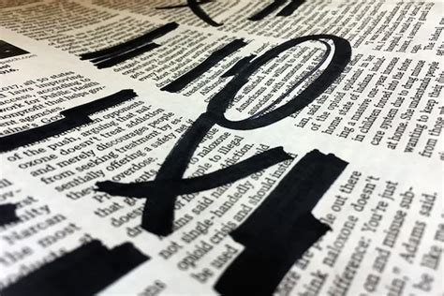
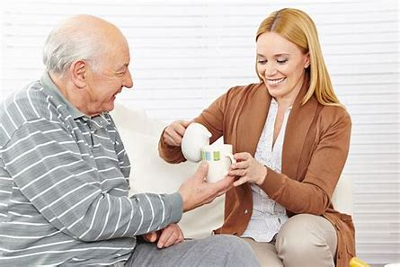
crafts man ship lead er ship cham pi on ship
com pan ion ship ap pren tice ship cen sor ship

Slide 17
Activity Page
Spelling<-ship>

Slide 18
Their long friendship had started in childhood.
Subject
friendship
Their long
Verb
had started
in childhood
Object
(intransitive)

Slide 19
Dictation

Slide 20
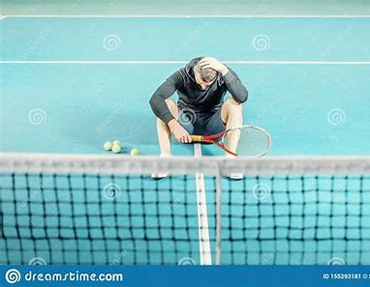

Slide 21
The tennis player was furious when he lost the championship.

Slide 22
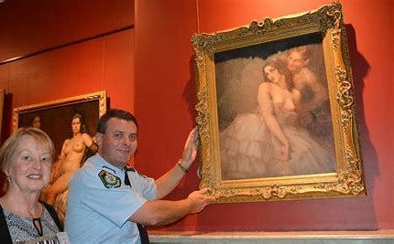

Slide 23
The ownership of the priceless painting is in question.

Slide 24
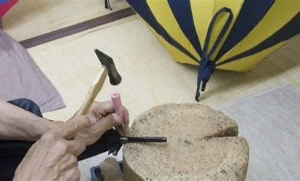

Slide 25
The art expert exclaimed, “What fabulous craftsmanship!”

Slide 26
See you
next time!

