Slide 1
Jolly Grammar
5b-30

Slide 2
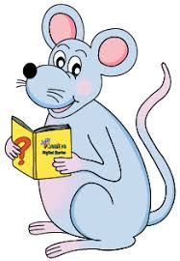
Spelling Test 33

Slide 3
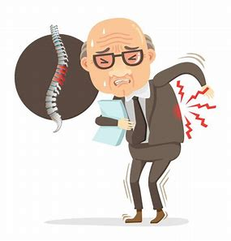
ailment

Slide 4
ailment
treatment

Slide 5
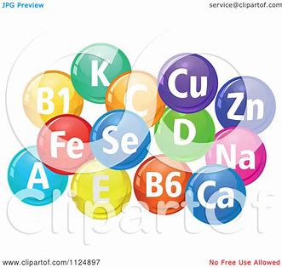
ailment
treatment
element

Slide 6
ailment
treatment
element
comment

Slide 7
ailment
treatment
element
comment
payment

Slide 8
ailment
treatment
element
comment
payment
assortment

Slide 9
ailment
treatment
element
comment
payment
assortment
agreement

Slide 10
ailment
treatment
element
comment
payment
assortment
agreement
government

Slide 11
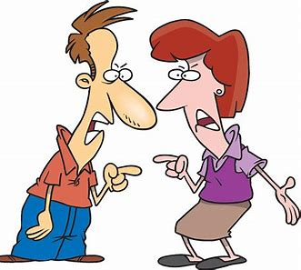
ailment
treatment
element
comment
payment
assortment
agreement
government
argument

Slide 12
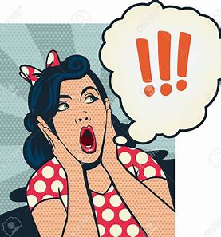
ailment
treatment
element
comment
payment
assortment
agreement
government
argument
10. astonishment

Slide 13
ailment
treatment
element
comment
payment
assortment
agreement
government
argument
10. astonishment
11. statement

Slide 14
ailment
treatment
element
comment
payment
assortment
agreement
government
argument
10. astonishment
11. statement
12. enjoyment

Slide 15
ailment
treatment
element
comment
payment
assortment
agreement
government
argument
10. astonishment
11. statement
12. enjoyment
13. parliament

Slide 16
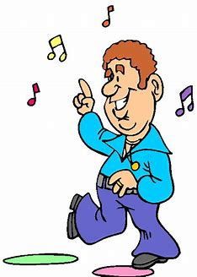
ailment
treatment
element
comment
payment
assortment
agreement
government
argument
10. astonishment
11. statement
12. enjoyment
13. parliament
14. entertainment

Slide 17
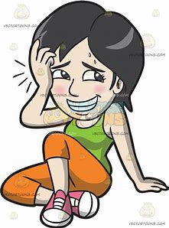
ailment
treatment
element
comment
payment
assortment
agreement
government
argument
10. astonishment
11. statement
12. enjoyment
13. parliament
14. entertainment
15. embarrassment

Slide 18
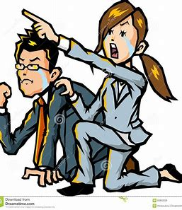
ailment
treatment
element
comment
payment
assortment
agreement
government
argument
10. astonishment
11. statement
12. enjoyment
13. parliament
14. entertainment
15. embarrassment
16. encouragement

Slide 19
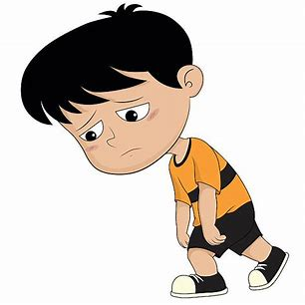
ailment
treatment
element
comment
payment
assortment
agreement
government
argument
10. astonishment
11. statement
12. enjoyment
13. parliament
14. entertainment
15. embarrassment
16. encouragement
17. disappointment

Slide 20
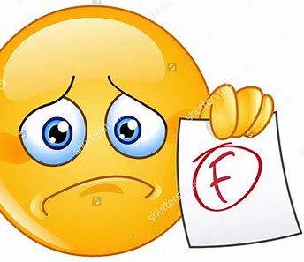
ailment
treatment
element
comment
payment
assortment
agreement
government
argument
10. astonishment
11. statement
12. enjoyment
13. parliament
14. entertainment
15. embarrassment
16. encouragement
17. disappointment
18. discouragement

Slide 21
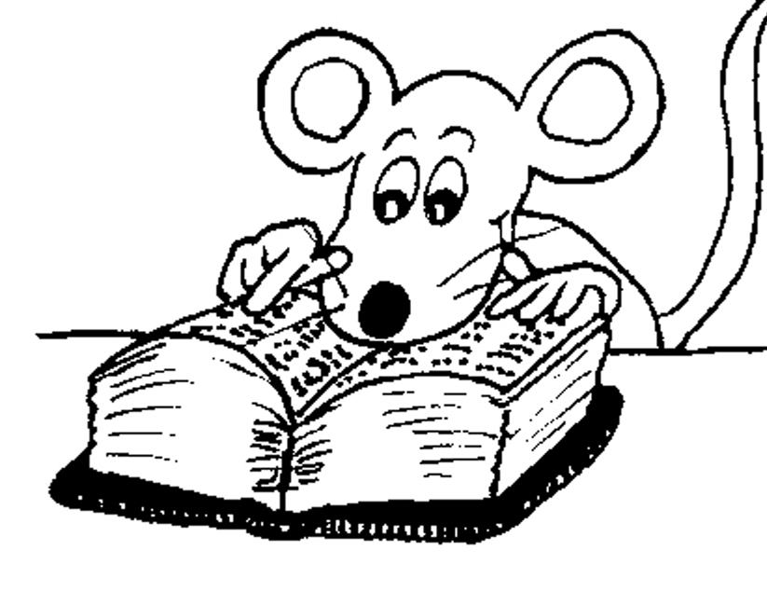
Let’s Revise
homophones.

Slide 22
our are

Slide 23
our are
their there they’re

Slide 24
our are
their there they’re
your you’re

Slide 25
our are
their there they’re
your you’re
its it’s

Slide 26
our are
their there they’re
your you’re
its it’s
to two too

Slide 27
our are
their there they’re
your you’re
its it’s
to two too
where wear were

Slide 28
our are
their there they’re
your you’re
its it’s
to two too
where were were
practice practise

Slide 29
our are
their there they’re
your you’re
its it’s
to two too
where wear were
practice practise
licence license

Slide 30
Activity Page
Homophone
Mix-ups

Slide 31
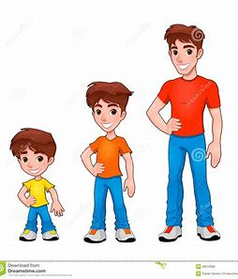
alter
altar
an elevated place or structure, as a mound or platform at which religious rites are performed or on which sacrifices are offered to gods, ancestors, etc.
to make different in some particular, as size, style, course, or the like; modify

Slide 32
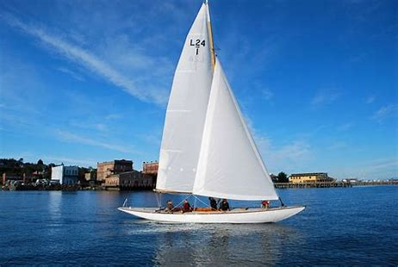
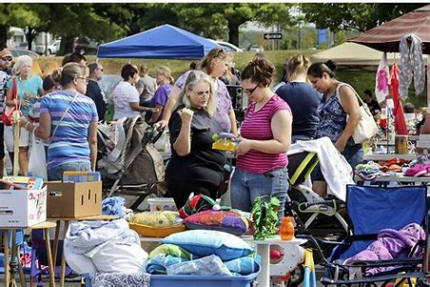
sail
sale
an area of canvas or other fabric extended to the wind in such a way as to transmit the force of the wind to an assemblage of spars and rigging mounted firmly on a hull, raft, iceboat, etc., so as to drive it along.
the act of selling.

Slide 33
piece
peace
a separate or limited portion or quantity of something
the normal, nonwarring condition of a nation, group of nations, or the world.

Slide 34
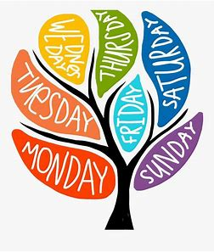
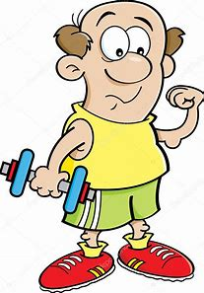
week
weak
a period of seven successive days
not strong

Slide 35
hire
higher
to engage the services of (a person or persons) for wages or other payment
the comparative of high

Slide 36
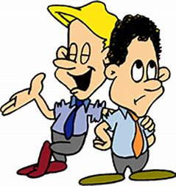
medal
meddle
a flat piece of metal, often a disk but sometimes a cross, star, or other form, usually bearing an inscription or design, issued to commemorate a person, action, or event, or given as a reward for bravery, merit, or the like:
to involve oneself in a matter without right or invitation; interfere officiously and unwantedly:

Slide 37
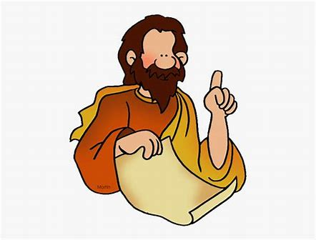
profit
prophet
pecuniary gain resulting from the employment of capital in any transaction.
a person who speaks for God or a deity, or by divine inspiration

Slide 38
See you
next time!

