Slide 1
Jolly Grammar
5b-29

Slide 2
Let’s revise
suffixes

Slide 3
multitude
automatic
megaphone
microchip
superior
centipede
millipede
postpone

Slide 4
multitude
automatic
megaphone
microchip
superior
centipede
millipede
postpone
many

Slide 5
multitude
automatic
megaphone
microchip
superior
centipede
millipede
postpone
many
self

Slide 6
multitude
automatic
megaphone
microchip
superior
centipede
millipede
postpone
many
self
great

Slide 7
multitude
automatic
megaphone
microchip
superior
centipede
millipede
postpone
many
self
great
small

Slide 8
multitude
automatic
megaphone
microchip
superior
centipede
millipede
postpone
many
self
great
small
above

Slide 9
multitude
automatic
megaphone
microchip
superior
centipede
millipede
postpone
many
self
great
small
above
hundred

Slide 10
multitude
automatic
megaphone
microchip
superior
centipede
millipede
postpone
many
self
great
small
above
hundred
thousand

Slide 11
multitude
automatic
megaphone
microchip
superior
centipede
millipede
postpone
many
self
great
small
above
hundred
thousand
after

Slide 12
Let’s learn
Spelling
<-ment>.

Slide 13
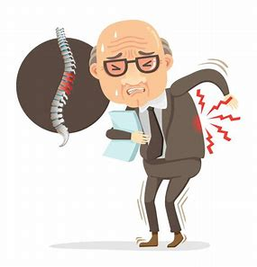
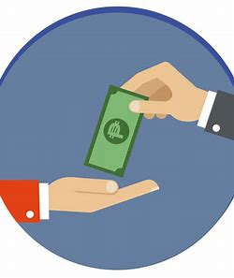
ail ment treat ment el e ment
com ment pay ment as sort ment

Slide 14
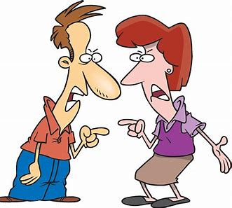
a gree ment gov ern ment ar gu ment
as ton ish ment state ment en joy ment

Slide 15
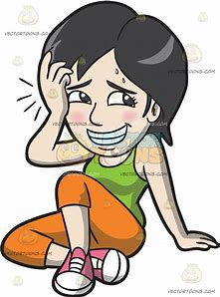
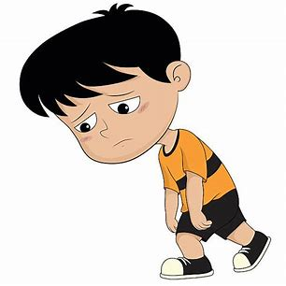
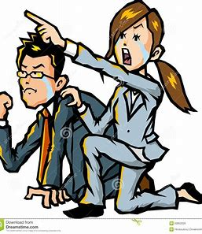
par lia ment en ter tain ment em bar rass ment
en cour age ment dis ap point ment dis cour age ment

Slide 18
Activity Page
Spelling<-ment>

Slide 19
a c c o m p l i s h m e n t

Slide 20
a c c o m p l i s h m e n t
an act or instance of carrying into effect

Slide 21
a c c o m p l i s h m e n t
an act or instance of carrying into effect
ant
the lime
stop
come
as
comment
man
men

Slide 22
The two friends reached an agreement after their argument.
Subject
friends
The two
Verb
reached
after their argument
Object
agreement
an
(transitive)

Slide 23
Dictation

Slide 24
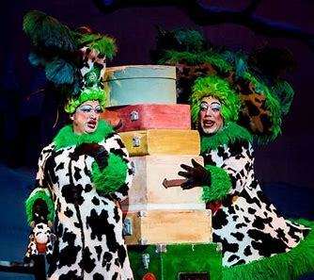

Slide 25
The entertainment was a terrible disappointment.

Slide 26
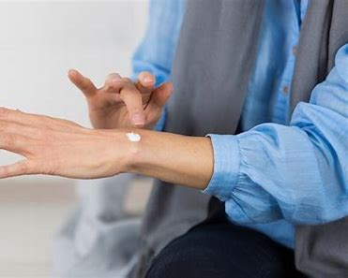
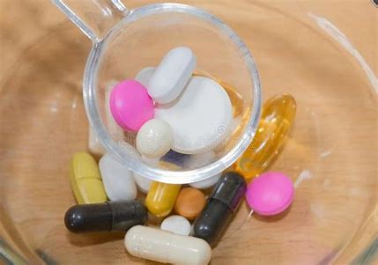

Slide 27
The patient had an assortment of treatments to cure his ailment.

Slide 28
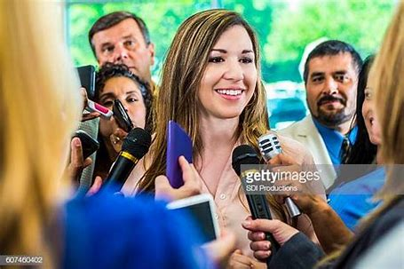

Slide 29
“Can you comment on the failure of the government?” she was asked.

Slide 30
See you
next time!

