Slide 1
Jolly Grammar
5b-28

Slide 2
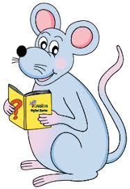
Spelling Test 32

Slide 3
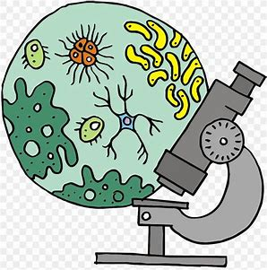
biology

Slide 4
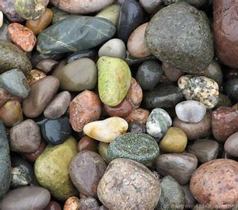
biology
geology

Slide 5
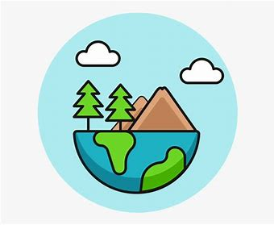
biology
geology
ecology

Slide 6
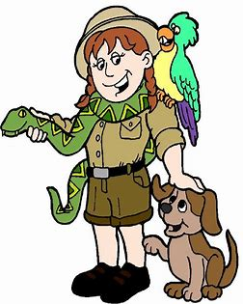
biology
geology
ecology
zoology

Slide 7
biology
geology
ecology
zoology
technology

Slide 8
biology
geology
ecology
zoology
technology
terminology

Slide 9
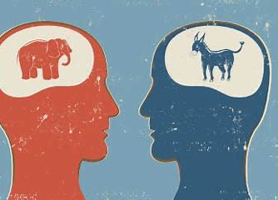
biology
geology
ecology
zoology
technology
terminology
ideology

Slide 10
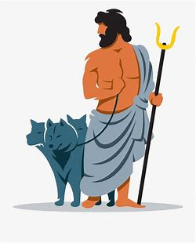
biology
geology
ecology
zoology
technology
terminology
ideology
mythology

Slide 11
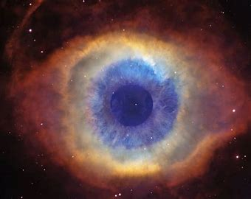
biology
geology
ecology
zoology
technology
terminology
ideology
mythology
cosmology

Slide 12
biology
geology
ecology
zoology
technology
terminology
ideology
mythology
cosmology
10. anthology

Slide 13
biology
geology
ecology
zoology
technology
terminology
ideology
mythology
cosmology
10. anthology
11. chronology

Slide 14
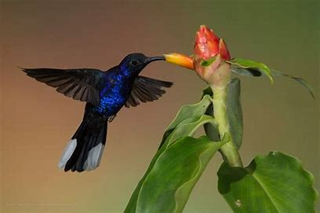
biology
geology
ecology
zoology
technology
terminology
ideology
mythology
cosmology
10. anthology
11. chronology
12. ornithology

Slide 15
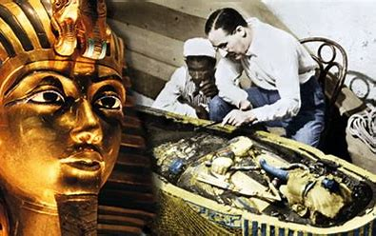
biology
geology
ecology
zoology
technology
terminology
ideology
mythology
cosmology
10. anthology
11. chronology
12. ornithology
13. Egyptology

Slide 16
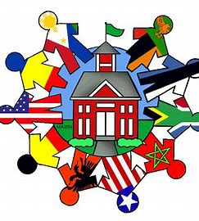
biology
geology
ecology
zoology
technology
terminology
ideology
mythology
cosmology
10. anthology
11. chronology
12. ornithology
13. Egyptology
14. sociology

Slide 17
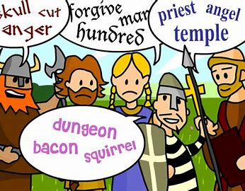
biology
geology
ecology
zoology
technology
terminology
ideology
mythology
cosmology
10. anthology
11. chronology
12. ornithology
13. Egyptology
14. sociology
15. etymology

Slide 18
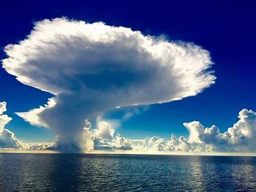
biology
geology
ecology
zoology
technology
terminology
ideology
mythology
cosmology
10. anthology
11. chronology
12. ornithology
13. Egyptology
14. sociology
15. etymology
16. meteorology

Slide 19
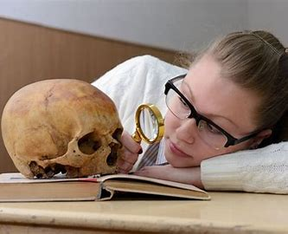
biology
geology
ecology
zoology
technology
terminology
ideology
mythology
cosmology
10. anthology
11. chronology
12. ornithology
13. Egyptology
14. sociology
15. etymology
16. meteorology
17. anthropology

Slide 20
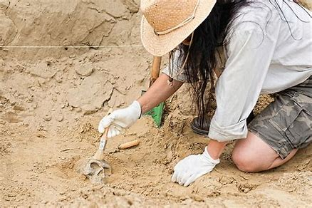
biology
geology
ecology
zoology
technology
terminology
ideology
mythology
cosmology
10. anthology
11. chronology
12. ornithology
13. Egyptology
14. sociology
15. etymology
16. meteorology
17. anthropology
18. archaeology

Slide 21
Let’s learn parentheses.

Slide 22
Can you find parentheses?
I am still reading the anthology (there are over 500 poems!) that you gave me last year.

Slide 23
Can you find parentheses?
I am still reading the anthology (there are over 500 poems!) that you gave me last year.
The desserts available are (a) carrot cake, (b) strawberry ice cream and (c) fruit salad.

Slide 24
Activity Page
Parentheses

Slide 25
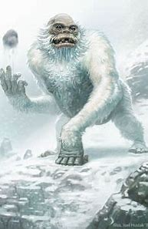
I am still reading the anthology (there are over 500 poems!) that you gave me last year.
Please remember to use paragraphs in your writing (It makes it so much easier to read!).
Some people believe the yeti (or Abominable Snowman) is real, but others think it is a mythological creature.
Koi carp are cold-water fish that prefer temperatures between 15 and 25°C (59-77°F).

Slide 26
He is the author of many books on zoology (the scientific study of animals and how they behave).

Slide 27
He is the author of many books on zoology (the scientific study of animals and how they behave).
He is the author of many books on zoology. Zoology is the scientific study of animals and how they behave.

Slide 28
They are going on an African safari (meaning ‘journey’) to see the lions, giraffes and hippopotamuses.

Slide 29
They are going on an African safari (meaning ‘journey’) to see the lions, giraffes and hippopotamuses.
They are going on an African safari to see the lions, giraffes and hippopotamuses. Safari means ‘journey’.

Slide 30
This biography is about Samuel Morse (born in April 1791), who helped invent the telegraph and Morse code.

Slide 31
This biography is about Samuel Morse (born in April 1791), who helped invent the telegraph and Morse code.
This biography is about Samuel Morse, who helped invent the telegraph and Morse code. He was born in April 1791.

Slide 32
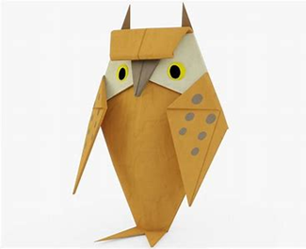
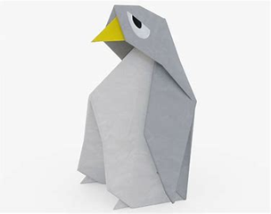
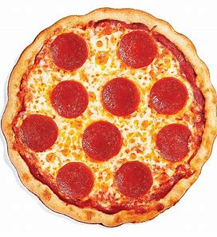
This year, I join the YOC Young Ornithologists
Club to learn more about birds. I’m also learning how
to make animals in origami that’s the traditional
Japanese art of paper folding. Vicky she’s my
younger sister is doing it too. Here’s a photograph
of the owl and penguin my favorite! that we made
last week. Tonight we’re having either a pepperoni,
b salami or c sausage pizza!

Slide 33
This year, I join the YCC (Young Ornithologists
Club) to learn more about birds. I’m also learning how
to make animals in origami (that’s the traditional
Japanese art of paper folding). Vicky (she’s my
younger sister) is doing it too. Here’s a photograph
of the owl and penguin (my favorite!) that we made
last week. Tonight we’re having either (a) pepperoni,
(b) salami or (c) sausage pizza!

Slide 34
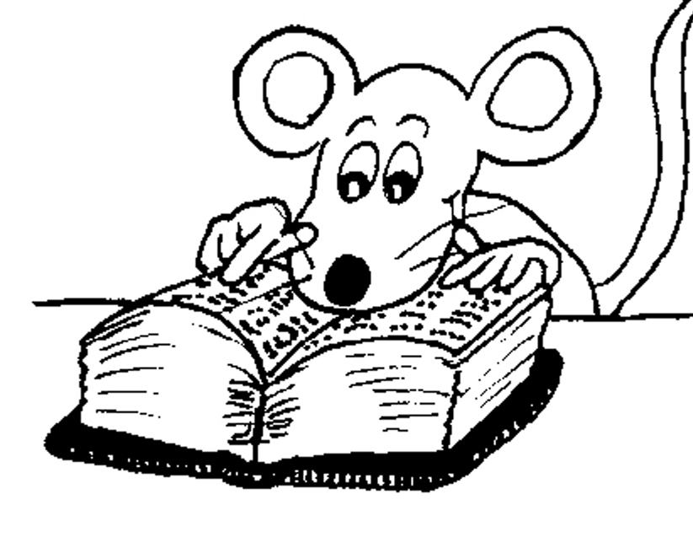
Let’s write without parentheses. Does it make sense?

Slide 35
See you
next time!

