Slide 1
Jolly Grammar
5a-27

Slide 2
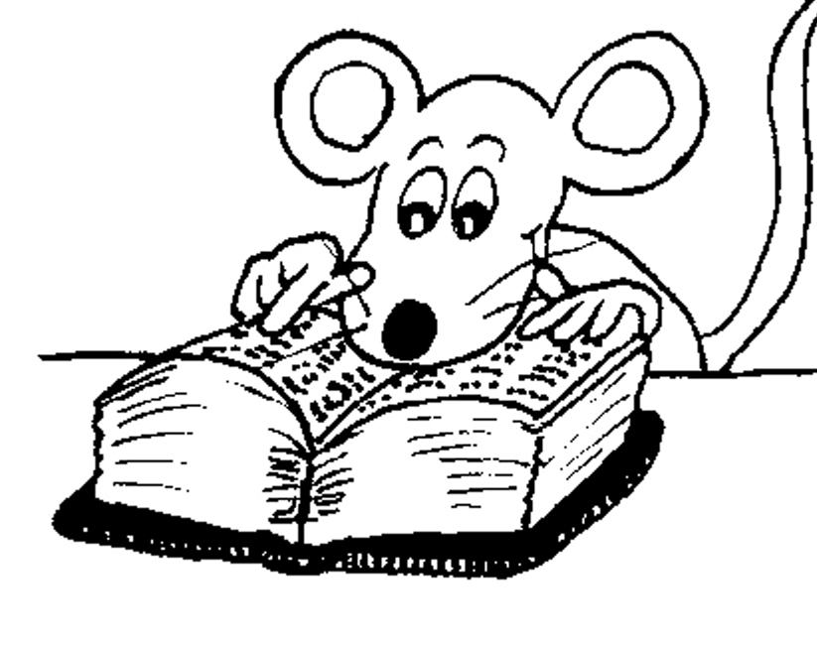
Let’s Revise
A Colon and
Bullet points.

Slide 3
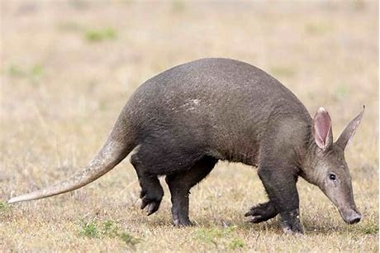
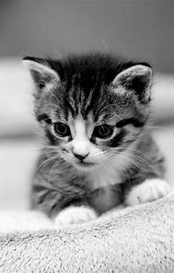
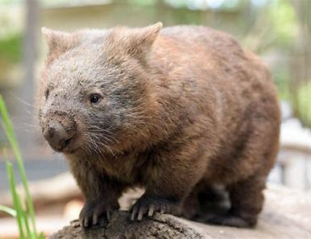
My favorite animals are aardvarks, cats and wombats.
colon
My favorite animals are:
・aardvarks
・cats
・wombats
bullet points
1, 2, 3 or A, B, C

Slide 4
Activity Page
Spelling: <-ology>

Slide 5
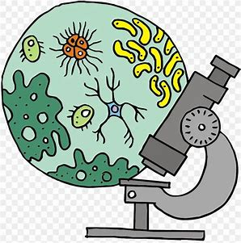
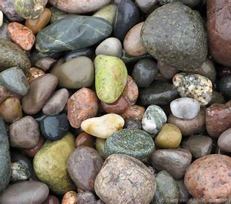
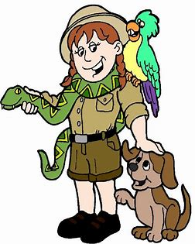
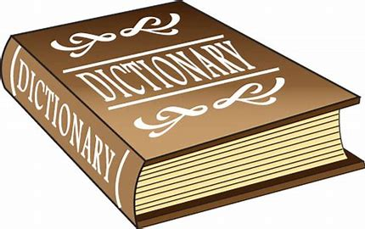
biology geology ecology
zoology technology terminology

Slide 6
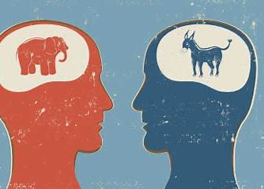
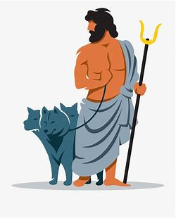
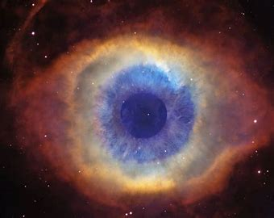
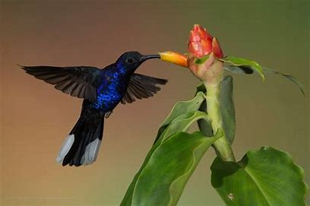
ideology mythology cosmology
anthology chronology ornithology

Slide 7
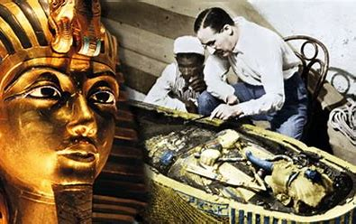
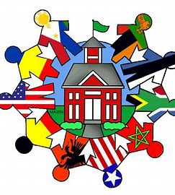
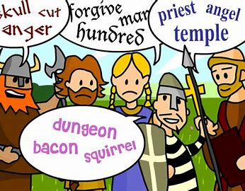
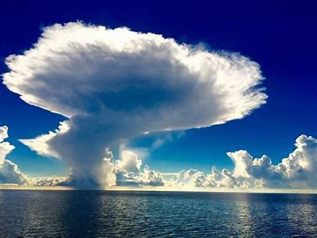
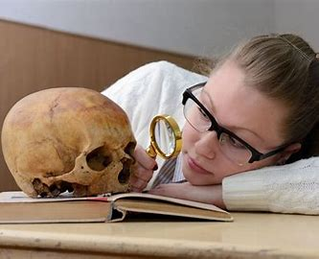
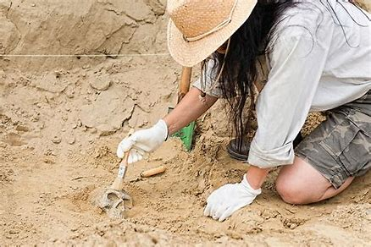
Egyptology sociology etymology
meteorology anthropology archaeology

Slide 10
Parsing & Sentence Walls

Slide 11
Modern technology is developing
(at the rapid rate).
Subject
technology
Moden
Verb
is developing
(intransitive)
at a rapid rate
Object

Slide 12
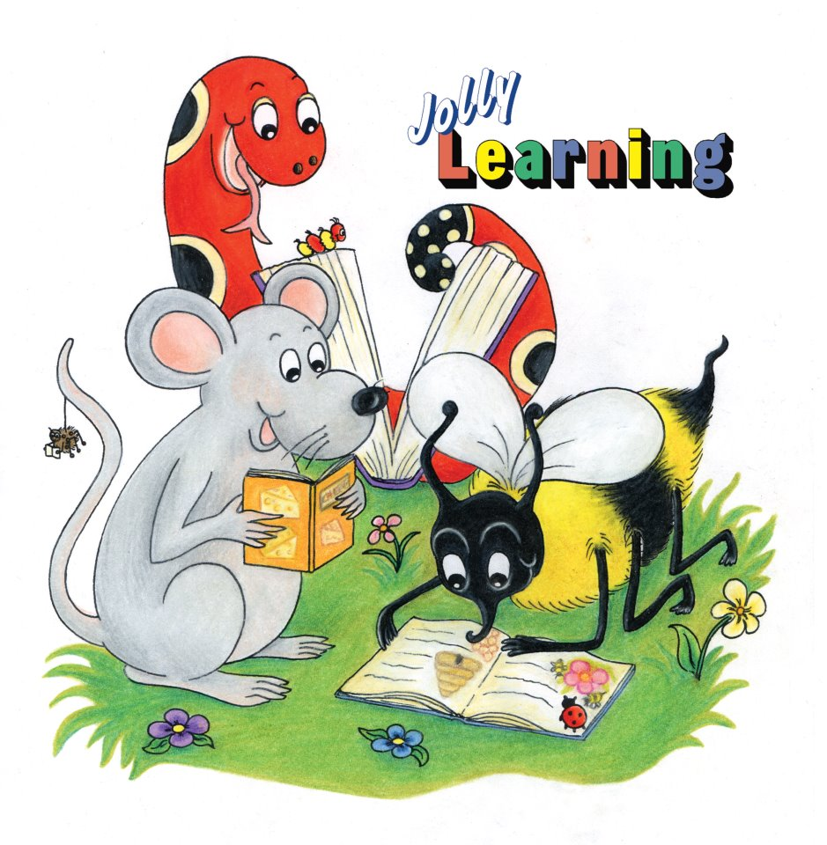
Make Lists

Slide 13
My favorite animals are aardvarks, cats and wombats.
colon
My favorite animals are:
・aardvarks
・cats
・wombats
bullet points
1, 2, 3 or A, B, C

Slide 14
Dictation

Slide 15
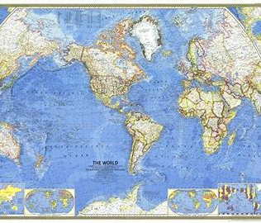

Slide 16
“Shall I study geography or geology?” mused the student.

Slide 17
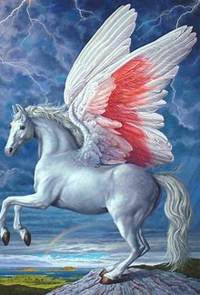

Slide 18
The flying horse from Greek mythology is called Pegasus.

Slide 20
The anthology has a superb collection of interesting stories.

Slide 21
See you
next time!

