Slide 1
Jolly Grammar
5b-26

Slide 2
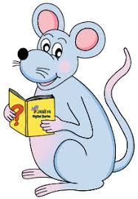
Spelling Test 31

Slide 3
Let’s Revise
plurals.

Slide 4
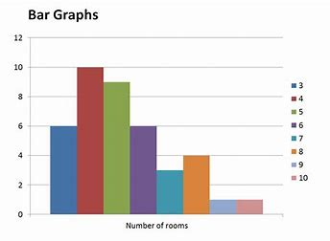
graph

Slide 5
graph
graphic

Slide 6
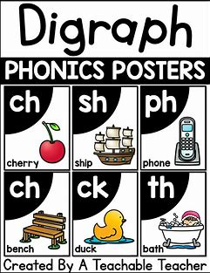
graph
graphic
digraph

Slide 7
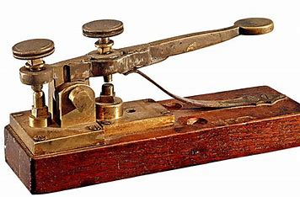
graph
graphic
digraph
telegraph

Slide 8
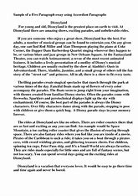
graph
graphic
digraph
telegraph
paragraph

Slide 9
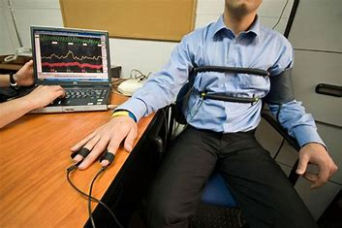
graph
graphic
digraph
telegraph
paragraph
polygraph

Slide 10
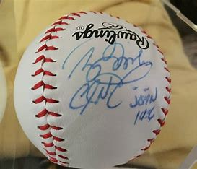
graph
graphic
digraph
telegraph
paragraph
polygraph
autograph

Slide 11
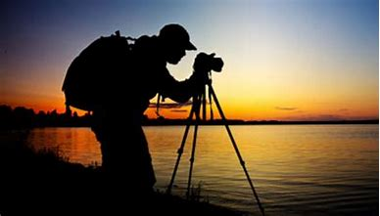
graph
graphic
digraph
telegraph
paragraph
polygraph
autograph
photograph

Slide 12
graph
graphic
digraph
telegraph
paragraph
polygraph
autograph
photograph
biography

Slide 13
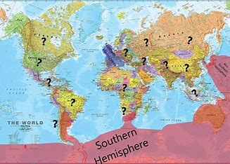
graph
graphic
digraph
telegraph
paragraph
polygraph
autograph
photograph
biography
10. geography

Slide 14
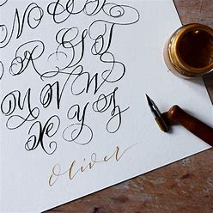
graph
graphic
digraph
telegraph
paragraph
polygraph
autograph
photograph
biography
10. geography
11. calligraphy

Slide 15
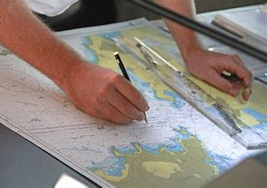
graph
graphic
digraph
telegraph
paragraph
polygraph
autograph
photograph
biography
10. geography
11. calligraphy
12. cartographer

Slide 16
graph
graphic
digraph
telegraph
paragraph
polygraph
autograph
photograph
biography
10. geography
11. calligraphy
12. cartographer
13. homograph

Slide 17
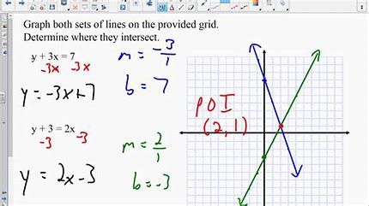
graph
graphic
digraph
telegraph
paragraph
polygraph
autograph
photograph
biography
10. geography
11. calligraphy
12. cartographer
13. homograph
14. graphically

Slide 18
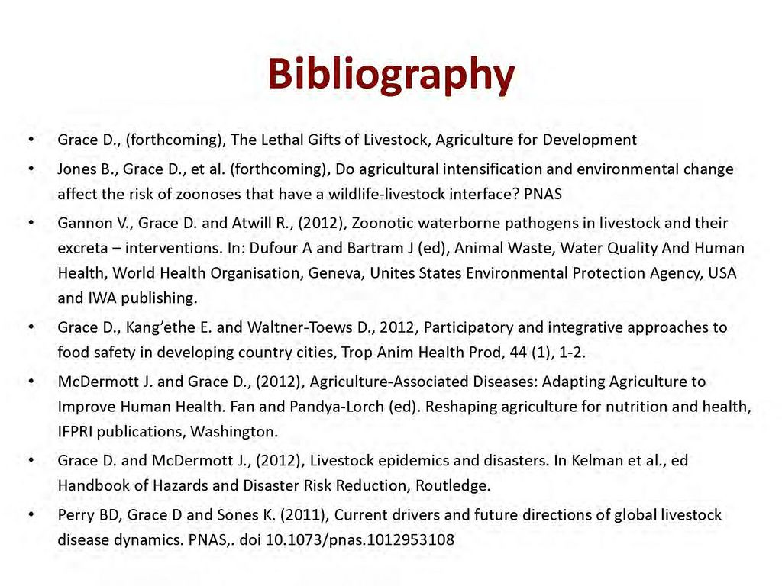
graph
graphic
digraph
telegraph
paragraph
polygraph
autograph
photograph
biography
10. geography
11. calligraphy
12. cartographer
13. homograph
14. graphically
15. bibliography

Slide 19
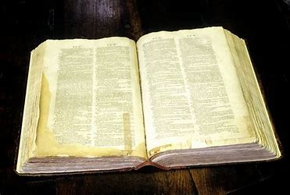
graph
graphic
digraph
telegraph
paragraph
polygraph
autograph
photograph
biography
10. geography
11. calligraphy
12. cartographer
13. homograph
14. graphically
15. bibliography
16. lexicography

Slide 20
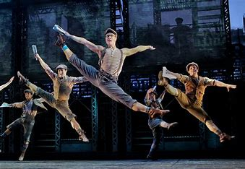
graph
graphic
digraph
telegraph
paragraph
polygraph
autograph
photograph
biography
10. geography
11. calligraphy
12. cartographer
13. homograph
14. graphically
15. bibliography
16. lexicography
17. choreography

Slide 21
graph
graphic
digraph
telegraph
paragraph
polygraph
autograph
photograph
biography
10. geography
11. calligraphy
12. cartographer
13. homograph
14. graphically
15. bibliography
16. lexicography
17. choreography
18. autobiography

Slide 22
Let’s Revise
Punctuation.

Slide 23
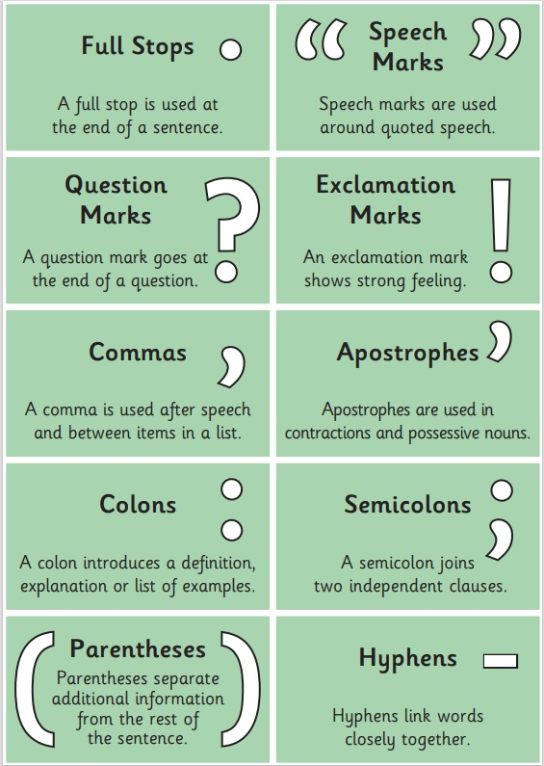

Slide 24
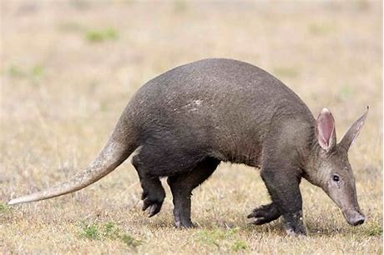
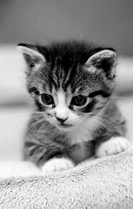
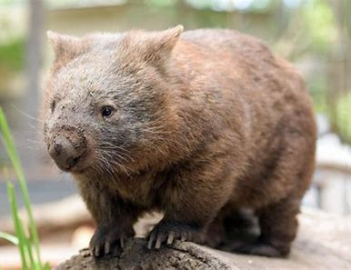
My favorite animals are aardvarks, cats and wombats.

Slide 25
My favorite animals are aardvarks, cats and wombats.
My favorite animals are:
・aardvarks
・cats
・wombats

Slide 26
My favorite animals are aardvarks, cats and wombats.
colon
My favorite animals are:
・aardvarks
・cats
・wombats
bullet points

Slide 27
My favorite animals are aardvarks, cats and wombats.
colon
My favorite animals are:
・aardvarks
・cats
・wombats
bullet points
1, 2, 3 or A, B, C

Slide 28
Activity Page
Using a Colon and Bullet Points in a List

Slide 29
My favorite sports
Things I would like to do in my life
My favorite animals
Things I need to pack for school

Slide 30
fried chicken
eels
clam chowder
vanilla
green tea

Slide 31
See you
next time!

