Slide 1
Jolly Grammar
5a-25

Slide 2
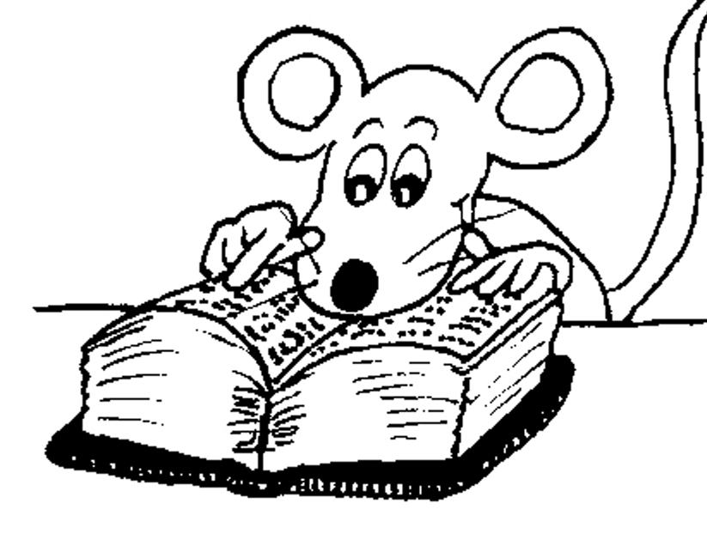
Let’s Revise
Plurals.

Slide 3
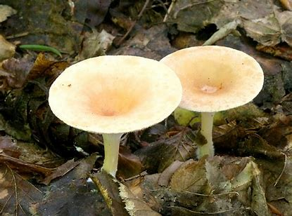
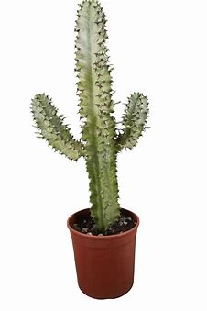
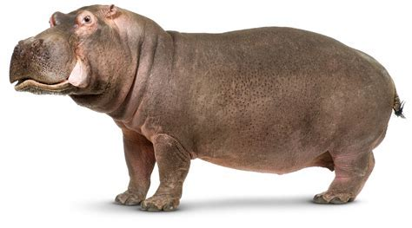
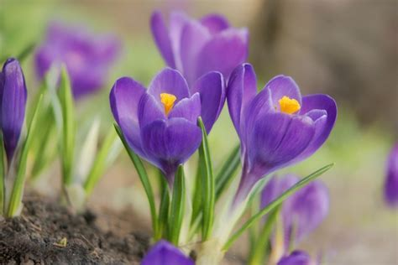
Some nouns can be made in either way, adding <-es> or replacing <-us> with <-i>.
cactus
hippopotamus
crocus
fungus
fungi
funguses
hippopotami
hippopotamuses
cacti
cactuses
croci
crocuses

Slide 4
Activity Page
Spelling: <graph>

Slide 5
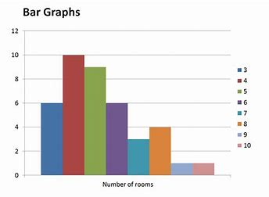
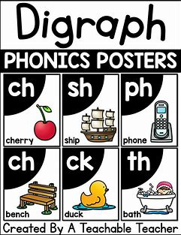
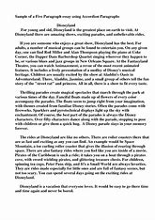
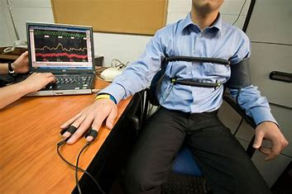
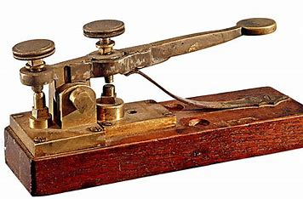
graph graphic digraph
telegraph paragraph polygraph

Slide 6
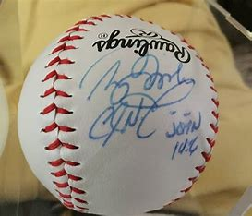
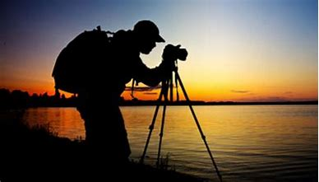
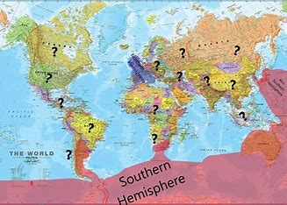
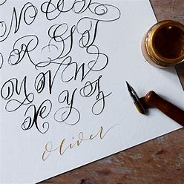
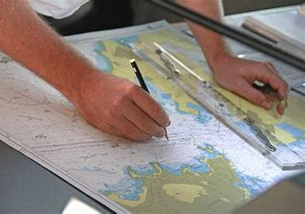
autograph photograph biography
geography calligraphy cartographer

Slide 7
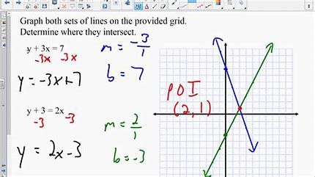
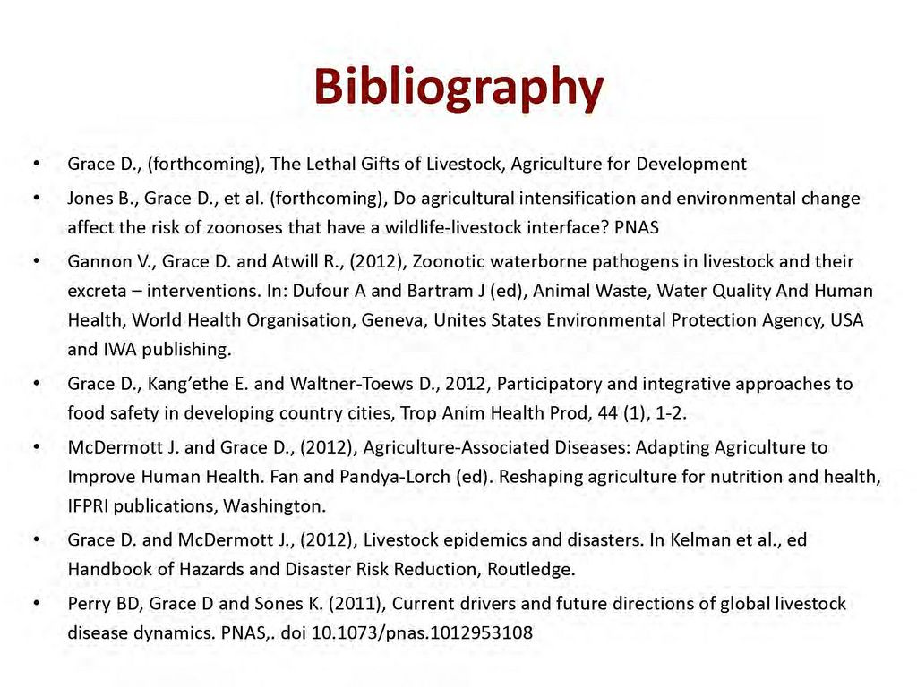
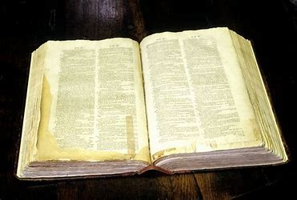
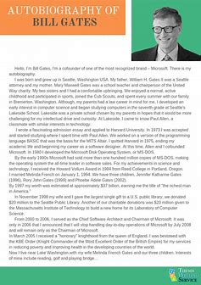
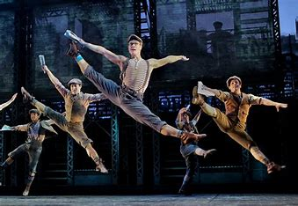
homograph graphically bibliography
lexicography choreography autobiography

Slide 10
Parsing & Sentence Walls

Slide 11
The cartographer decorated his map with beautiful calligraphy.
Subject
cartographer
The
Verb
decorated
(transitive)
(with beautiful
calligraphy)
Object
map
his

Slide 12
Write the plurals

Slide 13
doorways
ditches
women
potatoes
hoaxes
pies
kilos
mice
octopuses
lives
princesses
cacti
dairies
crashes
nuclei
people
knives
galleries
cowboys
sheep

Slide 14
Dictation

Slide 15
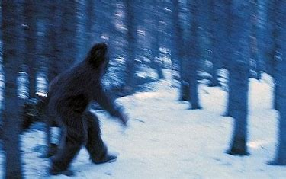

Slide 16
“Can this photograph of a yeti be real?” asked the editor.

Slide 17
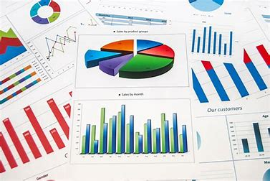
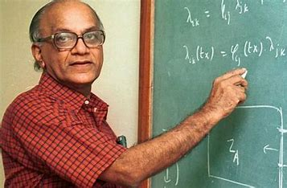

Slide 18
Mathematicians often use graphs and charts in their work.

Slide 19
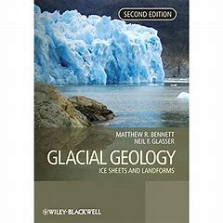

Slide 20
The geography book had several paragraphs on glacial valleys.

Slide 21
See you
next time!

