Slide 1
Jolly Grammar
5b-24

Slide 2
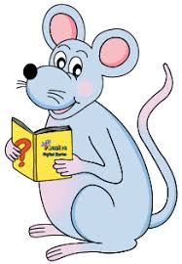
Spelling Test 30

Slide 3
taxi

Slide 4
taxi
kiwi

Slide 5
taxi
kiwi
ski

Slide 6
taxi
kiwi
ski
deli

Slide 7
taxi
kiwi
ski
deli
yeti

Slide 8
taxi
kiwi
ski
deli
yeti
koi

Slide 9
taxi
kiwi
ski
deli
yeti
koi
bikini

Slide 10
taxi
kiwi
ski
deli
yeti
koi
bikini
salami

Slide 11
taxi
kiwi
ski
deli
yeti
koi
bikini
salami
alibi

Slide 12
taxi
kiwi
ski
deli
yeti
koi
bikini
salami
alibi
10. bonsai

Slide 13
taxi
kiwi
ski
deli
yeti
koi
bikini
salami
alibi
10. bonsai
11. graffiti

Slide 14
taxi
kiwi
ski
deli
yeti
koi
bikini
salami
alibi
10. bonsai
11. graffiti
12. safari

Slide 15
taxi
kiwi
ski
deli
yeti
koi
bikini
salami
alibi
10. bonsai
11. graffiti
12. safari
13. spaghetti

Slide 16
taxi
kiwi
ski
deli
yeti
koi
bikini
salami
alibi
10. bonsai
11. graffiti
12. safari
13. spaghetti
14. broccoli

Slide 17
taxi
kiwi
ski
deli
yeti
koi
bikini
salami
alibi
10. bonsai
11. graffiti
12. safari
13. spaghetti
14. broccoli
15. origami

Slide 18
taxi
kiwi
ski
deli
yeti
koi
bikini
salami
alibi
10. bonsai
11. graffiti
12. safari
13. spaghetti
14. broccoli
15. origami
16. tsunami

Slide 19
taxi
kiwi
ski
deli
yeti
koi
bikini
salami
alibi
10. bonsai
11. graffiti
12. safari
13. spaghetti
14. broccoli
15. origami
16. tsunami
17. pepperoni

Slide 20
taxi
kiwi
ski
deli
yeti
koi
bikini
salami
alibi
10. bonsai
11. graffiti
12. safari
13. spaghetti
14. broccoli
15. origami
16. tsunami
17. pepperoni
18. paparazzi

Slide 21
Let’s Revise
plurals.

Slide 22
flower
cat
ash
tax
tomato
volcano
berry
pony
monkey
toy
flowers
cats
foot
mouse
woman
wolf
leaf
wife
sheep
fish
deer
fungus
alumnus

Slide 23
flower
cat
ash
tax
tomato
volcano
berry
pony
monkey
toy
flowers
cats
ashes
taxes
foot
mouse
woman
wolf
leaf
wife
sheep
fish
deer
fungus
alumnus

Slide 24
flower
cat
ash
tax
tomato
volcano
berry
pony
monkey
toy
flowers
cats
ashes
taxes
tomatoes
volcanoes
foot
mouse
woman
wolf
leaf
wife
sheep
fish
deer
fungus
alumnus

Slide 25
flower
cat
ash
tax
tomato
volcano
berry
pony
monkey
toy
flowers
cats
ashes
taxes
tomatoes
volcanoes
berries
ponies
foot
mouse
woman
wolf
leaf
wife
sheep
fish
deer
fungus
alumnus

Slide 26
flower
cat
ash
tax
tomato
volcano
berry
pony
monkey
toy
flowers
cats
ashes
taxes
tomatoes
volcanoes
berries
ponies
monkeys
toys
foot
mouse
woman
wolf
leaf
wife
sheep
fish
deer
fungus
alumnus

Slide 27
flower
cat
ash
tax
tomato
volcano
berry
pony
monkey
toy
flowers
cats
ashes
taxes
tomatoes
volcanoes
berries
ponies
monkeys
toys
foot
mouse
woman
wolf
leaf
wife
sheep
fish
deer
fungus
alumnus
feet
mice
women

Slide 28
flower
cat
ash
tax
tomato
volcano
berry
pony
monkey
toy
flowers
cats
ashes
taxes
tomatoes
volcanoes
berries
ponies
monkeys
toys
foot
mouse
woman
wolf
leaf
wife
sheep
fish
deer
fungus
alumnus
feet
mice
women
wolves
leaves
wives

Slide 29
flower
cat
ash
tax
tomato
volcano
berry
pony
monkey
toy
flowers
cats
ashes
taxes
tomatoes
volcanoes
berries
ponies
monkeys
toys
foot
mouse
woman
wolf
leaf
wife
sheep
fish
deer
fungus
alumnus
feet
mice
women
wolves
leaves
wives
sheep
fish
deer

Slide 30
flower
cat
ash
tax
tomato
volcano
berry
pony
monkey
toy
flowers
cats
ashes
taxes
tomatoes
volcanoes
berries
ponies
monkeys
toys
foot
mouse
woman
wolf
leaf
wife
sheep
fish
deer
fungus
alumnus
feet
mice
women
wolves
leaves
wives
sheep
fish
deer
fungi
alumni

Slide 31
Activity Page
Irregular Plurals:
<-i>

Slide 32
Many nouns in English that end in <-us> have a Latin origin. Most of theme have a regular plural, but some make the plural in the Latin way, replacing <-us> with<-i>. Make these words plural and look them up in a dictionary to find out their meanings.
stimulus
nucleus
alumnus

Slide 33
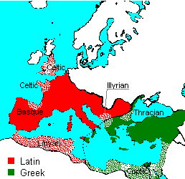

Slide 34
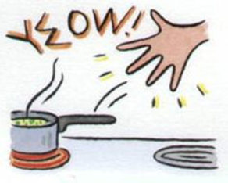
Many nouns in English that end in <-us> have a Latin origin. Most of theme have a regular plural, but some make the plural in the Latin way, replacing <-us> with<-i>. Make these words plural and look them up in a dictionary to find out their meanings.
stimulus
nucleus
alumnus
stimuli

Slide 35
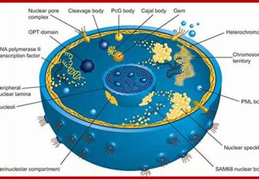
Many nouns in English that end in <-us> have a Latin origin. Most of theme have a regular plural, but some make the plural in the Latin way, replacing <-us> with<-i>. Make these words plural and look them up in a dictionary to find out their meanings.
stimulus
nucleus
alumnus
stimuli
nuclei

Slide 36
Many nouns in English that end in <-us> have a Latin origin. Most of theme have a regular plural, but some make the plural in the Latin way, replacing <-us> with<-i>. Make these words plural and look them up in a dictionary to find out their meanings.
stimulus
nucleus
alumnus
stimuli
nuclei
alumni

Slide 37
Some nouns ending <-us> come from Greek rather than Latin. Most nouns with a Greek or Latin origin from their plurals in the usual way by adding <-es>. Turn these singular nouns into plural ones.
octopus
platypus
virus

Slide 39
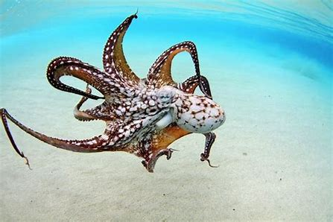
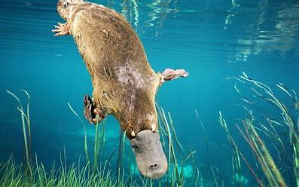
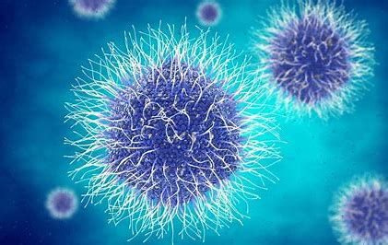
Some nouns ending <-us> come from Greek rather than Latin. Most nouns with a Greek or Latin origin from their plurals in the usual way by adding <-es>. Turn these singular nouns into plural ones.
octopus
platypus
virus

Slide 40
Some nouns ending <-us> come from Greek rather than Latin. Most nouns with a Greek or Latin origin from their plurals in the usual way by adding <-es>. Turn these singular nouns into plural ones.
octopus
platypus
virus
octopuses

Slide 41
Some nouns ending <-us> come from Greek rather than Latin. Most nouns with a Greek or Latin origin from their plurals in the usual way by adding <-es>. Turn these singular nouns into plural ones.
octopus
platypus
virus
octopuses
platypuses

Slide 42
Some nouns ending <-us> come from Greek rather than Latin. Most nouns with a Greek or Latin origin from their plurals in the usual way by adding <-es>. Turn these singular nouns into plural ones.
octopus
platypus
virus
octopuses
platypuses
viruses

Slide 43
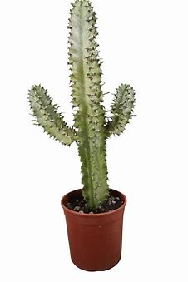
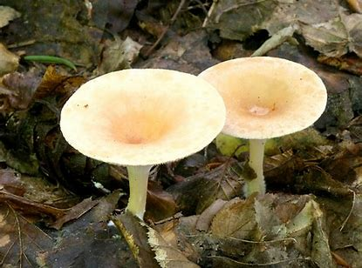
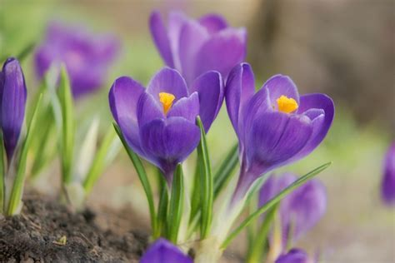
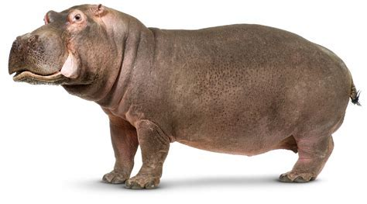
Some nouns can be made in either way, adding <-es> or replacing <-us> with <-i>. Rewrite these sentences so that the nouns in bold is plural and make sure everything else agrees. Then draw several picture of each item to match.
cactus
hippopotamus
fungus
Crocus

Slide 44
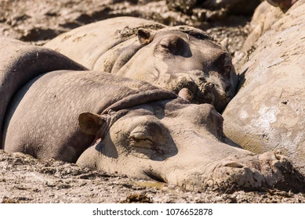
The hippopotamuses/hippopotami wallow in mud to stay cool.

Slide 45
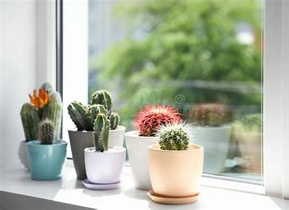
I have some cactuses/cacti in some pots on my windowsill.

Slide 46
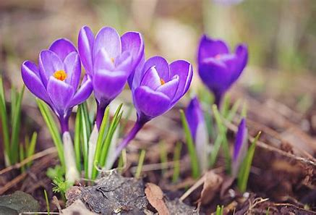
Crocuses/Croci are small flowers that grow in the spring.

Slide 47
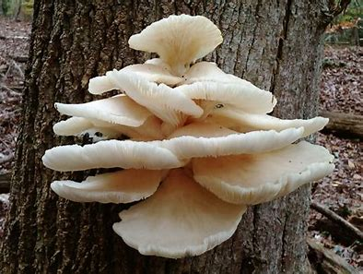
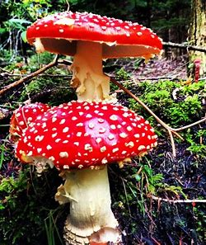
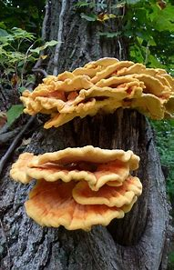
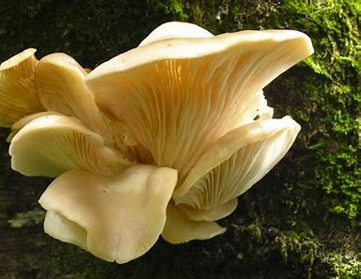
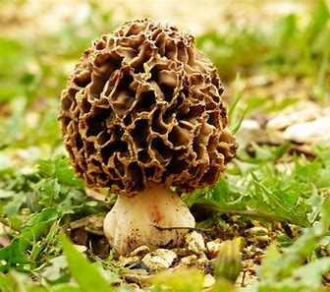
Mushrooms are funguses/fungi that are often edible.

Slide 48
See you
next time!

