Slide 1
Jolly Grammar
5a-23

Slide 2
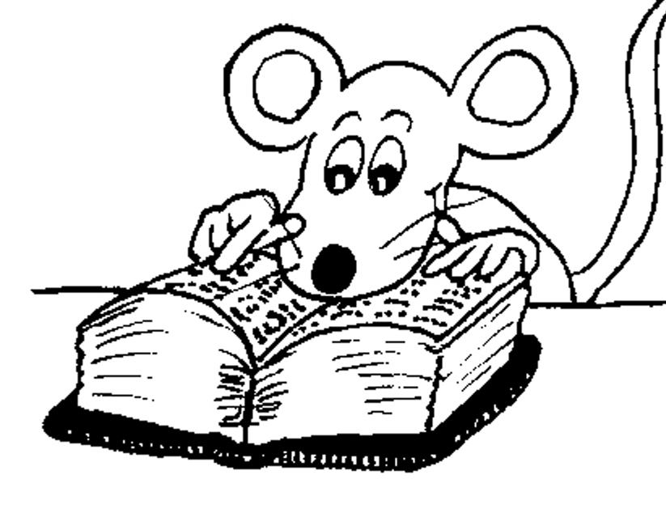
Let’s Revise
Adverbs.

Slide 3
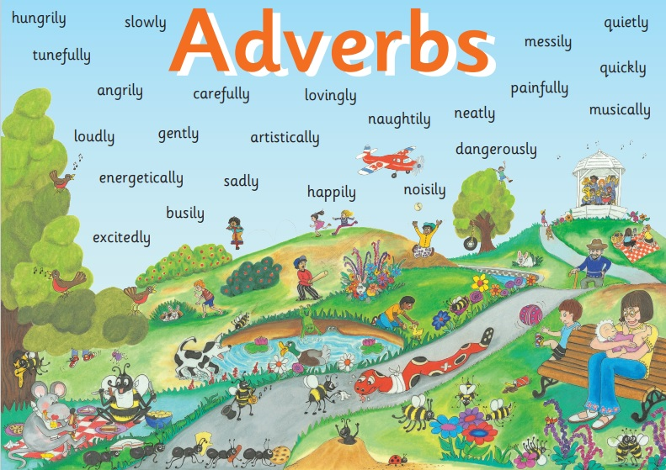

Slide 4
✔ Adverbs of Manner
The children were eating their snacks happily.
✔Adverbs of Degree and Place
The dog ran indoors.
✔ Adverbs of Time and Frequency
I am exercising now.
✔ Adverbs Describing Other Adverbs
The actor was speaking really clearly.
✔ Adverbs Describing Adjectives
The chairs were uncomfortably hard.

Slide 5
Activity Page
Spelling: <-i>

Slide 6
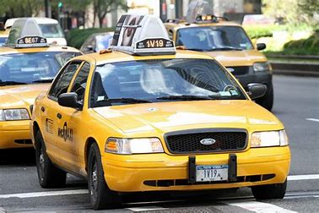
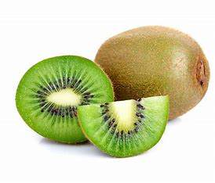
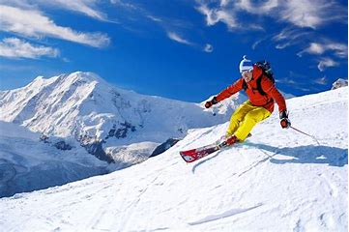
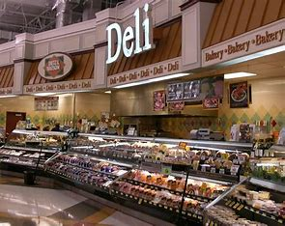
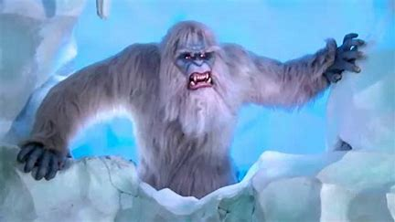
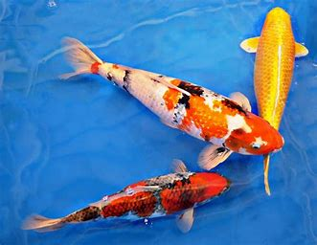
taxi kiwi ski
deli yeti koi

Slide 7
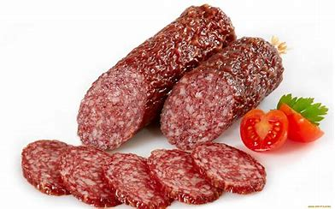
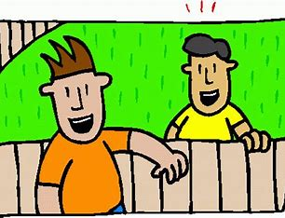
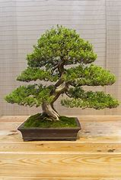
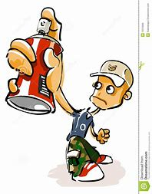
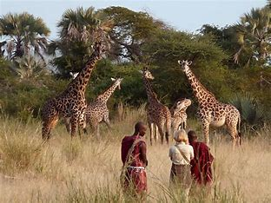
bikini salami alibi
bonsai graffiti safari

Slide 8
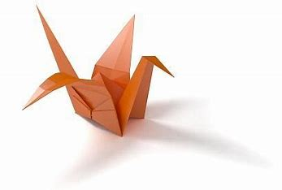
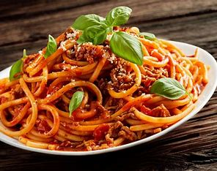
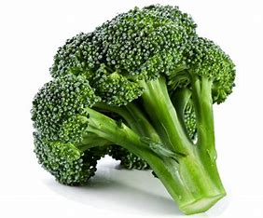
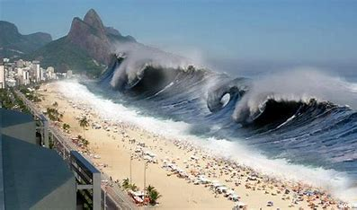
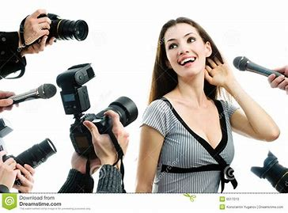
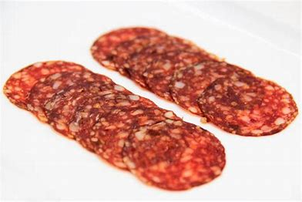
spaghetti broccoli origami
tsunami pepperoni paparazzi

Slide 11
Parsing & Sentence Walls

Slide 12
The local deli sells extremely
expensive salami.
Subject
deli
The local
Verb
sells
(transitive)
Object
salami
expensive
/extremely

Slide 13
Dictation

Slide 14
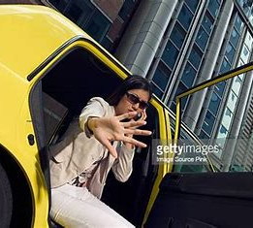

Slide 15
The film star took a taxi to avoid the paparazzi.

Slide 16
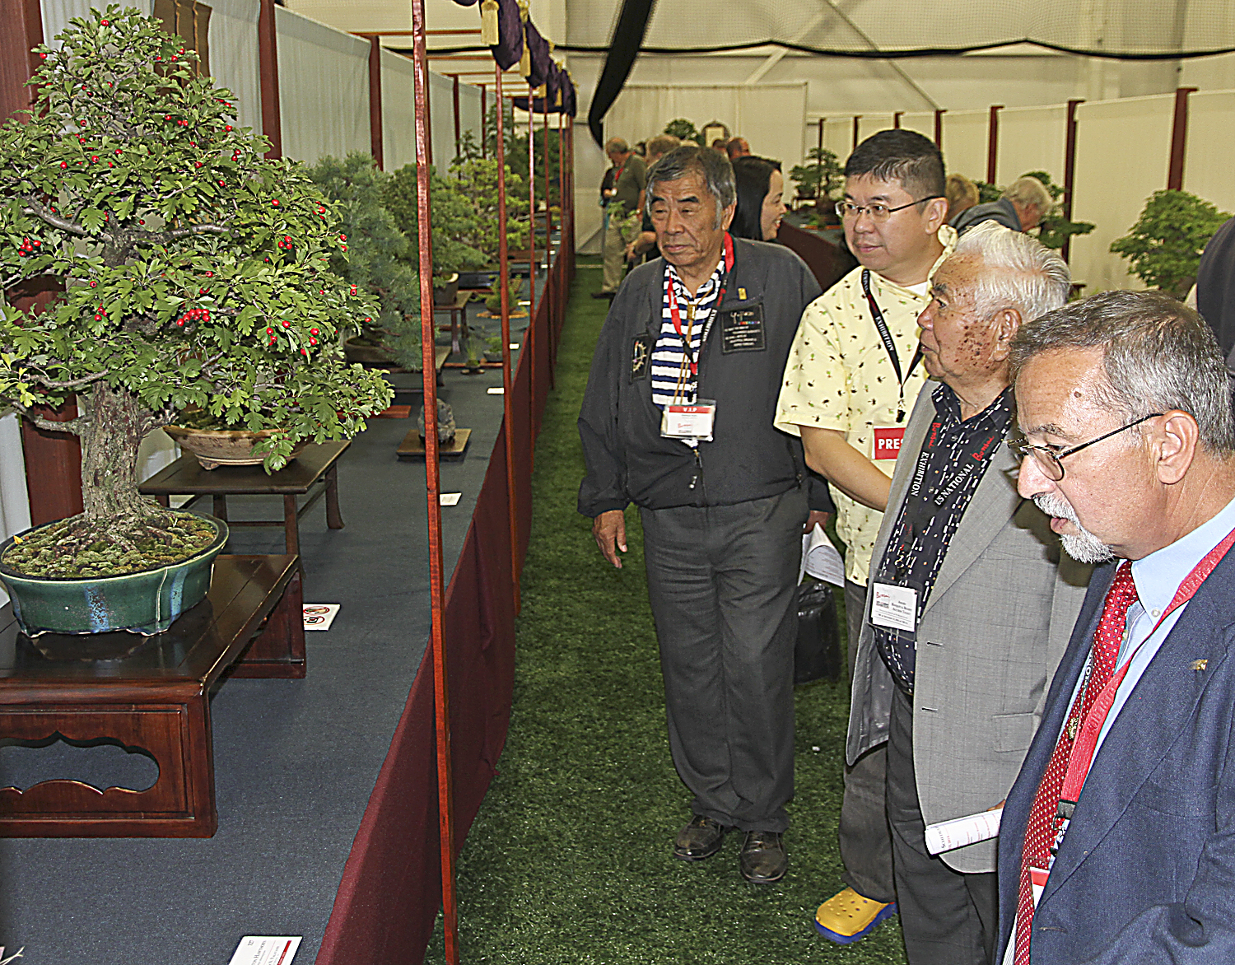

Slide 17
The visitors were captivated by the Japanese bonsai trees.

Slide 18
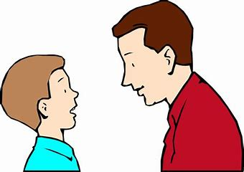
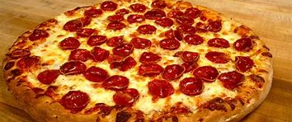

Slide 19
“Would you like pepperoni pizza or spaghetti tonight?” asked Dad.

Slide 20
See you
next time!

