Slide 1
Jolly Grammar
5b-22

Slide 2
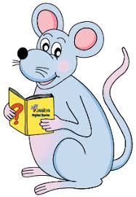
Spelling Test 29

Slide 3
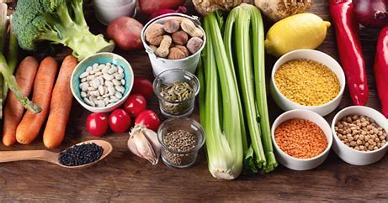
essential

Slide 4
essential
potential

Slide 5
essential
potential
initial

Slide 6
essential
potential
initial
partial

Slide 7
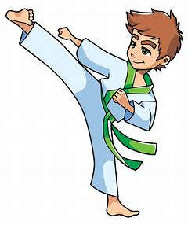
essential
potential
initial
partial
martial

Slide 8
essential
potential
initial
partial
martial
impartial

Slide 9
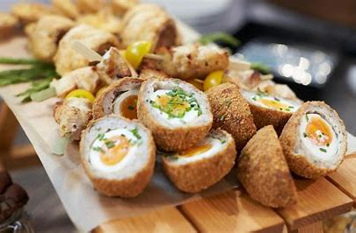
essential
potential
initial
partial
martial
impartial
substantial

Slide 10
essential
potential
initial
partial
martial
impartial
substantial
confidential

Slide 11
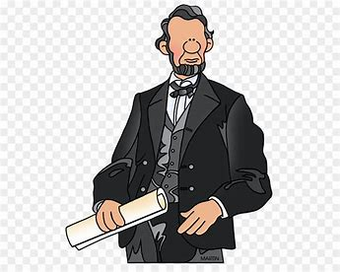
essential
potential
initial
partial
martial
impartial
substantial
confidential
presidential

Slide 12
essential
potential
initial
partial
martial
impartial
substantial
confidential
presidential
10. residential

Slide 13
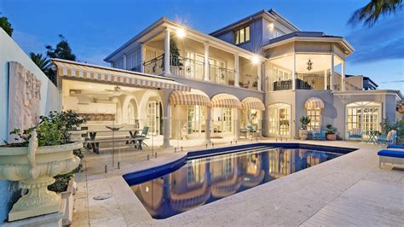
essential
potential
initial
partial
martial
impartial
substantial
confidential
presidential
10. residential
11. palatial

Slide 14
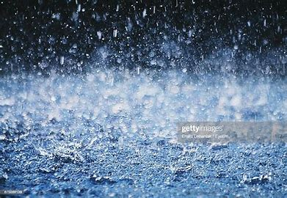
essential
potential
initial
partial
martial
impartial
substantial
confidential
presidential
10. residential
11. palatial
12. torrential

Slide 15
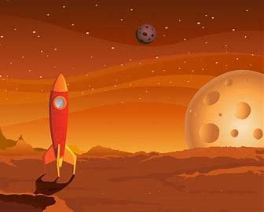
essential
potential
initial
partial
martial
impartial
substantial
confidential
presidential
10. residential
11. palatial
12. torrential
13. spatial

Slide 16
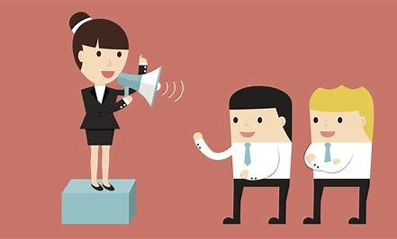
essential
potential
initial
partial
martial
impartial
substantial
confidential
presidential
10. residential
11. palatial
12. torrential
13. spatial
14. influential

Slide 17
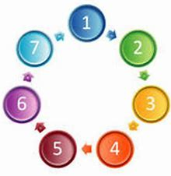
essential
potential
initial
partial
martial
impartial
substantial
confidential
presidential
10. residential
11. palatial
12. torrential
13. spatial
14. influential
15. sequential

Slide 18
essential
potential
initial
partial
martial
impartial
substantial
confidential
presidential
10. residential
11. palatial
12. torrential
13. spatial
14. influential
15. sequential
16. preferential

Slide 19
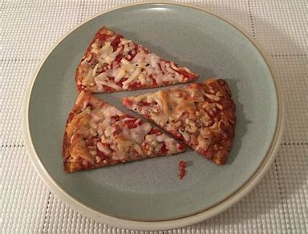
essential
potential
initial
partial
martial
impartial
substantial
confidential
presidential
10. residential
11. palatial
12. torrential
13. spatial
14. influential
15. sequential
16. preferential
17. insubstantial

Slide 20
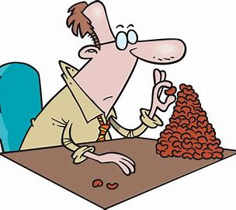
essential
potential
initial
partial
martial
impartial
substantial
confidential
presidential
10. residential
11. palatial
12. torrential
13. spatial
14. influential
15. sequential
16. preferential
17. insubstantial
18. inconsequential

Slide 21
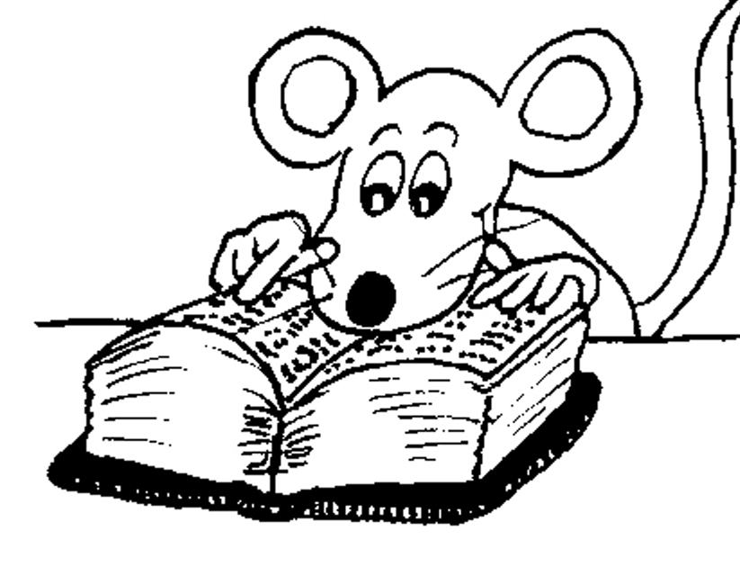
Let’s Revise
Adverbs.

Slide 22
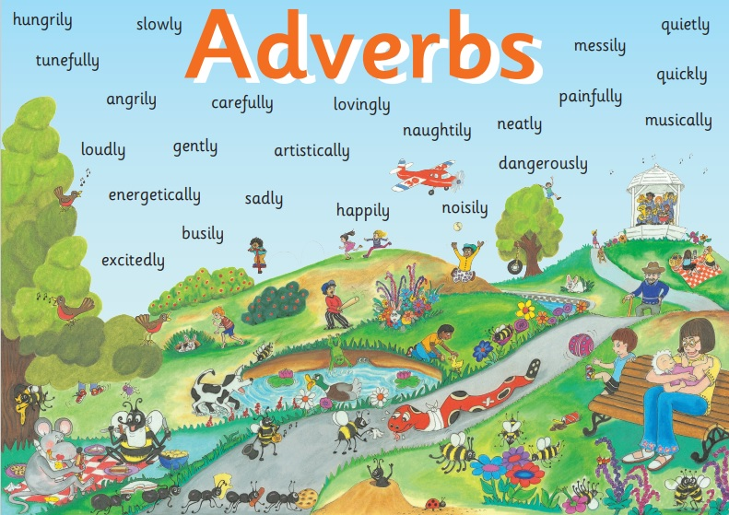

Slide 23
● Adverbs of Manner
The children were eating their snacks happily.
● Adverbs of Degree and Place
The dog ran indoors.
● Adverbs of Time and Frequency
I am exercising now.
● Adverbs Describing Other Adverbs
The actor was speaking really clearly.
● Adverbs Describing Adjectives
The chairs were uncomfortably hard.

Slide 24
She sang absolutely beautifully.
She sang with a beautifully clear voice.

Slide 25
She sang absolutely beautifully.
She sang with a beautifully clear voice.

Slide 26
She sang absolutely beautifully.
She sang with a beautifully clear voice.

Slide 27
She sang absolutely beautifully.
She sang with a beautifully clear voice.

Slide 28
She sang absolutely beautifully.
She sang with a beautifully clear voice.

Slide 29
She sang absolutely beautifully.
She sang with a beautifully clear voice.

Slide 30
She sang absolutely beautifully.
She sang with a beautifully clear voice.

Slide 31
She sang absolutely beautifully.
She sang with a beautifully clear voice.

Slide 32
She sang absolutely beautifully.
She sang with a beautifully clear voice.
The sun is hot.

Slide 33
She sang absolutely beautifully.
She sang with a beautifully clear voice.
The sun is surprisingly hot.

Slide 34
She sang absolutely beautifully.
She sang with a beautifully clear voice.
The sun is intensely hot.

Slide 35
She sang absolutely beautifully.
She sang with a beautifully clear voice.
The sun is really hot.

Slide 36
She sang absolutely beautifully.
She sang with a beautifully clear voice.
The sun is always hot.

Slide 37
She sang absolutely beautifully.
She sang with a beautifully clear voice.
The sun is often hot.

Slide 38
She sang absolutely beautifully.
She sang with a beautifully clear voice.
The sun is sometimes hot.

Slide 39
She sang absolutely beautifully.
She sang with a beautifully clear voice.
The sun is very hot.

Slide 40
Activity Page
Adverbs of Describing Adjectives

Slide 41
uncomfortably
The chairs were uncomfortably hard.

Slide 42
uncomfortably
The chairs were hard.

Slide 43
quite
I am quite curious about the surprise.

Slide 44
quite
I am curious about the surprise.

Slide 45
unusually
The cheese had an unusually strong smell.

Slide 46
unusually
The cheese had a strong smell.

Slide 47
always
The cakes from the bakery are always delicious.

Slide 48
always
The cakes from the bakery are delicious.

Slide 49
really
Her grandmother’s ring was really expensive.

Slide 50
really
Her grandmother’s ring was expensive.

Slide 51
rather
The prize for the winner is rather unusual.

Slide 52
rather
The prize for the winner is unusual.

Slide 53
extremely
She has become an extremely beautiful woman.

Slide 54
extremely
She has become a beautiful woman.

Slide 55
very
The way through the mountains will be very dangerous.

Slide 56
very
The way through the mountains will be dangerous.

Slide 57
powerfully exceedingly
The powerfully fragrant flowers had grown exceedingly tall.

Slide 58
powerfully exceedingly
The fragrant flowers had grown tall.

Slide 59
See you
next time!

