Slide 1
Jolly Grammar
5a-21

Slide 2
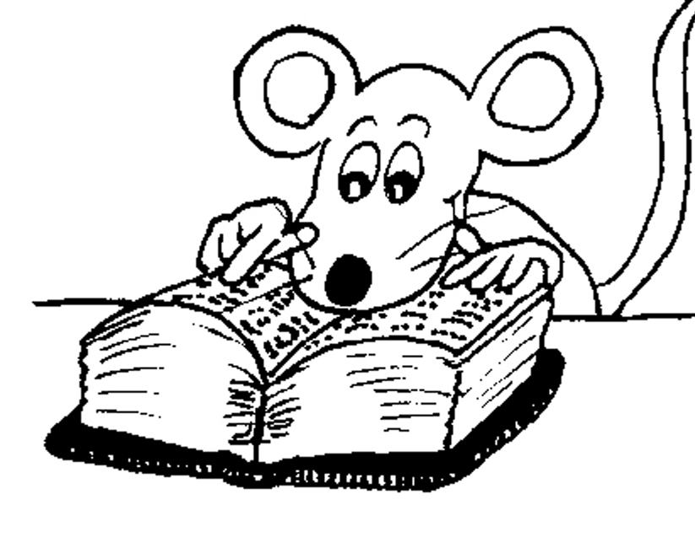
Let’s Revise
Adverbs.

Slide 3
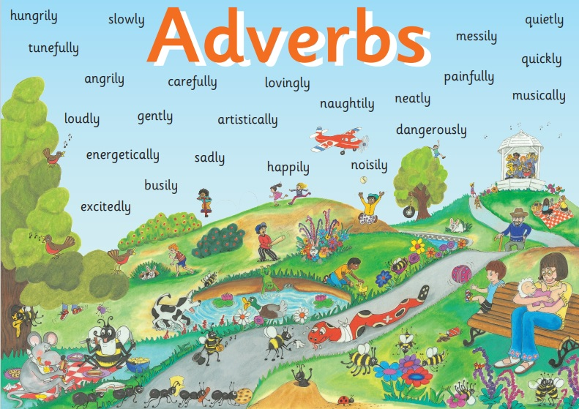

Slide 4
✔ Adverbs of Manner
The children were eating their snacks happily.
✔Adverbs of Degree and Place
The dog ran indoors.
✔ Adverbs of Time and Frequency
I am exercising now.
✔ Adverbs Describing Other Adverbs
The actor was speaking really clearly.
● Adverbs Describing Adjectives
The chairs were uncomfortably hard.

Slide 5
Activity Page
Spelling: <tial>

Slide 6
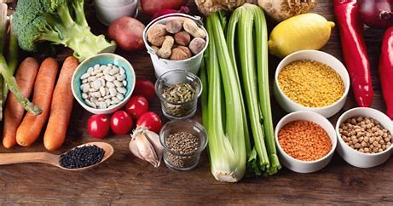
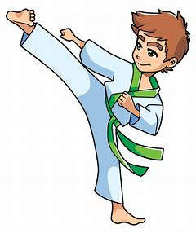
essential potential initial
partial martial impartial

Slide 7
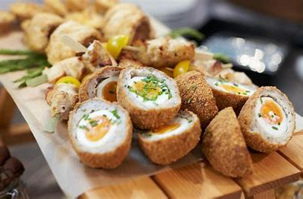
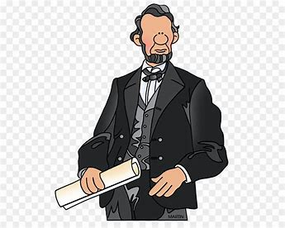
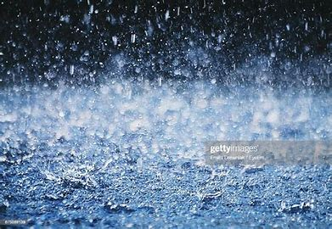
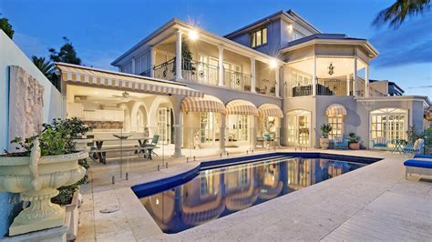
substantial confidential presidential
residential palatial torrential

Slide 8
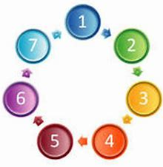
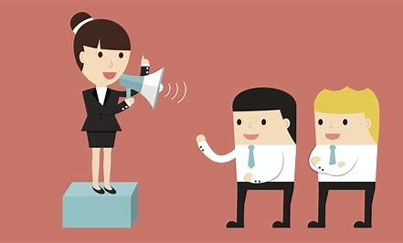
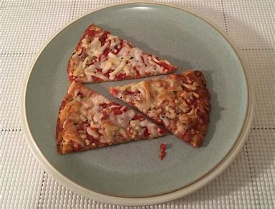
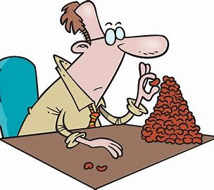
spatial influential sequential
preferential insubstantial inconsequential

Slide 11
official
officially
essential
essentially
potential
potentially
controversial
controversially
confidential
confidentially
substantial
substantially
social
socially
partial
partially
crucial
crucially

Slide 12
Parsing & Sentence Walls

Slide 13
The torrential rain drenched the crowd really quickly.
Subject
rain
The torrential
Verb
drenched
(transitive)
quickly/really
Object
crowd
the

Slide 14
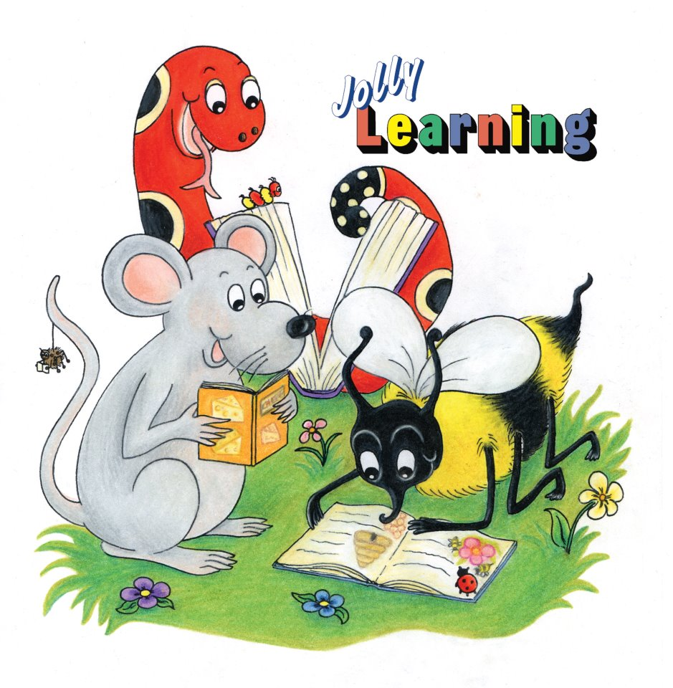
Dictation

Slide 16
The crucial documents were strictly confidential.

Slide 17
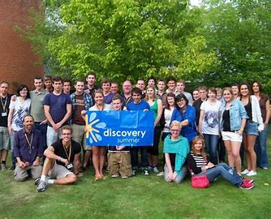

Slide 18
There will be a residential summer school at the college.

Slide 20
The dietician declared, “A balanced diet is essential for everyone.”

Slide 21
See you
next time!

