Slide 1
Jolly Grammar
5b-20

Slide 2
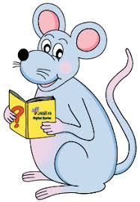
Spelling Test 28

Slide 3
special

Slide 4
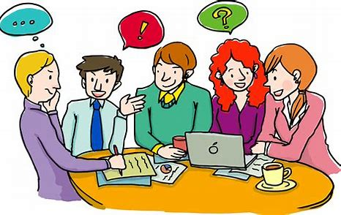
special
social

Slide 5
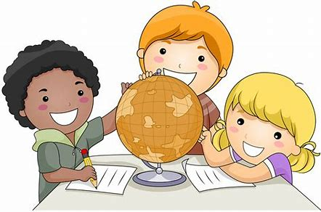
special
social
crucial

Slide 6
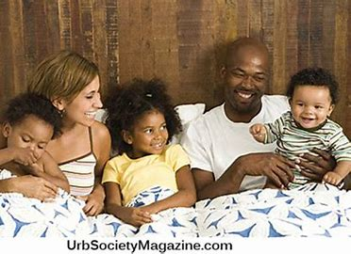
special
social
crucial
racial

Slide 7
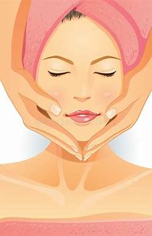
special
social
crucial
racial
facial

Slide 8
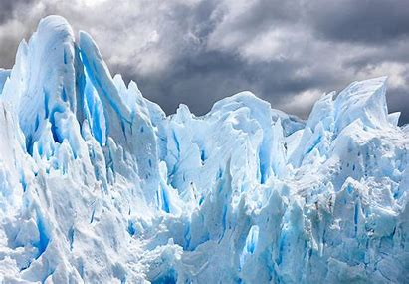
special
social
crucial
racial
facial
glacial

Slide 9
special
social
crucial
racial
facial
glacial
official

Slide 10
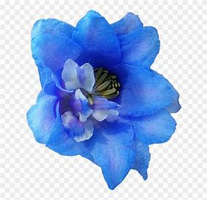
special
social
crucial
racial
facial
glacial
official
artificial

Slide 11
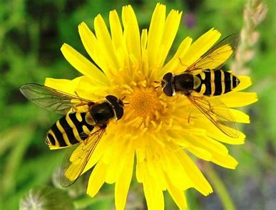
special
social
crucial
racial
facial
glacial
official
artificial
beneficial

Slide 12
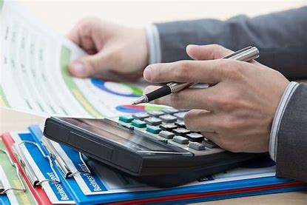
special
social
crucial
racial
facial
glacial
official
artificial
beneficial
10. financial

Slide 13
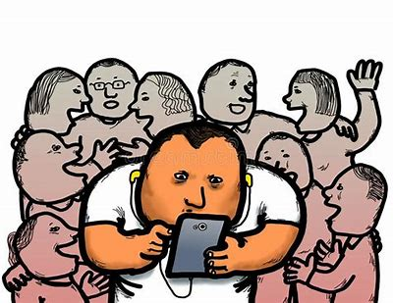
special
social
crucial
racial
facial
glacial
official
artificial
beneficial
10. financial
11. antisocial

Slide 14
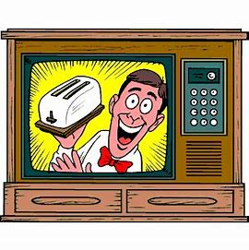
special
social
crucial
racial
facial
glacial
official
artificial
beneficial
10. financial
11. antisocial
12. commercial

Slide 15
special
social
crucial
racial
facial
glacial
official
artificial
beneficial
10. financial
11. antisocial
12. commercial
13. unofficial

Slide 16
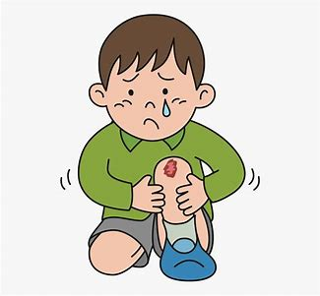
special
social
crucial
racial
facial
glacial
official
artificial
beneficial
10. financial
11. antisocial
12. commercial
13. unofficial
14. superficial

Slide 17
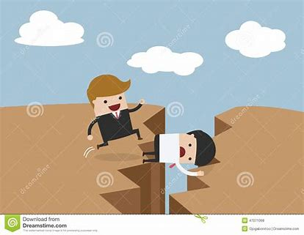
special
social
crucial
racial
facial
glacial
official
artificial
beneficial
10. financial
11. antisocial
12. commercial
13. unofficial
14. superficial
15. sacrificial

Slide 18
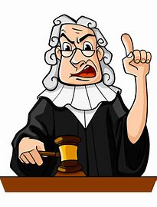
special
social
crucial
racial
facial
glacial
official
artificial
beneficial
10. financial
11. antisocial
12. commercial
13. unofficial
14. superficial
15. sacrificial
16. judicial

Slide 19
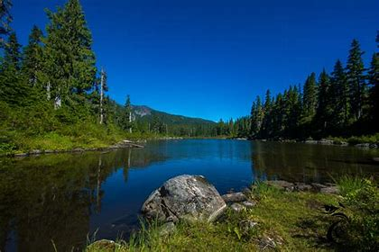
special
social
crucial
racial
facial
glacial
official
artificial
beneficial
10. financial
11. antisocial
12. commercial
13. unofficial
14. superficial
15. sacrificial
16. judicial
17. provincial

Slide 20
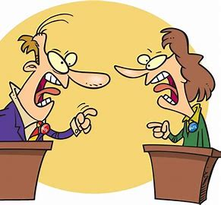
special
social
crucial
racial
facial
glacial
official
artificial
beneficial
10. financial
11. antisocial
12. commercial
13. unofficial
14. superficial
15. sacrificial
16. judicial
17. provincial
18. controversial

Slide 21
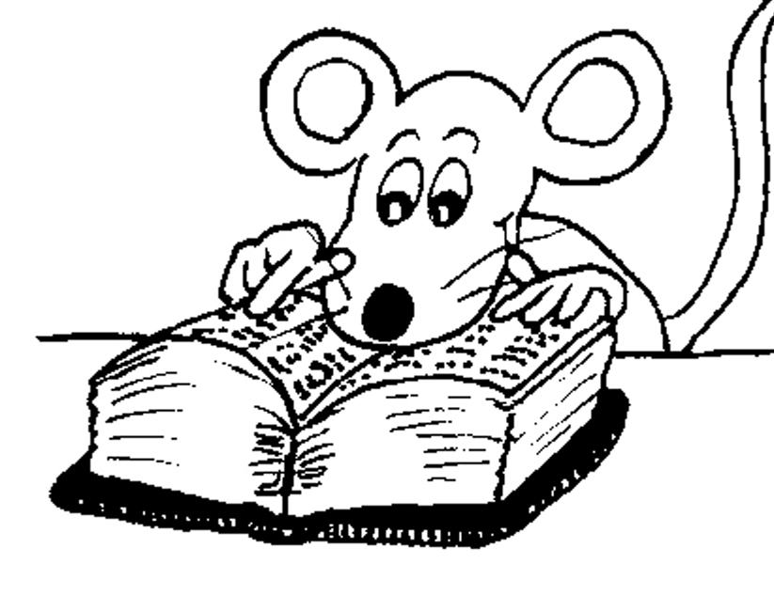
Let’s Revise
Adverbs.

Slide 22
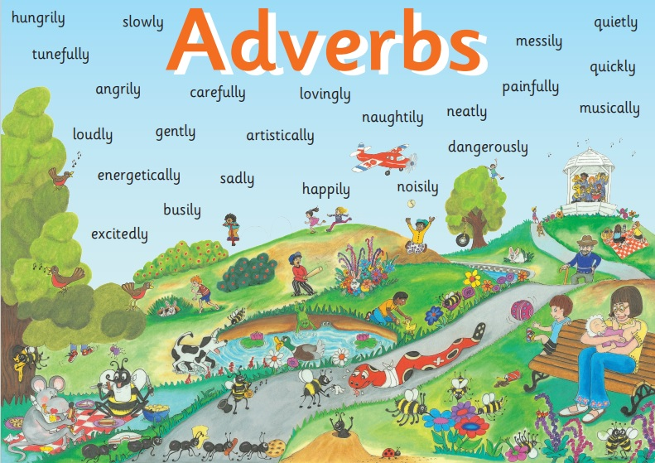

Slide 23
● Adverbs of Manner
The children were eating their snacks happily.
● Adverbs of Degree and Place
The dog ran indoors.
● Adverbs of Time and Frequency
I am exercising now.
● Adverbs Describing Other Adverbs
The actor was speaking really clearly.
● Adverbs Describing Adjectives
The chairs were uncomfortably hard.

Slide 24
● Adverbs of Describing Other Adverbs
She really enjoyed the book.
She grinned really cheekily.
He is nearly always laughing.

Slide 25
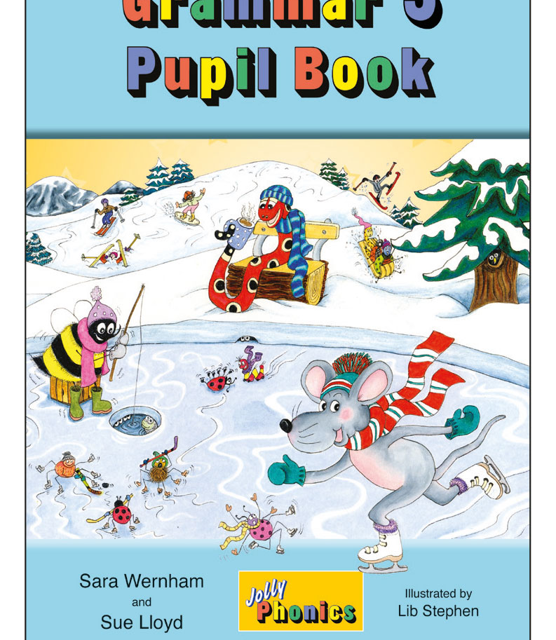
Activity Page
Adverbs of Describing Other Adverbs

Slide 26
The jam jar opened fairly easily.
Subject jar | Verb opened instransitive | Object
The jam | Easily fairly

Slide 27
The cleaner polished the furniture extremely vigorously.
Subject Cleaner | Verb Poslished (transitive) | Object Furniture
The | Vigorously extremely | the

Slide 28
The children were playing perfectly happily.
Subject children | Verb were playing (intransitive) | Object
The | perfectly happily

Slide 29
The pastry chef decorated the cake absolutely beautifully.
Subject chef | Verb decorated (transitive) | Object Cake
The pastry | absolutely beautifully | the

Slide 30
See you
next time!

