Slide 1
Jolly Grammar
5a-19

Slide 2
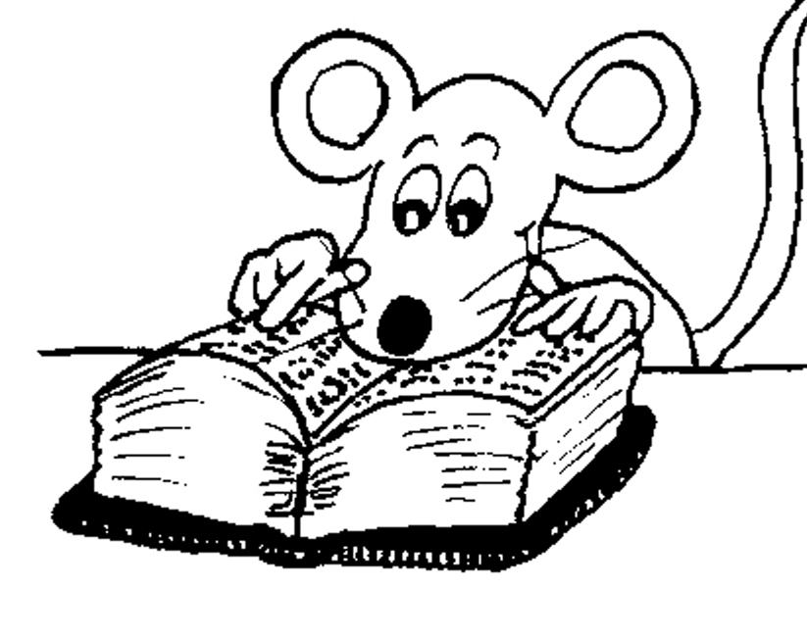
Let’s Revise
Adverbs.

Slide 3
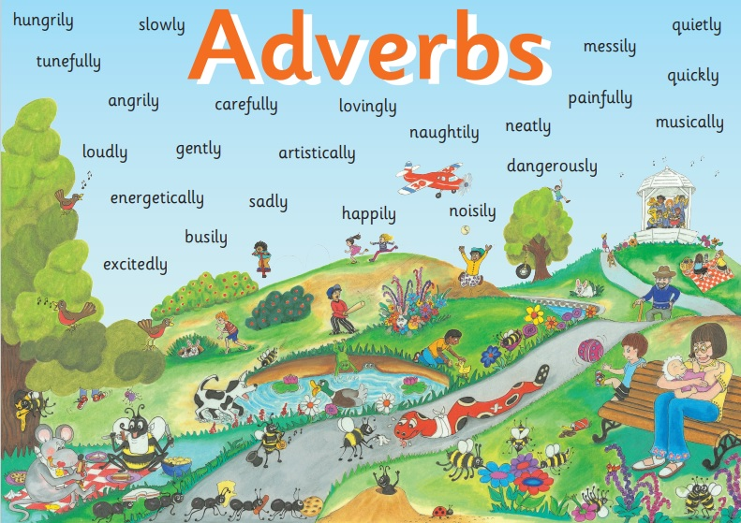

Slide 4
✔ Adverbs of Manner
The children were eating their snacks happily.
✔Adverbs of Degree and Place
The dog ran indoors.
✔ Adverbs of Time and Frequency
I am exercising now.
● Adverbs Describing Other Adverbs
The actor was speaking really clearly.
● Adverbs Describing Adjectives
The chairs were uncomfortably hard.

Slide 5
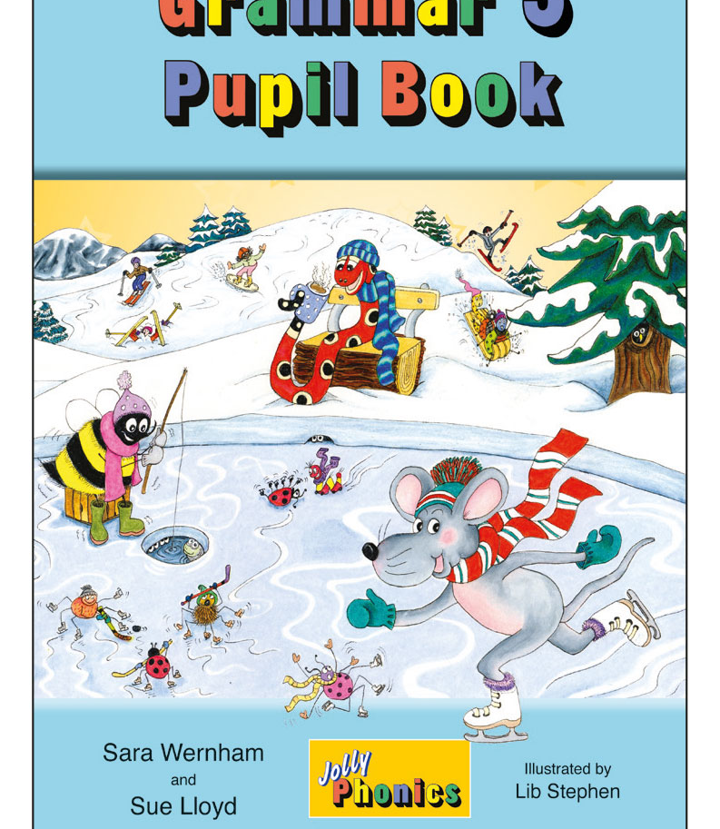
Activity Page
Spelling: <cial>

Slide 6
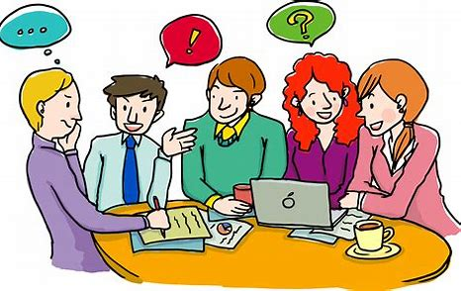
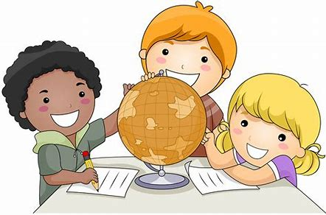
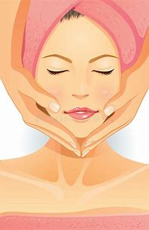
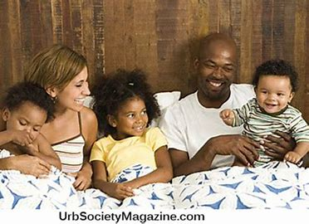
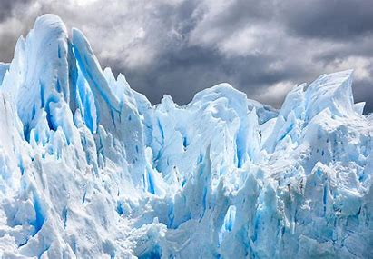
special social crucial
racial facial glacial

Slide 7
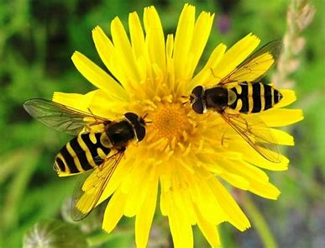
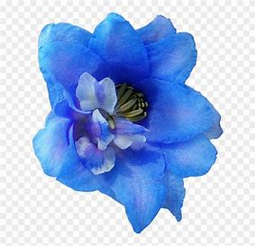
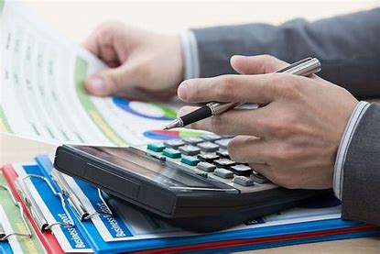
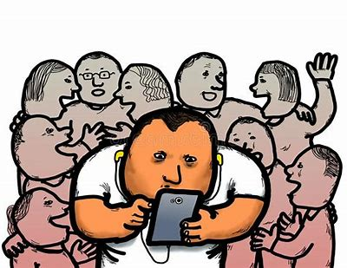
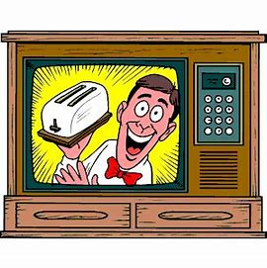
official artificial beneficial
financial antisocial commercial

Slide 8
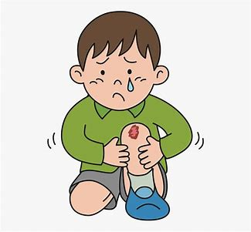
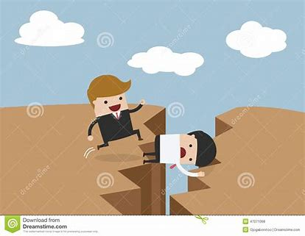
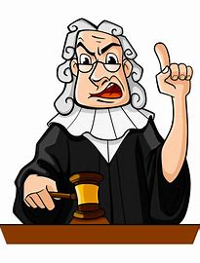
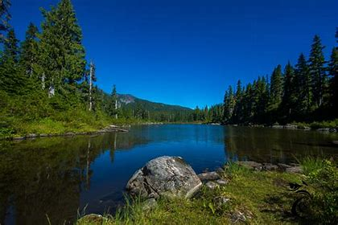
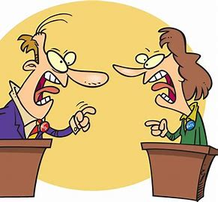
unofficial superficial sacrificial
judicial provincial controversial

Slide 11
a special day
social communication
a YouTube commercial
my official essay
an antisocial person
an artificial flower

Slide 12
Adjective Adverb
office official officially
danger dangerous dangerously
caution cautious cautiously
nerves nervous nervously
benefit beneficial beneficially
disaster disastrous disastrously
ambition ambitious ambitiously
anxiety anxious anxiously
finance financial financially
suspicion suspicious suspiciously

Slide 14
Parsing & Sentence Walls

Slide 15
The famous artist recently painted a controversial portrait.
Subject
artist
The famous
Verb
painted
(transitive)
recently
Object
portrait
controversial

Slide 16
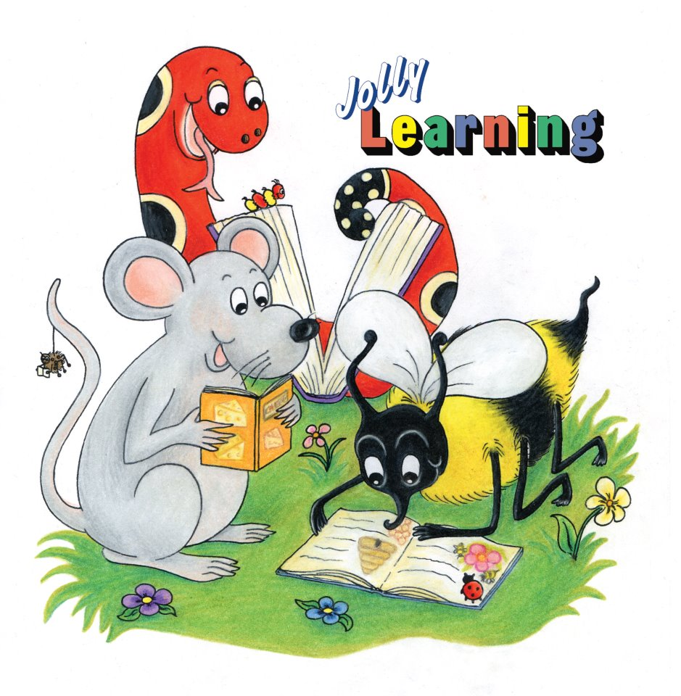
Dictation

Slide 17
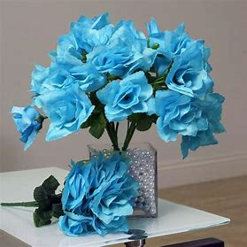

Slide 18
The artificial flowers were obviously not real.

Slide 19
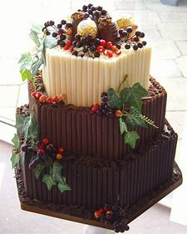

Slide 20
I will bake a scrumptious cake for this special occasion.

Slide 21
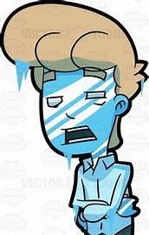

Slide 22
“The expression on his face was glacial!” exclaimed Jim.

Slide 23
See you
next time!

