Slide 1
Jolly Grammar
5b-20

Slide 2
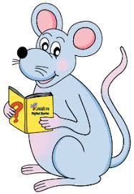
Spelling Test 28

Slide 3
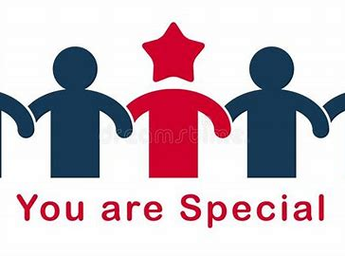
special

Slide 4
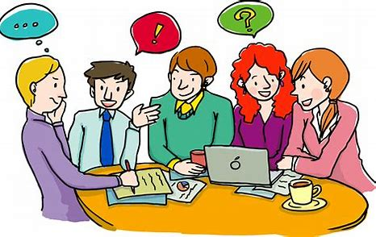
special
social

Slide 5
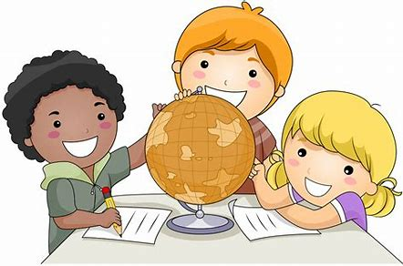
special
social
crucial

Slide 6
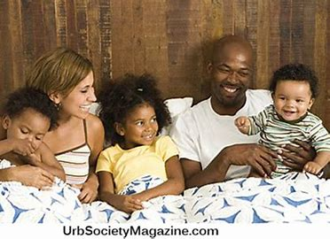
special
social
crucial
racial

Slide 7
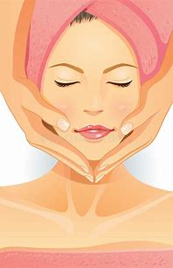
special
social
crucial
racial
facial

Slide 8
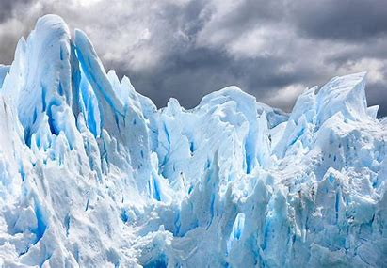
special
social
crucial
racial
facial
glacial

Slide 9
special
social
crucial
racial
facial
glacial
official

Slide 10
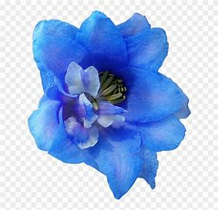
special
social
crucial
racial
facial
glacial
official
artificial

Slide 11
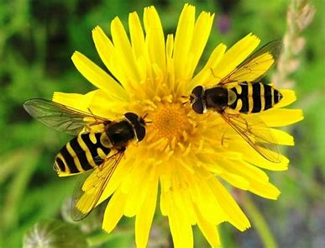
special
social
crucial
racial
facial
glacial
official
artificial
beneficial

Slide 12
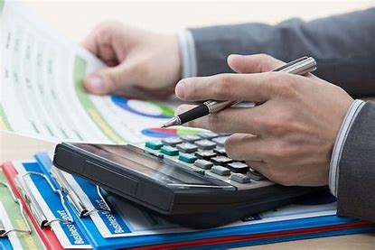
special
social
crucial
racial
facial
glacial
official
artificial
beneficial
10. financial

Slide 13
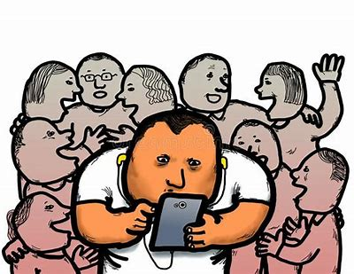
special
social
crucial
racial
facial
glacial
official
artificial
beneficial
10. financial
11. antisocial

Slide 14
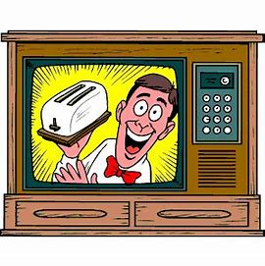
special
social
crucial
racial
facial
glacial
official
artificial
beneficial
10. financial
11. antisocial
12. commercial

Slide 15
special
social
crucial
racial
facial
glacial
official
artificial
beneficial
10. financial
11. antisocial
12. commercial
13. unofficial

Slide 16
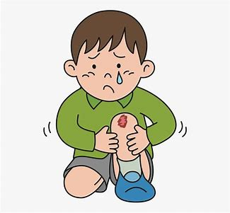
special
social
crucial
racial
facial
glacial
official
artificial
beneficial
10. financial
11. antisocial
12. commercial
13. unofficial
14. superficial

Slide 17
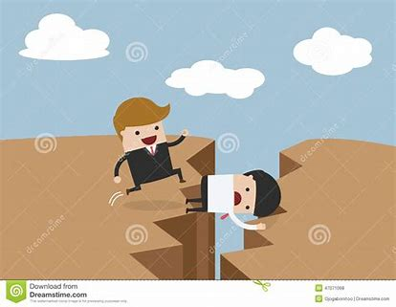
special
social
crucial
racial
facial
glacial
official
artificial
beneficial
10. financial
11. antisocial
12. commercial
13. unofficial
14. superficial
15. sacrificial

Slide 18
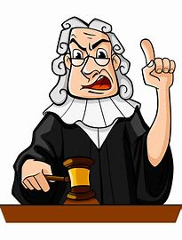
special
social
crucial
racial
facial
glacial
official
artificial
beneficial
10. financial
11. antisocial
12. commercial
13. unofficial
14. superficial
15. sacrificial
16. judicial

Slide 19
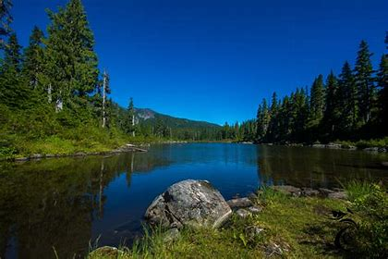
special
social
crucial
racial
facial
glacial
official
artificial
beneficial
10. financial
11. antisocial
12. commercial
13. unofficial
14. superficial
15. sacrificial
16. judicial
17. provincial

Slide 20
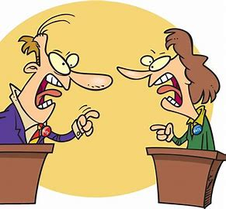
special
social
crucial
racial
facial
glacial
official
artificial
beneficial
10. financial
11. antisocial
12. commercial
13. unofficial
14. superficial
15. sacrificial
16. judicial
17. provincial
18. controversial

Slide 21
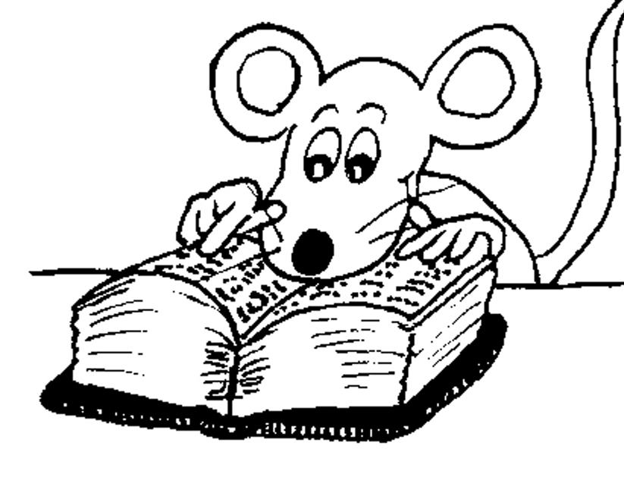
Let’s Revise
Adverbs.

Slide 22
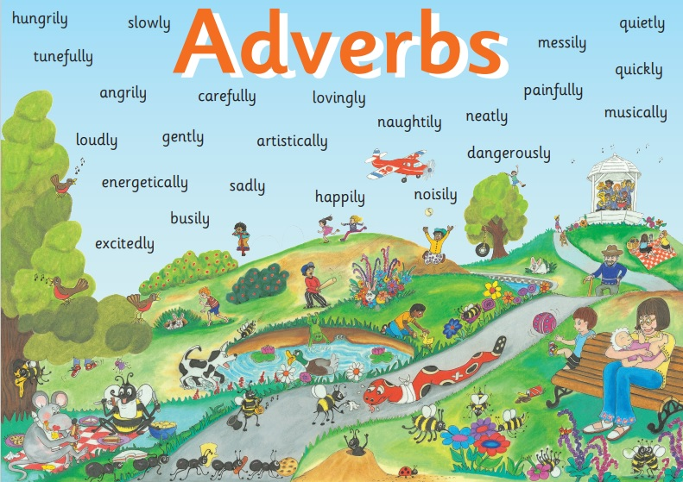

Slide 23
● Adverbs of Manner
The children were eating their snacks happily.
● Adverbs of Degree and Place
The dog ran indoors.
● Adverbs of Time and Frequency
I am exercising now.
● Adverbs Describing Other Adverbs
The actor was speaking really clearly.
● Adverbs Describing Adjectives
The chairs were uncomfortably hard.

Slide 24
● Adverbs of Describing Other Adverbs
She really enjoyed the book.
She grinned really cheekily.
He is nearly always laughing.

Slide 25
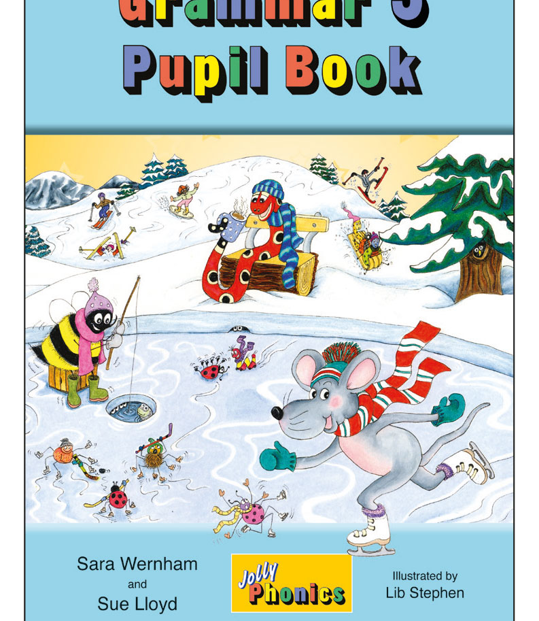
Activity Page
Adverbs of Time and Frequency

Slide 26
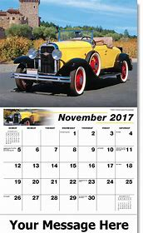
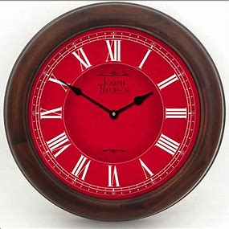
Adverbs of time and frequency tell us more about when or how often something is done. Underline the verbs in red and the adverbs in orange. Then write each adverb on the line underneath.

Slide 27
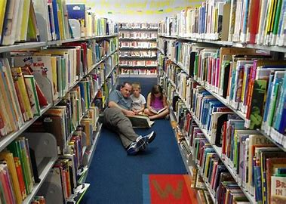
Dad goes to the library occasionally.

Slide 28
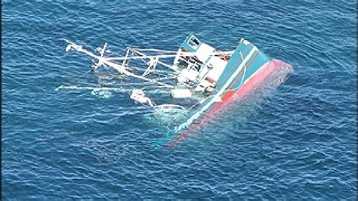
His boat capsized recently.

Slide 29
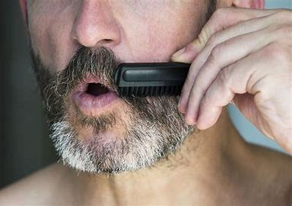
He trimmed his mustache regularly.

Slide 30
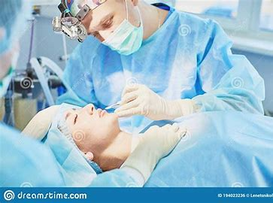
The patient needs an operation soon.

Slide 31
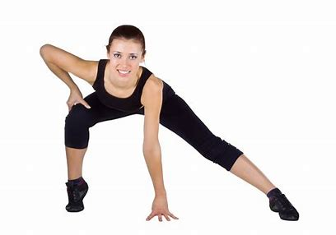
I am exercising now.

Slide 32
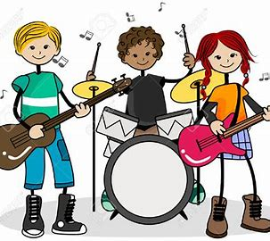
They meet weekly for band practice.

Slide 33
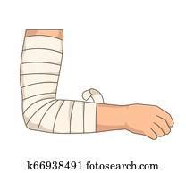
Previously, she fractured her elbow.

Slide 34
Identify the verb in each sentence and underline it in red. Then write the prepositional phrase that is describing the verb on the line underneath.

Slide 35
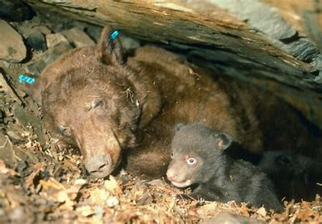
Bears hibernate (in the winter).

Slide 36
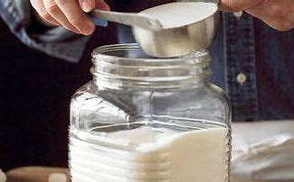
Measure the sugar (before the flour).

Slide 37
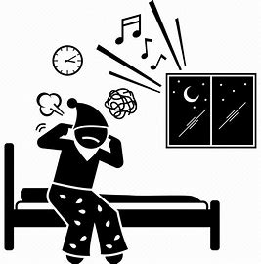
Mysterious noises terrified them (throughout the night).

Slide 38
See you
next time!

